Slide 1
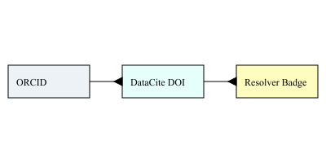

AIDE Infographic — From Disclosure to Provenance Badge

