Slide 1
PRISM Demo
Adding Tool Interactions - Main Form & Quick Add
MaLDReTH II Working Group - Co-Chairs Demo

Slide 2
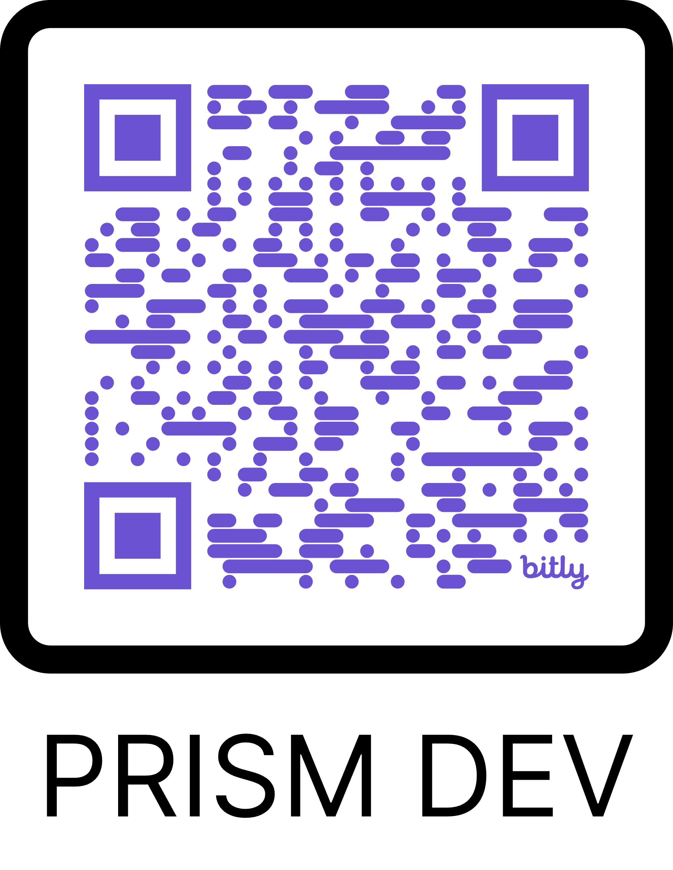
What is PRISM?
• Platform for Recording Infrastructure & Service Mappings
• Community-driven catalog of tool interactions across the research data lifecycle
• Current Status: Alpha development with 157 tools, 12 lifecycle stages
• Goal: Map the digital research infrastructure ecosystem
https://bit.ly/prism-cochair

Slide 3
Recent Updates - Phase 1 Complete
✅ Interactive User Guide - Step-by-step documentation
✅ Alpha Status Banner - Setting expectations
✅ Feedback Collection System - Gathering user input
✅ Quick Add Form - Rapid interaction entry (NEW!)

Slide 4
Today's Demo Focus
🎯 Two ways to add tool interactions:
1. Main Form - Comprehensive, detailed entry
• All fields available
• Rich documentation options
• Best for well-documented interactions
2. Quick Add - Rapid entry workflow
• 5 essential fields only
• "Save & add another" mode
• Best for bulk entry sessions

Slide 5
🎬 5-Minute Platform Tour
Let's explore PRISM together

Slide 6
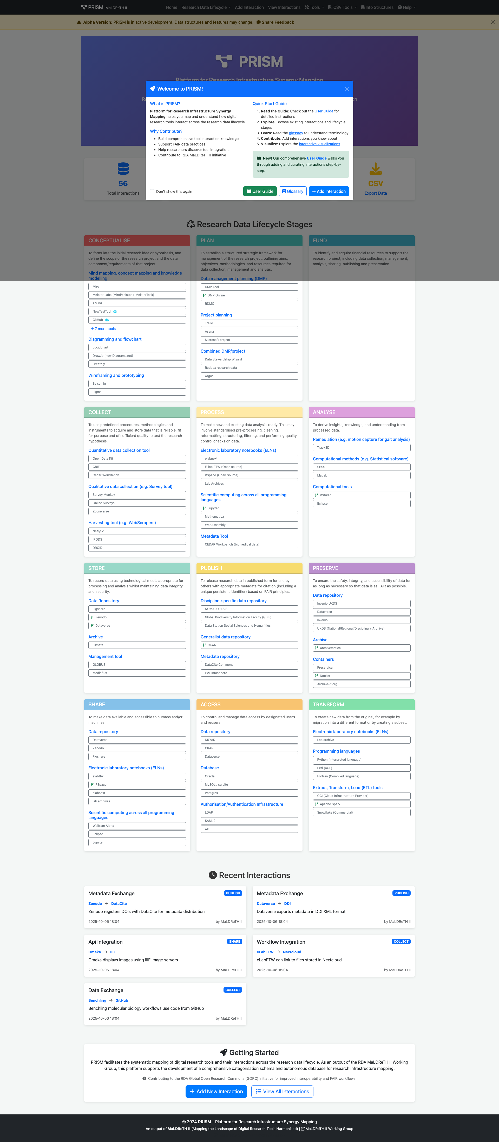
Tour 1/5: Home Dashboard
📊 Central hub showing stats, recent interactions, and navigation. Alpha banner prompts feedback.

Slide 7
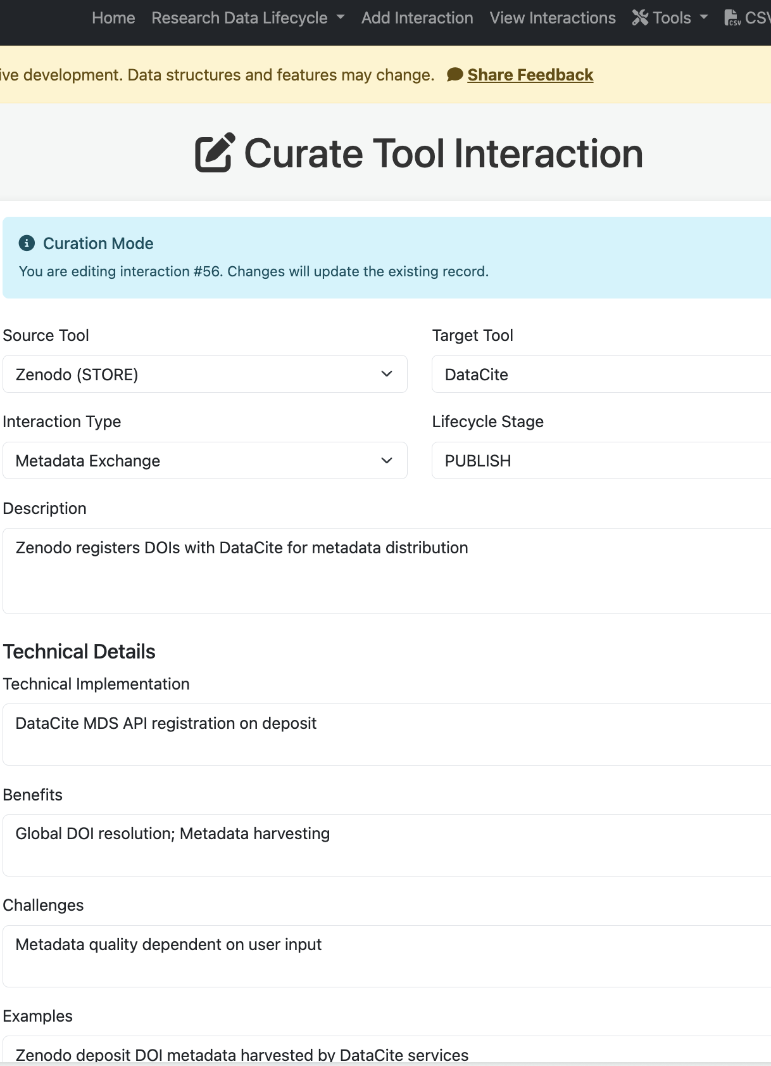
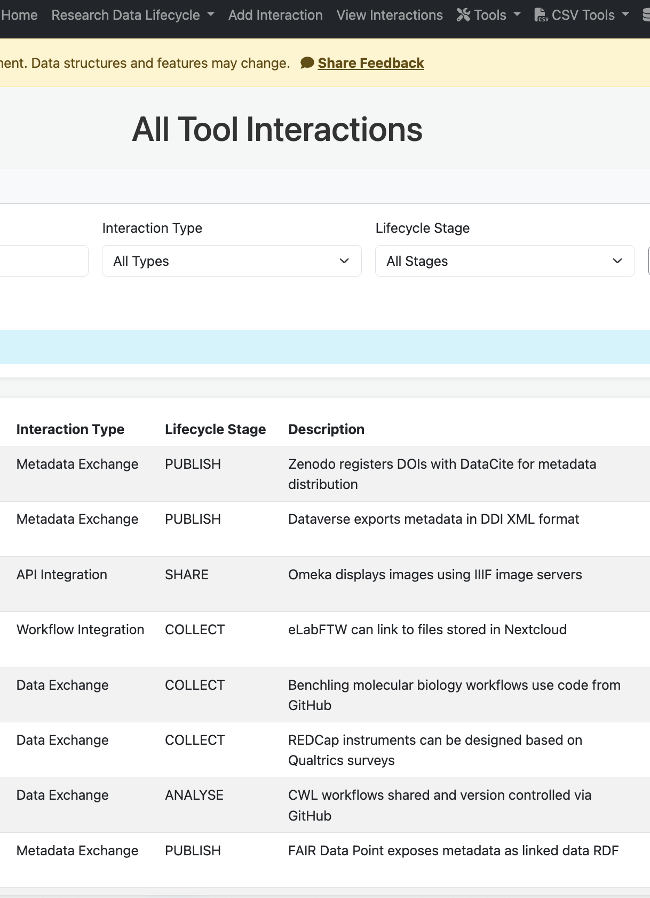
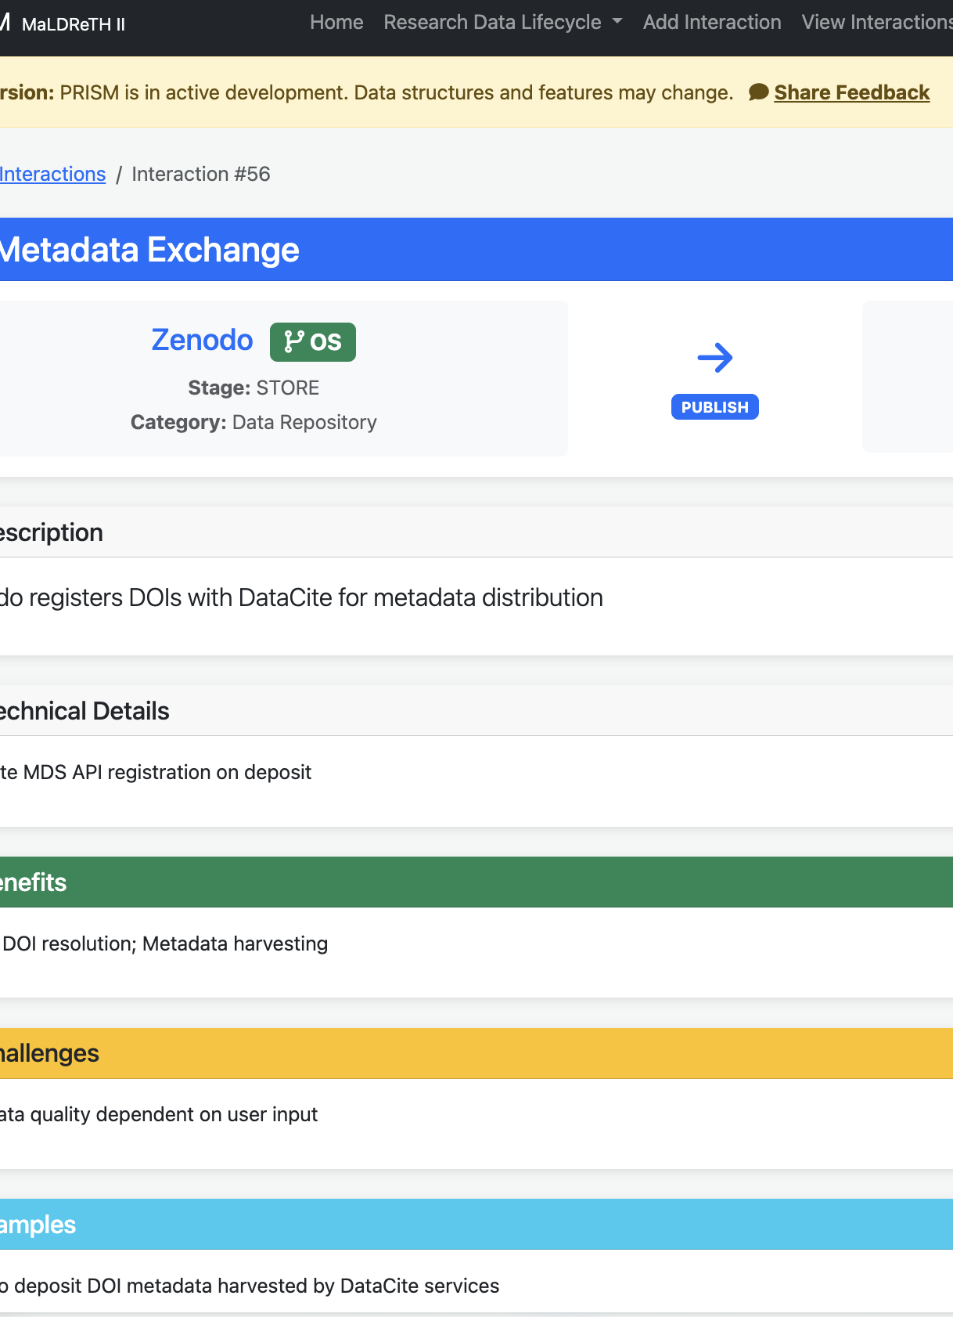
Tour 2/5: Interactions
🔍 Browse, search, and filter all documented tool interactions. Export to CSV or view details.

Slide 8
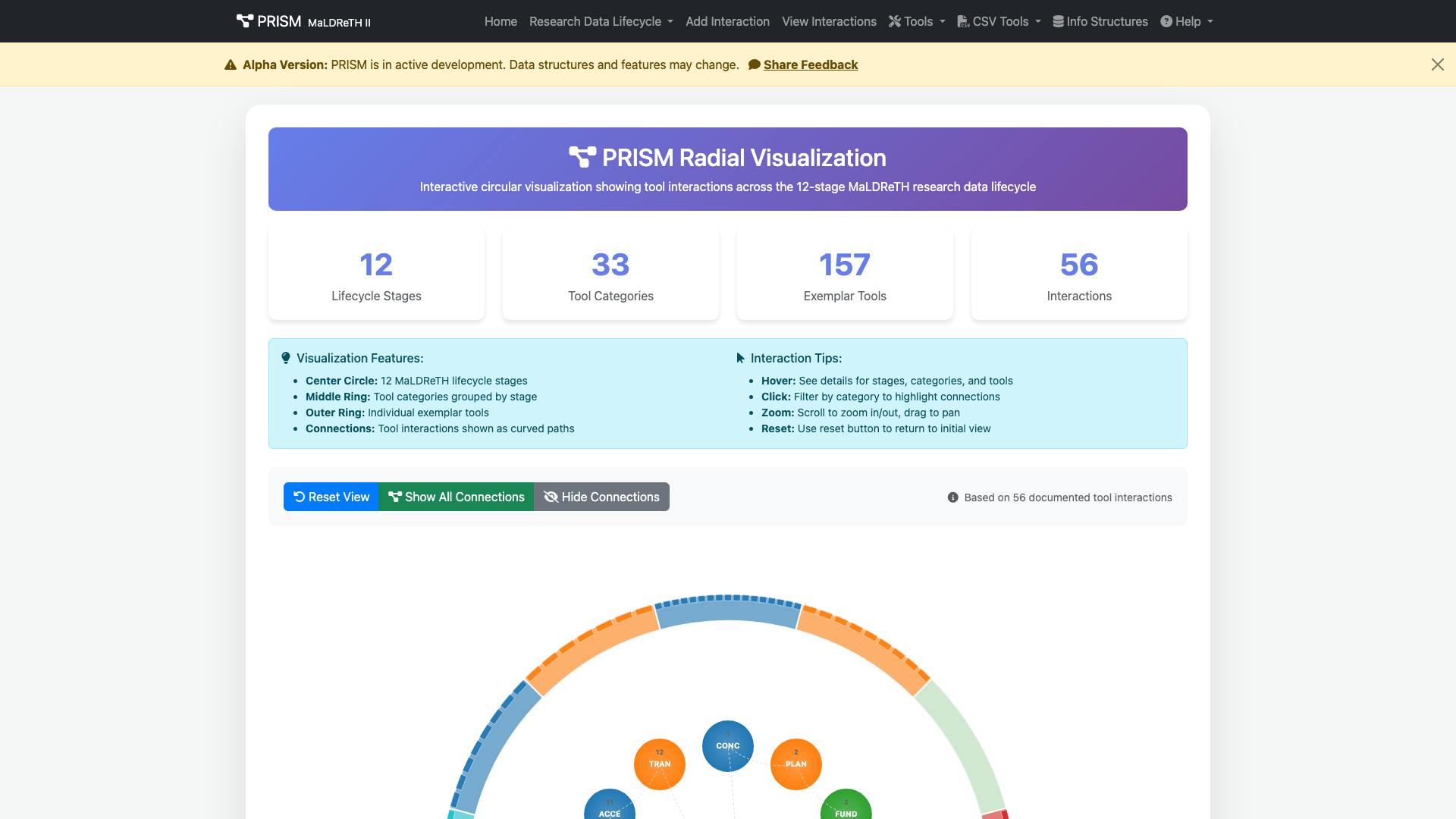
Tour 3/5: Interactive Visualizations
🎨 Radial visualization maps tools by lifecycle stage. Interactive exploration of relationships.

Slide 9
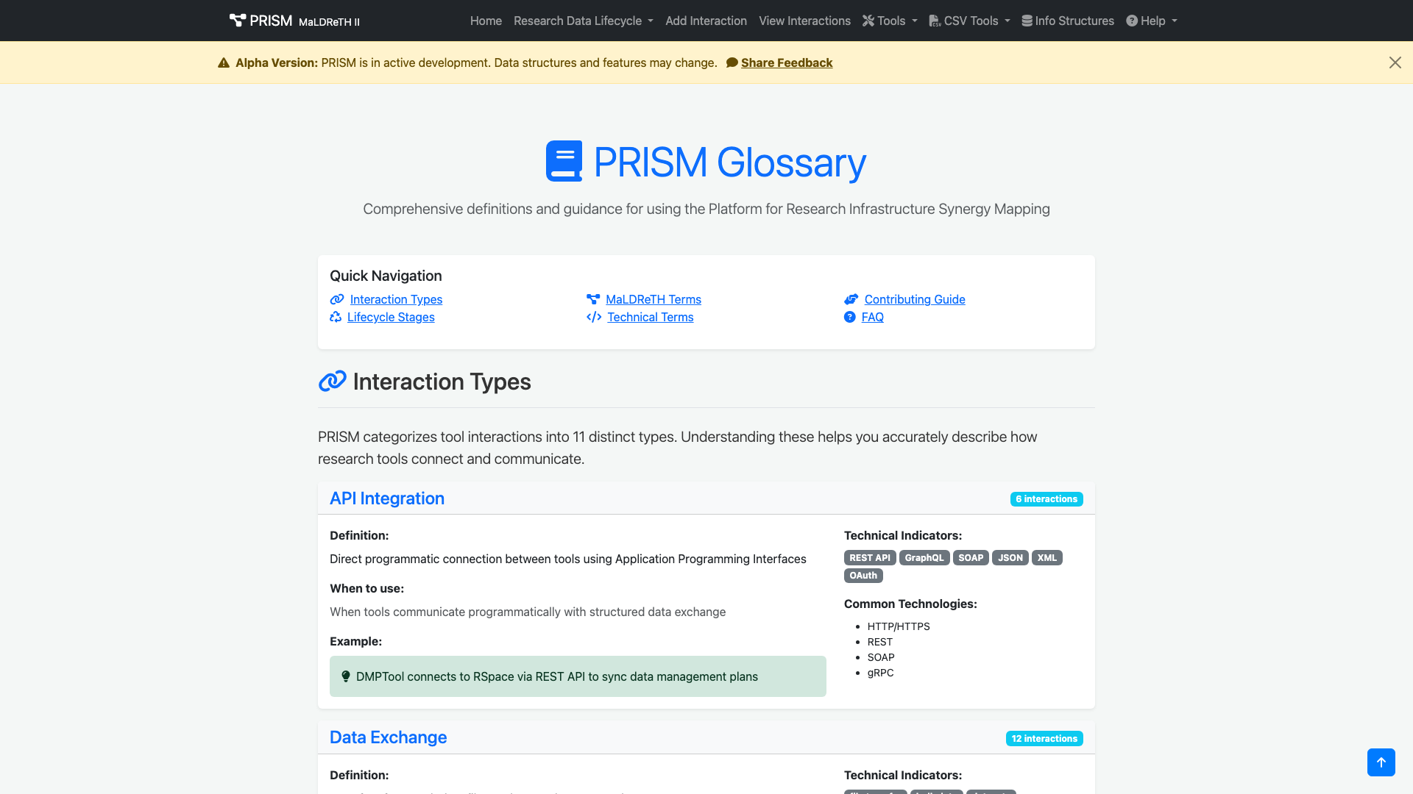
Tour 4/5: Documentation
📚 Comprehensive User Guide with interactive features. Glossary defines all terms and concepts.

Slide 10
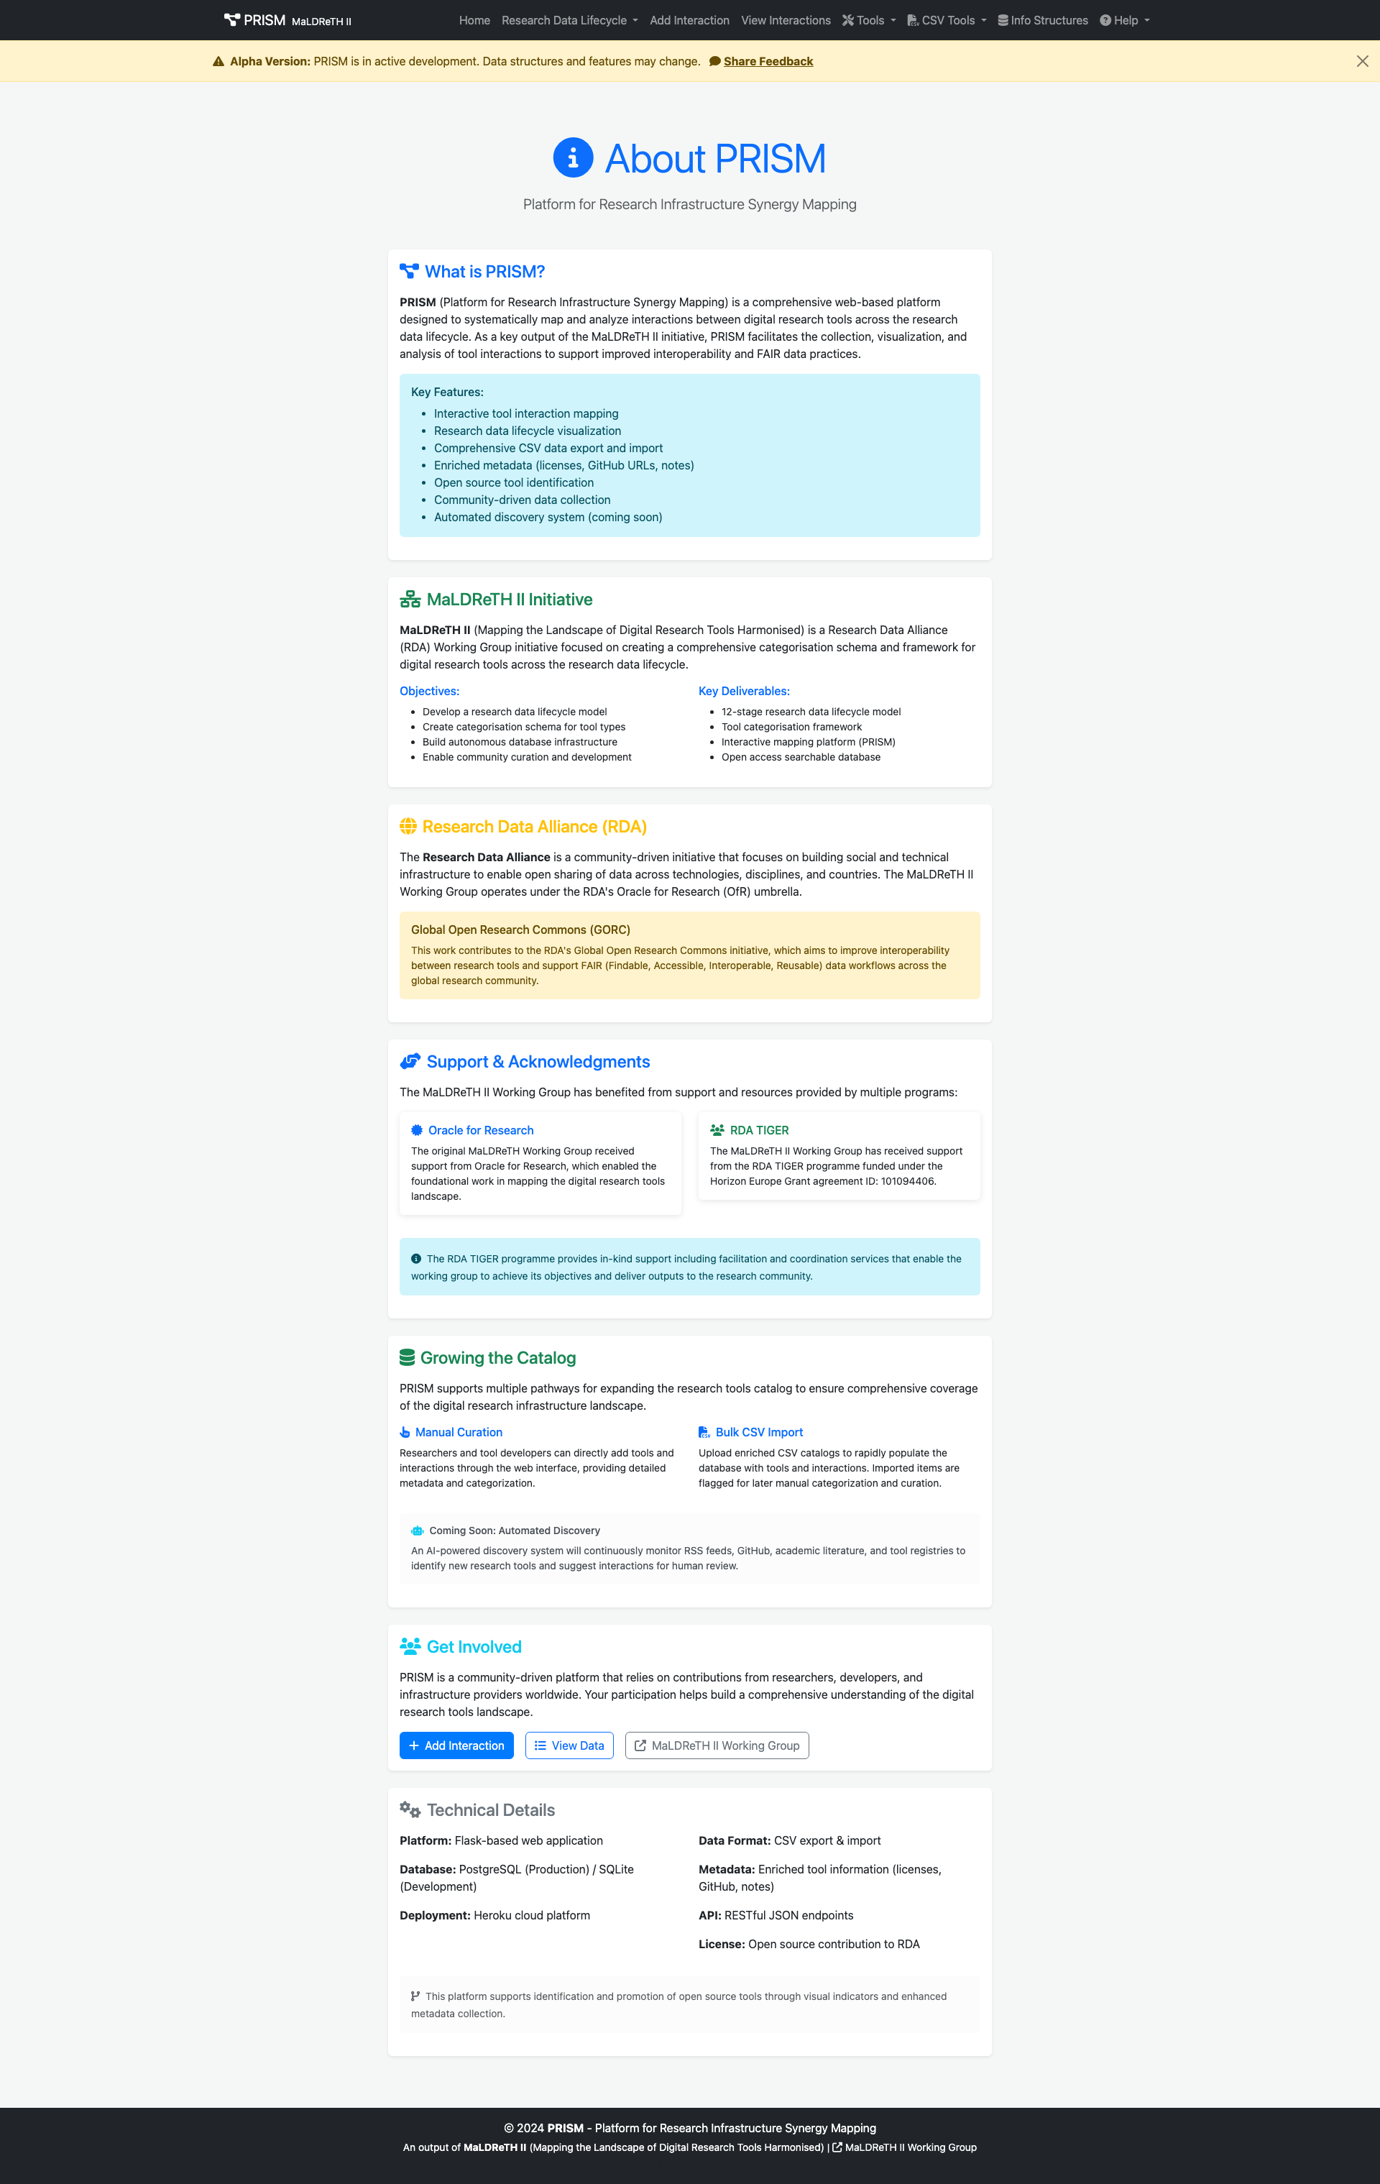
Tour 5/5: About & Community
👥 Learn about MaLDReTH working group, RDA TIGER support, and how to contribute.

Slide 11
Main Form - Comprehensive Entry
📝 Full-featured interaction documentation:
• Source & Target Tools (searchable dropdowns)
• Interaction Type (11 categories)
• Lifecycle Stage (12 stages)
• Description (what happens?)
• Technical Details (how it works?)
• Benefits (why it matters?)
• Challenges (what to watch for?)
• Examples (real-world use cases)
• Contact Information (optional)

Slide 12
Main Form - Key Features
💡 Smart Features:
• Searchable tool dropdowns (157 tools)
• Contextual help for each interaction type
• Field-level guidance and examples
• Preview before submission
• Links to User Guide and Glossary

Slide 13
Quick Add - Rapid Entry
⚡ Streamlined for speed:
• Only 5 required fields:
1. Source Tool
2. Target Tool
3. Interaction Type
4. Lifecycle Stage
5. Brief Description (1 sentence)
• Optional: Your name
• Target: ~30 seconds per entry

Slide 14
Quick Add - Key Features
🚀 Built for rapid entry:
✓ "Add another after saving" checkbox (default ON)
✓ Form clears automatically for next entry
✓ Searchable tool dropdowns
✓ Keyboard shortcuts (Ctrl/Cmd + S to save)
✓ Tab navigation for keyboard-only workflow
✓ Link to switch to full form anytime

Slide 15
Main Form vs Quick Add
📋 Main Form
⚡ Quick Add
• 12+ fields available
• Rich documentation
• Technical details
• Benefits & challenges
• Examples
• Best for: Well-researched interactions
• Time: 3-5 minutes per entry
• 5 required fields only
• Brief description
• No technical details needed
• Focus on essentials
• Details can be added later
• Best for: Bulk entry sessions
• Time: ~30 seconds per entry

Slide 16
DEMO: Main Form Workflow
Let's walk through a detailed entry:
1. Navigate to: Add Interaction
2. Select Source Tool (e.g., DMPTool)
3. Select Target Tool (e.g., RSpace)
4. Choose Interaction Type (e.g., API Integration)
5. Select Lifecycle Stage (e.g., PLAN)
6. Fill in detailed description
7. Add technical details, benefits, challenges
8. Submit and view

Slide 17
DEMO: Quick Add Workflow
Let's do rapid entry:
1. Navigate to: Quick Add (/quick-add)
2. Source Tool → Target Tool (searchable)
3. Interaction Type → Lifecycle Stage
4. One-sentence description
5. Click "Quick Save"
6. Form clears → Ready for next entry
7. Repeat for bulk entry sessions

Slide 18
When to Use Each Approach?
📋 Use Main Form when:
• You have detailed technical knowledge
• Documenting complex integrations
• Adding benefits, challenges, examples
• First-time detailed documentation
⚡ Use Quick Add when:
• You know many interactions exist
• Rapid brainstorming/mapping session
• Cataloging from documentation review
• Details can be filled in later
• Workshop or group activity

Slide 19
Data Quality & Curation
🎯 Both forms create valid database entries
• Quick Add interactions can be enhanced later
• Edit function available for all interactions
• Community curation encouraged
• Feedback system captures improvement suggestions
• Goal: Balance speed with quality

Slide 20
🎬 LIVE DEMO TIME
Let's see both forms in action...
(Navigate to live application)
Questions during demo are welcome!

Slide 21
Other New Features
📚 Interactive User Guide
• Step-by-step walkthrough
• Searchable, collapsible sections
• Reading progress indicator
💬 Feedback System
• Alpha version feedback collection
• 6 categories (Usability, Data Quality, etc.)
• Admin review page with CSV export

Slide 22
Your Feedback & Questions
💭 Discussion Points:
• Are both entry methods useful?
• What's your preferred workflow?
• Which fields are most/least important?
• How can we improve the user experience?
• What other features would be valuable?
🔗 Access: http://prism-int-dev-f2cc90f8dc1f.herokuapp.com

Slide 23
Next Steps - Phase 2
📋 Upcoming (Implementation Plan):
• Enhanced CSV validation and import
• Batch review interface for curators
• Website cross-linking improvements
Timeline: Weeks 2-3

Slide 24
Thank You!
Questions & Feedback Welcome
MaLDReTH II Working Group - Co-Chairs Demo

