Slide 1
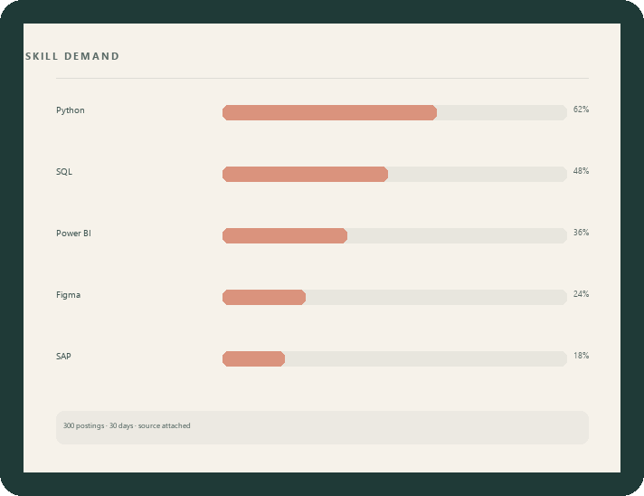
SDC HACKATHON 2026 · DOMAIN 1 · THE AIVERSECITY FUTURE-READY WORKFORCE DOMAIN
AURA-Workforce
Four checkpoints from the market evidence to a study plan
a person can actually follow.
overinfinity · Ahmad Adam Hakimi bin Naeman
International Islamic University Malaysia
aura-workforce.replit.app
github.com/adamnaemman/sdc-hackathon

Slide 2
THE PROBLEM
Workers are told to reskill,
but not what to do on Monday.
56%
600,000+
39%
of Malaysian professionals already use AI at work — only 26% have had formal training.
workers projected to need reskilling within three to five years.
of workers' core skills are expected to change by 2030.
Hays Asia Salary Guide 2025
MOSTI
WEF · Future of Jobs 2025
Yet the advice a worker receives is generic, static and rarely cites a source — while the training they are told to buy is expensive and often already out of date.
Domain 1 brief · problem statement
02 / 12

Slide 3
WHO IT IS FOR
Four people, one moment of need.
The displaced worker
The switcher
A procurement assistant whose routine work is being automated. Needs a route out, not sympathy.
A nurse, designer or clerk deciding where existing skills can carry them next.
HR and L&D
TVET and university advisers
Planning next year's reskilling budget and needing evidence, not vendor decks.
Advising students from a printed list that was accurate five years ago.
The moment: the week a person learns their role is changing. They do not want a prediction — they want to know what to do next, and whether to trust it.
Personas derived from the Domain 1 brief
03 / 12

Slide 4

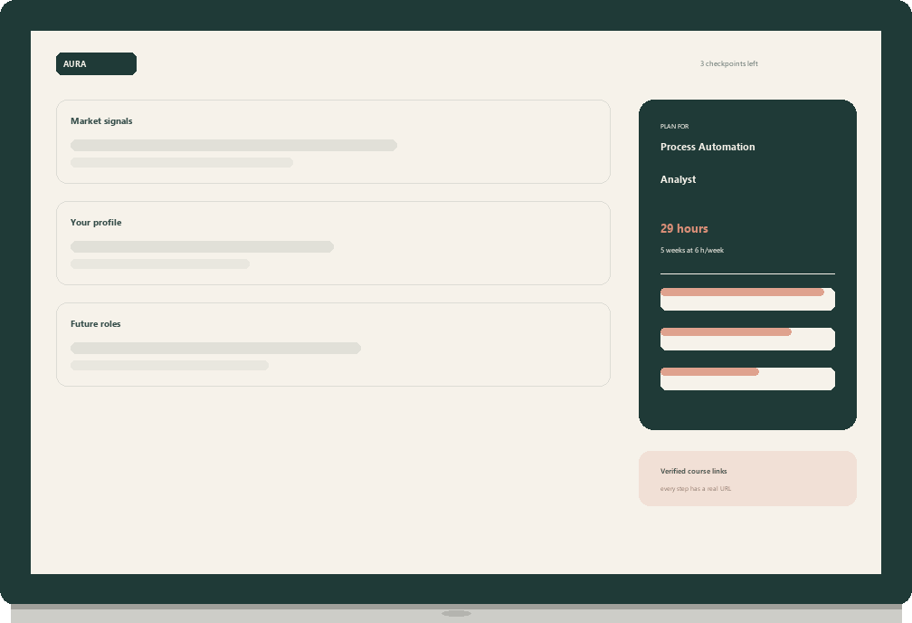
THE PRODUCT
One page. Four checkpoints.
01
Market signals
Live demand from real postings,
with the source and date.
02
Your profile
The AI expands what you write
into skills you choose.
03
Future roles
Occupations proposed from your
profile — not a fixed catalogue.
04
Learning path
A plan fitted to your weekly hours,
with verified course links.
Same page on phone, tablet and desktop
04 / 12

Slide 5
CHECKPOINT 01 · MARKET SIGNALS
Evidence, with its source attached.
Three hundred recent public postings, refreshed on demand.
The most requested skills plotted week by week — not a shortlist of our own roles.
Source, fetch time and sample size printed on the chart.
Six sourced labour-market signals from BLS and WEF, each with a source note.
The screen says what it is not: a global feed, not Malaysian vacancy counts.
Numbers that cannot be checked are not shown at all.
Checkpoint 01
05 / 12

Slide 6
CHECKPOINT 02 · YOUR PROFILE
Name what you already bring.
Role, industry and years of experience, then one model call.
The AI expands that into concrete, selectable skills and tools.
Tools are pre-ticked because they are factual; judgement skills stay unticked.
Custom skills survive, so a title we never modelled still counts.
Weekly hours entered here become the schedule in checkpoint 04.
Suggestions are offered, never applied on the person's behalf.
Checkpoint 02
06 / 12

Slide 7
CHECKPOINT 03 · FUTURE ROLES
The roles the AI chose for you.
The model proposes occupations from the profile — including ones outside our catalogue.
Each comes with its reasoning, the skills to build, a first step, and a reference you can check.
No salary, growth figure or course link is shown for those occupations, because we could not source one.
They carry an explicit badge: exploratory, no verified pathway.
If the model cannot name a reference, the suggestion is discarded.
Checkpoint 03
07 / 12

Slide 8
CHECKPOINT 04 · LEARNING PATH
A plan built around the hours you actually have.
The model may only choose courses from a library we verified, link by link.
Every step shows provider, hours and the reason it was ordered there.
The plan is divided by the weekly hours the person said they have.
If nothing fits, it returns study topics with real search links — never an invented course.
Export to PDF, with a QR code on every step for the classroom or a printed handout.
Verified means fetched and checked before shipping.
Checkpoint 04
08 / 12

Slide 9
TRUST, BY CONSTRUCTION
What the AI may not do.
Closed vocabulary
Visible disagreement
No storage
Injection treated as data
Every role and module identifier is validated against our catalogue; anything unknown is discarded before it reaches the screen.
The model's fit score is shown next to the deterministic estimate, so the two can be compared rather than blended.
No account, no database, no CV. The profile lives in the browser tab and is gone when it closes.
Free text is delimited, output is schema-validated, and the model never receives a tool that can write.
Each rule is a validation path in the repository — not a promise in a document.
The model chooses and explains; it never writes the catalogue.
Enforced in code, not in a policy document
09 / 12

Slide 10
SDG IMPACT FRAMEWORK
Baseline, KPI, and a target we can be held to.
TARGETS
MEASUREMENT
4.4.1 Relevant skills for employment
4.3.1 Access to lifelong learning
8.5.2 Employment and decent work
8.2.1 Productivity through technology
Baseline — 56% use AI, 26% trained, 600k need reskilling.
KPI — share of recommendations carrying a verifiable source and date; time to a ranked plan.
Phase 2 target — 100% sourced, under five minutes, with a Malaysian trend source.
We report the KPI we can be measured on, not the one that flatters us.
SDG 4 · 8
10 / 12

Slide 11
FEASIBILITY, AND THE RISK WE NAME
Hardest risk: the model inventing a job or a course.
RISK AND FALLBACK
STACK
A generated role, course or statistic that does not exist.
· Catalogue and library are closed; unknown IDs are dropped server-side.
· The exploratory tier must name an occupational reference or the suggestion is removed.
· Course steps resolve only to URLs we fetched and verified before shipping.
Second risk: a global job feed is not Malaysian vacancy data — stated on screen, fixed in Phase 2.
React 19 · Vite · Tailwind 4
TanStack Query · Wouter
Express 5 · Zod · OpenAPI + Orval
DeepSeek (declared)
O*NET 30.1 · Arbeitnow
Replit hosting and deploy
Live prototype: aura-workforce.replit.app Repository: github.com/adamnaemman/sdc-hackathon
Every claim in this deck is reproducible from the repository
11 / 12

Slide 12
WHAT COMES NEXT
Phase 2: local data, sharper matching, proof.
Malaysian demand data
DOSM and local postings, so ranking reflects the country rather than a global feed.
Semantic skill matching
Embeddings instead of lexical overlap — the weakest part of the current engine.
Counsellor view
Cohort gaps and shared plans for TVET and university advisers.
Self-hosted model
RunPod credit already allocated; the client is OpenAI-compatible.
overinfinity · Ahmad Adam Hakimi bin Naeman · IIUM · SDC 2026, Domain 1
12 / 12

