Slide 1
CPU Scheduling Section 2.4: Tanenbaum’s book Chapter 5: Silberschatz’s book
Kartik Gopalan

Slide 2
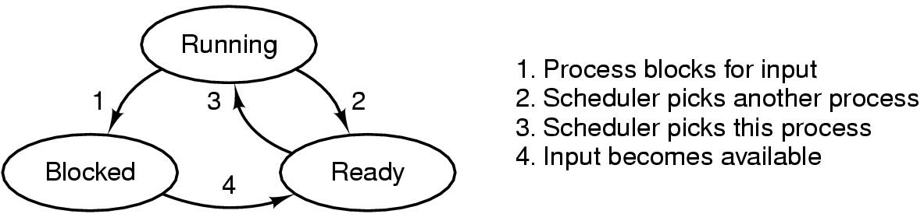
Process Lifecycle Revisited
Ready
Process is ready to execute, but not yet executing
Its waiting in the scheduling queue for the CPU scheduler to pick it up.
Running
Process is executing on the CPU
Blocked
Process is waiting (sleeping) for some event to occur.
Once the event occurs, process will be woken up, and placed on the scheduling queue.

Slide 3
CPU scheduler
Who’s Next?
CPU
Queue of Ready Process
CPU Scheduler
Selects the next process to run on the CPU from among the processes that are ready to execute
CPU scheduling decision may take place when any process:
1. Switches from running to waiting state
2. Switches from running to ready state (pre-emptive scheduling)
3. Switches from waiting to ready
4. Terminates

Slide 4
Dispatcher
Not the same as scheduler.
Dispatcher gives control of the CPU to the process selected by the scheduler; this involves:
switching context
switching to user mode
jumping to the proper location in the user program to restart that program
Dispatch latency
Time it takes for the dispatcher to stop one process and start another running

Slide 5
Linux CPU Scheduling Code
To browse, go to http://lxr.free-electrons.com
To download, modify, and compile, go to
http://ftp.kernel.org/
Scheduling code is located under
kernel/sched/core.c
Three ways to invoke kernel code
System calls
Hardware interrups
Exceptions
For x86, all entry points into the 4.2 kernel are located in assembly code in
arch/x86/entry/entry_32.S
OR arch/x86/entry/entry_64.S

Slide 6
When does the scheduler execute?
Timer interrupt fires OR
Some process blocks (or gives up CPU)‏
Look at the CPU scheduler code in Linux
schedule() function in kernel/sched/core.c
http://lxr.free-electrons.com/source/kernel/sched/core.c#L2988
Entry point to the kernel (in entry_*.S) invokes schedule() function which then
Figures out the next process to schedule and
Swaps the prev and next process via context_switch() function, which in turn
Switches memory state using switch_mm() and
Switches register+stack state using switch_to()‏

Slide 7
Scheduling Criteria
CPU utilization – keep the CPU as busy as possible
Throughput – Number of processes that complete their execution per time unit
Turnaround time – amount of time to execute a particular process, from submission to termination.
Waiting time – amount of time a process has been waiting in the ready queue
Response time – amount of time it takes from when a request was submitted until the first response is produced.
Optimization Criteria
Max CPU utilization
Max throughput
Min turnaround time
Min waiting time
Min response time

Slide 8
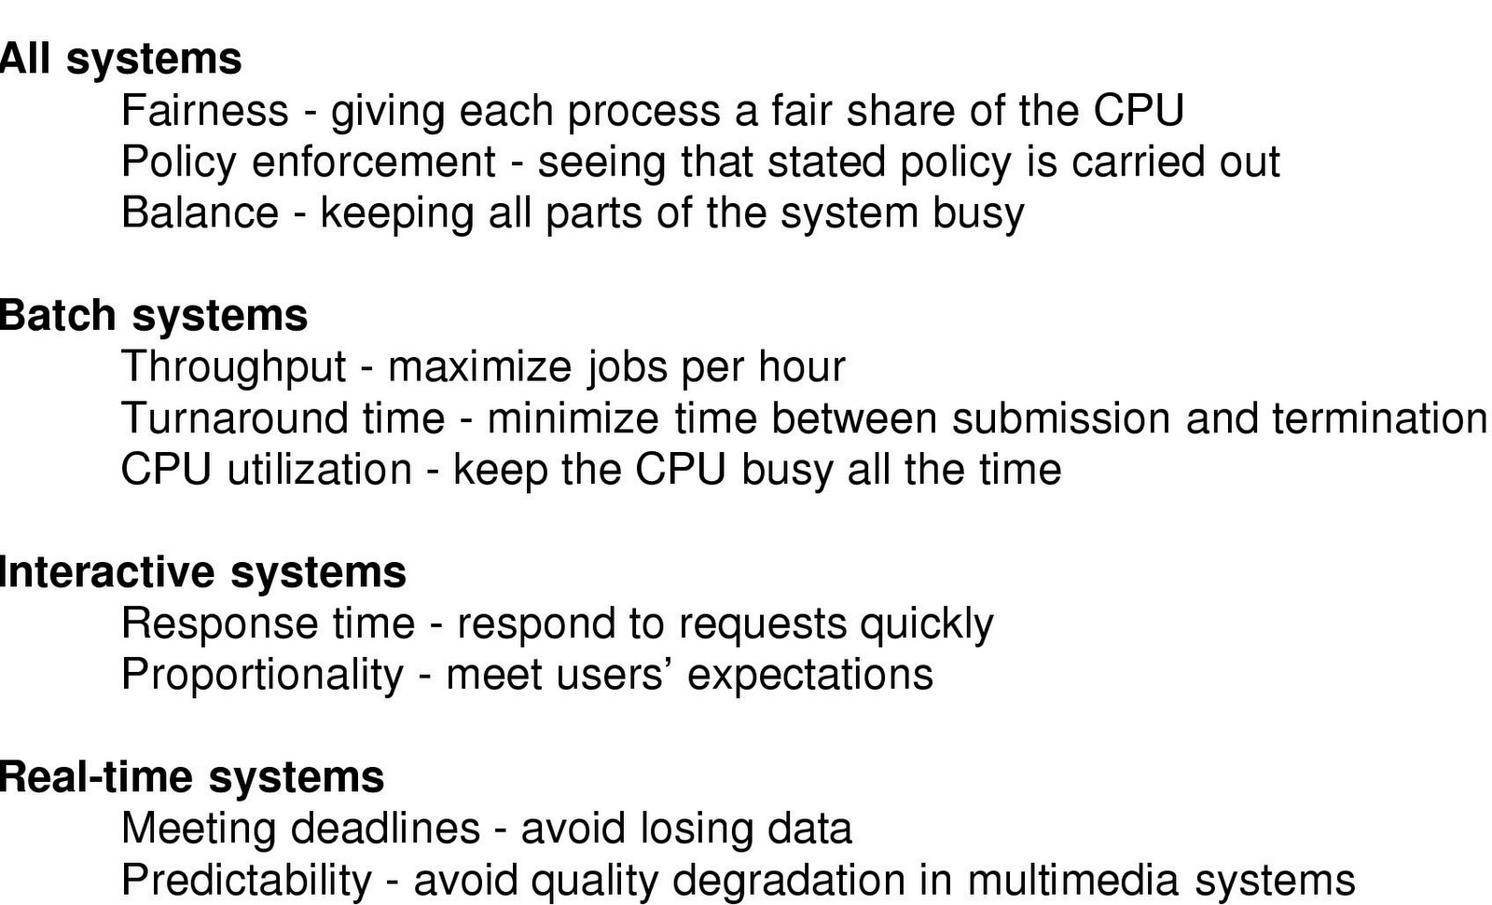
Different systems have different scheduling goals

Slide 9
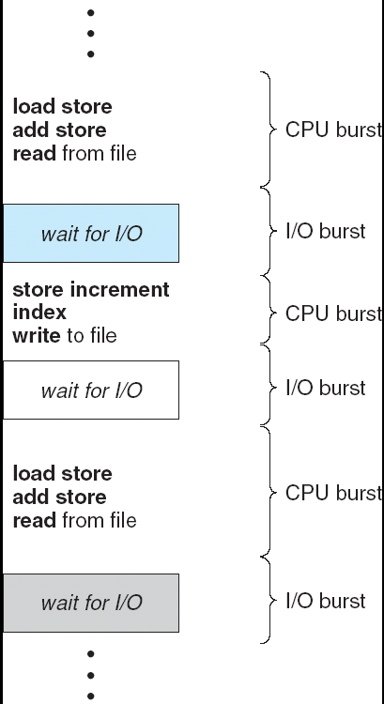
Alternating Sequence of CPU And I/O Bursts in a Typical Program

Slide 10
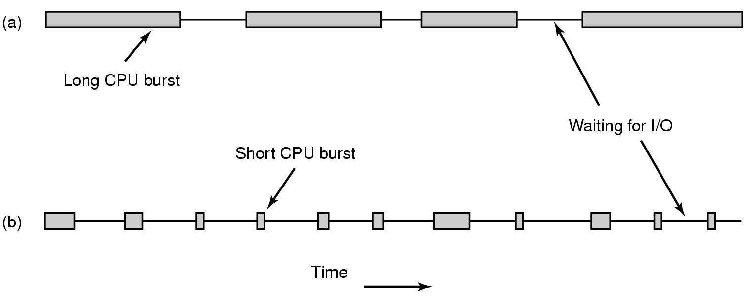
Alternating Sequence of CPU And I/O Bursts (contd)
A CPU-bound process
An I/O-bound process

Slide 11
First-Come, First-Served (FCFS) Scheduling
Process Burst Time
P₁ 24
P₂ 3
P₃ 3
Suppose that the processes arrive in the order: P₁ , P₂ , P₃ The Gantt Chart for the schedule is:
Waiting time for P₁ = 0; P₂ = 24; P₃ = 27
Average waiting time: (0 + 24 + 27)/3 = 17
P₁
P₂
P₃
0
24
27
30

Slide 12
FCFS Scheduling (Cont.)
Suppose that the processes arrive in the order
P₂ , P₃ , P₁
The Gantt chart for the schedule is:
Waiting time for P₁ = 6; P₂ = 0; P₃ = 3
Average waiting time: (6 + 0 + 3)/3 = 3
Much better than previous case
Convoy effect : short process behind long process
P₂
P₃
P₁
0
3
6
30

Slide 13
Shortest-Job-First (SJF) Scheduling
Consider the length of its next CPU burst for each process.
Schedule the process having the shortest next CPU burst.
Two schemes:
nonpreemptive – once CPU given to the process it cannot be preempted until completes its CPU burst
preemptive – if a new process arrives with CPU burst length less than remaining time of currently executing process, preempt the current process. This scheme is know as the Shortest Remaining Time First (SRTF)
Claim: SJF algorithm is optimal
SJF Gives a schedule with least average waiting time compared to any possible scheduling algorithm.

Slide 14
Example of Non-Preemptive SJF
Process Arrival Time Burst Time
P₁ 0.0 7
P₂ 2.0 4
P₃ 4.0 1
P₄ 5.0 4
SJF (non-preemptive)
Average waiting time = (0 + 6 + 3 + 7)/4 = 4
P₁
P₃
P₂
P₄
0
3
7
8
12
16

Slide 15
Example of Preemptive SJF
Process Arrival Time Burst Time
P₁ 0.0 7
P₂ 2.0 4
P₃ 4.0 1
P₄ 5.0 4
SJF (preemptive)
Average waiting time = (9 + 1 + 0 +2)/4 = 3
P₁
P₂
P₃
P₂
P₄
P₁
0
2
4
5
7
11
16

Slide 16
SJF is Optimal w.r.t average wait time
Meaning that no other algorithm can achieve a lower wait time than SJF
Proof:
Assume that there was an algorithm X that gave better average wait time than SJF for a set of N processes.
Since X is not the same as SJF, it means that there must be at least two processes P1 and P2 in the schedule generated by X such that
P1 executes before P2 does and
The CPU execution time of P1 is longer than that of P2 and
The average wait time of the schedule is smaller than that given by SJF
BUT, is you swap the positions of P1 and P2 in the schedule generated by X, then the average wait time goes down!
So keep swapping all such process pairs that satisfy conditions (a) and (b) above. Each swap will reduce the average wait time.
Finally you will end up with a schedule generated by SJF, whose wait time cannot be reduced any further. Hence SJF is Optimal.

Slide 17
Exponential Averaging:
Determining the Length of Next CPU Burst
Not easy. Can only guess the length of next CPU burst
Can be done by using the length of previous CPU bursts, using exponential averaging
t_{n} = actual length of the n^{th} CPU burst
τ_{n} = predicted value of the n^{th} CPU burst
α, 0 <= α <= 1
Define:
τ_{n+1} = α t_{n} + (1-α) * τ_{n}

Slide 18
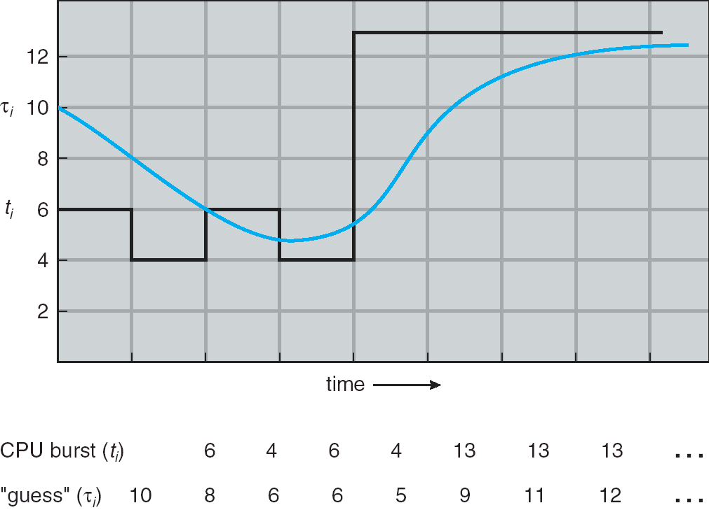
Prediction of the Length of the Next CPU Burst

Slide 19
Examples of Exponential Averaging
τ_{n+1} = α t_{n} + (1-α) * τ_{n}
α =0
τ_{n+1} = τ_{n}
CPU burst history does not count
α =1
τ_{n+1} = α t_{n}
Only the actual last CPU burst counts
If we expand the formula, we get:
τ_{n+1} = α t_{n}+(1 - α)α t_{n-1} + …
+(1 - α )^{j} α t_{n} _{-j} + …
+(1 - α )^{n +1} τ₀
Since both α and (1 - α) are less than or equal to 1, each successive term has less weight than its predecessor

Slide 20
Round Robin (RR)
Each process gets a fixed unit of CPU burst time (time quantum)
usually 10 to 100 milliseconds.
After this time has elapsed, the process is preempted and added to the end of the ready queue.
If there are n processes in the ready queue and the time quantum is q, then each process gets 1/n of the CPU time in bursts of at most q time units at once. No process waits more than (n-1)q time units.
Performance
q large ⇒ FIFO, because processes rarely get pre-empted
q small ⇒ Smaller response times, but too much context switching overhead. q must be large compared to context switch time, otherwise overhead is too high

Slide 21
Example of RR with Time Quantum = 20
Process Burst Time
P₁ 53
P₂ 17
P₃ 68
P₄ 24
The Gantt chart is:
Typically, higher average turnaround than SJF, but
Better response time
No Starvation
P₁
P₂
P₃
P₄
P₁
P₃
P₄
P₁
P₃
P₃
0
20
37
57
77
97
117
121
134
154
162

Slide 22
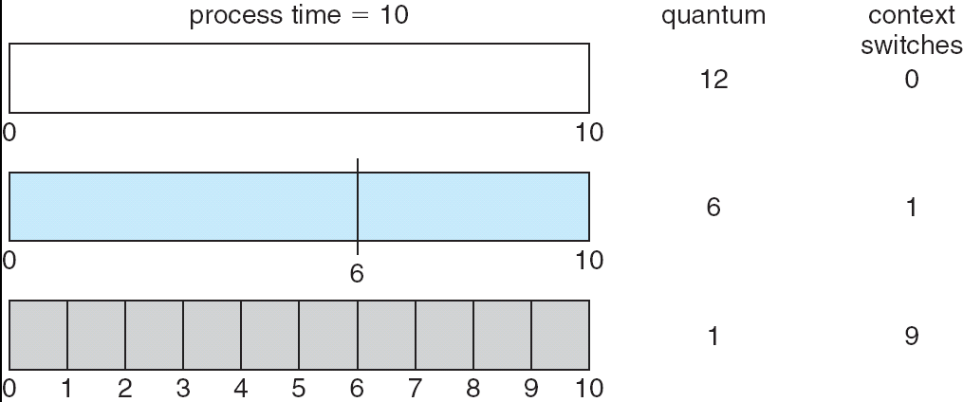
Time Quantum and Context Switch Time
Smaller the time quantum, more the number of context switches.
Larger the time quantum, larger the response time.
Scheduling algorithm needs to find a balance between context switch overhead and response time.

Slide 23
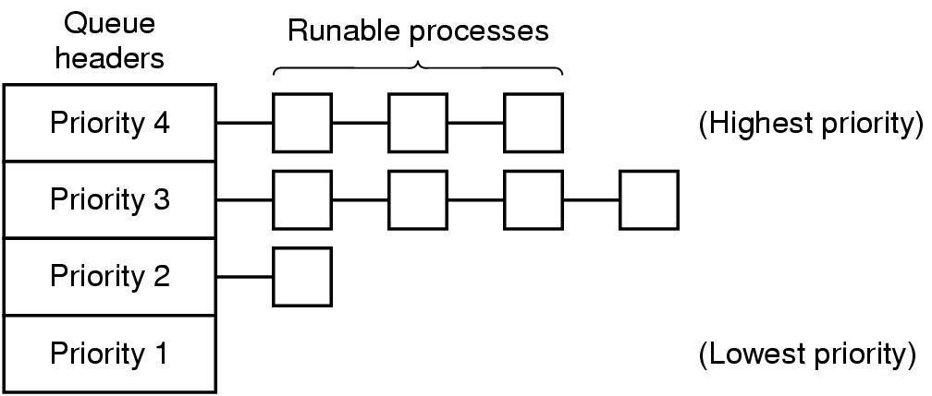
Priority Scheduling
A priority number (integer) is associated with each process
The CPU is allocated to the process with the highest priority (smallest integer ≡ highest priority)
Again two types
Preemptive
nonpreemptive
SJF is a priority scheduling algorithm where priority is the predicted next CPU burst time
Problem ≡ Starvation ➔ low priority processes may never execute
Solution ≡ Aging ➔ as time progresses increase the priority of a lower priority process that is not receiving CPU time.
Example with four priority classes

Slide 24
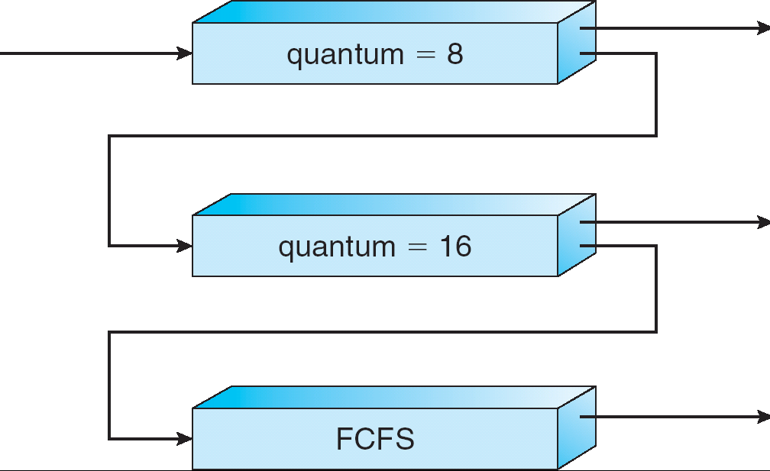
Multilevel Feedback Queue (MFQ)
Ready queue is partitioned into separate queues
Each queue has its own scheduling algorithm
A process can move between the various queues;
MFQ scheduler defined by :
number of queues
scheduling algorithms for each queue
method used to determine when to upgrade or demote a process
Example of MFQ that gives higher priority to interactive jobs
A new job enters queue Q₀ which is served RR.
When it gains CPU, it receives 8 ms. If it doesn’t finish in 8 ms, job is moved to Q₁.
At Q₁ job is again served RR; receives 16 ms.
If it still doesn’t complete, it is preempted and moved to queue Q₂ where it is served FCFS.
Q0
RR
Q1
RR
Q2
FCFS

Slide 25
Real-Time Scheduling
When each task needs to be completed before a given deadline
Hard real-time systems
Required to complete a critical task before its deadline
For example, in a flight control system, or nuclear reactor
Soft real-time systems
Meeting deadlines desirable, but not essential
For example, video or audio
Schedulability criteria
Given m periodic events, where event i occurs within period P_{i} and requires C_{i} computation time each period
Then the load can be handled only if
sum_{i} (C_{i}/P_{i}) <= 1
The above condition is necessary but NOT sufficient.

Slide 26
Fair Scheduling
Notion of “fairness” does not necessarily mean equal CPU share for all processes.
Say you have N processes
Each process P_{i} is assigned a weight w_{i}
The the CPU time will be divided among processes in proportion to their weights.
Let's say some process does not use its assigned CPU time.
The the “spare” CPU time is divided among the remaining ready processed according to the ratio of their weights.

Slide 27
Work-conserving versus non-work-conserving
Work-conserving scheduler
CPU will not remain idle if there are processes in the ready queue
Non-work-conserving scheduler
Under some conditions, scheduler may decide to “waste” CPU time even though there may be processes sitting in the ready queue
E.g. Sometimes real-time process cannot be started before a given time (release time).

Slide 28
Linux CPU Scheduling Code
To browse, go to http://lxr.linux.no/
To download, modify, and compile, go to
http://ftp.kernel.org/
Scheduling code is located under
kernel/sched.c
Entry points into the kernel are located at
arch/x86/entry_32.S
OR arch/x86/entry_64.S

