Slide 1
Memory Management Basics
From Chapter 4, Modern Operating Systems, Andrew S. Tanenbaum

Slide 2
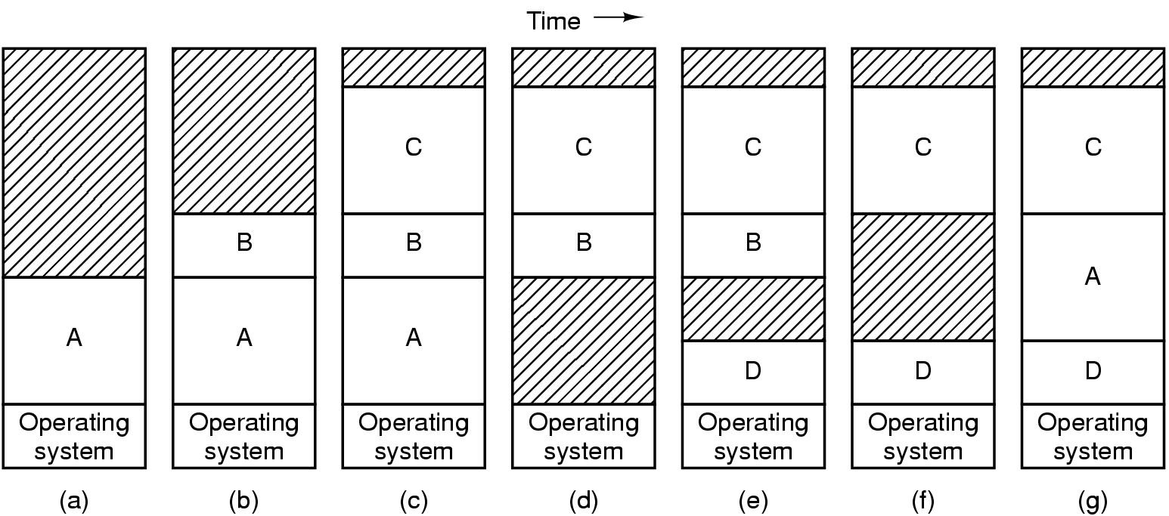
Swapping (1)
Physical memory may not be enough to accommodate needs of all processes
Memory allocation changes as
processes come into memory
leave memory and are swapped out to disk
Re-enter memory by getting swapped-in from disk
Shaded regions are unused memory

Slide 3
Virtual Memory
Swapping is useful when the sum total of memory requirements of all processes is greater than DRAM available in the system.
But sometimes, a single process might require more memory than the available DRAM in the system.
In such cases swapping is not enough. Rather, we need to break up the memory space of a process into smaller equal-sized pieces (called pages).
Operating system then decides which pages stay in memory and which get moved to disk.
Virtual memory: means that each process gets an illusion that it has more memory than the physical DRAM in the system.
}
Page
Physical DRAM
Process Virtual Address Space

Slide 4
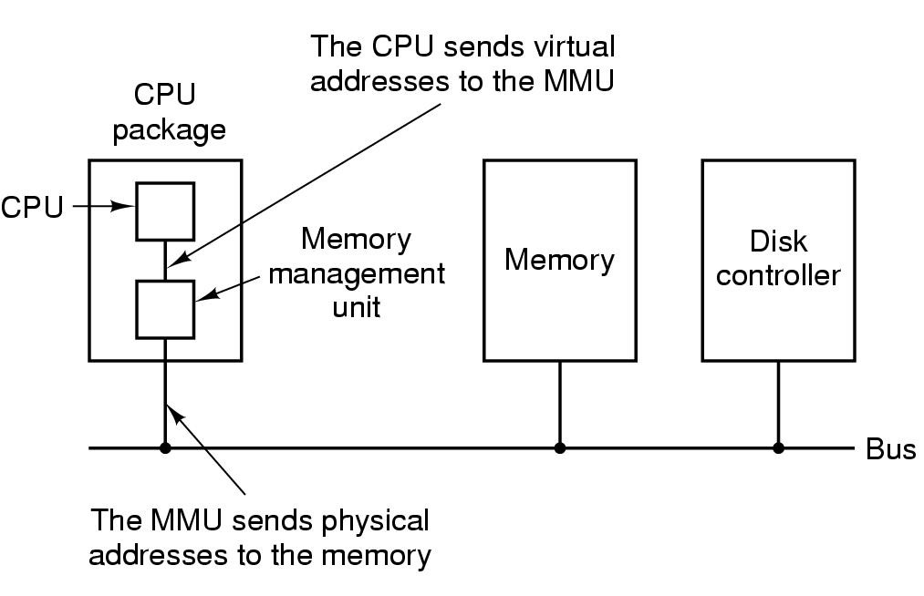
Virtual Memory and MMU
MMU = Memory Management Unit
Part of Hardware that accompanies the CPU
Converts Virtual Addresses to Physical Addresses

Slide 5
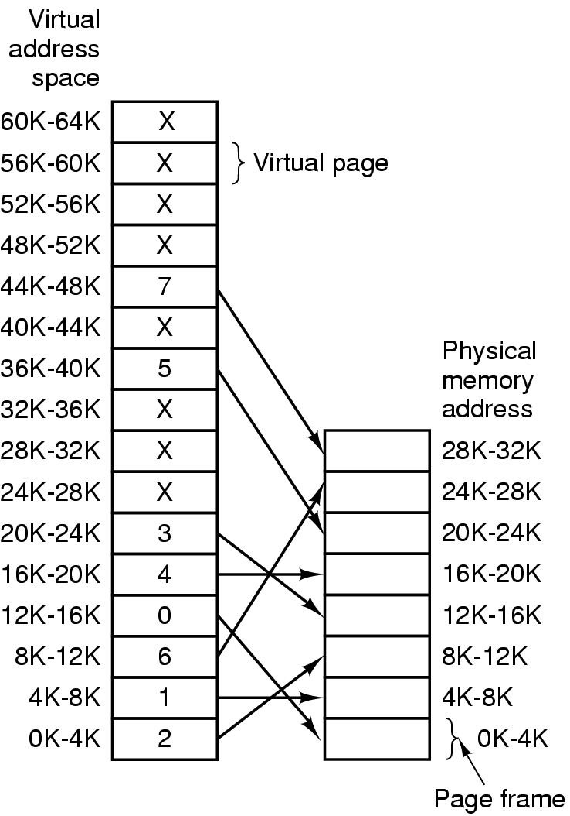
Paging
The relation between virtual addresses and physical memory addres- ses given by page table

Slide 6
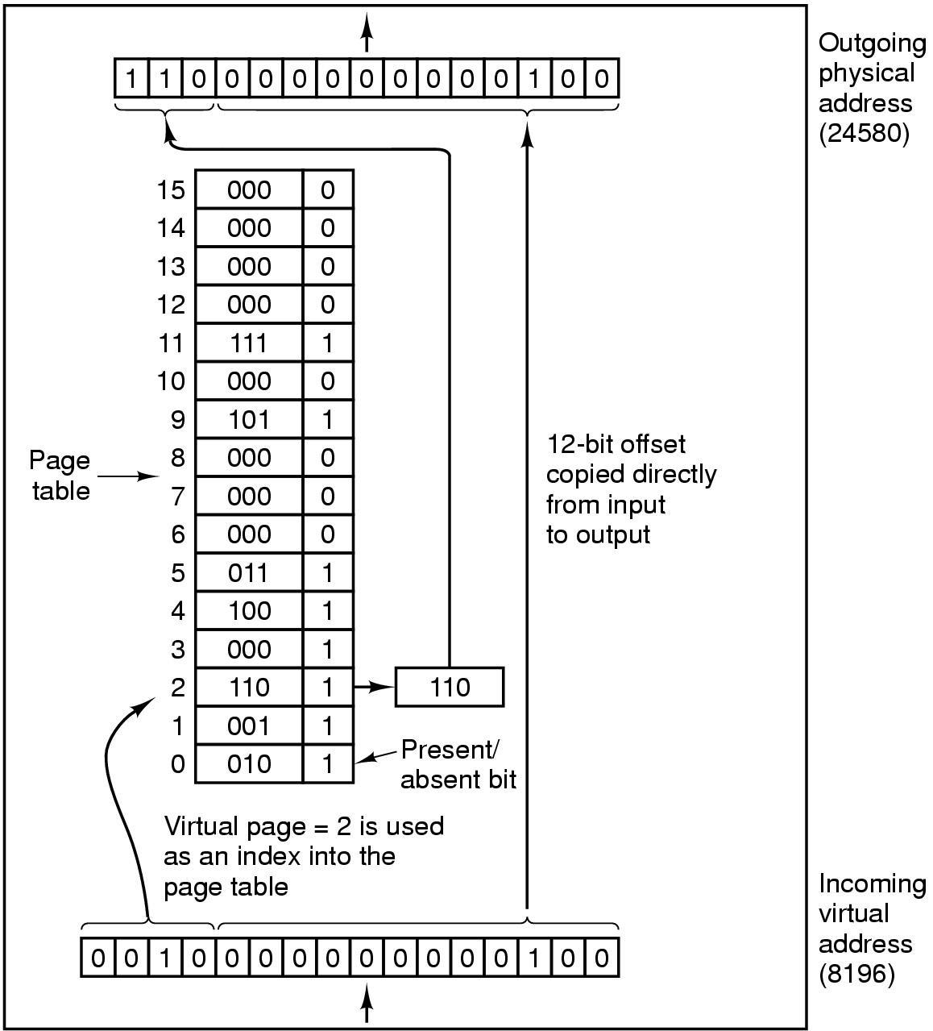
Page Tables (1)
Internal operation of MMU with 16 4 KB pages

Slide 7
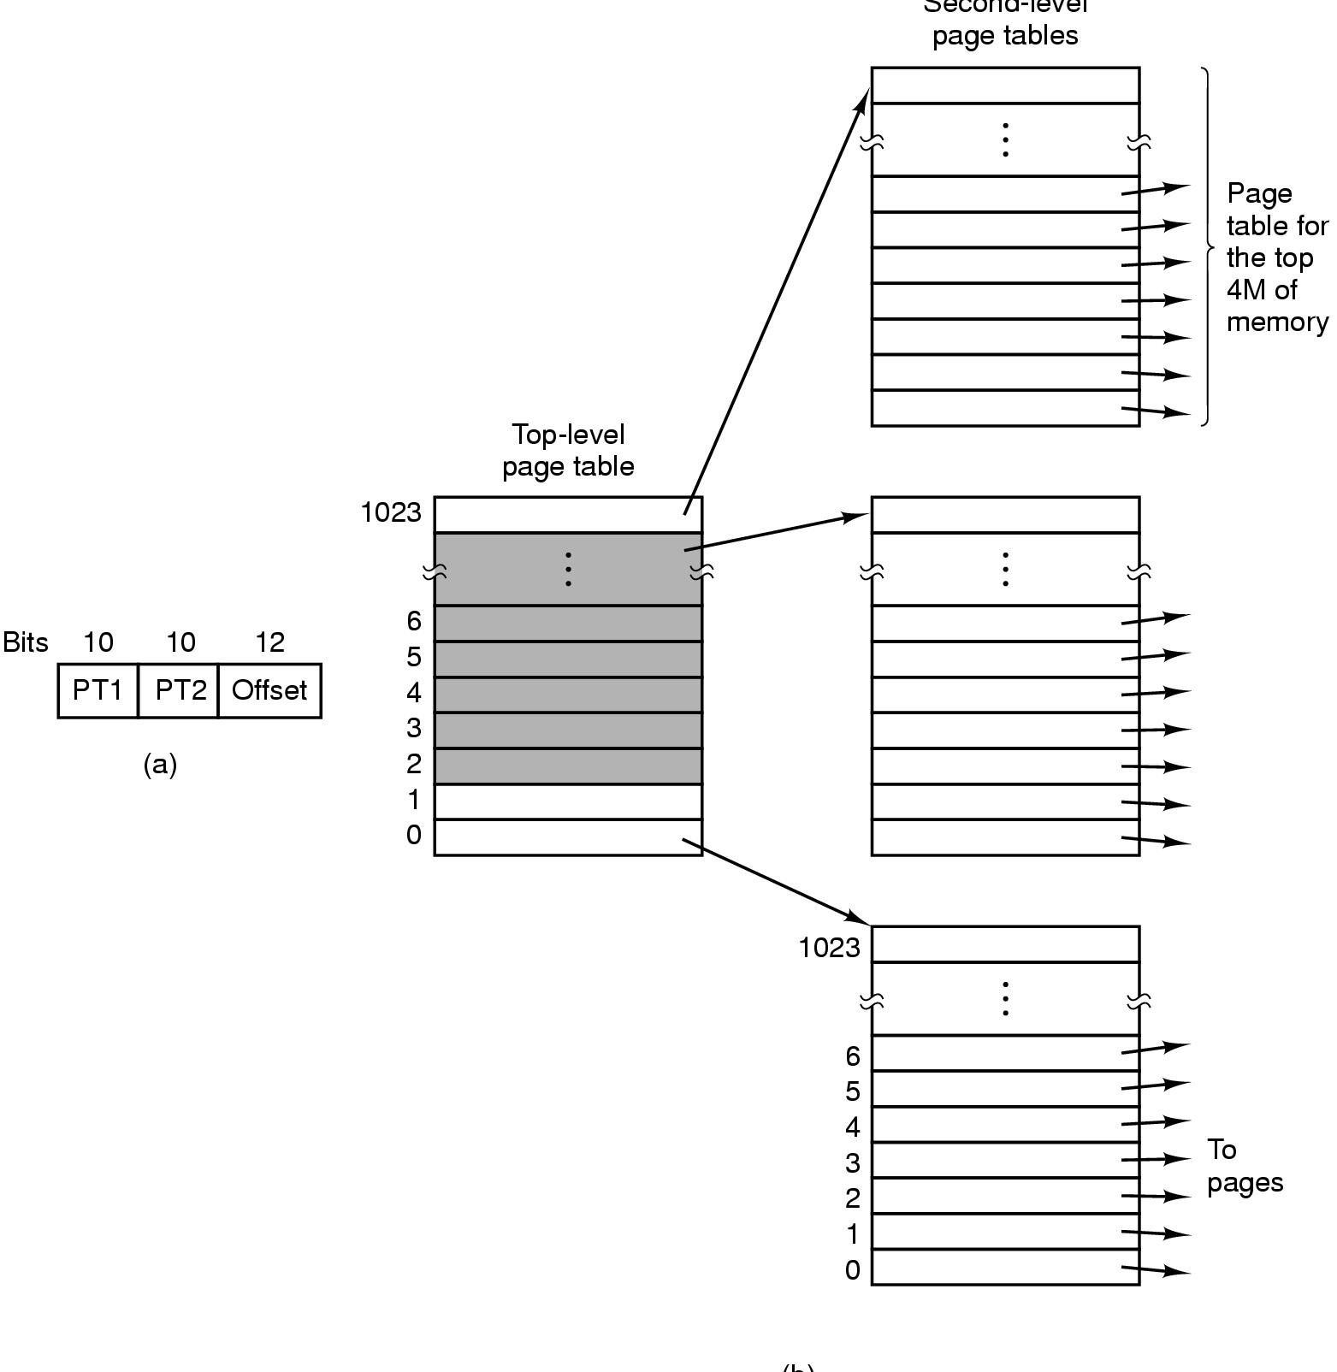
Page Tables (2)
32 bit address with 2 page table fields
Two-level page tables
PT too Big for MMU
Place it in main memory
But how does MMU know where to find PT?
Registers (CR2 on Intel)
Second-level page tables
Top-level
page table

Slide 8
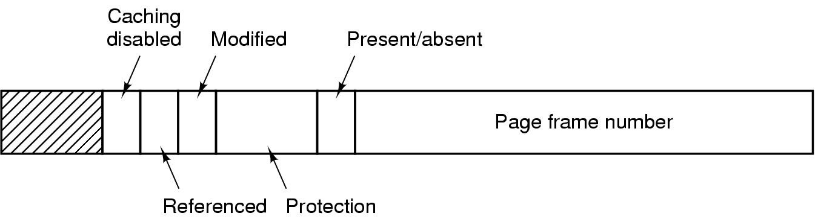
Typical page table entry
Page Frame number = physical page number for the virtual page represented by the PTE
Referenced bit: Whether the page was accessed since last time the bit was reset.
Modified bit: Also called “Dirty” bit. Whether the page was written to, since the last time the bit was reset.
Protection bits: Whether the page is readable? writeable? executable? contains higher privilege code/data?
Present/Absent bit: Whether the PTE contains a valid page frame #. Used for marking swapped/unallocated pages.

Slide 9
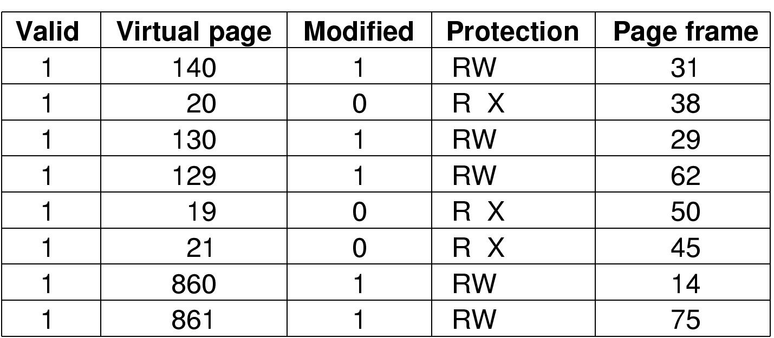
TLBs – Translation Lookaside Buffers
TLB is a small cache that speeds up the translation of virtual addresses to physical addresses.
TLB is part of the MMU hardware (comes with CPU)
It is not a Data Cache or Instruction Cache. Those are separate.
TLB simply caches translations from virtual page number to physical page number so that the MMU don’t have to access page-table in memory too often.
On x86 architecture, TLB has to be “flushed” upon every context switch because there is no field in TLB to identify the process context.

Slide 10
Practical, transparent operating system support for superpages
Juan Navarro ● Sitaram Iyer
Peter Druschel ● Alan Cox
Rice University
OSDI 2002

Slide 11
Overview
Increasing cost in TLB miss overhead
growing working sets
TLB size does not grow at same pace
Processors now provide superpages
one TLB entry can map a large region
OSs have been slow to harness them
no transparent superpage support for apps
This talk: a practical and transparent solution to support superpages

Slide 12
Translation look-aside buffer
TLB caches virtual-to-physical address translations
TLB coverage
amount of memory mapped by TLB
amount of memory that can be accessed without TLB misses
Notes:
Application with working sets larger than 1MB will pay the cost of TLB misses

Slide 13
How to increase TLB coverage
Typical TLB coverage ≈ 1 MB
Use superpages!
large and small pages
Increase TLB coverage
no increase in TLB size

Slide 14
What are these superpages anyway?
Memory pages of larger sizes
supported by most modern CPUs
Otherwise, same as normal pages
power of 2 size
use only one TLB entry
contiguous
aligned (physically and virtually)
uniform protection attributes
one reference bit, one dirty bit

Slide 15
A superpage TLB
Alpha: 8,64,512KB; 4MB
Itanium:
4,8,16,64,256KB;
1,4,16,64,256MB
virtual memory
base page entry (size=1)
virtual
address
superpage entry (size=4)
physical
address
TLB
physical memory

Slide 16
II The superpage problem

Slide 17
Issue 1: superpage allocation
A
B
C
D
virtual memory
superpage boundaries
B
D
A
A
B
C
D
C
physical memory
How / when / what size to allocate?

Slide 18
Issue 2: promotion
Promotion: create a superpage out of a set of smaller pages
mark page table entry of each base page
When to promote?
Forcibly populate pages?
May incur I/O cost or increase internal fragmentation.
Wait for app to touch pages? May lose opportunity to increase TLB coverage.
Create small superpage?
May incur overhead.

Slide 19
Issue 3: demotion
Demotion: convert a superpage into smaller pages
when page attributes of base pages of a superpage become non-uniform
during partial pageouts

Slide 20
Issue 4: fragmentation
Memory becomes fragmented due to
use of multiple page sizes
scattered wired (non-pageable) pages
Contiguity: contended resource
OS must
use contiguity restoration techniques
trade off impact of contiguity restoration against superpage benefits

Slide 21
Previous approaches
Reservations
one superpage size only
Relocation
move pages at promotion time
must recover copying costs
Eager superpage creation (IRIX, HP-UX)
size specified by user: non-transparent
Hardware support
Contiguous virtual superpage mapped to discontiguous physical base pages
Demotion issues not addressed
large pages partially dirty/referenced

Slide 22
III Design

Slide 23
Key observation
Once an application touches the first page of a memory object then it is likely that it will quickly touch every page of that object
Example: array initialization
Opportunistic policies
superpages as large and as soon as possible
as long as no penalty if wrong decision

Slide 24
Superpage allocation
Preemptible reservations
A
B
C
D
virtual memory
superpage boundaries
A
B
C
D
physical memory
reserved
frames
How much do we reserve? Goal: good TLB coverage, without internal fragmentation.

Slide 25
Allocation: reservation size
Opportunistic policy
Go for biggest size that is no larger than the memory object (e.g., file)
If required size not available, try preemption before resigning to a smaller size
preempted reservation had its chance

Slide 26
Allocation: managing reservations
largest unused (and aligned) chunk
4
2
1
best candidate for preemption at front:
reservation whose most recently populated frame was populated the least recently

Slide 27
Incremental promotions
Promotion policy: opportunistic
2
4
4+2
8

Slide 28
Speculative demotions
One reference bit per superpage
How do we detect portions of a superpage not referenced anymore?
On memory pressure, demote superpages when resetting ref bit
Re-promote (incrementally) as pages are referenced
Demote also when the page daemon selects a base page as a victim page.

Slide 29
Demotions: dirty superpages
One dirty bit per superpage
what’s dirty and what’s not?
page out entire superpage
Demote on first write to clean superpage
write
Re-promote (incrementally) as other pages are dirtied

Slide 30
Fragmentation control
Low contiguity: modified page daemon for victim selection
restore contiguity
move clean, inactive pages to the free list
minimize impact
prefer pages that contribute the most to contiguity
Cluster wired pages

Slide 31
IV Experimental evaluation

Slide 32
Experimental setup
FreeBSD 4.3
Alpha 21264, 500 MHz, 512 MB RAM
8 KB, 64 KB, 512 KB, 4 MB pages
128-entry DTLB, 128-entry ITLB
Unmodified applications

Slide 33
Best-case benefits
TLB miss reduction usually above 95%
SPEC CPU2000 integer
11.2% improvement (0 to 38%)
SPEC CPU2000 floating point
11.0% improvement (-1.5% to 83%)
Other benchmarks
FFT (200³ matrix): 55%
1000x1000 matrix transpose: 655%
30%+ in 8 out of 35 benchmarks

Slide 34
Why multiple superpage sizes
 | 64KB | 512KB | 4MB | All
FFT | 1% | 0% | 55% | 55%
galgel | 28% | 28% | 1% | 29%
mcf | 24% | 31% | 22% | 68%
Improvements with only one superpage size vs. all sizes

Slide 35
Conclusions
Superpages: 30%+ improvement
transparently realized; low overhead
Contiguity restoration is necessary
sustains benefits; low impact
Multiple page sizes are important
scales to very large superpages

Slide 36
More info at
www.cs.rice.edu/~jnavarro/superpages

