Slide 1
Network Boot Image

Slide 2




Normally, a computer boots from its local hard drive
Kernel
Boot Image
File System
Local Disk
First the kernel (the operating system boots up) from the local disk
Then your file system (storage for your files) is “mounted” by the kernel, again from the local disk

Slide 3

The alternative: Network boot
Remote file server
Kernel
Local Disk
is unused
Network
File System
Kernel Image and File Systems are on a remote server connected over the network
Local disk is unused.

Slide 4
How network boot works
Remote file server
(1) Fetch kernel image over network
Kernel
Local Disk
is unused
(2) Mount file system over network
File System
First the boot loader will fetch the kernel from remote server over the network (using a network boot protocol, such as PXE).
Then it will mount the File System over the network (using NFS).

Slide 5
Do this first before you do anything else
Log into your CS LDAP account (your CS account…not bingsuns)
Open a text terminal (using xterm or Terminal programs)
Read the contents of .virtual_access file
$ cat .virtual_access
Don’t forget the DOT at the start of the file name
Write down (in paper) the cryptic password.
This is the root password for your linux system that you’ll need later.
If you every forget your root password in the future or need to reset it, simply delete the .virtual_access file. The system will reset your root password and generate a new .virtual_access file within a few minutes.
If this doesn’t work, please email the system administrator (csadmin@binghamton.edu)

Slide 6
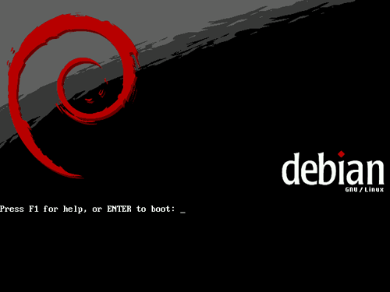
Now load YOUR OWN Linux kernel over the network
Reboot the machine.
Do not simply press the power button.
It may corrupt the currently loaded file-system
Either use the reboot option in the GUI
Or press Ctrl-Alt-F1 (all at once) to go to text console. Then press Ctrl-Alt-Del to reboot the machine.
Then wait till you see the Debian Splash screen
At the “boot:” prompt, quickly enter your kernel name
boot: <yourid>
<yourid> = same as your LDAP ID
But the two are not related.
If you ever corrupt your default kernel <yourid> then you can boot a backup kernel <yourid>.safe
<yourid>.safe is never corrupted.

Slide 7
If your GUI doesn't work, there’s text console
In fact there are six text Consoles
- Select one of them by pressing Ctrl-Alt-F1, to Ctrl-Alt-F6 keys
GUI can be accessed by Ctrl-Alt-F7
Try it now.

Slide 8
Log in as root into your Linux system
After your system boots up, it should display a graphical login screen
But you can’t log in from GUI yet!
Because there’s no valid user account configured in your system
So, you have to first log in as root and create a regular user account
But you can’t log in as root from the graphical mode
So, Press Ctrl-Alt-F1
You’ll get a text console
now log in as root using the password that you wrote down in slide 5
Userid: root
passwd: what you wrote down
Immediately change your root password to something you can remember, but not too simple
$ passwd

Slide 9
Next, create a regular user account
$ adduser <userid_of_your_choice>
Follow the prompts, and create a password for the new user account
but skip entering the address, phone number etc, not needed.
Add the new account to “sudoers” list
sudoers = special users who are allowed to execute commands as root
$ vi /etc/sudoers
(or use any other editor)
Add a line
userid ALL=(ALL) ALL
Quit the editor
Then press Ctrl-Alt-F7 to go back to GUI
Log in using the account id and password that you just created
There you go!
Familiarize yourself with the environment
Find the web browser, text editor, terminal, etc.
Make you you have gcc, make, gdb etc installed.

