Slide 1
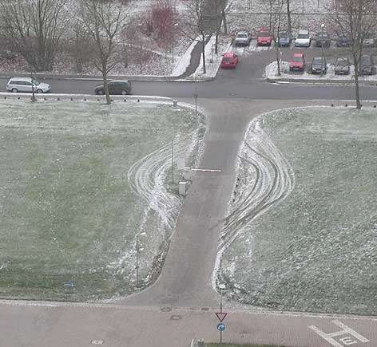
Operating System
and Security
Kartik Gopalan
From: http://www.syslog.com/~jwilson/pics-i-like/kurios119.jpg

Slide 2
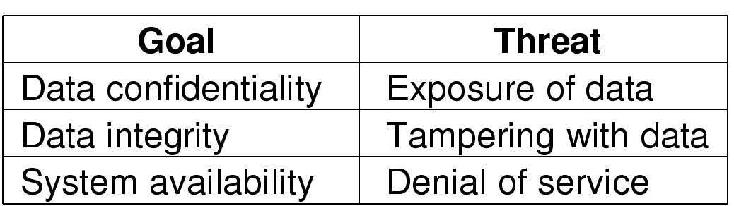
What is Security
C.I.A
Preventing unauthorized users from executing undesirable actions, such as
Stealing your data (C)
Giving you fake data/Tampering your data (I)
Preventing you from doing your work (A)

Slide 3
Securing what?
Securing the OS from users
OS-level mechanisms
Securing one user from another
Access control, isolation
Securing users from OS!
Yes, sometimes the OS is not trusted by the user.
E.g. in a cloud users may not trust the cloud platform’s OS.

Slide 4
Security mechanisms in OS and hardware
CPU Execution privileges (“Who can access?”)
Part of CPU state
x86 privilege rings (0,1,2,3) in EFLAGS
VTx provides root and non-root modes
Memory protection (“What can be accessed?”)
Protection bits in segment descriptors
Protection bits in page-table registers
Virtual Memory (naming)
File system privileges (“What can be accessed?”)
User accounts
Access permissions

Slide 5
Common Motivations of Intruders
Peeping Tom
Casual prying by nontechnical users
Insider threat
Disgruntled insiders, programmer’s backdoor
Extortion
Make money
Espionage/Intelligence gathering
Commercial or military or government
Hacktivism
Political or social motivation
Sometimes motivations may overlap
Was Snowden incident 2? 4? 5? All?

Slide 6
User Authentication
Verifying that you are who you claim you are.
File permissions and user’s rights are set according to user’s identity, which is established by authentication.
Basic Principles. Authentication must identify:
Something the user knows
Something the user has
Something the user is
This is done before user can use the system

Slide 7
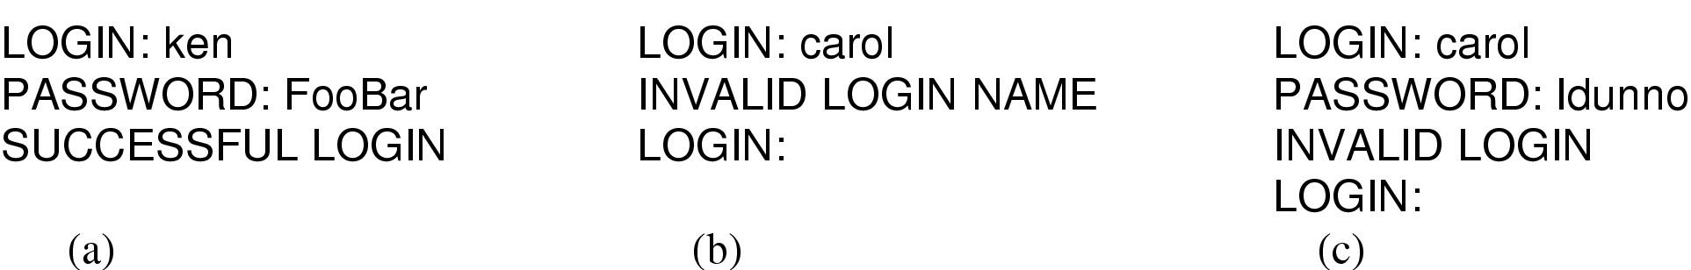
Something the user knows: Passwords
(a) A successful login
(b) Login rejected after name entered
(c) Login rejected after name and password typed

Slide 8
Storing passwords
Originally stored in plaintext in a “secure” file.
Secure only as long as root account is not compromised
Also, users may not want sysadmins to know their passwords, which usually contain private data.
Now these are hashed using one-way functions
Given password input x
easy to evaluate y = f(x)
But given y
computationally infeasible (or at least non-trivial) to compute x = f⁻¹(y)

Slide 9
Challenge-Response Authentication
Forgot password?
Ask user something that no one else would know.
Poor choices: Mother’s maiden name, where you were born, first girlfriend/boyfriend, pet’s name, high school, childhood street etc.
All easily guessed
Not sure why websites still do this
Ask user to compute something
“What is the fifth smallest prime number?”
Assuming the question can’t be understood by a program.
Attack: Beg customer service to help a poor user who forgot password

Slide 10
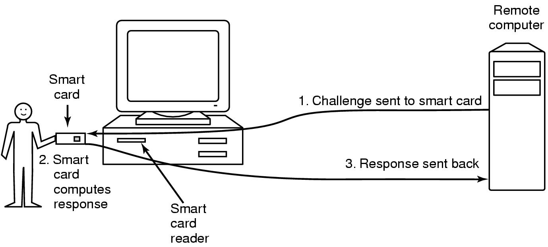
Something the user has:
Authentication Using a Physical Object
magnetic stripe cards, chip cards: stored value cards, smart cards

Slide 11
Something the user is: The user’s body
Biometrics:
voice
face
fingerprint
iris scan
typing style
These have both false-positives and false-negatives
Susceptible to spoofing attacks

Slide 12
Countermeasures against authentication attacks
Limiting times when someone can log in
“Sorry: You can’t log in at 2am”
Limited number of login tries
“Too many invalid logins. Your account is now LOCKED.”
Two-factor authentication
Password + Automatic callback/SMS at number prespecified
Logging: Tracking all logins and locations of login
“Your last login: from Timbuktu yesterday.”
Ask user to recognize text in a figure
CAPTCHA = Completely Automated Public Turing test to tell Computers and Humans Apart
Honeypot accounts: Simple login name/password as a trap
security personnel notified when attacker bites
Only if you want to track/catch the intruder (sometimes don’t care)

Slide 13
Common Attacks and Countermeasures

Slide 14
Trojan Horses
Malicious email attachments
CM: Don’t open. Open in a VM. Use a cloud-based reader.
Malicious websites that exploit browser vulnerabilities
Visit and get hacked
CM: Turn off Flash plugins, Javascript. Affects usability.
“Free” program made available to unsuspecting user
Actually contains code to do harm
CM: Run in VM. Don’t download.
Place altered version of utility program on victim's computer
Trick user into running that program
CM: Administrator must strictly control file permissions

Slide 15
Virus and Worm
Virus
program that can reproduce itself by attaching its code to another program
requires human intervention to spread to another machine
Worms
spread across machines
automatically, or with human assistance

Slide 16
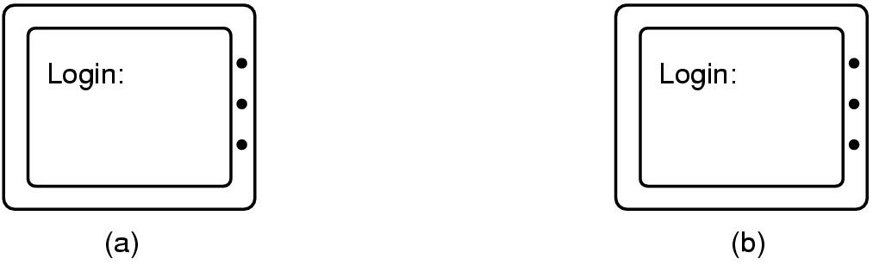
Login Spoofing
“I’m sure I entered the right password. What happened?”
Correct login Screen
Phony login Screen
Countermeasures:
Cautious user can intentionally enter a fake password the first (few) time(s).
Use “Trusted Path”
A sequence of user actions that is guaranteed to give control to the OS.
E.g. pressing Ctrl-Alt-Del could guarantee that legitimate login (or logout) screen will show up.

Slide 17
Logic Bombs
Company programmer writes a program with potential to do harm
OK as long as he/she enters password daily
If programmer fired, no password and bomb “explodes”
CM: Log all activity
Easy to detect and correlate.
Don’t try this at work!
Your employer may be smarter than you give them credit for.

Slide 18
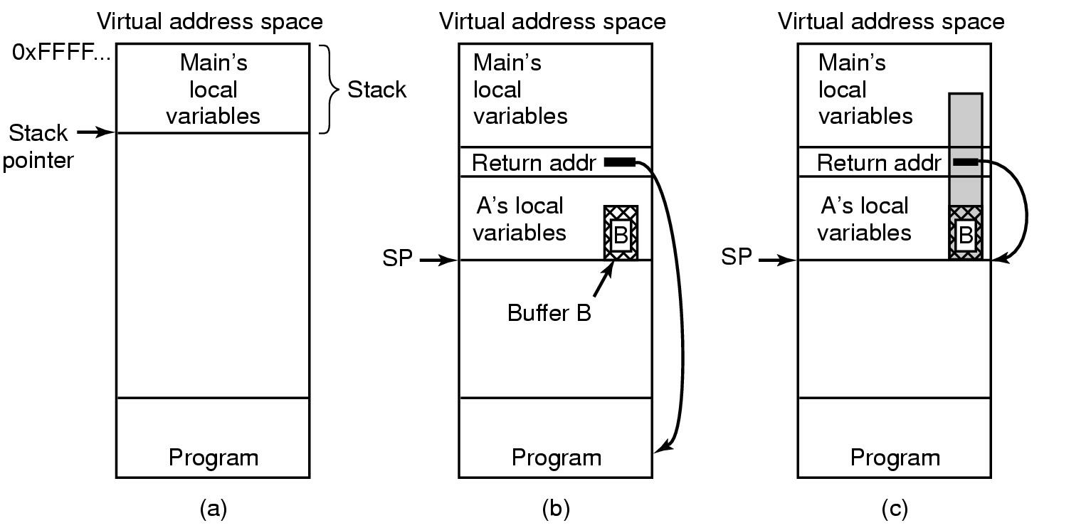
Buffer Overflow
(a) Situation when main program is running
(b) After function A called
(c) Buffer overflow shown in gray

Slide 19
Memory reuse — Dumpster Diving
Request memory, disk space, tapes
Don’t write. Just read and interpret existing data.
May find passwords, ssh keys, emails, personal information, browsing history, etc.
CM:
Scrub memory/storage before allocating to user.
Encrypt data. Throw away the key once done.
Disadvantage: Takes more time.

Slide 20
Logging
Logs: A time-wise record of system activity.
Events always appended. “Never” erased.
Logs must be analyzed often to detect suspect activity
What to log?
Too much logging
takes up storage
slows down normal operations.
Slows down analysis.
Too little logging and you miss critical events.
Privacy risk
Can break laws.
Or violate user’s perception of privacy. (sometimes more important.)

Slide 21
Other ways to gain access
Trying privileged system calls to see what happens
Doing specified DO NOTs
“Only authorized personnel beyond this point”
Convince a system programmer to add a backdoor

Slide 22
Design Principles for Security
Default should be no access
Check for current authority
Give each process least privilege possible
Protection mechanism should be
simple
uniform
in lowest layers of system
Scheme should be simple and psychologically acceptable
If its too hard, users will get around it.
Like using post-it notes on the monitor.

Slide 23
Sandboxes
Run dowloaded code/browser in a VM or a “Jail”.
Isolate trojans/viruses, worms
Effectiveness of isolation only as effective as the security of the Sandbox.
VM Escapes and Jail-breaks are possible.
Usually due to implementation bugs in the hypervisor or runtime

Slide 24
Access control
Discretionary access control (DAC)
“John can access X. Alice can do Y.”
Commodity systems
Mandatory access control (MAC)
Military/spy systems
More later
Role-based access control (RBAC)
“CEO can do X. Software Engineer can do Y. Secretary can do Z”.
Enterprise systems
Administrative Role-based Access Control
“Dean can allow department chair to do X. Dept chair can allow secretary to do Y”

Slide 25
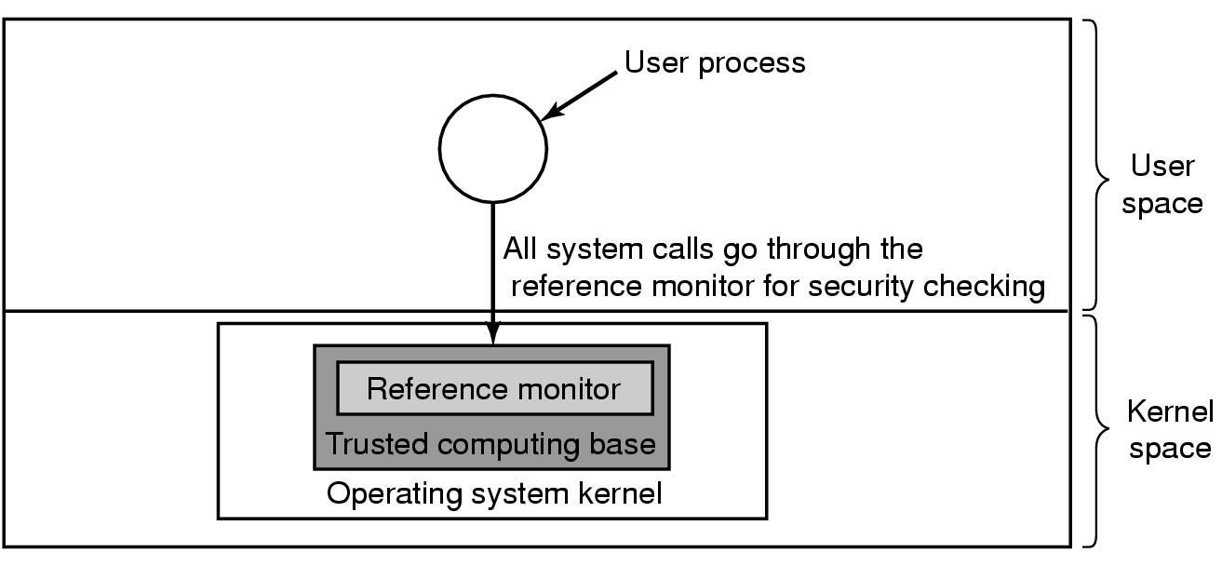
Reference Monitor and Trusted Computing Base
A reference monitor, enforces access control/capabilities.
also called “security kernel”
Its “trusted” because it MUST work correctly to ensure rest of the system is secure.
Usually small, so it can be verified easily.
Verification: either manual or automated. Hard either way.

Slide 26
Multi-level Security
Also called Mandatory Access Control (MAC)
As opposed to Discretionary Access Control (DAC) in commodity systems.
Data objects are classified at different levels
Top secret, secret, confidential, unclassified etc
Sometimes additional compartments: Crypto, Subs, NoForn
People (and computers) have clearances
Informally: To see a data object, you must have clearance for that level and for that compartment.

Slide 27
MLS: No Read UP, No Write DOWN
Security Level
Disallowed
Allowed
High
Low
Read
UP
Write
DOWN
Read
DOWN
Write
UP
Entity
Data
No Read UP: Lower classification level should not read data from higher-level.
No Write DOWN: Higher level should not write data to lower level.

Slide 28
MLS Pump
In practice, to get things done, upper-level must at least acknowledge the receipt of data from lower level.
But acks create a backdoor for covert channels (surreptitious communication)
An MLS Pump
Allows acks from higher to lower levels,
but at such a low data rate that covert channels become impractical.

