Slide 1
The UNIX Time- Sharing System
Dennis M. Ritchie and Ken Thompson Bell Laboratories
Communications of the ACM
July 1974, Volume 17, Number 7

Slide 2
UNIX overview
Unix is a general-purpose, multi-user, interactive operating system
Originally developed for DEC PDP-7, -9, and -11 computers
PDP-11/45
16-bit word (8-bit byte) computer
144KB main memory
UNIX occupies 42KB
1MB fixed head disk
Four 2.5MB removable disk cartridges
One 40MB disk pack
Also Picturephone, voice response, voice synthesizer, photo typesetter, digital switching network etc.
Written in C language
Now widely supported across almost all hardware platforms in various variants
System V, FreeBSD, Linux, Solaris etc.

Slide 3
Major Innovations
Hierarchical file system
Compatible file, device, and inter-process I/O
Background (asynchronous) and foreground processes
Interactive Shell

Slide 4
Original use around 1969-70s
“preparation and formatting of patent applications and other textual material, the collection and processing of trouble data from various switching machines within the Bell System, and recording and checking telephone service orders”

Slide 5
Now
Widely used in
Servers
Desktops
Laptops, Netbooks
PDAs, phones
Mainframes
Embedded systems
Real-time systems
Switches, routers
Almost any computing platform you can think of
“Perhaps paradoxically, the success of UNIX is largely due to the fact that it was not designed to meet any predefined objectives.”

Slide 6
Inexpensive!
“UNIX can run on hardware costing as little as $40,000”
“Less than two man years were spent on the main system software.”
“users of UNIX will find that the most important characteristics of the system are its simplicity, elegance, and ease of use.”

Slide 7
File System
“Most important role of UNIX is to provide a file-system”.
Why?
Three types of files
Ordinary files
No particular structure imposed by OS
Directories
Mapping between filenames and files
Special files
I/O devices

Slide 8
What is a File System?
File system is the OS component that organizes data on the raw storage device.
Data, by itself, is just a meaningless sequence of bits and bytes.
Metadata is the information that describes the data.
Also called attributes.
Without meta-data, data itself will be incomprehensible.
A File System defines
Format of the data objects.
The format/meaning of meta-data associated with each data object. E.g. File name, permissions, and size of a file.
Location of the individual data blocks of for each data object.
A framework to manage free space on the raw storage.

Slide 9
Virtual File System (VFS)
VFS provides
A common system call interface to user applications to access different file systems implemented in the OS.
A common interface to file systems to “plug into” the operating system and provide services to user applications.
User Applications
System Calls
Virtual File System
File System 1
File System 2
File System N
……
File System Cache
Device Drivers
Storage 1
Storage 2
……
Storage 3

Slide 10
Directories
Directory groups files together
Directories can contain sub-directories
root directory is at the top
/bin contains all executables
Two special entries in each directory -- . and ..
Directories are treated just like ordinary files
Except they cannot be written by unprivileged programs
Filenames had 14 or fewer characters
Pathname = sequence of filenames separated by /
/alpha/beta/gamma
Linking: different directories can contain the same non-directory file under different names
In modern UNIX, this is a hard link.
As opposed to soft link, which is?
Directory structure is a single rooted tree.

Slide 11
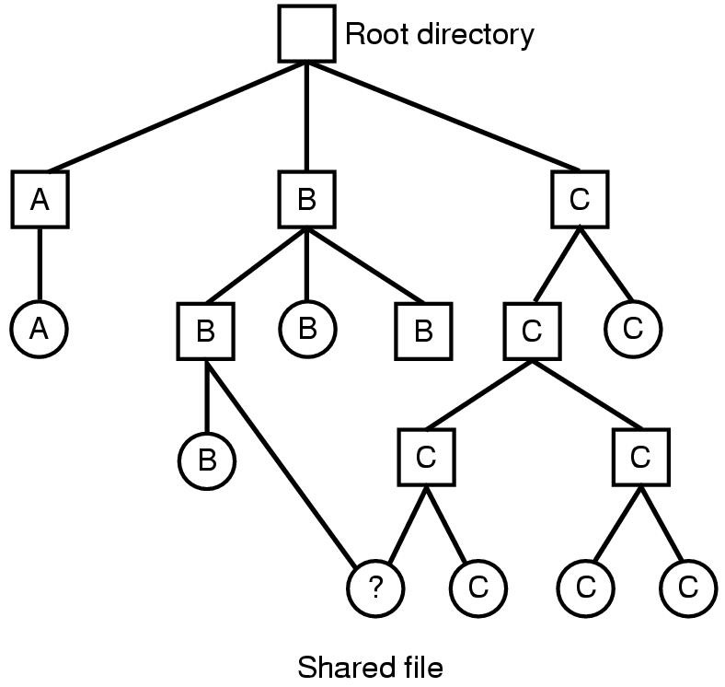
Shared Files — Hard Links
A file shared between two directories

Slide 12
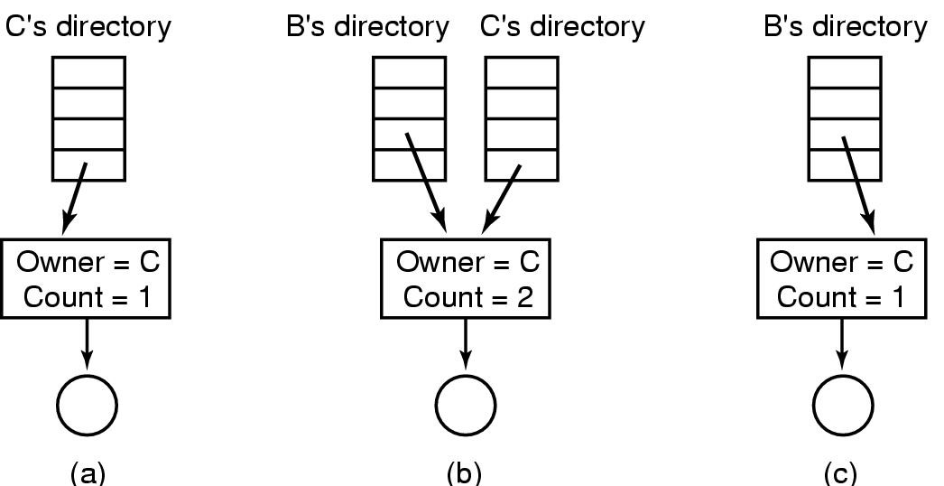
Shared Files – Hard Links
Situation prior to linking
After the hard link is created
After the original owner removes the file
File still exists, but with count decremented

Slide 13
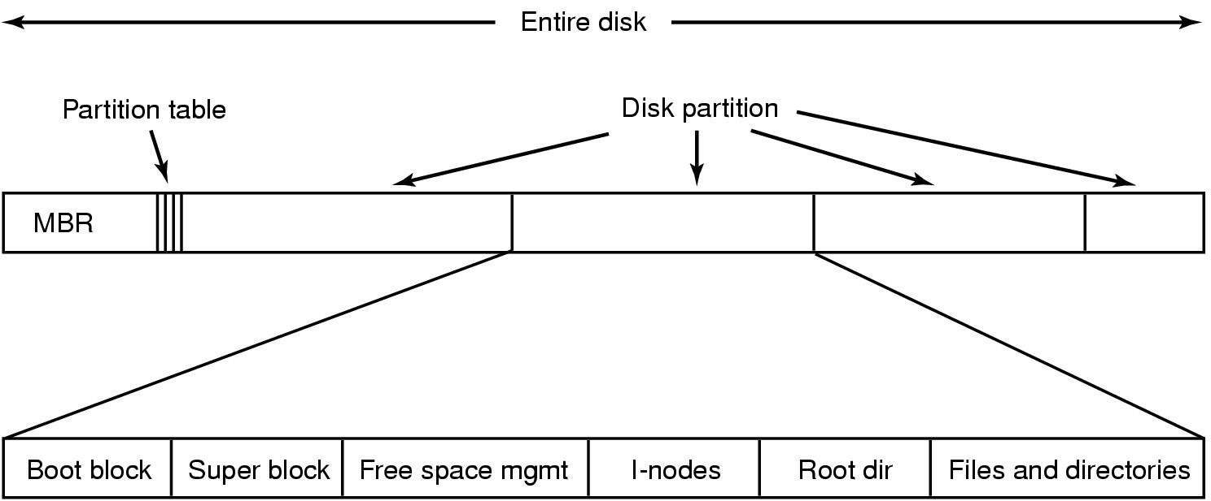
Partitions and File-system Layout
File System 1
File System 2
File System 3
…

Slide 14
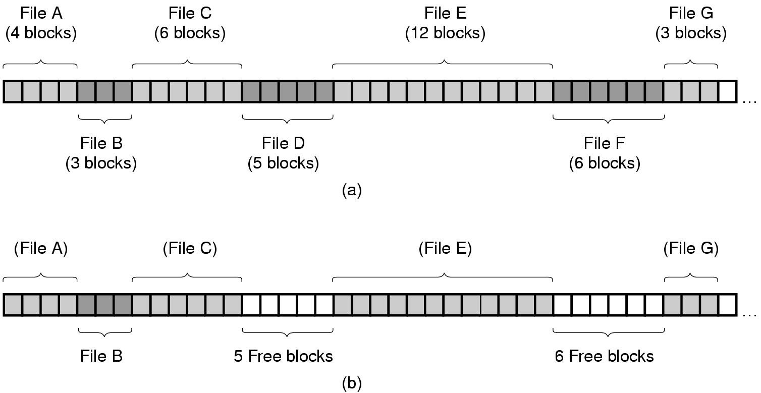
Organizing Files on Disk: Contiguous Allocation
(a) Contiguous allocation of disk space for 7 files
(b) State of the disk after files D and E have been removed

Slide 15
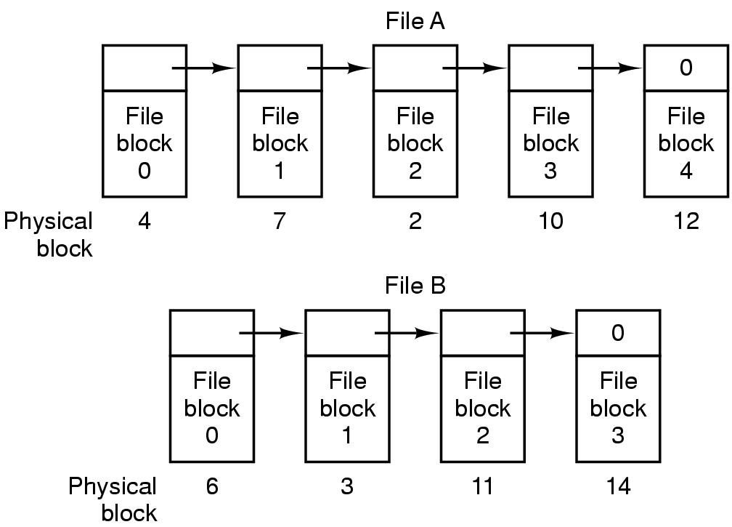
Organizing Files on Disk: Singly Linked List of Blocks
Advantage: Logically contiguous blocks can be discontiguous on disk
Disadvantage: Random seeks are expensive. Requires traversal from the start.

Slide 16
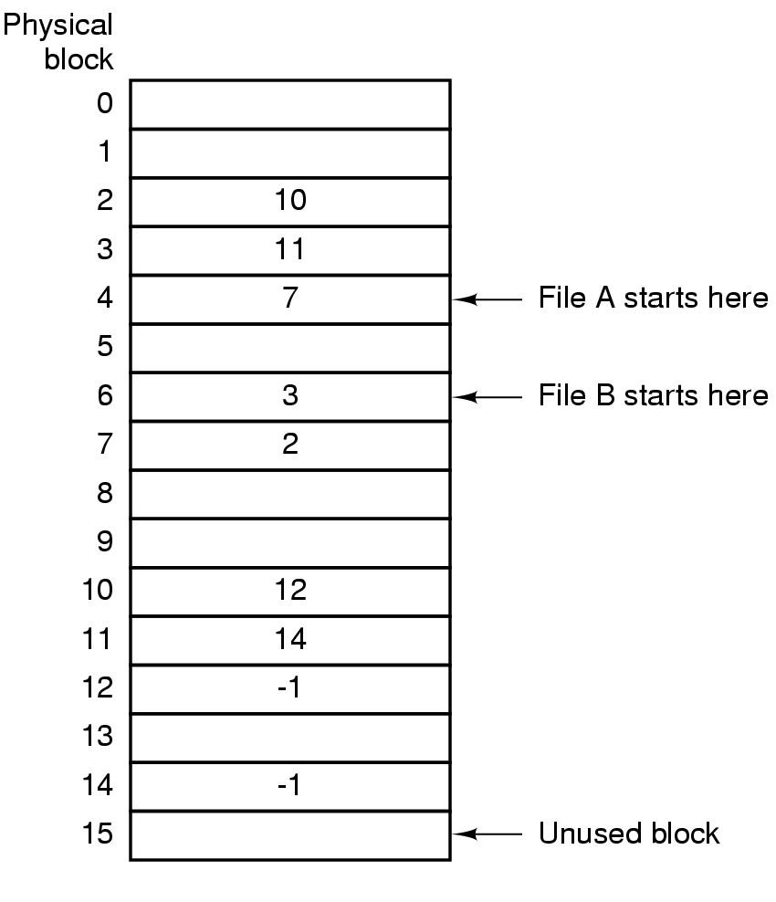
Organizing Files on Disk: File Allocation Table
Linked list allocation using a file allocation table in RAM
Doesn’t need a separate “next” pointer within each block
But random seeks are still expensive

Slide 17
i-nodes (index nodes)
Each file is described by an i-node
i-node stores the metadata for the file
Metadata = file info + location of data blocks
i-nodes are stored on the disk
An i-node is to a file what a page-table is to a virtual address space
Page table maps
virtual page number in a virtual address space ——> physical page frame number in DRAM
i-node maps
logical block number in a file ——> physical block location on disk

Slide 18
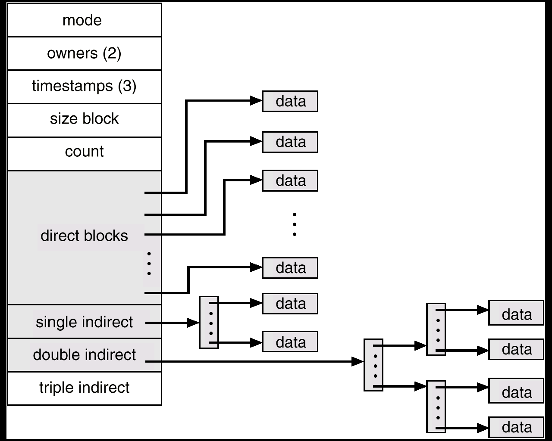
Unix i-node (index node)
Small files can be accessed quickly
If each block is 4KB
First 48KB of file reachable from 12 direct blocks
Next 4MB available from single-indirect blocks
Next 4GB available from double-indirect blocks
Next 4TB available through the triple-indirect blocks
Any block can be found with at most 3 disk accesses

Slide 19
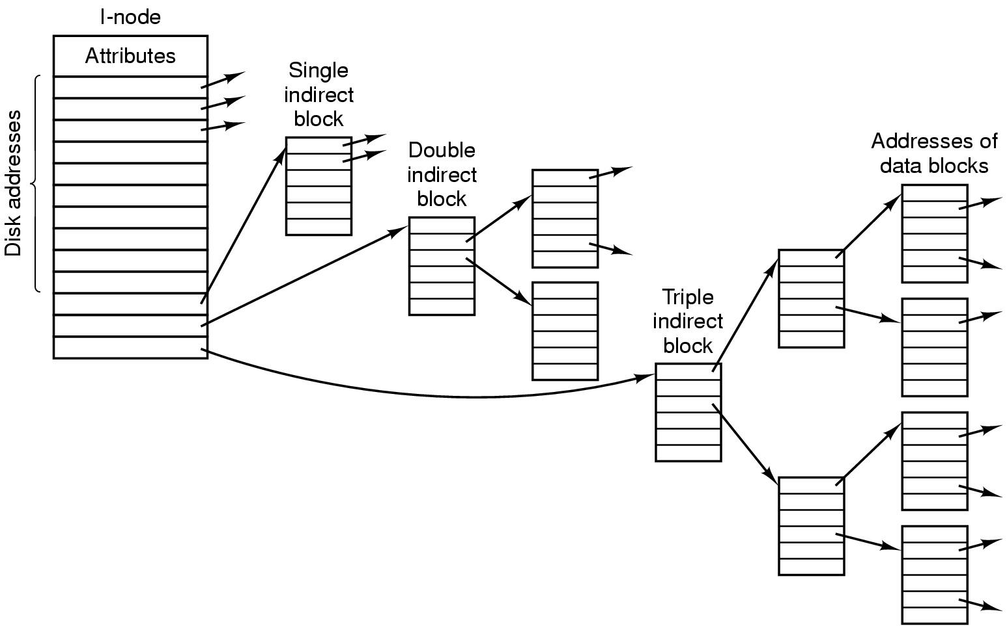
Another view of a UNIX i-node
Ref: Tanenbaum’s OS book
The whole data structure above is ONE i-node for ONE file
i-node grows dynamically as the file grows
Just like page-tables, i-node tracks a giant array broken up into many pieces

Slide 20
Special files
“most unusual feature”
Located in /dev
Just like ordinary files.
But read/write requests result in activation of the associated device.
Advantages of treating I/O devices as files:
File and device I/O are similar
File and device names have same syntax and meaning.
Programs that operate on files can also operate on devices.
Same protection mechanisms as regular files

Slide 21
Removable file system
Different parts of filesystem can be on different devices
mount
Allows a storage device to be referenced as a subtree of existing rooted filesystem.
Hard links across mounted file systems disallowed. Why?

Slide 22
Protection
Each user has a userid
Files marked as owned with userid of the creator
Seven protection bits
Six bits for read, write, and execute permissions for user, group, and others
7th bit → set-user-ID bit
Temporarily change the userid of current user to the owner when file is executed as a program.
Allows the safe use of privileged programs that require access to special system files (e.g. system logs).
Actual userid of the invoker is available to the program for credential checks.

Slide 23
I/O calls
filep = open (name, flag)
Create system call creates and opens a new file. Truncates to zero if file exists.
filep is a file descriptor
Notion of a file descriptor hasn’t changed over the years
No locking provided by OS for multi-user access
Lets users figure out synchronization.
Locks are “neither necessary nor sufficient”. Why?
Internal OS locks for consistency of data structures
n = read(filep, buffer, count)
Read returns 0 when end of file (EOF) reached
n = write(filep, buffer, count)
Write beyond end of file grows the file automatically
location = seek(filep, base, offset)
For random I/O

Slide 24
Processes and images
processid = fork(label)
filep = pipe( )
execute(file, args, argo, ..., arg,+)
processid = wait( )
exit (status)

Slide 25
Shell
Triggered upon login by the init process
Can be replaced by other commands
command arg1 arg2 • • - argn
ls > there
ed < script
Filters: ls | grep foo | wc -l
Multitasking
ls; ed
as source > output &
as source > output & ls > files &
(date; ls) > x &

Slide 26
read/write buffering
System buffers to hide block I/O activity
Users can read/write at any byte granularity
OS converts these to block-level I/O

Slide 27
File System Cache
Small area in main memory that stores frequently accessed data blocks in the file system.
Before accessing the disk, look in the FS cache.
If data block is in FS cache, no need to go to disk.
Periodically, purge the cache of infrequently used data blocks.
Claim: If the cache works well, then most I/O accesses to the physical disk will be writes. Why?

Slide 28
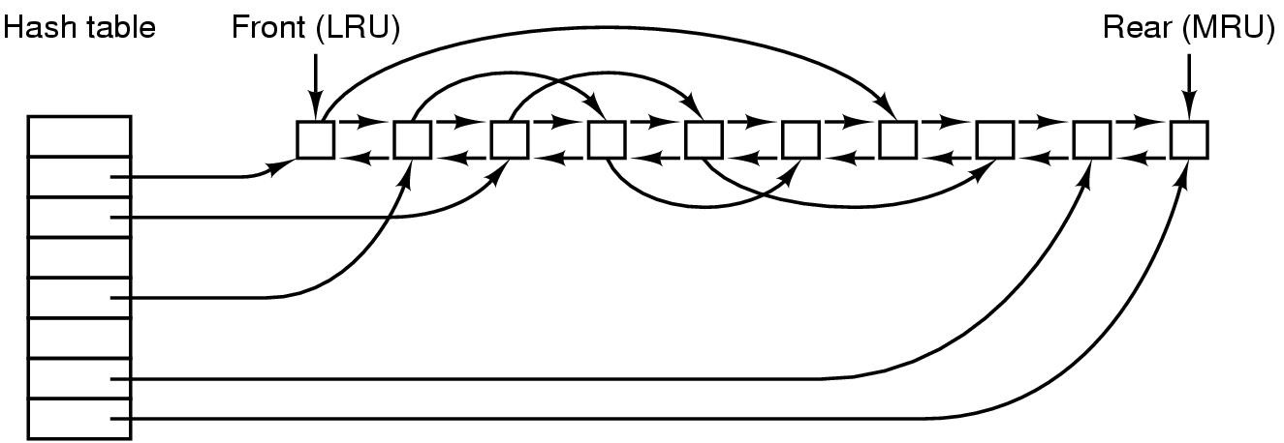
Data Structure for File-System Cache
Cache Lookup:
Pages in cache are looked up via a hash table for fast access.
Cache Eviction:
Another doubly-linked list maintained to identify least-recently used (LRU) victim pages that are periodically purged.
Is the victim page dirty? Then write to disk. Else discard.

Slide 29
Virtual memory page cache and FS cache
Often they are managed in a unified manner
Meaning: one common page-cache is used for managing pages for both virtual memory and file system.
For example, Linux maintains one common set of data structures to keep track of active and inactive (LRU) pages.

Slide 30
Log-Structured File Systems
With CPUs faster, memory larger
disk caches are also getting larger
increasing number of read requests come from file system cache
Thus, most disk accesses will be writes
LFS treats the entire disk as a log
all writes are initially buffered in memory
periodically commit the writes to the end of the disk log
When file is opened, locate i-node, then find blocks

Slide 31
Quiz on Inodes
All blocks in a disk are of size 4KB (4096 bytes).
The top level of an inode is stored in a disk block of size 4KB.
All file attributes, except data block locations, take up a total of 128 bytes (out of the above 4KB).
Each direct block address takes up 8 bytes of space and gives the address of a disk block of size 4KB.
Last three entries of the first level of the inode point to single, double, and triple indirect blocks respectively.
Question: What is the largest size of a file that can be accessed through direct block entries of the inode?

