Slide 1
Redundant Array of Inexpensive Disks (RAID)
Kartik Gopalan
Chapter 5 Tanenbaum’s book

Slide 2
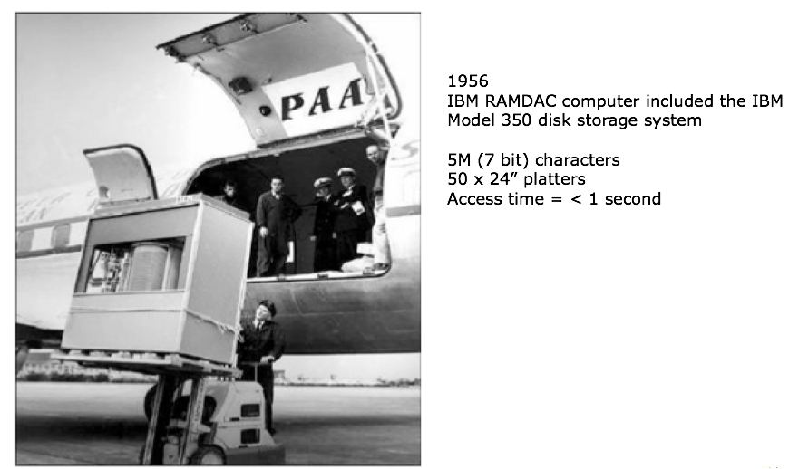
First Commercial Disk Drive

Slide 3
RAID — Original Motivation
Replacing large and expensive mainframe hard drives (IBM 3310) by several cheaper Winchester disk drives
Will work but introduces a data reliability problem:
Consider Mean Time To Failure (MTTF)
Assume MTTF of a disk drive is 30,000 hours
MTTF for a set of n drives is 30,000/n
n = 10 means MTTF of 3,000 hours

Slide 4
RAID — Today’s Motivation
“Cheap” hard drives are now big enough for most applications
We use RAID today for
Increasing disk throughput by allowing parallel access
Eliminating the need to make disk backups
Disks are too big to be backed up efficiently

Slide 5
Logical-to-Physical I/O Address Space Mapping
File Systems
READ / WRITE
Logical I/O Space (block device)
0
MAX
SOFTWARE / FIRMWARE
BASED MAPPING
Physical I/O Space

Slide 6
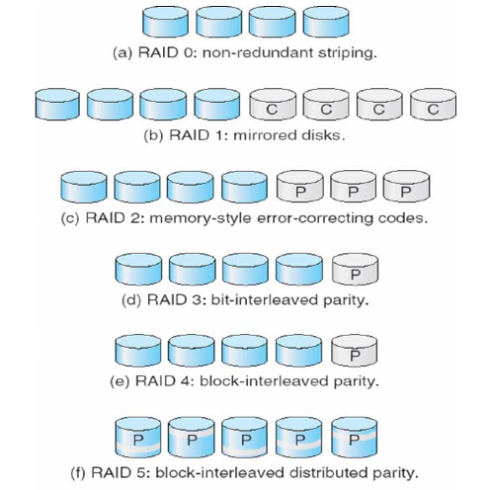
Several Levels of RAID

Slide 7
RAID 0
Striping
Spread the data over multiple disk drives
No fault tolerance
But, much better I/O throughput
Number of I/O operations per second
DISK 0 | DISK 1 | DISK 2 | DISK 3
BLOCK 0 | BLOCK 1 | BLOCK 2 | BLOCK 3
BLOCK 4 | BLOCK 5 | BLOCK 6 | BLOCK 7
BLOCK 8 | BLOCK 9 | BLOCK 10 | BLOCK 11
BLOCK 12 | BLOCK 13 | BLOCK 14 | BLOCK 15

Slide 8
RAID 1
Mirroring
Two copies of each disk block
Advantage
Simple to implement
Fault-tolerant
Disadvantage
Requires twice the disk capacity
DISK 0 | DISK 1 | MIRROR 0 | MIRROR 1
BLOCK 0 | BLOCK 1 | BLOCK 0 | BLOCK 1
BLOCK 2 | BLOCK 3 | BLOCK 2 | BLOCK 3
BLOCK 4 | BLOCK 5 | BLOCK 4 | BLOCK 5
BLOCK 6 | BLOCK 7 | BLOCK 6 | BLOCK 7

Slide 9
RAID 2
Use an error (detection + correction) code instead of duplicating the data blocks
Meant for disks that don’t have built-in error detection.
Modern disks support built-in error detection, so this level is mostly unused.
DISK 0 | DISK 1 | DISK 2 | PARITY 1 | PARITY 2
BLOCK 0 | BLOCK 1 | BLOCK 2 | F(0,1,2)
BLOCK 3 | BLOCK 4 | BLOCK 5 | F(3,4,5)
BLOCK 6 | BLOCK 7 | BLOCK 8 | F(6,7,8)
BLOCK 9 | BLOCK 10 | BLOCK 11 | F(9,10,11)
F = FUNCTION FOR ERROR DETECTION + CORRECTION

Slide 10
XOR Primer
Truth Table
0 XOR 0 = 0
0 XOR 1 = 1
1 XOR 0 = 1
1 XOR 1 = 0
Associative and commutative
Lost any one bit? XOR the rest to recover.
If 1 XOR (lost bit) = 0
then lost bit = 1 XOR 0 = 1
Extends to any number of data bits
If 1 XOR (lost bit) XOR 1 = 0
then lost bit = 1 XOR 1 XOR 0 = 0

Slide 11
RAID 3
N+1 disk drives: N data drives + 1 parity drive
Data Block b[k] partitioned into N fragments b[k,1], b[k,2], ... b[k,N]
Parity drive contains XOR (exclusive or) of these N fragments
p[k] = b[k,1] XOR b[k,2] XOR ... XOR b[k,N]
Upon a failure, reconstruct the lost fragments by XOR of corresponding fragments from remaining drives.
b[k,i] = p[k] XOR b[k,1] XOR ... b[k,i-1] XOR b[k,i+1] … XOR b[k,N]
Simple to implement in firmware/software
Permits only one I/O operation at a time over entire array
DISK 0 | DISK 1 | DISK 2 | PARITY
BLOCK [0,1] | BLOCK [0,2] | BLOCK [0,3] | PARITY 0
BLOCK [1,1] | BLOCK [1,2] | BLOCK [1,3] | PARITY 1
BLOCK [2,1] | BLOCK [2,2] | BLOCK [2,3] | PARITY 2
BLOCK [3,1] | BLOCK [3,2] | BLOCK [3,3] | PARITY 3

Slide 12
RAID 4
Requires N+1 disk drives (as in RAID 3)
N data drives + 1 Parity drive
Data striped at block granularity (as in RAID 0)
Disk 1 has block 1, disk 2 has block 2, and so on.
Parity drive contains exclusive or of the N blocks in stripe
p[k] = b[Nk] XOR b[Nk+1] XOR ... XOR b[Nk+N-1]
Multiple Read I/O operations can be processed in parallel
But how about parallel writes I/O operations?
DISK 0 | DISK 1 | DISK 2 | PARITY
BLOCK 0 | BLOCK 1 | BLOCK 2 | PARITY 0
BLOCK 3 | BLOCK 4 | BLOCK 5 | PARITY 1
BLOCK 6 | BLOCK 7 | BLOCK 8 | PARITY 2
BLOCK 9 | BLOCK 10 | BLOCK 11 | PARITY 3

Slide 13
RAID 5
Single parity drive of RAID-4 is involved in every write
Will limit write parallelism
Exercises one parity disk more than others
Solution in RAID-5
Distribute the parity blocks among all N+1 drives
Up to N/2 parallel writes
DISK 0 | DISK 1 | DISK 2 | DISK 3
BLOCK 0 | BLOCK 1 | BLOCK 2 | PARITY 0
BLOCK 3 | BLOCK 4 | PARITY 1 | BLOCK 5
BLOCK 6 | PARITY 2 | BLOCK 7 | BLOCK 8
PARITY 3 | BLOCK 9 | BLOCK 10 | BLOCK 11

Slide 14




The write problem
What happens when we want to update a single block?
Block belongs to a stripe
Every time a block is updated, the parity must be updated as well.
Problem: How do we compute the new parity?
b[Nk]
b[Nk+1]
b[Nk+2]
...
p[k]

Slide 15
First (naïve) solution
Read values of N-1 other blocks in stripe
Re-compute
p[k] = b[Nk] XOR b[Nk+1] XOR ... XOR b[Nk+N-1]
Solution requires
N-1 reads
2 writes (new block and parity block)

Slide 16
Second solution
Assume we want to update block b[Nk+i]
Read old values of b[Nk+i] and parity block p[k]
Compute
p[k] = new b[Nk+i] XOR old b[Nk+i] XOR old p[k]
Solution requires
2 reads (old values of block and parity block)
Or just one read, if old b[Nk+i] kept in memory.
2 writes (new block and parity block)

Slide 17
Comparison
 | RAID 0 (N disks) | RAID 1 (N disks) | RAID 2 (N+1) disks | RAID 3 (N+1) disks | RAID 4 (N+1) disks | RAID 5 (N+1) disks
Fault-tolerance | None | All 1-disk and most 2-disk failures | 1-disk failure with error detection and correction | 1-disk failure with Error Correction | 1-disk failure with Error Correction | 1-disk failure with Error Correction
Max. READ Parallelism | N | N | N | 1 (none) | N | N+1
Max. WRITE Parallelism | N | N/2 | 1 (none) | 1 (none) | 1 (none) | (N+1)/2
Space Overhead | 0% | 100% | (k/N)x100% for K parity disks | (1/N)x100% | (1/N)x100% | (1/N)x100%

Slide 18
Conclusion
RAID original purpose was to take advantage of commodity drives that were smaller and cheaper than conventional disk drives
Replace a single large drive by an array of smaller drives
Nobody does that anymore!
Today: Main purpose of RAID is to build fault-tolerant storage systems that do not need backups and deliver high throughput.
Low cost of disk drives makes RAID-1 attractive for small installations
We have now very cheap RAID controllers
Otherwise prefer
RAID-3 for simplicity
RAID-5 for higher parallelism
Often combined with NVRAM to improve write performance

