Slide 1
Kernel Modules
Kartik Gopalan

Slide 2
Kernel Modules
Allow code to be added to the kernel, dynamically
Only those modules that are needed are loaded. Unload when no longer required - frees up memory and other resources
Reduces kernel size.
Enables independent development of drivers for different devices

Slide 3
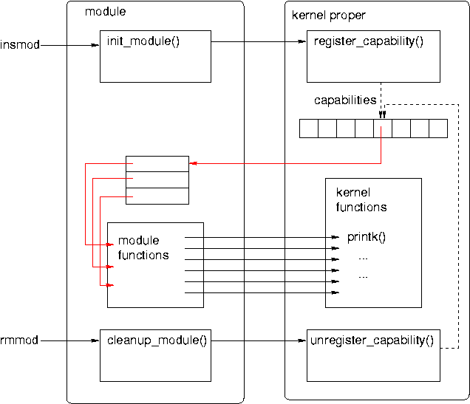
Workings of a generic module / typical usage:

Slide 4
Hello World Kernel Module
http://oscourse.github.io/examples/module/
#include <linux/init.h>
#include <linux/module.h>
MODULE_LICENSE("DUAL BSD/GPL");
// called when module is installed
int __init hello_init()
{
printk(KERN_ALERT "mymodule: Hello World!\n");
return 0;
}
// called when module is removed
void __exit hello_exit()
{
printk(KERN_ALERT "mymodule: Goodbye, cruel world!!\n");
}
module_init(hello_init);
module_exit(hello_exit);

Slide 5
Compiling the module
Makefile
obj-m := testmod.o
[ For multiple files: module-objs := file1.o file2.o ]
Compiling:
$ make -C /lib/modules/$(uname -r)/build M=`pwd` modules
More details on kernel Makefiles
https://www.kernel.org/doc/Documentation/kbuild/makefiles.txt
https://www.kernel.org/doc/Documentation/kbuild/modules.txt

Slide 6
Module Utilities
insmod hello.ko
Inserts a module
Internally, makes a call to sys_init_module
Calls vmalloc() to allocate kernel memory
Copies module binary to memory
Resolves any kernel references (e.g. printk) via kernel symbol table
Calls module’s initialization function
modprobe hello.ko
Same as insmod, except that it also loads any other modules that hello.ko references.
rmmod
Removes a module
Fails if module is still in use
lsmod
Tells what modules are currently loaded
Internally reads /proc/modules

Slide 7
Things to remember
Modules can call other kernel functions
Such as printk, kmalloc, kfree etc.
But only the functions that are EXPORTed by the kernel
using EXPORT(symbol_name)
Modules (or any kernel code for that matter) cannot call user-space library functions
Such as malloc, free, printf etc.
Modules should not include standard header files
Such as stdio.h, stdlib.h, etc.
Segmentation fault may be harmless in user space
But a kernel fault can crash the entire system
Version Dependency:
Module should be recompiled for each version of kernel that it is linked to.

Slide 8
Concurrency Issues
Many processes could try to access your module concurrently.
So different parts of your module may be active at the same time
Device interrupts can trigger Interrupt Service Routines (ISR)
ISRs may access common data that your module uses as well.
Kernel timers can concurrently execute with your module and access common data.
You may have symmetric multi-processor (SMP) system, so multiple processors may be executing your module code simultaneously (not just concurrently).
Therefore, your module code (and most kernel code, in general) should be re-enterant
Capable of correctly executing in more than one context simultaneously.

Slide 9
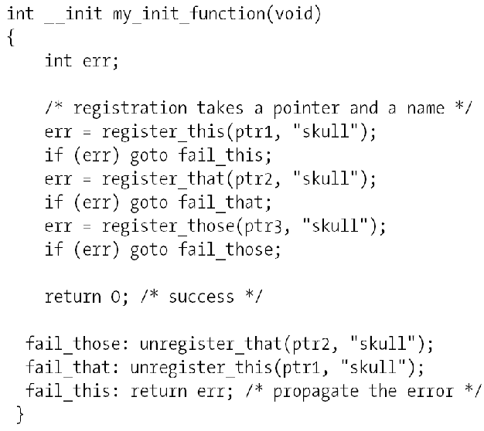
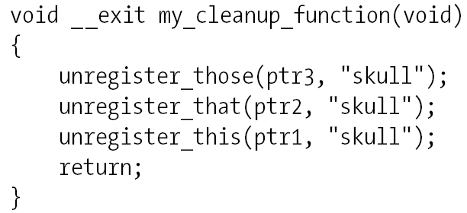
Error handling
In case of failure to go ahead; undo every registration activity
But only those that were registered successfully

Slide 10
Module Parameters
Command line:
insmod hellon.ko howmany=10 whom=“Class”
Module code has:
static char *whom = “world”;
static int howmany = 1;
module_param(howmany, int, S_IRUGO);
module_param(whom, charp, S_IRUGO);
See example module
http://oscourse.github.io/examples/module

Slide 11
Implementing character devices in Linux

Slide 12
Device Classification
Character (char) devices
byte-stream abstraction
E.g. keyboard, mouse
block devices
reads/writes in fixed block granularity
E.g. hard disks, CD drives
network devices
message abstraction
send/receive packets of varying sizes
E.g. network interface cards
others
USB, SCSI, Firewire, I2O
Can (mostly) be used to implement one or more of the above three classes

Slide 13



Major and Minor Number
Kernel
Minor Num 1
mydevice1
mydevice1
Major
Number
Minor Num 2
/dev/mydevice1
Driver
Userspace Code
mydevice2

Slide 14
“Miscellaneous” Devices in Linux
These are character devices used for simple device drivers.
All miscellaneous devices share a major number (10).
But each device gets its own minor number
Requested at registration time

Slide 15
Implementing a device driver for
a miscellaneous device
Step 1: Declare a device struct
static struct miscdevice my_misc_device = {
.minor = MISC_DYNAMIC_MINOR,
.name = “my device",
.fops = &my_fops
};

Slide 16
Implementing a device driver for
a miscellaneous device
Step 2: Declare the file operations struct
static struct file_operations my_fops = {
.owner = THIS_MODULE,
.open = my_open,
.release = my_close,
.read = my_read,
...
.llseek = noop_llseek
};
The function pointers that are not initialized above will be assigned some sensible default value by the kernel.

Slide 17
How do file ops work on character devices
A file operation on a device file will be handled by the kernel module associated with the device.
Call “open” system call to open “mydevice” file
Call “read” system call to read from the “mydevice” file
fd = open("/dev/mydevice", O_RDWR);
opens /dev/mydevice device for read and write operation.
OS will call my_open() file operation handler in the kernel module which is associated with the device.
misc_register(&my_misc_device) instruction in my_module_init() registers the module. It creates an entry in the “/dev” directory for “mydevice” file and informs the operating system what file-operations handler functions are available for this device.

Slide 18
Implementing a device driver for
a miscellaneous device
Step 3: register the device with kernel
usually in the module initialization code
static int __init my_module_init()
{
...
misc_register(&my_misc_device);
...
}
And don’t forget to unregister the device when removing the module
static void __exit my_exit(void)
{
misc_deregister(&my_misc_device);
...
}

Slide 19
Implementing a device driver for
a miscellaneous device
Step 4: Implement the fops functions
static ssize_t my_read(struct file *file, char __user * out, size_t size, loff_t * off)
{
….
sprintf(buf, “Hello World\n”);
copy_to_user(out, buf, strlen(buf)+1);
….
}
Don’t forget to
allocate memory for buf
Check if out points to a valid user memory location using access_OK()
check for errors during copy_to_user()

Slide 20
Moving data in and out of the Kernel
copy_to_user()
unsigned long copy_to_user (void __user * dst, const void * src, unsigned long n);
Copies data from kernel space to user space
Returns number of bytes that could not be copied. On success, this will be zero.
Checks that dst is writable by calling access_ok on dst with a type of VERIFY_WRITE. If it returns non-zero, copy_to_user proceeds to copy
copy_from_user()
unsigned long copy_from_user (void * dst, const void __user * src, unsigned long n);
Copies data from user space to kernel
Returns number of bytes that could not be copied. On success, this will be zero.
Question: Why shouldn’t you use memcpy or call by reference to access userspace data?

Slide 21
Memory allocation/deallocation in Kernel
Memory Allocation:
kmalloc(): Allocates physically contiguous memory
void * kmalloc(size_t size, int flags)
kzalloc(): Allocates memory and sets it to zero
vmalloc(): Allocates memory that is virtually contiguous and not necessarily physically contiguous.
void * vmalloc(unsigned long size)
Memory Deallocation: kfree()

Slide 22
GNU General Public License (GPL)
http://en.wikipedia.org/wiki/Gpl
Basis for all of the GNU software development, including Linux
Allows users to modify software as they see the need
Requires source code be distributed with binaries
EXPORT_SYMBOL Vs EXPORT_SYMBOL_GPL
Read http://lwn.net/Articles/154602/
Device drivers need not be licensed under the GPL, but the mainstream ones are

