Slide 1
Lab 03
Processes and Threads

Slide 2
Process
fork: create a child process.
execl, execlp, execle, execv, execvp, execvpe: execute a file
wait, waitpid, waitid: wait for process to change state

Slide 3
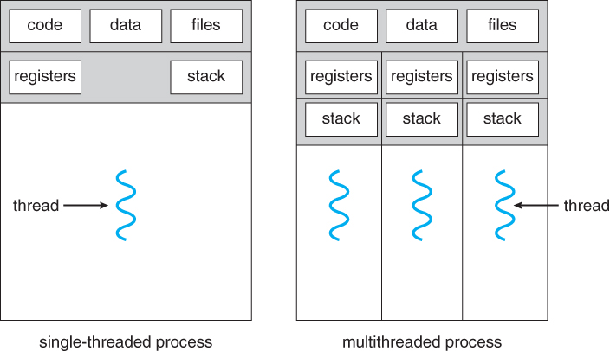
Thread

Slide 4
POSIX Threads
Historically, hardware vendors implement their own versions of threads.
Portability of thread implementation became a problem.
There was a need to have a standardized programming interface.
IEEE POSIX 1003.1c standard (1995)
Notes:
http://standards.ieee.org/findstds/standard/1003.1-2008.html
http://www.opengroup.org/austin/papers/posix_faq.html
http://www.unix.org/version3/ieee_std.html

Slide 5
POSIX Threads
int pthread_create( pthread_t *thread, const pthread_attr_t *attr, void *(*start_routine) (void *), void *arg);
int pthread_join( pthread_t thread, void **retval);
void pthread_exit(void *retval);

Slide 6
POSIX Thread Example
https://oscourse.github.io/examples/pthread_example.c
Compile and link with –pthread

Slide 7
POSIX Thread Exercise
Hash function is used to map data of arbitrary size to the data of fixed size.
Hash function is irreversible.
Hash function provides us a quick way to verify the data integrity.
OpenSSL library provides a general purpose cryptography library, including a set of hash functions.
Notes:
http://mathworld.wolfram.com/HashFunction.html
https://www.openssl.org/docs/man1.1.0/crypto/

Slide 8
Hash Functions
MD5
SHA256
SHA512

Slide 9
POSIX Thread Exercise
Please implement the C programs to compute MD5, SHA256 and SHA512 message digest of a large file (> 700MB) based on the three models.
Process model: single process and multiple processes.
Thread model.
For each implementation, please measure how long it will take to complete all three message digests.
Do not turn in your program.

Slide 10
Maybe Time to Use Your VM in CSVB?
If the Linux machine owned by a student does not have the OpenSSL development library, please install it.
For Ubuntu: $ sudo apt install libssl-dev
How to compile and link with OpenSSL library?
-lssl -lcrypto

