Slide 1
Memory Management -Segmentation
Kartik Gopalan
Chapter 3 Tanenbaum’s book

Slide 2
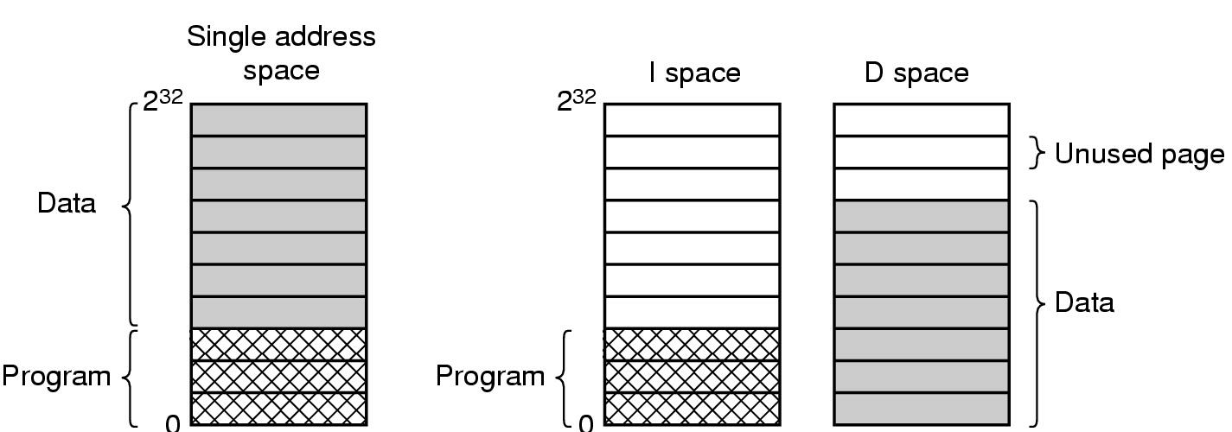
Separate Instruction and Data Spaces
One address space
Separate I and D spaces

Slide 3
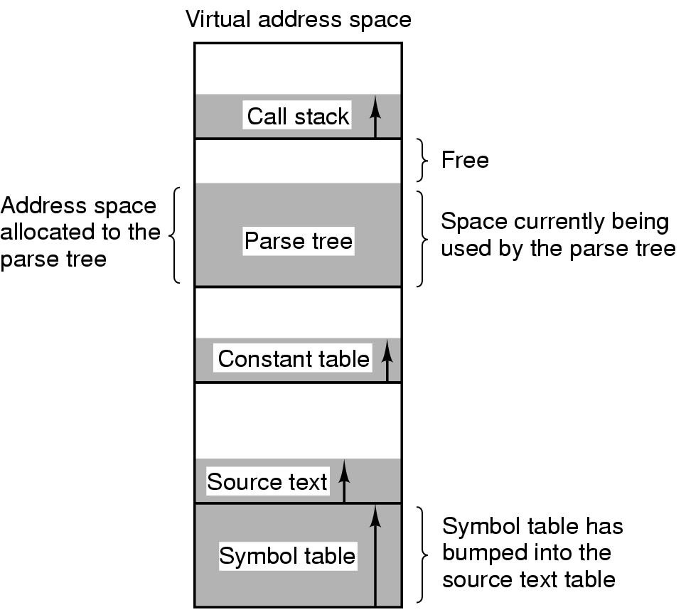
Example: Compiler program without segmentation
One-dimensional address space with growing tables

Slide 4
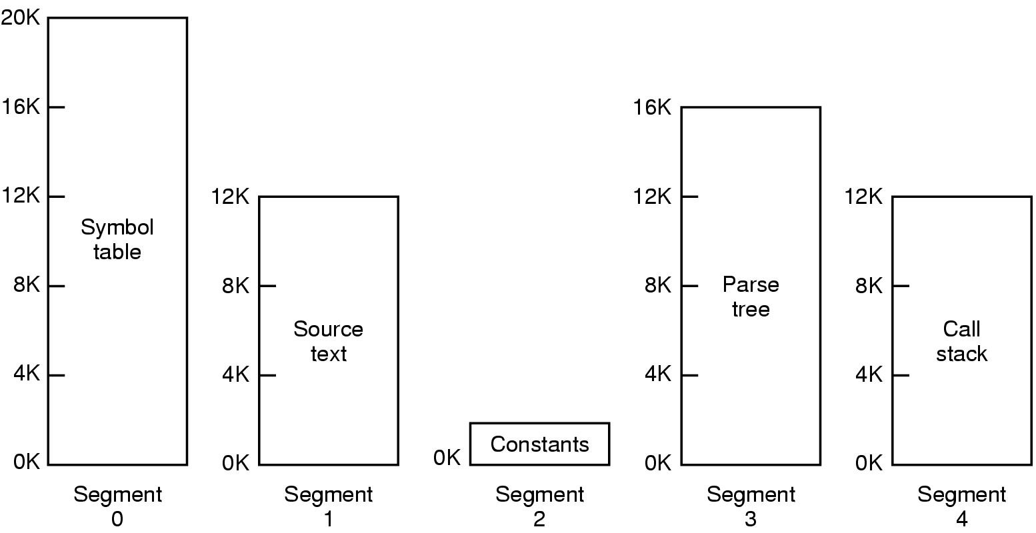
Example: Compiler program with segmentation
One process has multiple address spaces.
Each address space grows or shrink, independently

Slide 5
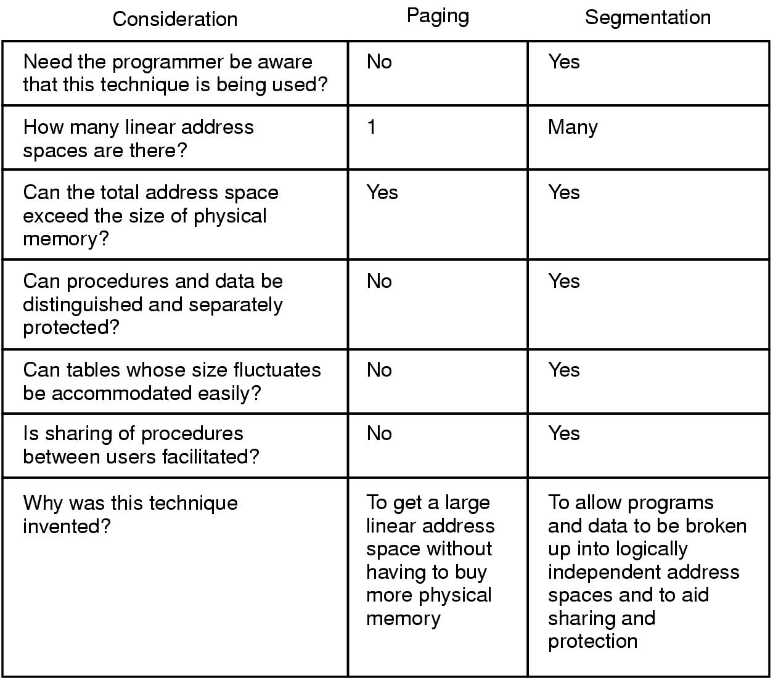
Comparison of paging and segmentation

Slide 6
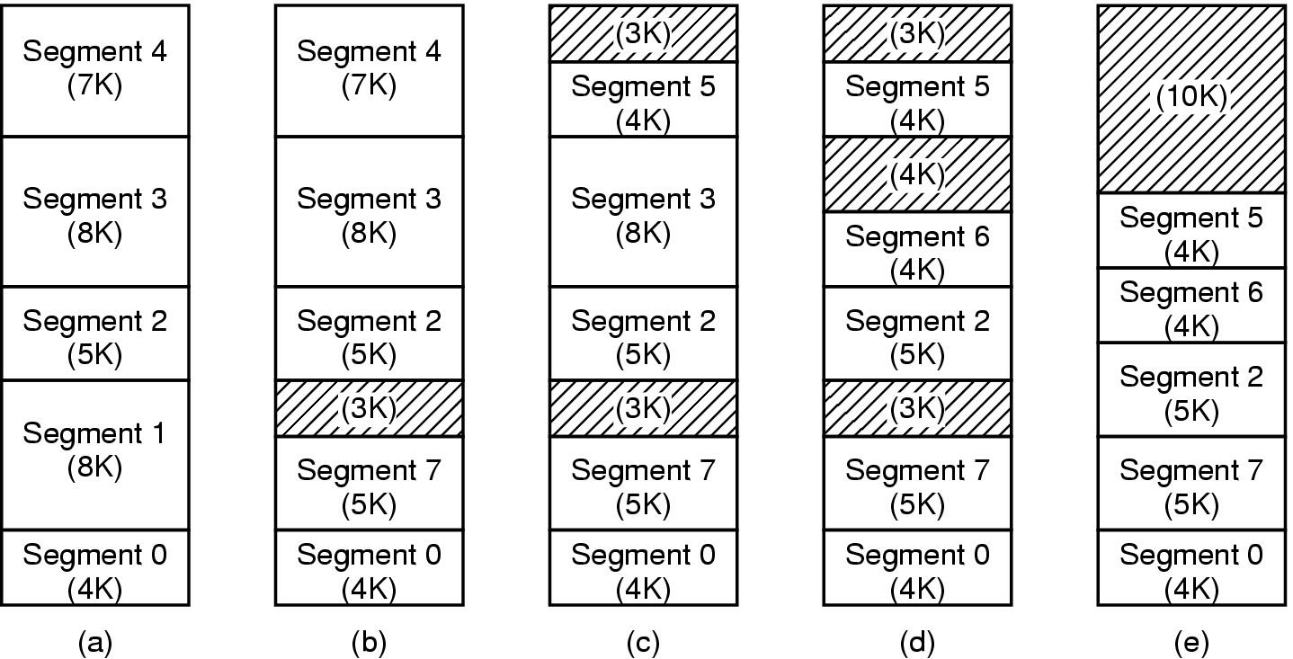
Implementation of Pure Segmentation
(a)-(d) Development of checkerboarding (external fragmentation)
(e) Removal of the checkerboarding by compaction

Slide 7
MULTICS — Paged Segmentation
Every process can have multiple virtual address spaces (or segments)
Each Segment has its own page table
Advantage
Each segment can have the full virtual address space allowed by number of address bits
Disadvantage
Switching from one segment to another has a high context switch penalty, even within the same process.

Slide 8
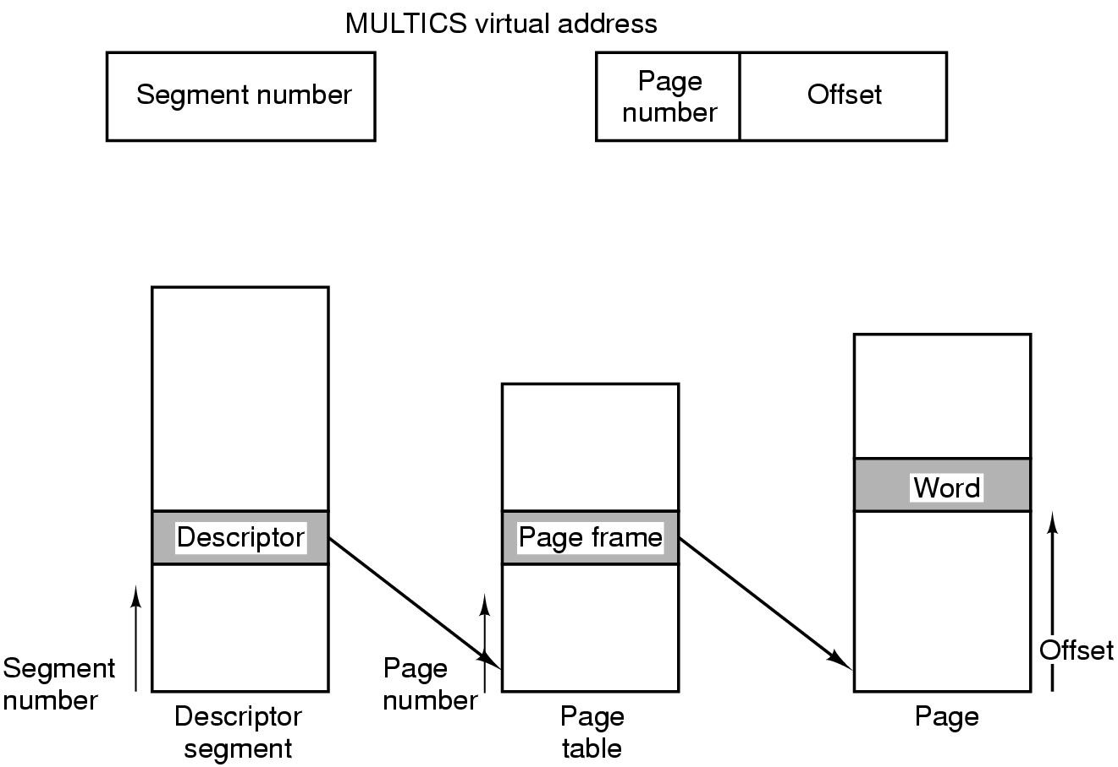
Translation of a Multics Virtual Address

Slide 9
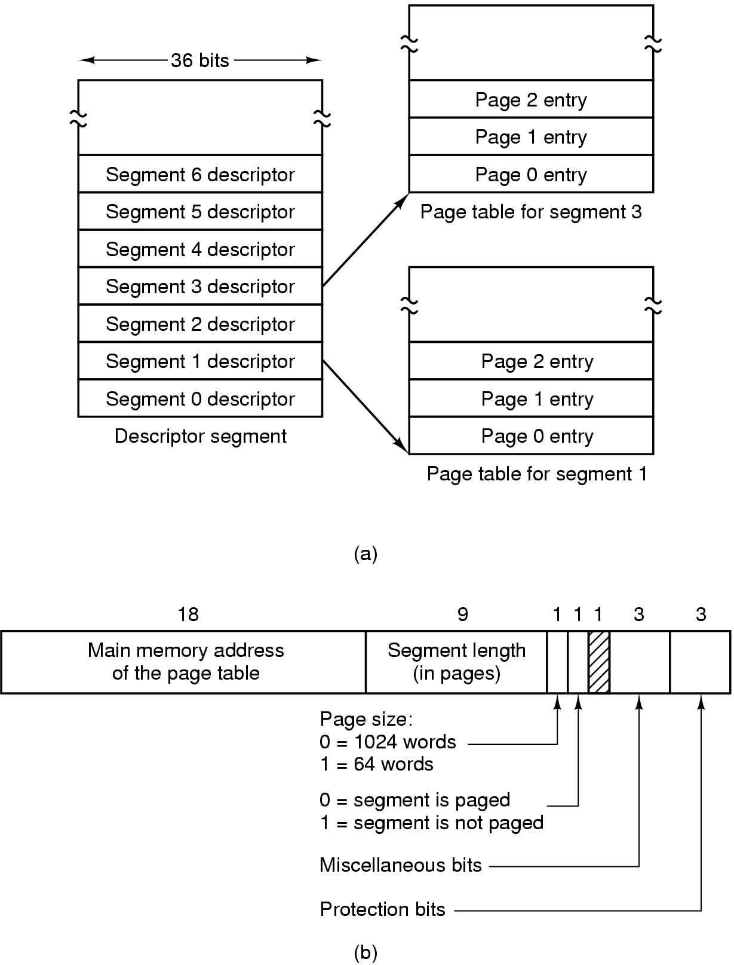
Segmentation with Paging: MULTICS
Segment descriptor table has one descriptor for each segment
Each segment descriptor points to a page table

Slide 10
Pentium — Paged Segmentation
Each process can have multiple segments
Multiple segments map to one linear address space
Linear address space has one page table
Segment 3
Limit 3
Linear
Address Space
Physical
Memory
Base 3
Segment 2
Limit 2
Page Table
Base 2
Segment 1
Limit 1
Base 1

Slide 11
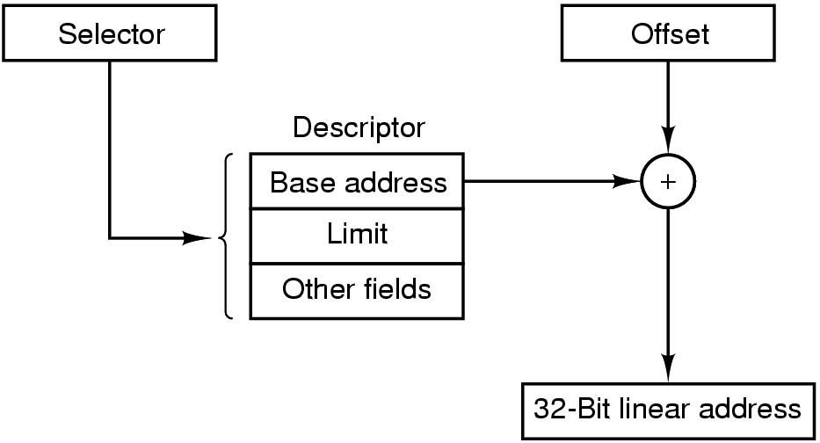
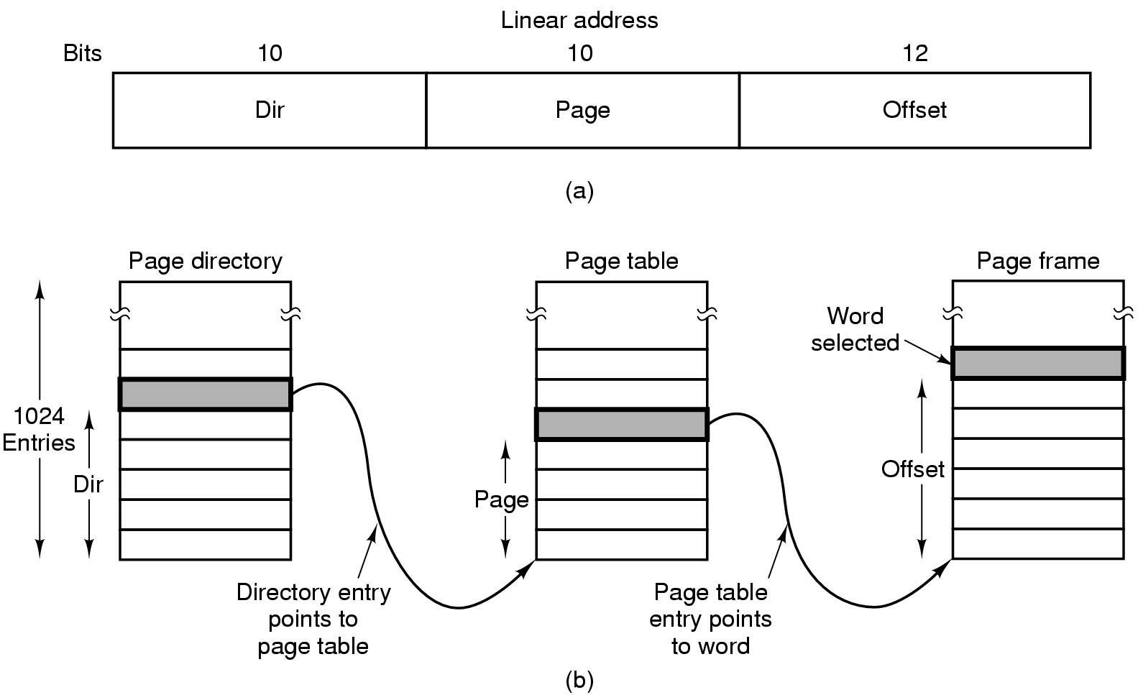
Translation of a Pentium Virtual Address
Segment
(or Virtual Address)
Step 1: Convert (selector, offset) pair to a linear address using segment descriptor
Step 2: Convert linear address onto a physical address using page table entry

Slide 12
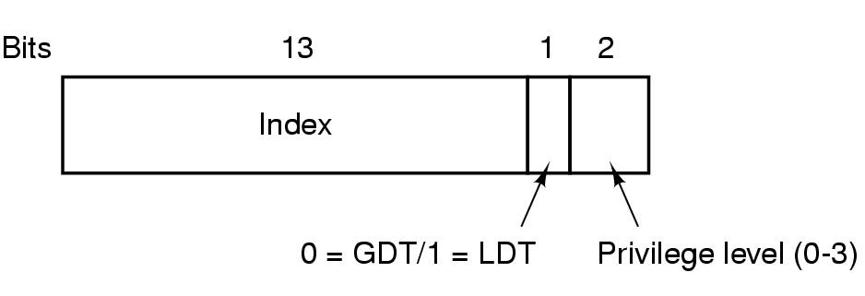
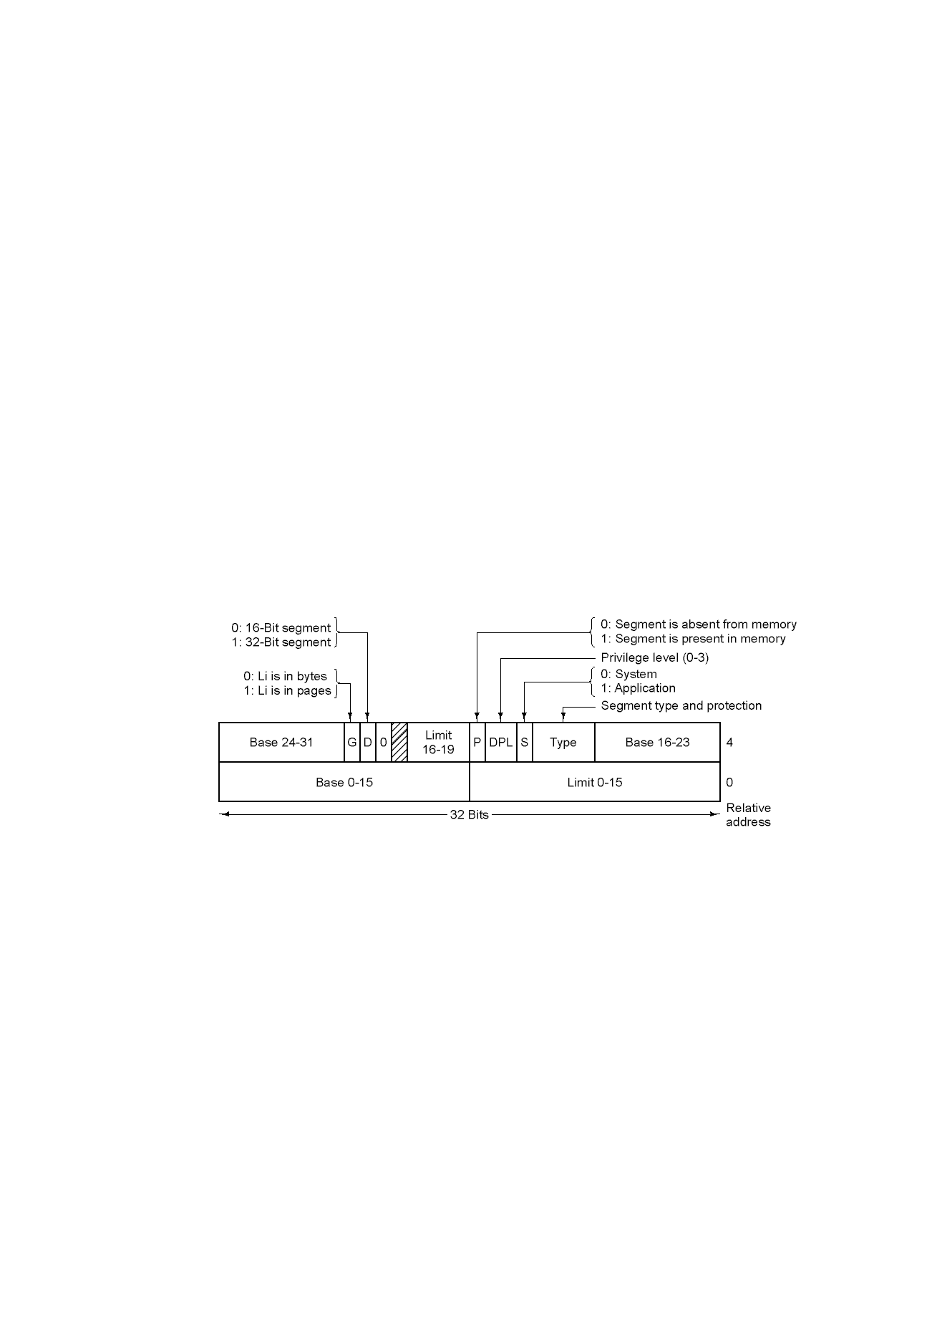
Segmentation with Paging: Pentium
Similar to MULTICS, but addresses a number of different design goals
A Pentium selector
(equivalent to Segment Number in Multics)
GDT = Global Descriptor Table
LDT = Local Descriptor Table
Four privilege levels in x86
Code segment descriptor
Data segment descriptors are slightly different

Slide 13
References
Chapter 3: Modern Operating Systems, Andrew S. Tanenbaum
Segmentation
http://en.wikipedia.org/wiki/Memory_segment
x86
http://en.wikipedia.org/wiki/X86
Intel Memory model
http://en.wikipedia.org/wiki/Intel_Memory_Model

