Slide 1
Threads
Operating Systems
Kartik Gopalan
Chapter 2 Modern Operating Systems, Andrew Tanenbaum
Chapters 26 and 27, OSTEP book
Chapter 11 Advanced Programming in Unix Environment, By Richard Stevens

Slide 2
If you want to do one task
Start one process
P1

Slide 3
If you want to do two task “concurrently”
Start two processes
Maybe P1 forks P2
and P3…PN etc if more than two tasks
Problem:
fork is expensive
cold-start penalty
P1
P2

Slide 4
If P1 and P2 want to talk to each other?
E.g. access the same data or synchronize?
Two different address spaces
Need to use IPC
shared memory, pipes, sockets, signals
Problem
kernel transitions are expensive
May need to copy data
user—->kernel—>user
Inter-process Shared memory is a pain to set up.
P1
P2
IPC

Slide 5
Option 1:Event-driven programming
Make one process do all the tasks
Busy loop polls for events and executes tasks for each event
No IPC needed
Length of the busy loop determines response latency
Stateful event responses complicate the code
What if i^{th} occurrence of event 1 effects the j^{th} event processing ?
P1
while(1)
{
if (event 1) do task 1;
if (event 2) do task 2;
…
if (event N) do task N;
}

Slide 6
Option 2: Use threads
Multiple threads of execution per process
Each thread has its own
Program counter
Stack, stack pointer
Registers
All threads share
one virtual address space
code, heap and static data
P1
T1 T2 T3 T4
Shared address space

Slide 7
Other Shared and non-shared components
Shared components
Open descriptors (files, sockets etc)
Signals and Signal handlers
Not shared
Thread ID
Errno
Priority

Slide 8
Address space layout

Slide 9
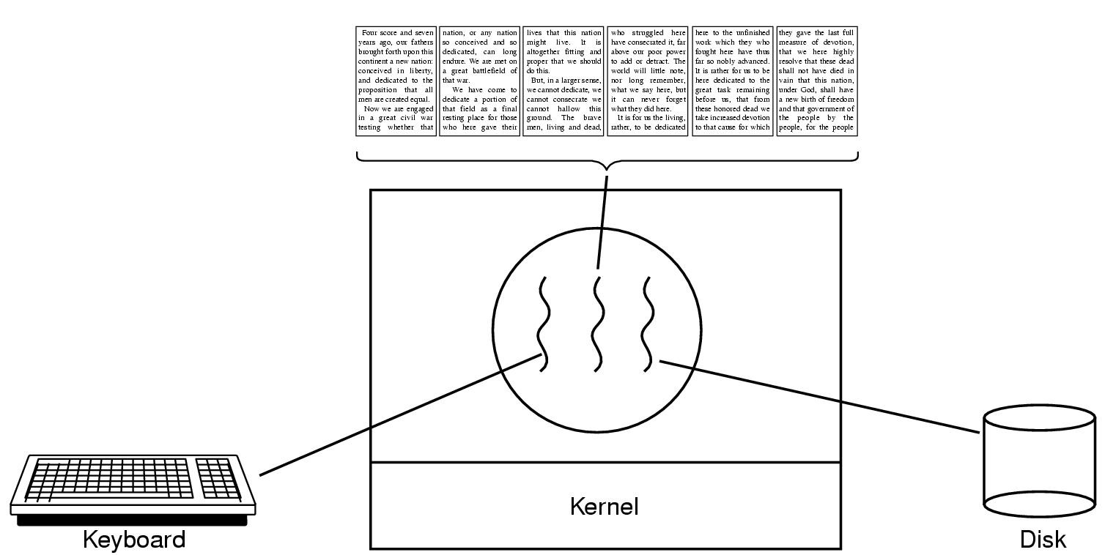
Example: A word processor with three threads
First thread handles keyboard input
Second thread handles screen display
Third thread handles saving the document to disk

Slide 10
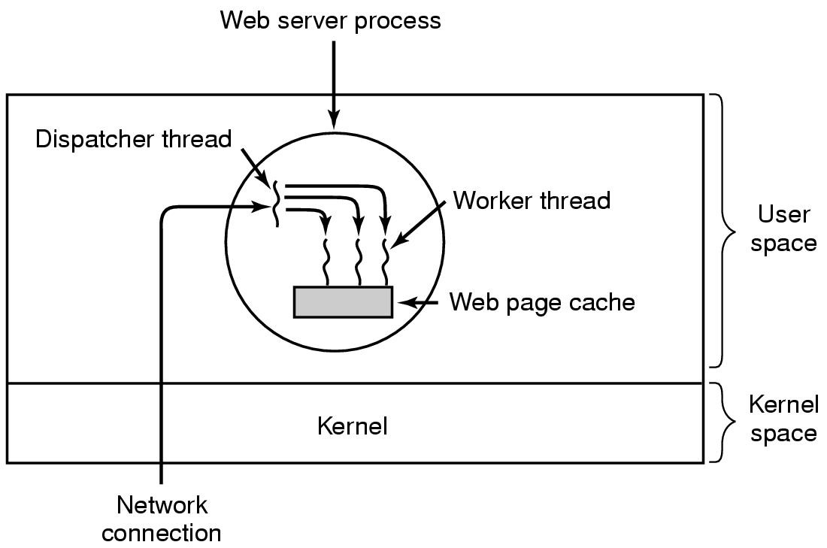
Example: a multi-threaded web server
A dispatcher thread waits for and accepts network connections
Several worker threads
Each worker processes one network connection concurrently

Slide 11
Advantages of threads
Lower inter-thread context switching overhead than processes
No Inter-process communication
Zero data transfer cost between threads
Only need inter-thread synchronization
Threads can be pre-empted at any point
Long-running threads are OK
As opposed to event-driven tasks that must be short.
Threads can exploit parallelism
But it depends…more later
Threads could block without blocking other threads
But it depends…more later

Slide 12
Disadvantages of Threads
Shared State!
Global variables are shared between threads.
Accidental data changes can cause errors.
Threads and signals don’t mix well
Common signal handler for all threads in a process
Which thread to signal? Everybody!
Royal pain to program correctly.
Lack of robustness
Crash in one thread will crash the entire process.
Some library functions may not be thread-safe
Library Functions that return pointers to static internal memory. E.g. gethostbyname()
Less of a problem these days.

Slide 13
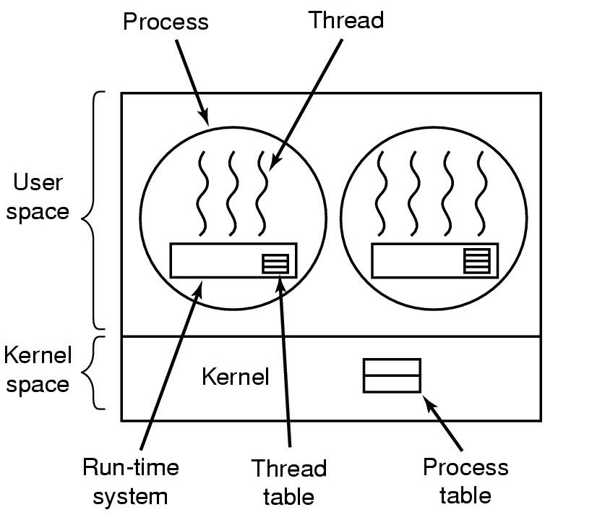
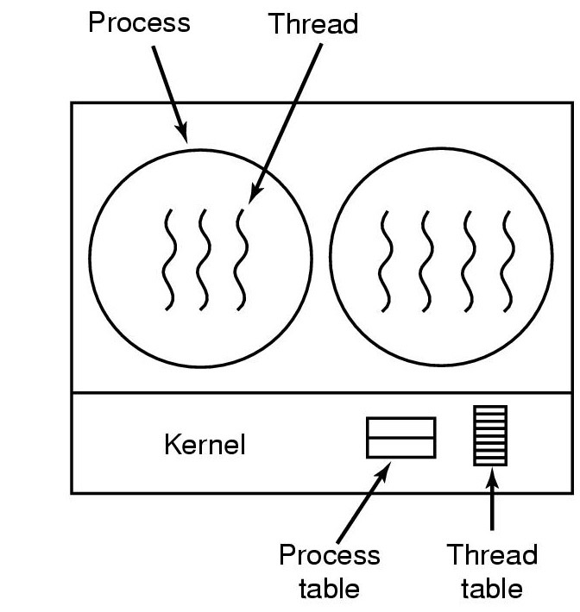
Two types of threads: user-level and kernel-level
User-level threads
User-level libraries provide multiple threads,
OS kernel does not recognize user-level threads
Threads execute when the process is scheduled
Kernel-level threads
OS kernel provides multiple threads per process
Each thread is scheduled independently by the kernel’s CPU scheduler

Slide 14
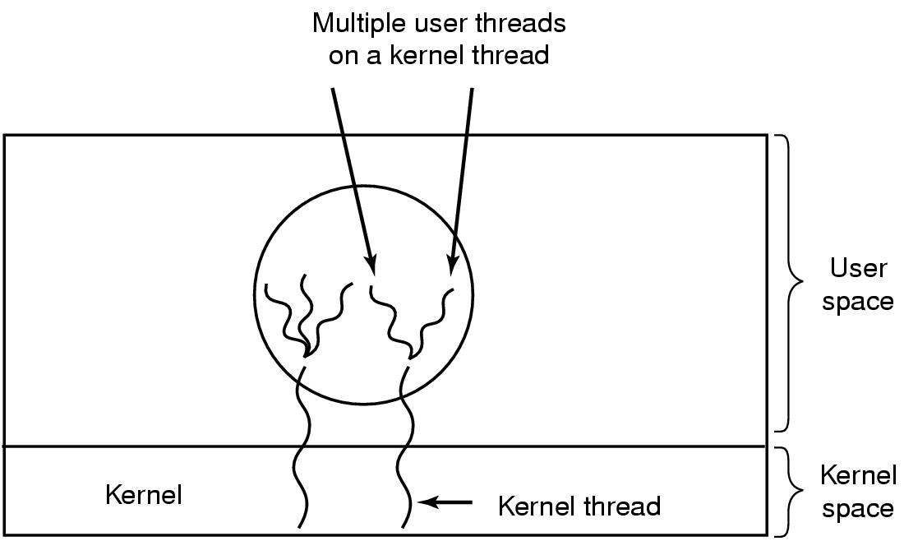
Hybrid Implementations
Multiplexing user-level threads within each kernel- level threads

Slide 15
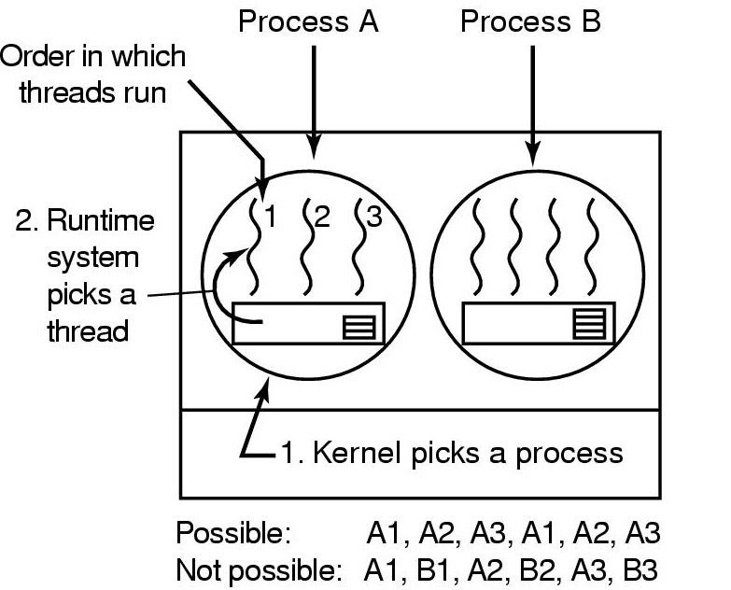
Local Thread Scheduling
Next thread is picked from among the threads belonging to the current process
Each process gets a timeslice from kernel.
Then the timeslice is divided up among the threads within the current process
Local scheduling can be implemented with either
Kernel-level threads OR
User-level threads.
Scheduling decision requires only local knowledge of threads within the current process.
For example, say process timeslice may be 50ms, and each thread within the process runs for 5 msec/CPU burst

Slide 16
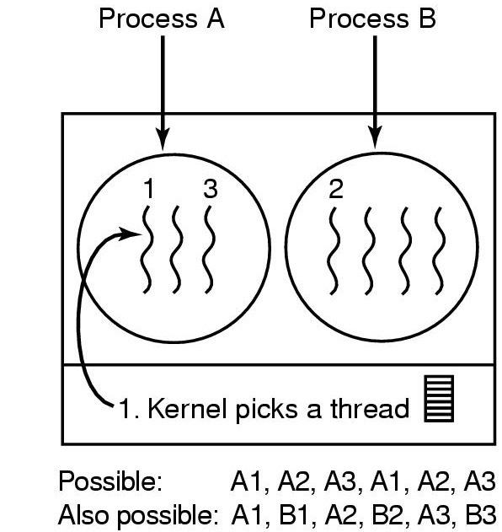
Global Thread scheduling
Next thread to be scheduled is picked up from ANY process in the system.
Not just the current process
Timeslice is allocated at the granularity of threads
No notion of per-process timeslice
Global scheduling can be implemented only with kernel-level threads
Picking the next thread requires global knowledge of threads in all processes.
For example each thread runs for 10msec per CPU burst

Slide 17
Thread Creation and termination
Creation
int pthread_create( pthread_t * thread, pthread_attr_t * attr, void * (*start_routine)(void *), void * arg);
Two ways to perform thread termination
Return from initial function.
void pthread_exit(void * status)
Waiting for child thread in parent
pthread_join(…)
equivalent to waitpid

Slide 18
Threaded program - example
// shared counter to be incremented by each thread
int counter = 0;
main()
{
pthread_t tid[N];
for (i=0;i<N;i++) {
/*Create a thread in thread_func routine*/
Pthread_create(&tid[i], NULL, thread_func, NULL);
}
for(i=0;i<N;i++)
/* wait for child thread */
Pthread_join(tid[i], NULL);
}
void *thread_func(void *arg)
{
/* unprotected code – race condition*/
counter = counter + 1;
return NULL; // thread dies upon return
}

Slide 19
pthread synchronization operations
Mutex operation
pthread_mutex_init(…)
pthread_mutex_lock(…)
pthread_mutex_unlock (…)
pthread_mutex_trylock (…)
Condition variables
pthread_cond_wait (…)
pthread_cond_signal (…)
pthread_cond_broadcast (…)
pthread_cond_timedwait (…)

