Slide 1
Concurrency
Race Conditions and Deadlocks
Kartik Gopalan
Chapters 2 (2.3) and 6 Tanenbaum’s Modern OS

Slide 2
Concurrent
Sequential
Parallel
Loosely, doing many things, but one after another
E.g. Finish one assignment, then another
For example, two tasks executed on one CPU one after another.
Loosely, concurrency is “juggling” many things within a time window.
E.g. switching your attention back-and-forth between two different assignments.
For example, two tasks share a single CPU over time.
Loosely, parallelism is doing many things simultaneously.
E.g. working on the computer and chewing gum at the same time.
Parallelism is a subset of concurrency.
All parallelism is concurrency
But not all concurrency is parallelism.
For example, two threads executing on two different CPUs simultaneously.
CPU 1
Task 1
Task 1
Task 2
Task 2
CPU 1
Task 1
Task 2
Task 1
Task 2
CPU 1 | CPU 2
Task 1 | Task 2
Task 1 | Task 2
Time

Slide 3
Concurrency and Synchronization
Concurrent tasks may either execute independently
Or, concurrent tasks may need to synchronize (communicate) now and then
Synchronization requires access to shared resources
Shared memory (buffers)
Pipes
Signals, etc

Slide 4
Critical Section
Also called critical region.
A section of code in a concurrent task that modifies or accesses a resource shared with another task.
Examples
A piece of code that reads from or writes to a shared memory region
Or a code that modifies or traverses a shared linked list.

Slide 5
Race Condition and Deadlocks
Race Condition
Incorrect behavior of a program due to concurrent execution of critical sections by two or more threads.
E.g. if thread 1 deletes an entry in a linked list while thread 2 is accessing the same entry.
Deadlocks
When two or more processes stop making progress indefinitely because they are all waiting for each other to do something.
E.g.
If process A waits for process B to release a resource, and
Process B is waiting for process A to release another resource at the same time.
In this case, neither A not B can proceed because both are waiting for the other to proceed.

Slide 6
Race Conditions and Locking
Race Condition: Incorrect behavior of a program due to concurrent execution of critical sections by two or more threads.

Slide 7
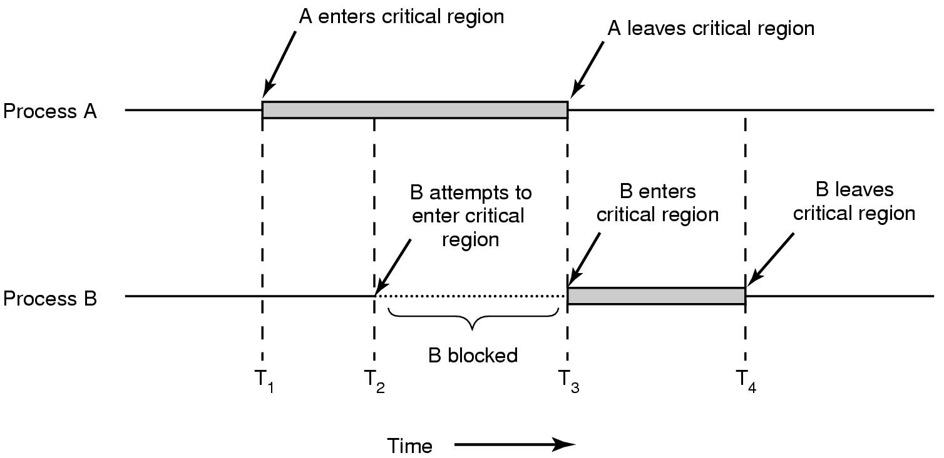
Solution: Mutual Exclusion
Don’t allow two or more processes to execute their critical sections concurrently (on the same resource).
Steps
Acquire Lock
Critical Section
Release Lock

Slide 8
Conditions for correct mutual exclusion
No two processes are simultaneously in the critical region
No assumptions are made about speeds or numbers of CPUs
No process running outside its critical region may block another process running in the critical region
No process must wait forever to enter its critical region
Waiting forever indicates a deadlock
(1) and (2) are enforced by the operating system’s implementation of locks
Programmers assume that locks satisfy (1) and (2)
(3) and (4) have to be ensured by the programmer using the locks.
OS cannot enforce these.

Slide 9
Mutual Exclusion among Readers and Writers
General rule
If any thread is writing to a shared resource, other threads are disallowed from reading or writing to the same resource.
Thread 1 | Thread 2 | Allowed/Disallowed
Read | Read | Allowed
Read | Write | Disallowed
Write | Read | Disallowed
Write | Write | Disallowed
Exceptions may be allowed for special types of lockless data structures.

Slide 10
Blocking Locks
Give up CPU till lock is available
while(lock unavailable)
yield CPU to others; // or block till lock available
return success;
Usage:
Lock(resource); // Claim a shared resource
Execute Critical Section;//access or modify the shared resource
Unlock(resource); // unclaim shared resource
Advantage: Simple to use. Locking always succeeds…ultimately.
Disadvantage: Blocking may be indefinite.
Process is moved out of “Running” state to “Blocked” state.
Also, too much overhead in getting back to running state if lock may be available soon.
running—>blocked—>ready—>running

Slide 11
Non-blocking locks
Don’t block if lock is unavailable
if(lock unavailable)
return failure;
else
return success
Usage
if(TryLock(resource) == success)
Execute Critical Section;
Unlock(resource);
else
Do something else; // plan B
Advantage: No unbounded blocking
Disadvantage: Need a “plan B” to handle locking failure

Slide 12
Spinlocks
Don’t block. Instead, constantly poll the lock for availability.
while (lock is unavailable)
continue; // try again
return success;
Usage: Just like blocking locks
SpinLock(resource);
Execute Critical Section;
SpinUnlock(resource);
Advantage
Very efficient with short critical sections
if you expect a lock to be released quickly
Disadvantage
Doesn’t yield the CPU and burns CPU cycles
Bad if critical sections are long.
Efficient only if machine has multiple CPUs.
Counterproductive on uni-processor machines

Slide 13
Best practices for locking
Associate locks with shared resources, NOT code.
E.g. a lock is for protecting a linked list
NOT for protecting insert() and remove() functions.
That way, you can use the same critical sections to operate on different shared resources having different locks.
Guard each shared resource by a separate lock
to improve concurrency
E.g. Linked list 1 should be guarded by Lock 1
Linked List 2 by Lock 2
and so on.
OS cannot enforce these properties
Up to the programmer to ensure these properties

Slide 14
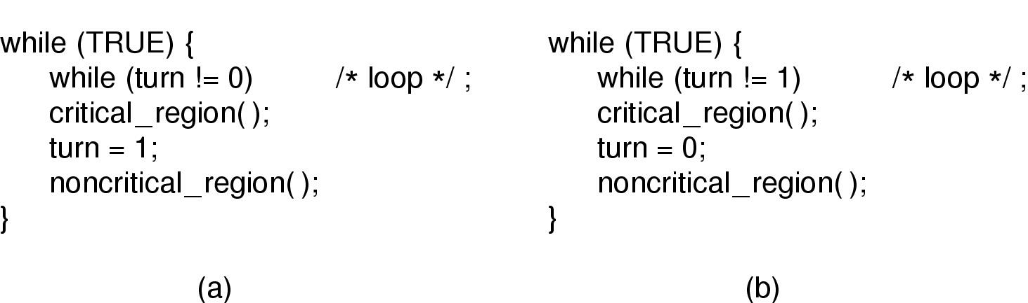
Mutual Exclusion with Busy Waiting
Process 0
Process 1

Slide 15
Deadlocks
When two or more processes stop making progress indefinitely because they are all waiting for each other to do something.

Slide 16
Deadlock when using multiple locks
Say you have two processes P1 and P2
Both need to acquire two locks L1 and L2 to access a resource.
Problem: Deadlock
P1 acquires L1
P2 acquires L2
P1 tries to acquire L2 and blocks
P2 tries to acquire L1 and blocks
We have a deadlock!
Solution: Lock Ordering
Sort the locks in a fixed order (say L1 followed by L2)
Always acquire locks in the sorted order.
Lock ordering example:
P1 acquires L1
P2 tries to acquire L1 and blocks
P1 acquires L2
P1 executes critical section
P1 releases L2
P1 releases L1
P2 wakes up
P2 acquires L1
P2 acquires L2
P2 executes critical section
P2 releases L2
P2 releases L1
No deadlock!

Slide 17
Generalizing the lock-ordering solution
Given
N Locks: L1, L2, …, LN
K Processes: P1, P2, …, Pk
A process must acquire any subset of locks in sorted order
A process doesn’t need to acquire ALL the locks.
But whatever locks it needs, it MUST acquire in sorted order.
E.g. Assume N=10, i.e. you have 10 Locks
(Allowed) Pi acquires L1, then L5, then L10
(Allowed) Pj acquires L1, then L3, then L10
(NOT Allowed) Pk acquires L5, then L2, then L1

Slide 18
Priority Inversion
Say there are three processes using priority based scheduling.
Ph – High priority
Pm – Medium priority
Pl – Low priority
Pl acquires a lock L
Pl starts executing critical section
Ph tries to acquire lock L and blocks
Pm becomes “ready” and preempts Pl from the CPU.
Pl might never exit critical section if Pm keeps preempting Pl
So Ph might never enter critical section
Problem: Priority Inversion
A high priority process Ph is blocked waiting for a low priority process Pl
Pl cannot proceed because a medium priority process Pm is executing.
Solution: Priority Inheritance
Temporarily increase the priority of Pl to HIGH PRIORITY
Pl will be scheduled and will exit critical section quickly
Then Ph can execute.

Slide 19
Interrupts and Deadlocks — Problem
Interrupts invoke interrupt service routines (ISR) in the kernel.
ISR must process the interrupt quickly and return.
So ISRs must never block or spin on a lock.
But what if ISRs need a lock to process the interrupt?
The problem:
A kernel thread T acquires lock L
An interrupt fires and ISR preempts T
ISR tries to acquire L and blocks (or spins)
T is also blocked because ISR cannot return
Deadlock!

Slide 20
Interrupts and Deadlocks — Solutions
Don’t lock in ISR!
Defer any locking work to thread context (softirqs in Linux)
If you must, use try_lock() instead of lock() in ISR
try_lock() = if lock is available then get it, else return with error.
Be ready to handle error return
Or disable interrupts in thread T before locking
If ISR cannot run when lock is acquired by T, then there’s no deadlock.
When ISR runs, it assumes that T doesn’t have the lock.
But, disabling interrupts too long is also not a good idea.
Or, on multi-CPU systems, use spinlocks, but carefully
ISRs on different CPUs can compete for locks without blocking
Threads must use interrupt disabling versions of spinlock (spinlock_irqsave). Why?

