Slide 1
Processes
Operating Systems
Kartik Gopalan
References:
Chapter 4 of OSTEP book
Chapter 2 of the Tanenbaum’s book
Notes:
Today we will discuss processes which are a central concept in operating systems. Everything that the operating system does is in one way or another related to a service that the the OS provides to processes.

Slide 2
Process
Informal definition:
A process is a program in execution.
Process is not the same as a program.
Program is a passive entity stored in the disk
Process is an actively executing entity
Program is just one component of a process.
Notes:
A process is informally defined as a program in execution.
There’s a difference between a process and a program. A program is simply a passive executable file sitting in the disk.
A process is created when a program starts running.
A program is just a sequence of instructions to be executed.
A process contains more than just a program. So what else constitutes a process? Let’s see.

Slide 3
So what else constitutes a process?
Memory space (static, dynamic)
Procedure call stack
Registers and counters :
Program counter, Stack pointer, General purpose registers
Open files, connections
……

Slide 4
Memory Layout of a typical process
MAX
Stack
Function Call Arguments, Return Address, Return Values
Gap
Heap
Dynamically allocated memory (e.g. malloc())
Data
Global variables, constants etc
Text
Program Code
0
Stack and heap grow towards each other

Slide 5
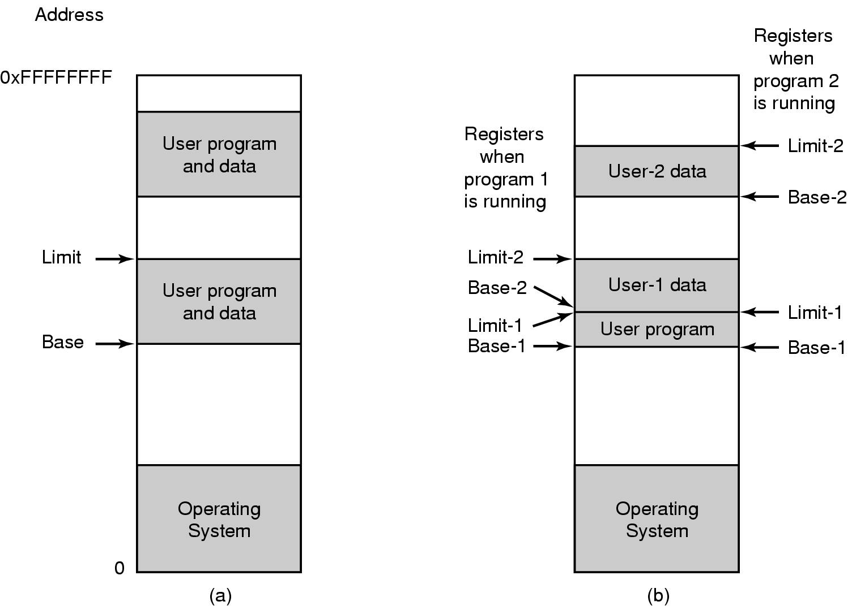
Multiple processes sharing main memory
Two processes
running different
programs
Two processes
running the same
program

Slide 6
Process Creation
Always using fork() system call.
When?
User runs a program at command line
OS creates a process to provide a service
Check the directory /etc/init.d/ on Linux for scripts that start off different services at boot time.
One process starts another process
For example in servers

Slide 7
Creating a New Process - fork()
Example code fork_ex.c
http://www.cs.binghamton.edu/~kartik/cs350/examples/fork_ex.c
pid = fork();
if (pid == -1) {
fprintf(stderr, "fork failed\n");
exit(1);
}
if (pid == 0) {
printf(“This is the child\n");
exit(0);
}
if (pid > 0) {
printf(“This is parent. The child is %d\n", pid);
exit(0);
}

Slide 8
Points to Note
fork() is called once …
But it returns twice!!
Once in the parent and
Once in the child
The parent and the child are two different processes.
Child is an exact “copy” of the parent.
So how to make the child process do something different?
Return value of fork in child = 0
Return value of fork in parent = [process ID of the child]
By examining fork’s return value, the parent and the child can take different code paths.

Slide 9
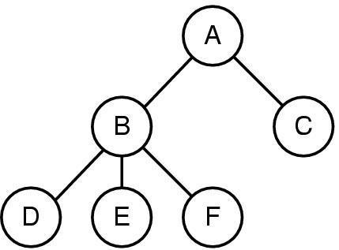
Process Hierarchy Tree
Parent of B and C
Child of A
Parent of D, E, F
Leaf
A created two child processes, B and C
B created three child processes, D, E, and F

Slide 10
CPU scheduler
Time-shares many processes on one CPU
Who’s Next?
CPU
Queue of Ready Process
CPU Scheduler

Slide 11
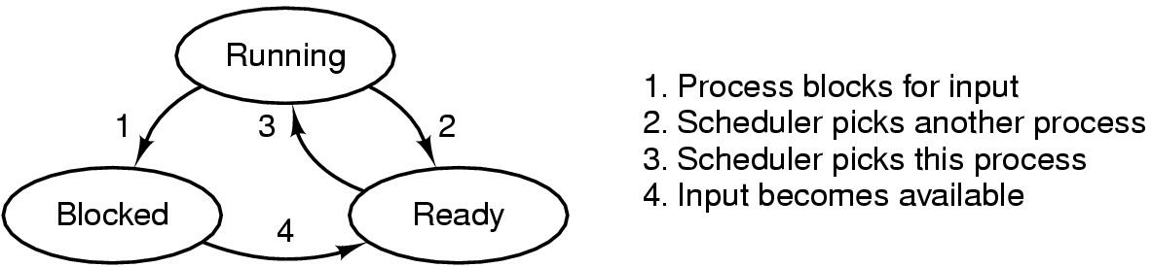
Process Lifecycle
Ready
Process is ready to execute, but not yet executing
Its waiting in the scheduling queue for the CPU scheduler to pick it up.
Running
Process is executing on the CPU
Blocked
Process is waiting (sleeping) for some event to occur.
Once the event occurs, process will be woken up, and placed on the scheduling queue.

Slide 12
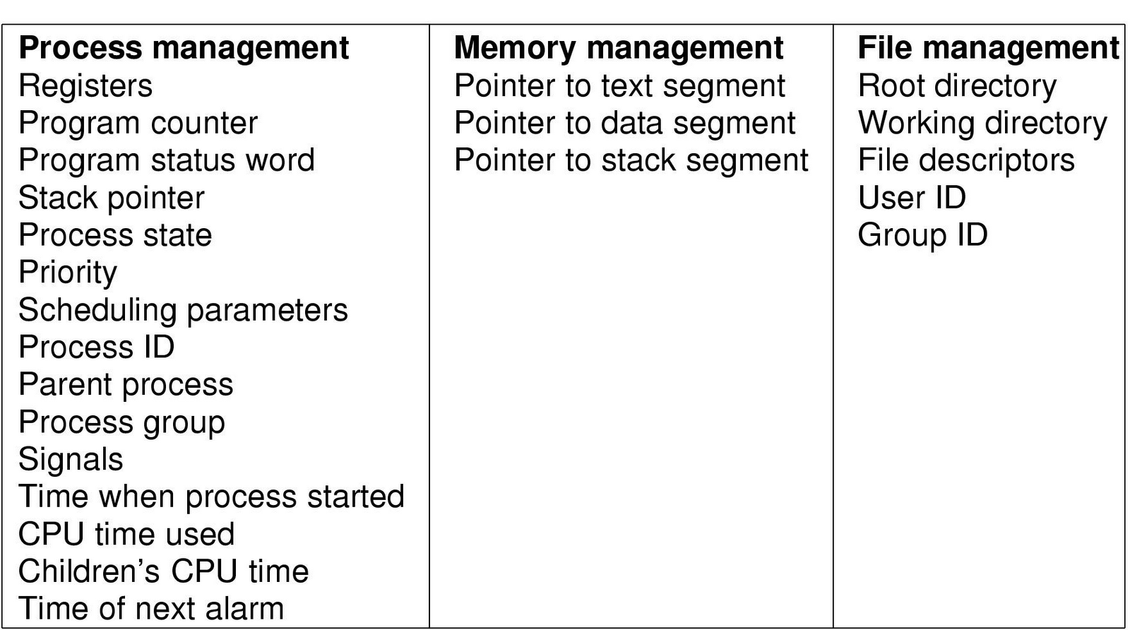
Typical Kernel-level data structure for each process
See task_struct in Linux at http://lxr.linux.no

Slide 13
Examining Processes in Unix/Linux
ps command
Standard process attributes
/proc directory
More interesting information if you are the root.
top command
Examining CPU and memory usage statistics.

Slide 14
The exec() system call
Consider how a shell executes a command
$ pwd
/home/kartik
How did that work?
Shell forked a child process
The child process executed /bin/pwd using the exec() system call
Exec replaces the process’ memory with a new program image.

Slide 15
Running another program in child – exec()
Parent
Child
Fork
Exec
New program
image
in execution

Slide 16
exec() — Example code exec_ex.c
http://www.cs.binghamton.edu/~kartik/cs350/examples/exec_ex.c
if ((pid = fork()) < 0) {
fprintf(stderr, "fork failed\n");
exit(1);
}
if (pid == 0) {
if( execlp("echo",
"echo",
"Hello from the child",
(char *) NULL) == -1)
fprintf(stderr, "execl failed\n");
exit(2);
}
printf("parent carries on\n");

Slide 17
Properties of exec()
Replaces current process image with new program image.
In the last example, parents’ image was replaced by the “echo” program image.
All I/O descriptors open before exec stay open after exec.
I/O descriptors = file descriptors, socket descriptors, pipe descriptors etc.
This property is very useful for implementing filters.

Slide 18
Different Types of exec()
int execl(char * pathname, char * arg0, … , (char *)0);
Full pathname + long listing of arguments
int execv(char * pathname, char * argv[]);
Full pathname + arguments in an array
int execle(char * pathname, char * arg0, … , (char *)0, char envp[]);
Full pathname + long listing of arguments + environment variables
int execve(char * pathname, char * argv[], char envp[]);
Full pathname + arguments in an array + environment variables
int execlp(char * filename, char * arg0, … , (char *)0);
Short pathname + long listing of arguments
int execvp(char * filename, char * argv[]);
Short pathname + arguments in an array
More info: check “man 3 exec”

Slide 19
wait() system call
Helps the parent process
to know when a child completes.
to check the return status of child

Slide 20
wait( ) system call
if ((pid = fork()) == 0) {
/* in the child – exec another program image */
ret = execlp("lpr", "lpr", "myfile", (char *) 0);
if( ret == -1 )
fprintf(stderr, "exec failed\n");
} else {
/* in the parent - do some other stuff */
……
/* now check for completion of child */
waitpid(pid, &status, 0);
/* Alternative ==> while (wait(&status) != pid); */
/* remove file */
unlink("myfile");
}

Slide 21
Few other useful syscalls
sleep(seconds)
suspend execution for certain time
exit(status)
Exit the program.
Status is retrieved by the parent using wait().
0 for normal status, non-zero for error

Slide 22
Orphan process
When a parent process dies, child process becomes an orphan process.
The init process (pid = 1) becomes the parent of the orphan processes.
Here’s an example:
http://www.cs.binghamton.edu/~kartik/cs350/examples/orphan.c
Do a ‘ps –l’ after running the above program and check parent’s PID of the orphan process.
After you are done remember to kill the orphan process ‘kill –9 <pid>’

Slide 23
Zombie Process
When a child dies, a SIGCHLD signal is sent to the parent.
If parent doesn’t wait()on the child, and child exit()s, it becomes a zombie (status “Z” seen with ps).
Zombies hang around till parent calls wait() or waitpid().
But they don’t take up any system resources.
Just an integer status is kept in the OS.
All other resources are freed up.

Slide 24
References
Chapter 4 of OSTEP book
Chapter 2 of the Tanenbaum’s book
Man pages for different system calls
Try “man 2 <syscall_name>”
E.g. man 2 exec
Syscalls are normally listed in section 2 of the man page
Google for “Linux source code"

