Slide 1
Operating Systems Course Overview
Instructor: Kartik Gopalan
Class website:
http://oscourse.github.io

Slide 2
Interfaces in a Computer System
(1)
User-level processes
(2)
(3)
Libraries
(3)
Operating System
User ISA : 7
System ISA : 8
Syscalls : 3
ABI : 3, 7
API : 2,7
(4)
(5)
(6)
Drivers
Memory Manager
Scheduler
(8)
(8)
(8)
(7)
(7)
Execution hardware
(9)
(10)
(10)
Memory Translation
System Interconnect (Bus)
(11)
(12)
Controllers
Controllers
Controllers
(11)
Controllers
(13)
(14)
ISA = Instruction Set Architecture
ABI = Application Binary Interface
API = Application Programming
Interface
I/O Devices
Main Memory

Slide 3
Layers of Software
Processes
User
Space
System Call Interface
OS
File system
CPU
scheduling
Memory
Manager
Device
Drivers
Network Stack
HyperCall Interface
Virtualization
Layer
Hypervisor

Slide 4
Coverage of Topics
Processes and Threads
CPU Scheduling
Memory Management
Concurrency
File Systems
Input/Output
Security
Virtualization
Basics of Programming in the Linux Kernel
Other topics as appropriate

Slide 5
Class Logistics
Course Material
Lecture slides and papers posted on the class website
Andrew Tanenbaum, Modern Operating Systems, 3rd or 4th edition
Operating Systems: Three Easy Pieces
http://pages.cs.wisc.edu/~remzi/OSTEP/
Online and free
No need to buy the books unless you want to.
Read the course policies on the class website.
Website will also have office hours, test dates, assignments, test samples etc.

Slide 6
Accounts you need
BU Email account
<yourid>@binghamton.edu
For communicating with me and TA
For receiving announcements
CS LDAP Account
To log into machines in G-7, Q-22, and remote.cs.binghamton.edu
Access to blackboard
For submitting your assignments
Getting grades
http://blackboard.binghamton.edu
A VM to work on
Either on google cloud, or your own machine, or G-7/Q-22 lab
Your own Linux kernel that you will work with.

Slide 7
Students with disabilities
Please contact me, preferably, within the first two weeks of class.
Please contact the SSD office for any accommodations.
Bring me their letter listing the accommodations required.
Don’t hesitate to tell me if some aspect of the class is not working for you.
We will promptly work with you and SSD to fix it.

Slide 8
To ask or not to ask?
Instructor and TAs are not a psychics!
If you don’t ask, then we won’t know how to help.
Please let us know if…
You are lost
You don’t understand something
You don’t have the background
Class can be improved in certain ways
Ask for help early
Don’t wait till the last minute
Feel free to give feedback
Especially in the middle of the semester
Direct feedback is always welcome.

Slide 9
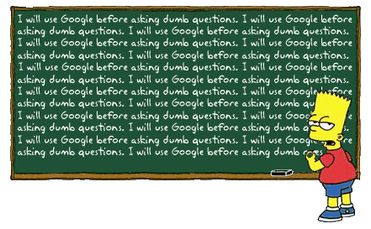
Asking Questions
Make Google your friend!
Can’t beat the response time!
Email me/TAs anytime
Stop by during office hours
Any other time
Please email me for an appointment.
Otherwise, you may not find me, or you may find me busy with something else.
Kidding…No question is dumb!

Slide 10
Stressed?
Keep the perspective
This is only one little course in the scheme of “things”.
If you are overwhelmed with the course, talk to us.
If you are depressed or panicking for any other reason.
Seek professional counseling.
http://counseling.binghamton.edu/
Hope you won’t need to ☺

Slide 11
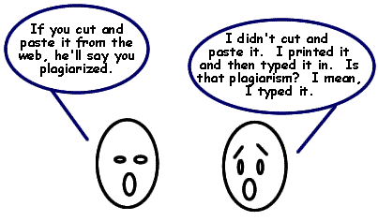
Academic Integrity
Means
• Do your own work. Don't do others' work.
• Don't ask/give solutions, including code.
• Don't get code from the Internet.
• Protect your code
Moss: A tool for detecting software plagiarism will be used.
Please read the policies on course web page
http://www.cs.binghamton.edu/~kartik/policies.html
Dishonesty ➔
You can get an F grade
Be referred to the Dean’s office
Its better to submit your own imperfect own than to submit a perfect copied one.
You get partial grades for incomplete work.
But you’ll get F for copied work.
Ctrl-C
Ctrl-V
http://library.kcc.hawaii.edu/main/instruction_info/plagiarism1.html

Slide 12
Missed Exams/Assignments
No makeup exams/assignments.
Except for medical emergencies or jury duty when accompanied with valid documentation.
Plan your other commitments (travel, interviews, etc) around deadlines.
Missing exams/deadlines due to such commitments is not a valid excuse.

Slide 13
Questions?

