Slide 1
Lab 02
Inter-Process Communication
fork-exec[-wait]
Signal
Pipe

Slide 2
fork-exec[-wait]
1 int main(void) {
2 pid_t return_pid = fork();
3
4 /* Error check for fork(). */
5
6 if (return_pid == 0) {
7 int exec_return_value = execlp("/bin/ls",
8 "ls", "-l", (char *) NULL);
9 /* Error check execlp(). */
10 }
11 else {
12 int wait_status;
13 pid_t terminated_child_pid = wait(&wait_status);
14
15 /* Error check wait(). */
16 }
17
18 exit(EXIT_SUCCESS);
19 }

Slide 3
Parent-Block and Child-Block
1 int main(void) {
2 pid_t return_pid = fork();
3
4 /* Error check for fork(). */
5
6 if (return_pid == 0) {
7 int exec_return_value = execlp("/bin/ls",
8 "ls", "-l", (char *) NULL);
9 /* Error check execlp(). */
10 }
11 else {
12 int wait_status;
13 pid_t terminated_child_pid = wait(&wait_status);
14
15 /* Error check wait(). */
16 }
17
18 exit(EXIT_SUCCESS);
19 }
Notes:
When the parent process issues the wait system call, it enters the blocked state and does not try to burn unnecessary CPU cycles. The child process continues executes its instructions independently from the parent process. Once the child finishes its task and terminates normally, the OS will notify the parent process by signaling it with SIGCHLD. Then, the parent process wakes up and continues to the next instruction.

Slide 4
Signal
Signal is a notification to a process that an event has occurred.
Different types of event determine different types of signal.
The process may choose to handle the signal in a different way than the default behavior.
List all the signals: kill -l

Slide 5
C Function Prototype for the Installer of Signal Handler
void (*installer(int sig, void (*handler)(int)))(int);
Before tackling this complex beast, let’s look at some simpler cases.
int x;
int *p;
int a[5];
int f();
int ***ppp;
int (**ppa)[];
int *fp();
int (*pf)();
int *(*func())();
Notes:
To handle the event, we need to associate our own signal handler with the intended signal.
Thanks to Rick Ord.
http://ieng9.ucsd.edu/~cs30x/rt_lt.rule.html
First, symbols. Read
* as "pointer to" - always on the left side
[] as "array of" - always on the right side
() as "function returning" - always on the right side
as you encounter them in the declaration.
STEP 1 ------ Find the identifier. This is your starting point. Then say to yourself, "identifier is." You've started your declaration.
STEP 2 ------ Look at the symbols on the right of the identifier. If, say, you find "()" there, then you know that this is the declaration for a function. So you would then have "identifier is function returning". Or if you found a "[]" there, you would say "identifier is array of". Continue right until you run out of symbols *OR* hit a *right* parenthesis ")". (If you hit a left parenthesis, that's the beginning of a () symbol, even if there is stuff in between the parentheses. More on that below.)
STEP 3 ------ Look at the symbols to the left of the identifier. If it is not one of our symbols above (say, something like "int"), just say it. Otherwise, translate it into English using that table above. Keep going left until you run out of symbols *OR* hit a *left* parenthesis "(".

Slide 6
void (*installer(int sig, void (*handler)(int)))(int);
void (*func)(int);
installer(int sig, void (*handler)(int))
void (*handler)(int)
Ready to translate the installer prototype?

Slide 7
Define and Change Our Own Signal Handler
void (*handler)(int signal);
Change the default behavior of handing the signal.
man sigaction

Slide 8
More Readable Installer Prototype
typedef void sigfunc_t(int);
sigfunc_t *install_signal_handler( int signal_number, sigfunc_t *signal_handler);

Slide 9
How to Send a Signal?
man 2 kill
https://oscourse.github.io/examples/signals_ex.c

Slide 10
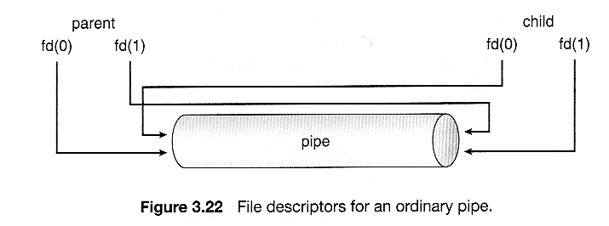
Pipe
Notes:
Abraham Silberschatz, Greg Gagne, and Peter Baer Galvin, "Operating System Concepts, Ninth Edition ", Chapter 3
fd[0]: read end.
fd[1]: write end.

Slide 11
Pipe Example Code
https://oscourse.github.io/examples/pipe1.c

Slide 12

Let’s Make a Little Game Using Pipes

Slide 13
What’s the game?
A die has 6 faces. Each face has a different number from 1 to 6.
After the parent rolls the die, its child will guess the number facing up.
The parent will pipe a hint to its child.
1: child’s number is larger than the target/right number.
0: child guesses it right.
-1: child’s number is smaller than the target/right number.
The child can guess 3 times in total.
A student can define any other details of this game.
Do not turn in your game.
Notes:
This may be a student’s first AI. How to make the child process guess smarter? or to have an educated guess ☺

