Slide 1
Concurrency
Semaphores, Condition Variables, Producer Consumer Problem
Kartik Gopalan
Chapters 2 (2.3) and 6 Tanenbaum’s Modern OS

Slide 2
Semaphore
Semaphore is a fundamental synchronization primitive used for
Locking around critical regions
Inter-process synchronization
A semaphore “sem” is a special integer on which only two operations can be performed.
DOWN(sem)
UP(sem)

Slide 3
The DOWN(sem) Operation
If (sem > 0) then
Decrements sem by 1
The caller continues executing.
This is a “successful” down operation.
If (sem == 0) then
Block the caller
The caller blocks until another process calls an UP.
The blocked process wakes up and tries DOWN again.
If it succeeds, then it moves to “ready” state
Otherwise it is blocked again till someone calls UP.
And so on.

Slide 4
The UP(sem) Operation
This operation increments the semaphore sem by 1.
If the original value of the semaphore was 0, then UP operation wakes up any process that was sleeping on the DOWN(sem) operation.
All woken up processes compete to perform DOWN(sem) again.
Only one of them succeeds and the rest are blocked again.

Slide 5

Semaphore Example — “Chair is taken”
sem = 3

Slide 6
Semaphore Example — “Chair is taken”
Down (sem)
sem = 2

Slide 7
Semaphore Example — “Chair is taken”
Down (sem)
sem = 1

Slide 8
Semaphore Example — “Chair is taken”
Down (sem)
sem = 0

Slide 9
Semaphore Example — “Chair is taken”
sem = 0
Down (sem)
Blocked

Slide 10
Semaphore Example — “Chair is taken”
sem = 0
Down (sem)
Down (sem)
Blocked

Slide 11
Semaphore Example — “Chair is taken”
UP (sem)
sem = 1
Down (sem)
Down (sem)
Blocked

Slide 12
Semaphore Example — “Chair is taken”
Down (sem)
sem = 0
Down (sem)
Blocked

Slide 13
Semaphore Example — “Chair is taken”
Up (sem)
sem = 1
Down (sem)
Blocked

Slide 14
Semaphore Example — “Chair is taken”
Up (sem)
sem = 2
Down (sem)
Blocked

Slide 15
Semaphore Example — “Chair is taken”
Down (sem)
sem = 1

Slide 16
Mutex
Mutex is simply a binary semaphore
It can have a value of either 0 or 1
Mutex is used as a LOCK around critical sections
Locking a mutex means calling Down(mutex)
If mutex==1, decrement mutex value to 0
Else, sleep until someone performs an UP
Unlocking a semaphore means calling UP(mutex)
Increment mutex value to 1
Wake up all sleepers on DOWN(mutex)
Only one sleeper succeeds in acquiring the mutex. Rest go back to sleep.
For example:
Down(mutex) // Acquire the lock, sleep if mutex is 0
Critical Section…
Up(mutex) // release the lock, wake up sleepers

Slide 17
Mutex Example — “Chair is taken”
mutex = 1

Slide 18
Mutex Example — “Chair is taken”
Down (mutex)
mutex = 0

Slide 19
Mutex Example — “Chair is taken”
mutex = 0
Down (mutex)
Blocked

Slide 20
Mutex Example — “Chair is taken”
UP (mutex)
mutex = 1
Blocked

Slide 21
Mutex Example — “Chair is taken”
Down (mutex)
mutex = 0

Slide 22
Example: Producer-Consumer Problem
Common Buffer
Empty
Full
Producers
Consumers
Producers and consumers run in concurrent processes.
Producers produce data and consumers consume data.
Producer informs consumers when data is available
Consumer informs producers when a buffer is empty.
Two types of synchronization needed
Locking the buffer to prevent concurrent modification
Informing the other side that data/buffer is available

Slide 23
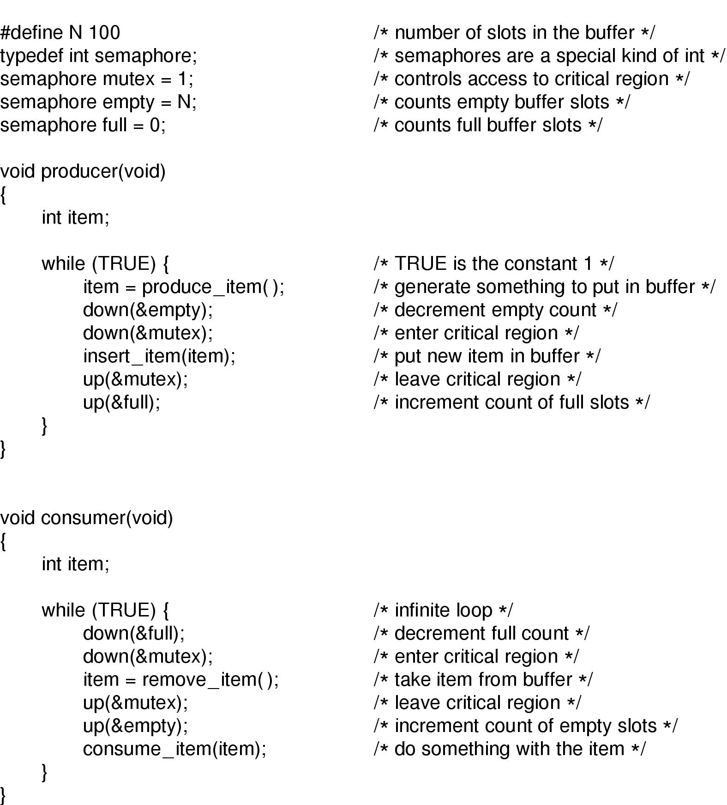
Using Semaphores for the P-C problem
Note: Two types of semaphores used here.
A binary semaphore to lock the queue (mutex)
Regular sems to block on event (empty and full).
Up: Increments the value of semaphore, wakes up sleepers to compete on sem
Down: Decrements semaphore, but blocks the caller if sem value is 0

Slide 24
Using Semaphores – POSIX interface
sem_open() -- Connects to, and optionally creates, a named semaphore
sem_init() -- Initializes a semaphore structure (internal to the calling program, so not a named semaphore).
sem_wait(), sem_trywait() -- Blocks while the semaphore is held by other processes or returns an error if the semaphore is held by another process.
sem_post() -- Increments the count of the semaphore.
sem_close() -- Ends the connection to an open semaphore.
sem_unlink() -- Ends the connection to an open semaphore and causes the semaphore to be removed when the last process closes it.
sem_destroy() -- Initializes a semaphore structure (internal to the calling program, so not a named semaphore).
sem_getvalue() -- Copies the value of the semaphore into the specified integer.
Semaphore overview : Do “man sem_overview” on any linux machine

Slide 25
Another way for using Semaphores - System V interface
Creation
int semget(key_t key, int nsems, int semflg);
Sets sem values to zero.
Initialization (NOT atomic with creation!)
union semun arg;
arg.val = 1;
if (semctl(semid, 0, SETVAL, arg) == -1) {
perror("semctl"); exit(1);
}
Incr/Decr/Test-and-set
int semop(int semid ,struct sembuf *sops, unsigned int nsops);
Deletion
semctl(semid, 0, IPC_RMID, 0);
Examples:
seminit.c
semdemo.c
semrm.c

Slide 26
Monitors and Condition Variables

Slide 27
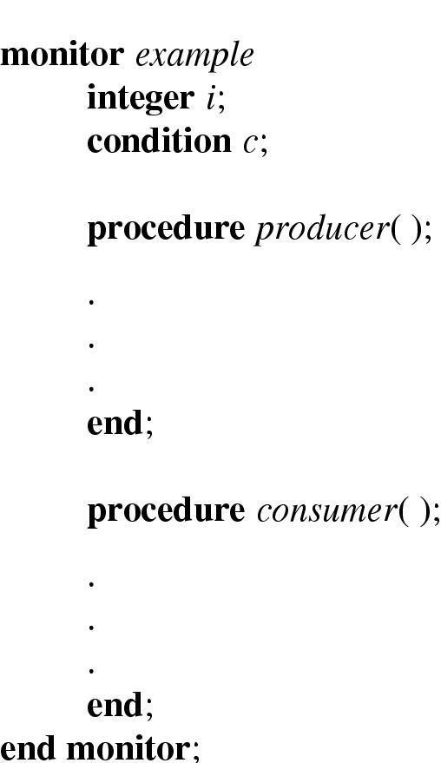
Monitors and condition variables
Monitor is a collection of procedures (functions)
There’s one global lock on all procedures in the monitor.
Only one procedure can be executed at any time
wait(c) : releases the lock on monitor and puts the calling process to sleep. ALSO:Automatically re-acquires the lock upon return from wait(c).
signal(c): wakes up all the processes sleeping on c; the woken processes then compete to obtain lock on the monitor.
Function1()
wait(c);
Function2()
signal(c);

Slide 28
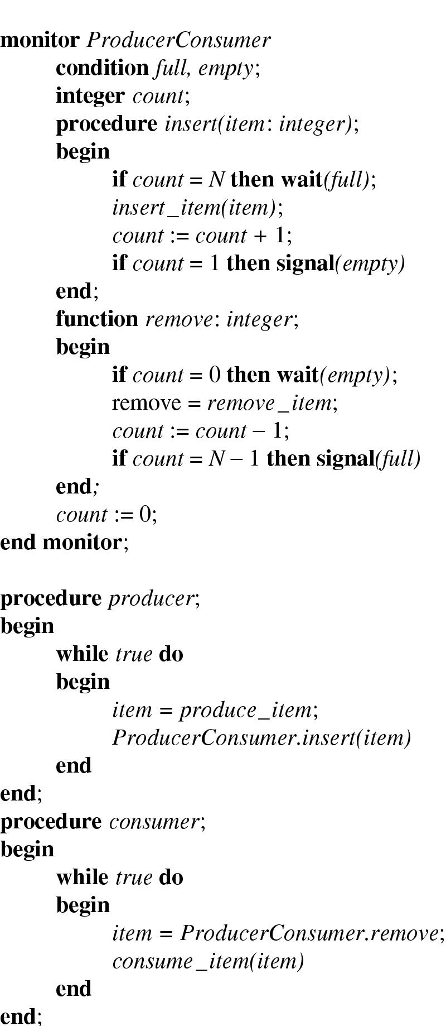
P-C problem with monitors and condition variables

Slide 29
Atomic Locking – TSL Instruction

Slide 30
Test-and-Set Lock (TSL) Instruction
Instruction format: TSL Register, Lock
Lock
Located in memory.
Has a value of 0 or 1
Register
One of CPU registers
TSL does the following two operations atomically (as one step)
Copies the old value of Lock to Register
Sets the new value of Lock to 1
Atomic: means that the caller cannot be preempted between the two operations
TSL is a basic primitive using which other more complex locking mechanisms can be implemented.

Slide 31
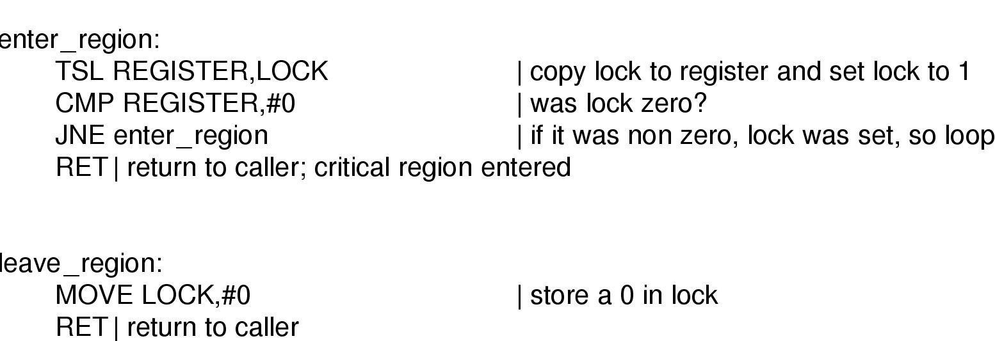
Busy waiting solution implemented using the TSL instruction
Entering and leaving a critical region using the TSL instruction

Slide 32
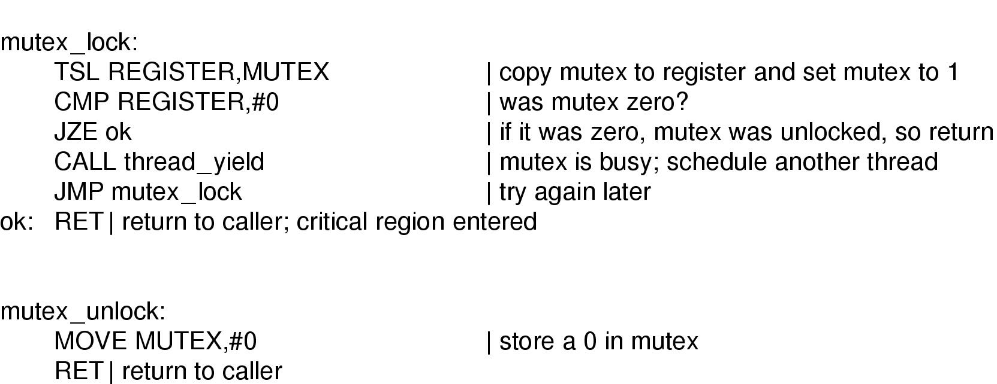
Implementation of Mutex Using TSL
In C-syntax:
void Lock(boolean *lock) {
while (test_and_set(lock) == true);
}

Slide 33
Compare and Set Instruction
Atomic Operation:
If a memory location equals a “given” value, then assign a “new” value to the memory location. Else return the old value of the memory location.
Intel’s instruction: CMPXCHG NEWVAL, MEMORY
NEWVAL: Explicit operand. A register.
MEMORY: Explicit operand. A memory location (or a register).
Plus two implicit operands:
EAX register : contains the “given” value and returns the final value of MEMORY
EFLAGS.ZF bit: Indicates if exchange was successful or not.
IF (%EAX == MEMORY) THEN
EFLAGS.ZF := 1
MEMORY := NEWVAL
ELSE
EFLAGS.ZF := 0
%EAX := MEMORY

Slide 34
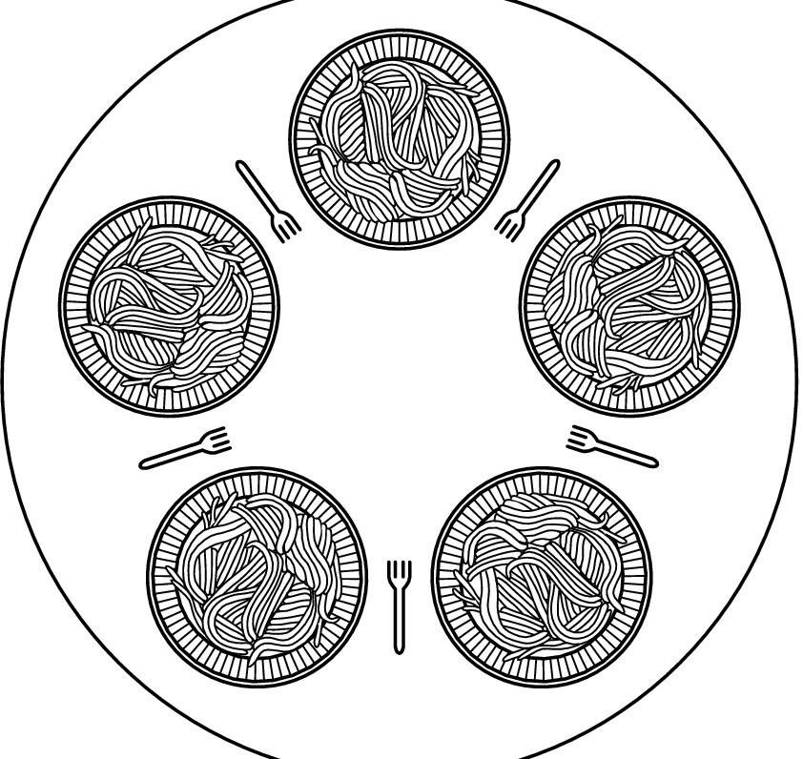
Dining Philosophers (1)
N Philosophers either eat or think
Eating needs 2 forks per philosopher.
But only N forks available
All philosophers get hungry at the same time.
Everyone picks their left fork at the simultaneously
Then everyone tries to pick their right fork, then there’s a deadlock
How to prevent deadlock?
Besides giving them more forks for better hygiene!

Slide 35
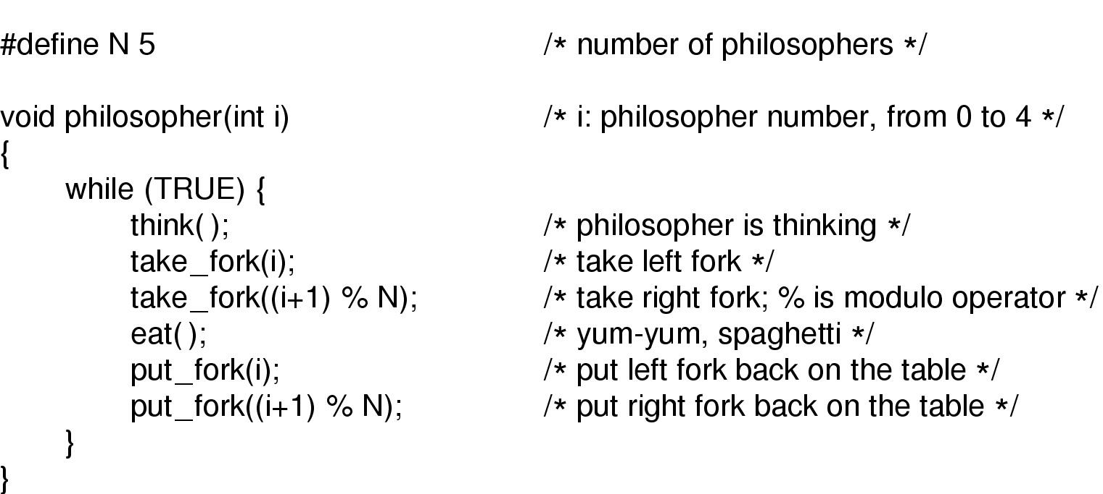
Dining Philosophers (2)
A non-solution to the dining philosophers problem

Slide 36
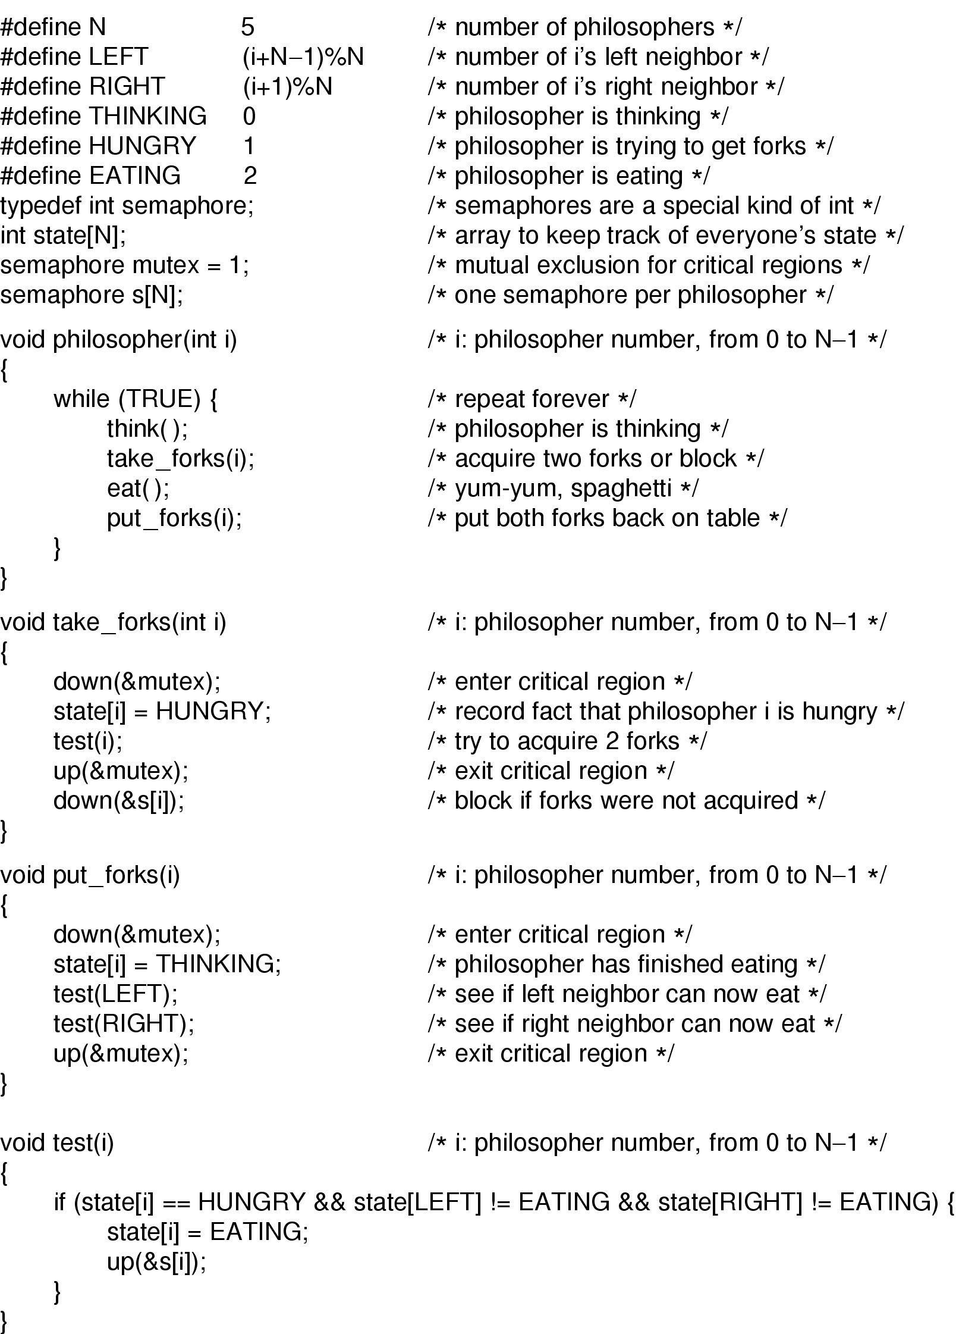
Dining Philosophers (3)
Solution to dining philosophers problem (part 1)

Slide 37
Dining Philosophers (4)
Solution to dining philosophers problem (part 2)

