Slide 1
Input/Output
Operating Systems
Kartik Gopalan
Chapter 5, Modern Operating Systems — Tanenbaum
Chapter 13, OS Concepts — Silberschatz (optional)

Slide 2
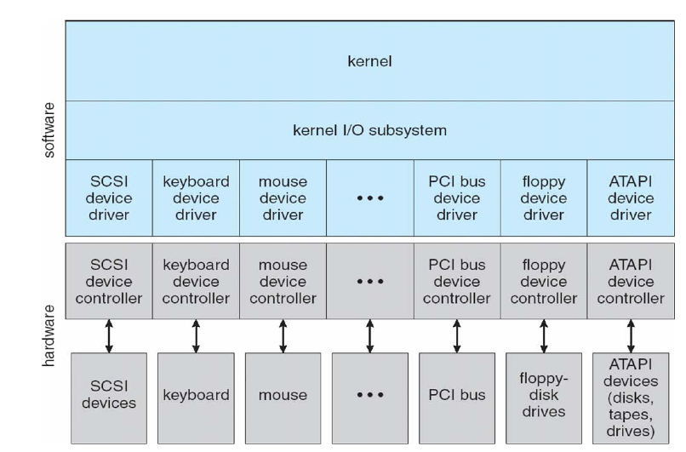
Layering in the I/O subsystem
User Applications

Slide 3
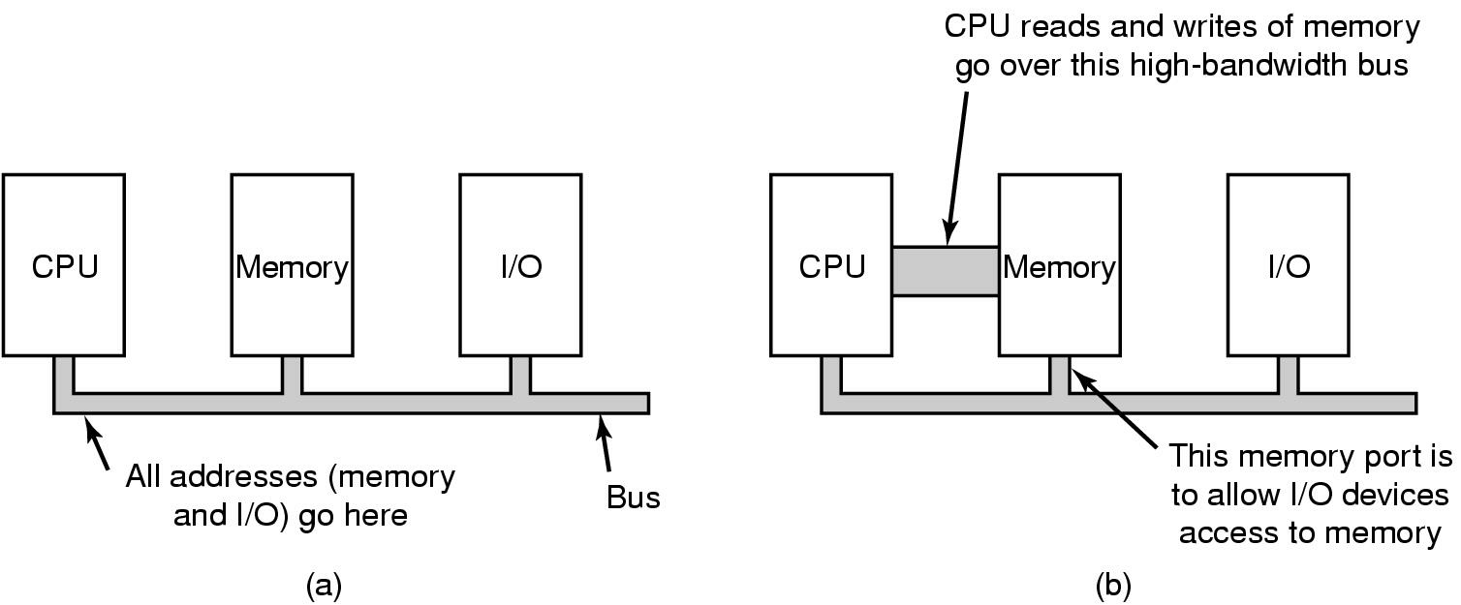
How CPU and I/O devices communicate
A single-bus architecture
A dual-bus memory architecture

Slide 4
Device Controllers
I/O devices may have
mechanical components
electronic components
Device controller is the electronic component
may be able to handle multiple devices
Controller's tasks
Intermediary between I/O devices, CPU, and memory
convert serial bit stream to block of bytes
perform error correction as necessary

Slide 5
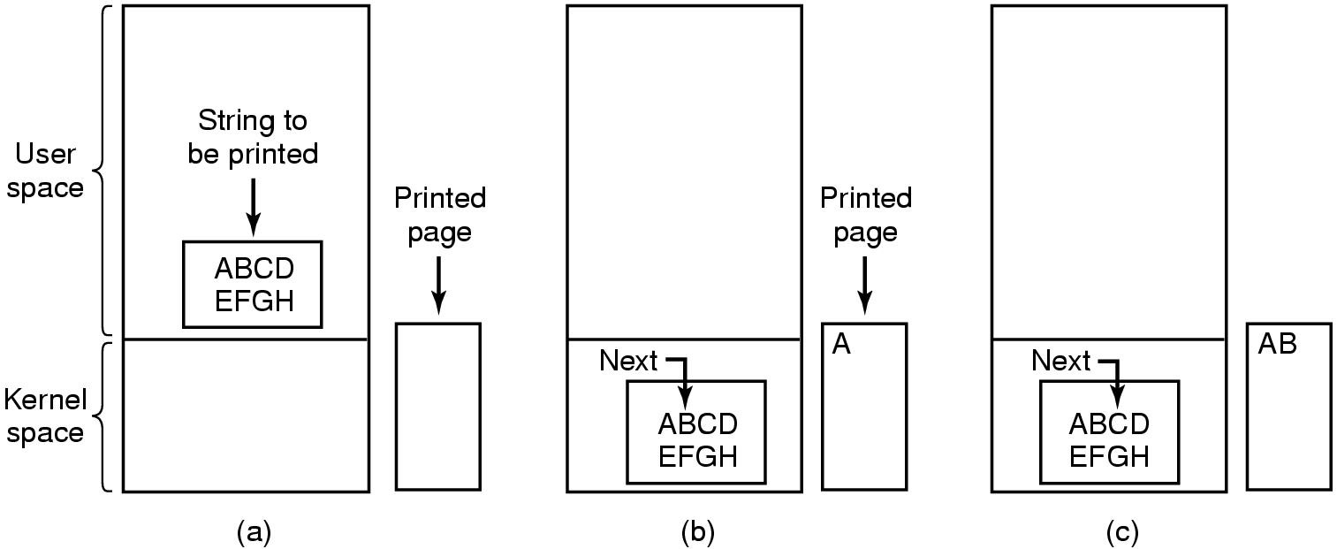
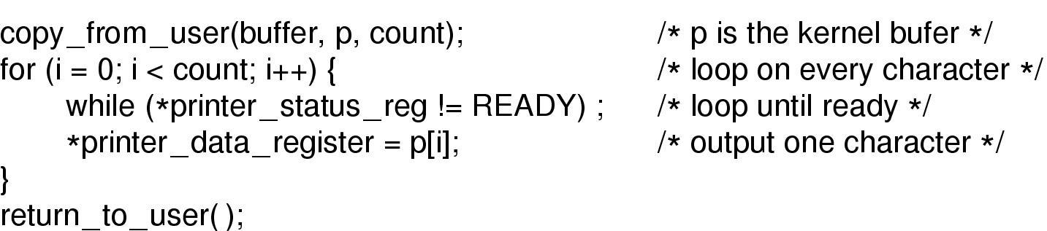
Programmed I/O
Printing a string: CPU transfers one byte at a time to device

Slide 6
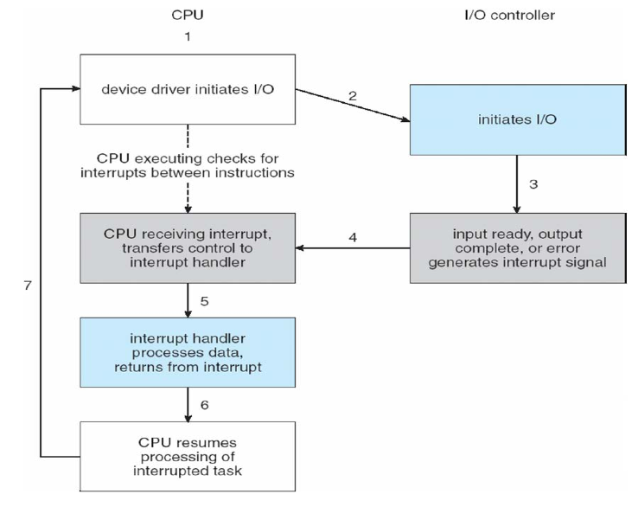
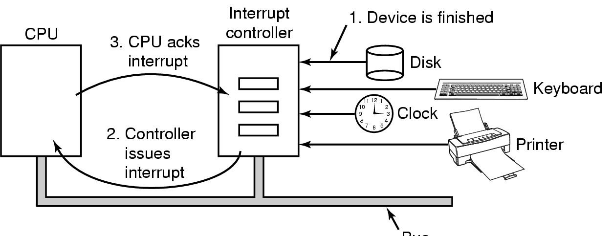
Interrupts
I/O events signaled by device to CPU
Interrupt-request (IRQ) line triggered by controller to CPU
Checked by CPU after each instruction
Interrupt vector table used to invoke the correct interrupt handler

Slide 7
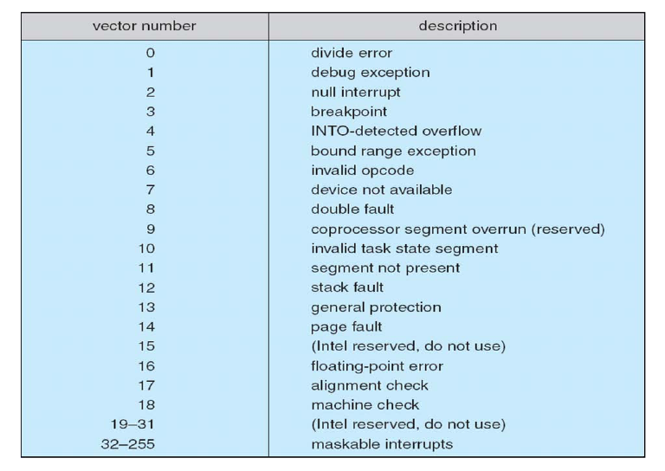
Example: Intel Pentium Interrupt Vector Table

Slide 8
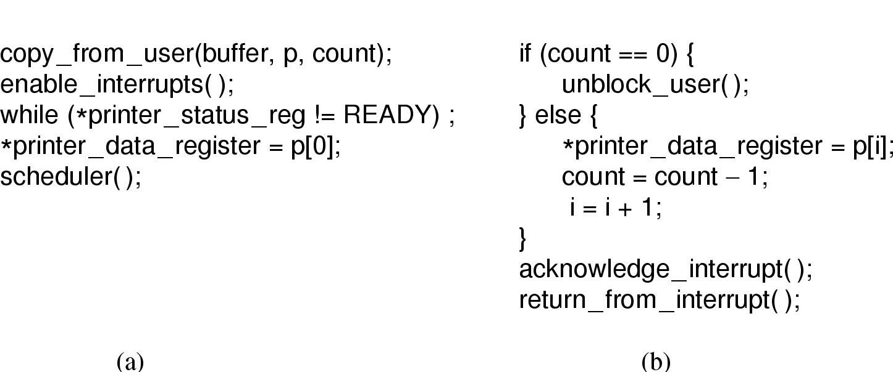
Interrupt-Driven I/O
Writing a string to the printer using interrupt-driven I/O
Code executed when print system call is made
Starts off by printing the first character
(b) Interrupt service procedure
called every time the printer completes printing one character and generates an interrupt

Slide 9
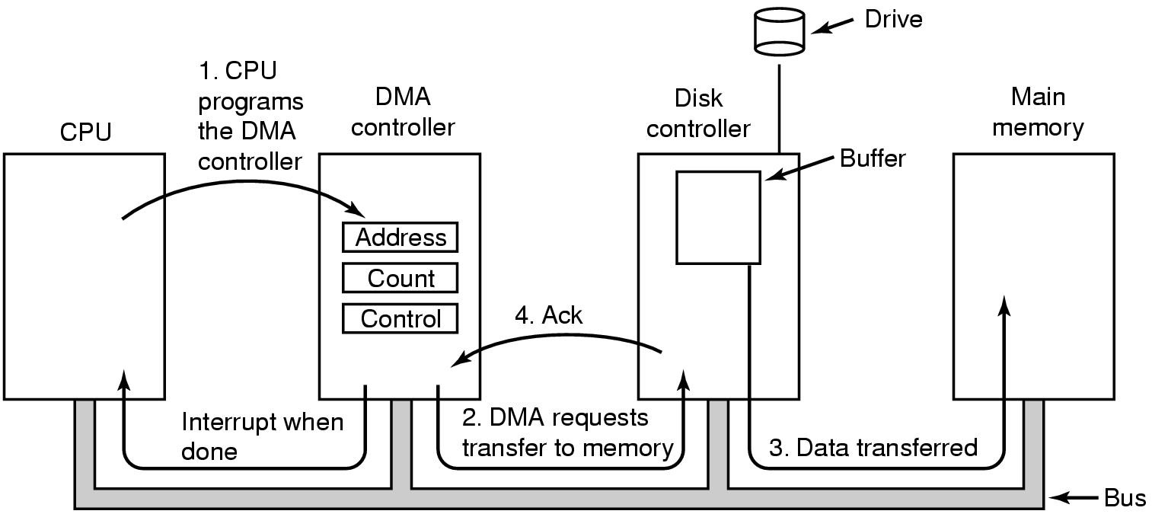
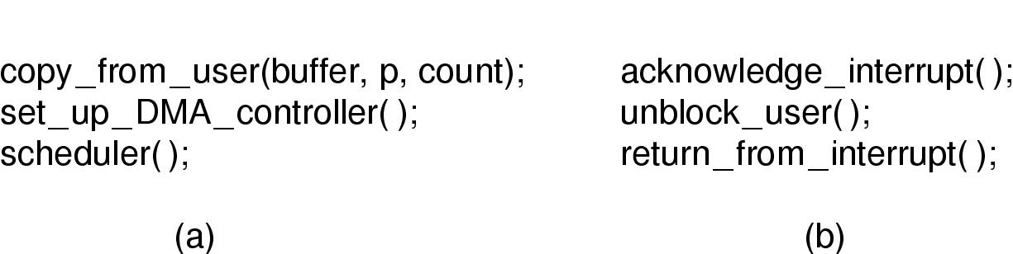
Direct Memory Access (DMA)
DMA allows I/O controllers to directly transfer data to/from the main memory.
Frees up the CPU for other tasks
Code executed by print system call
Interrupt service routine (ISR) called when the entire print job is completed

Slide 10
Device Classification
Character (char) devices
byte-stream abstraction
E.g. keyboard, mouse
block devices
reads/writes in fixed block granularity
E.g. hard disks, CD drives
network devices
message abstraction
send/receive packets of varying sizes
E.g. network interface cards
others
USB, SCSI, Firewire, I2O
Can (mostly) be used to implement one or more of the above three classes

Slide 11
Hard Disks

Slide 12
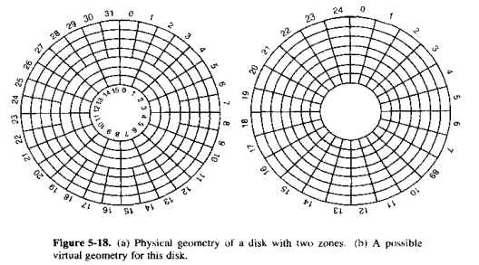
Hard disk organizes data in tracks and sectors
Seeking: Disk head moves across tracks
Rotation: Disk rotates to bring the correct sector under disk head

Slide 13
Factors affecting read/write latency
Seek time
Time to move magnetic head from one track to next.
Average 5 to 10 milliseconds.
Rotational delay
Time to rotate the disk to reach the sector containing the data
Depends on the rotational speed of the disk
E.g. A disk with 15,000 rotations per minute (rpm) will have 1 rotation every 4 milliseconds, or an average of 2 millisecond rotational latency (assuming that average latency is one-half of a rotational period).
Actual transfer time
Time to transfer data from the disk sector to memory
In microseconds
Seek time dominates
For most practical purposes, rotational and transfer times are ignored.

Slide 14
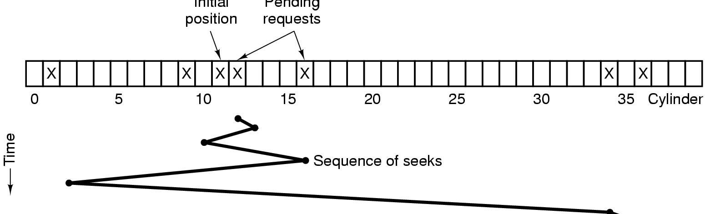
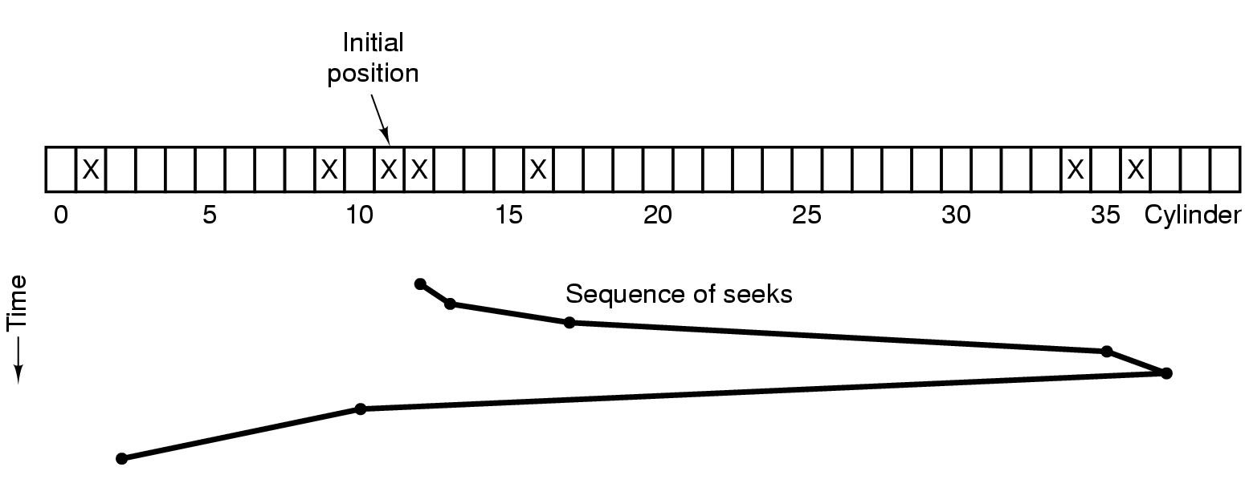
Disk Arm Scheduling Algorithms
Shortest Seek First (SSF) disk scheduling algorithm
High I/O throughput, but some I/O requests may starve
Elevator (SCAN) algorithm for scheduling disk requests
Reasonable I/O throughput and No starvation

Slide 15
Disk I/O Throughput
Seek Latency dominates
Sequential I/O throughput is much higher than random I/O throughput
Sequential access involves fewer seeks
I/O Operations per second (IOPS)
Better measure of disk throughput
Ignores the number of bytes in each I/O operation.
https://en.wikipedia.org/wiki/IOPS

Slide 16
Disk Buffer
Hard disk controllers have a small amount of buffer memory (RAM)
8MB to 128MB
Used to stage data moving between the physical disk and main memory
Hides seek latency in two ways:
Read-ahead
Read extra data near the requested sector and store in disk buffer. Return from disk buffer when OS requests the extra data.
Write Acceleration:
When OS writes data, store data in disk buffer and return completion interrupt. Commit the data to physical disk “later”.
If power fails, data in disk buffer could be lost!
https://en.wikipedia.org/wiki/Disk_buffer

Slide 17
Solid State Drives (SSD)
https://en.wikipedia.org/wiki/Solid-state_drive

Slide 18
SSD
NAND-based flash memory to store persistent data
Plus a controller performs Error Correction, Wear Leveling, Caching, etc.
No mechanical components
Works with various interfaces
SATA, SAS, PCI, USB, Fibre Channel, IDE
Disks in various form factors
Regular, Thumb, embedded
SSDs may also be used as buffer in Hard disks to improve reliability
Or DRAM could be used as buffer to improve SSD access latencies
SSD vs Hard Disks
Lower Access Latencies
Random access ~ 0.1ms
Higher throughput
Reliability
No moving parts
But repeated writes to the same cell makes the cell unreliable.
Wear leveling: write to a different cell each time
Silent operation
Low power consumption
Smaller capacities
More expensive

Slide 19
Network Attached Storage (NAS)
A storage server accessed over a Local Area Network (LAN)
LAN
Clients
NAS

Slide 20
Storage Area Network (SAN)
A dedicated network to access a collection of storage media
High speed network interconnect
Fiber Channel, iSCSI, AoE etc
Virtualized storage
Consolidated block-level access
Application Server
LAN
SAN
Clients
Storage Server

