Slide 1
An introduction to IBM Cloud Private for and by Cluster Administrators — Hans Kristian Moen IBM Cloud Architecture and Solution Engineering

Slide 2
Understanding the “stack”
Application
Understanding the components that comprise the environment is essential to being able to properly and effectively monitor and troubleshoot.
Container
Docker
Pod
Kubernetes
Network
Operating System
Hypervisor (optional)
Hardware

Slide 3
Top Kubernetes Concepts
POD
Controllers
ReplicationController
ReplicaSet
Deployment
Jobs
CronJob
DaemonSet
Configuration
Labels
ConfigMaps / Secrets
Environment Variables
Services (Network)
Volumes (Storage)

Slide 4
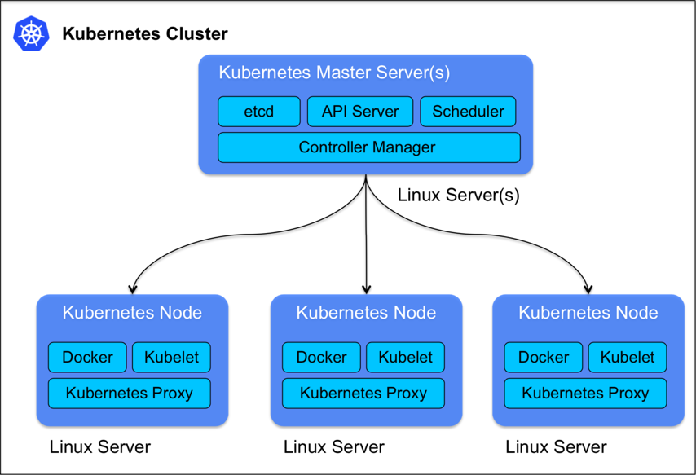
Kubernetes overview

Slide 5
Simple flow when creating a Pod
Source: Haptio

Slide 6
Considerations for docker
Source: Haptio

Slide 7
Docker storage drivers
Overlay2
Overlay
DeviceMapper
DirectLVM
LoopLVM
BTRFS

Slide 8
Troubleshooting Kubernetes My favorite tools and techniques

Slide 9
Command Line Interface (CLI) tools
bx – manage IBM Cloud Private with the use of ICP plugins (e.g. pr)
docker – used for interacting with docker
kubectl – used for running commands against Kubernetes clusters
etcdctl – used for interacting and getting information from etcd cluster
calicoctl – primary tool for viewing, manipulating, and creating Calico objects
systemctl – systemd is an init system used in Linux distributions to bootstrap the user space and to manage system processes after booting
journalctl – is a system utility used for querying and displaying messages from the journal
stern – streaming multiple container logs simultaneously

Slide 10
top – Linux Process Monitoring vmstat – Virtual Memory Statistics lsof – List Open File tcpdump – Network Packet Analyzer netstat – Network Statistics htop – Linux Process Monitoring monitorix – Sys and Ntwk Monitoring
Command Line Interface (CLI) tools to monitor Linux
iotop – Monitor Linux Disk I/O iostat – Input / Output Statistics iptraf – Real Time IP LAN Monitoring psacct – Monitor User Activity monit – Linux Process & Srvc Monitoring
nethogs – Monitor Per Process Network
nmon – Monitor Linux Performance
https://www.tecmint.com/command-line-tools-to-monitor-linux-performance/

