Slide 1
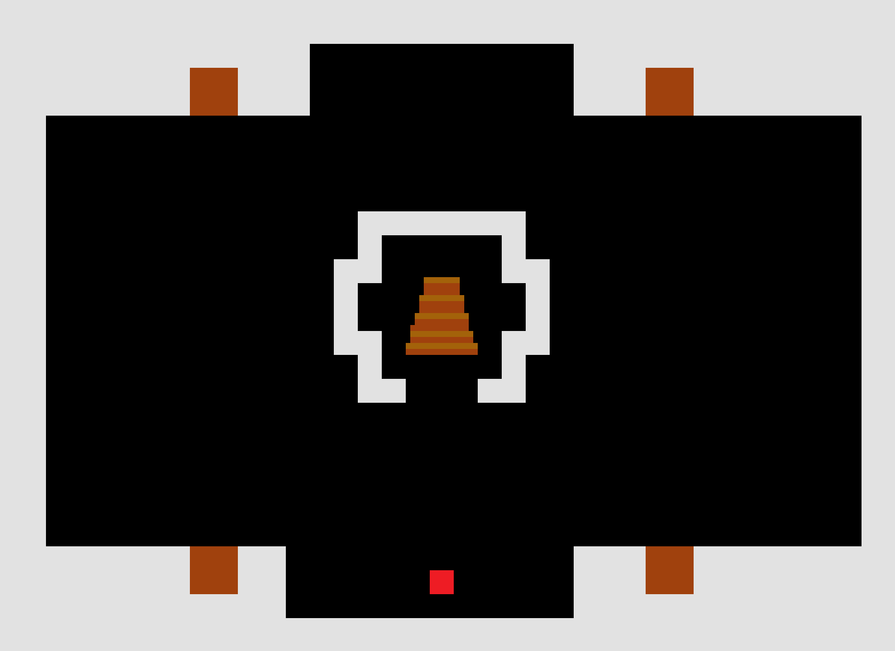
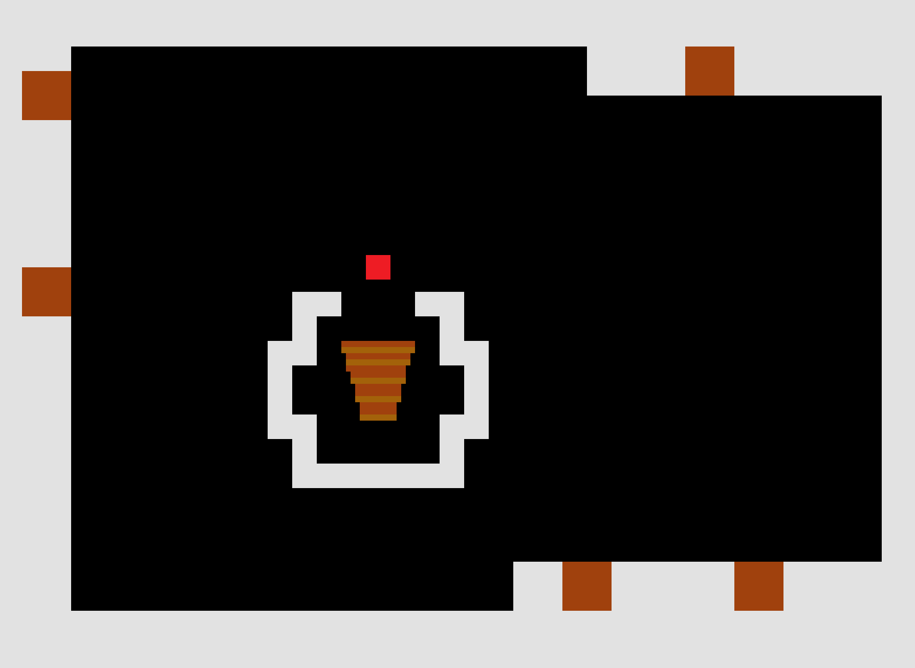
Grade Point Average
Play as an EC327 student, defeating Program, Lab and HW assignments in Photonics
Adam Shaikh, Robert Bona, Tejas Singh, Jeremy Sajda, Karl Naba

Slide 2
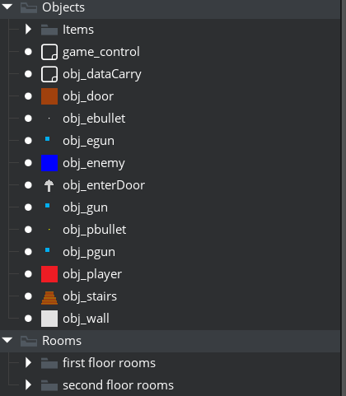
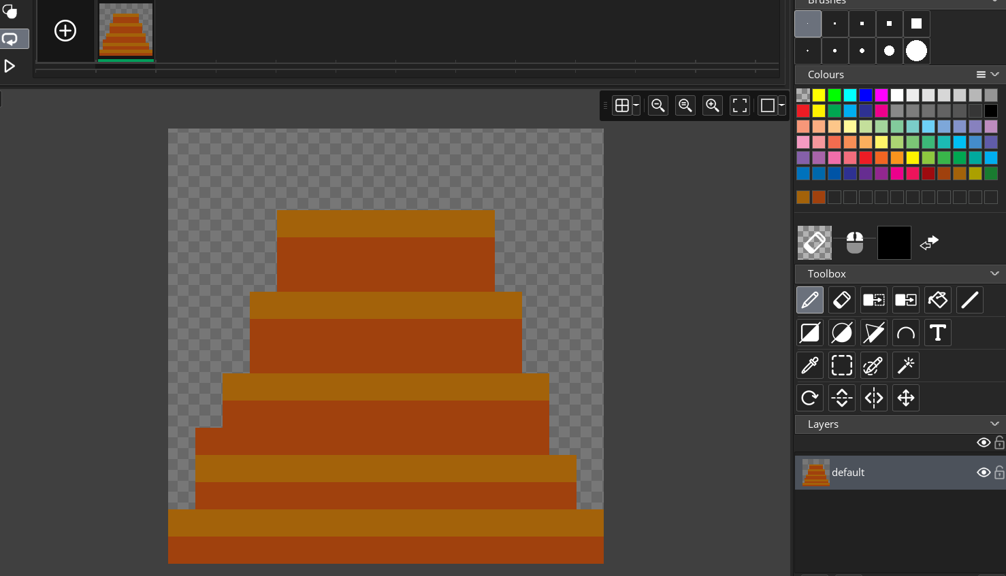
Development
Produced using GameMaker Studios 2
Best option for 2D top-down game development with built-in tools for sprites and in-game object placement
Minimizes boilerplate code typically required of a game built from scratch
Useful GUI, while also capable of being programmed for custom behaviors.
Object and Room file organization simplified by GameMaker
Custom stair sprite in GameMaker sprite editor

Slide 3
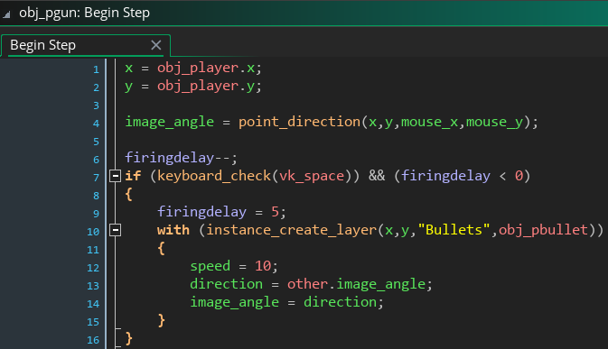
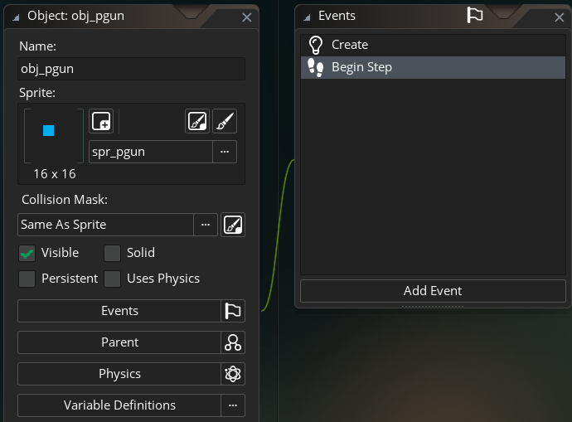
Software Architecture 1
Objects are created using GameMaker’s GUI, then associated with Events (“Create”, “Step”, etc.) that are ran when certain conditions in the game are met.
Gun object code, running for each tick of game time
Gamemaker object GUI, simplifying complex relationships between objects, events, sprites, and other base code.

Slide 4
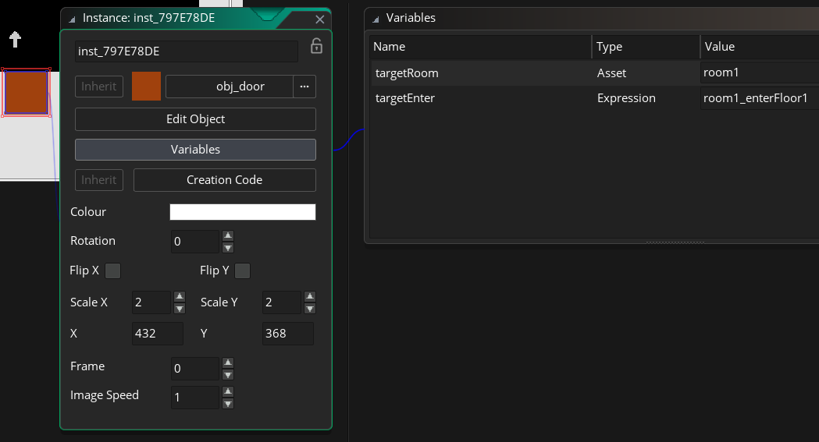
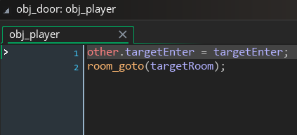
Software Architecture 2
Objects may have variables defined graphically for use within one specific instantiation of the object
These definitions are useful for their interaction with different objects, such as the player.
All door objects have a targetRoom and targetEnter variable. targetRoom transfers the player to the new room, while targetEnter sets their spawn to an invisible arrow object beside the door. The built-in function room_goto(room) facilitates the game’s switch to a new room.

Slide 5
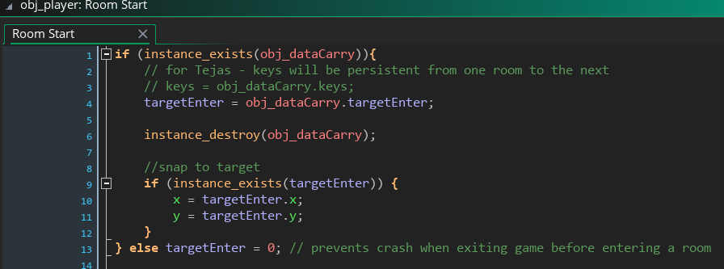
Software Architecture 3
Data is transferred from room to room using an object “obj_dataCarry”
Both the player and the keys are brought to the new room with current variable assignments intact

