Slide 1
Predicting Strength of High-Performance Concrete
Adam Philips
Springboard Data Science Capstone Project

Slide 2
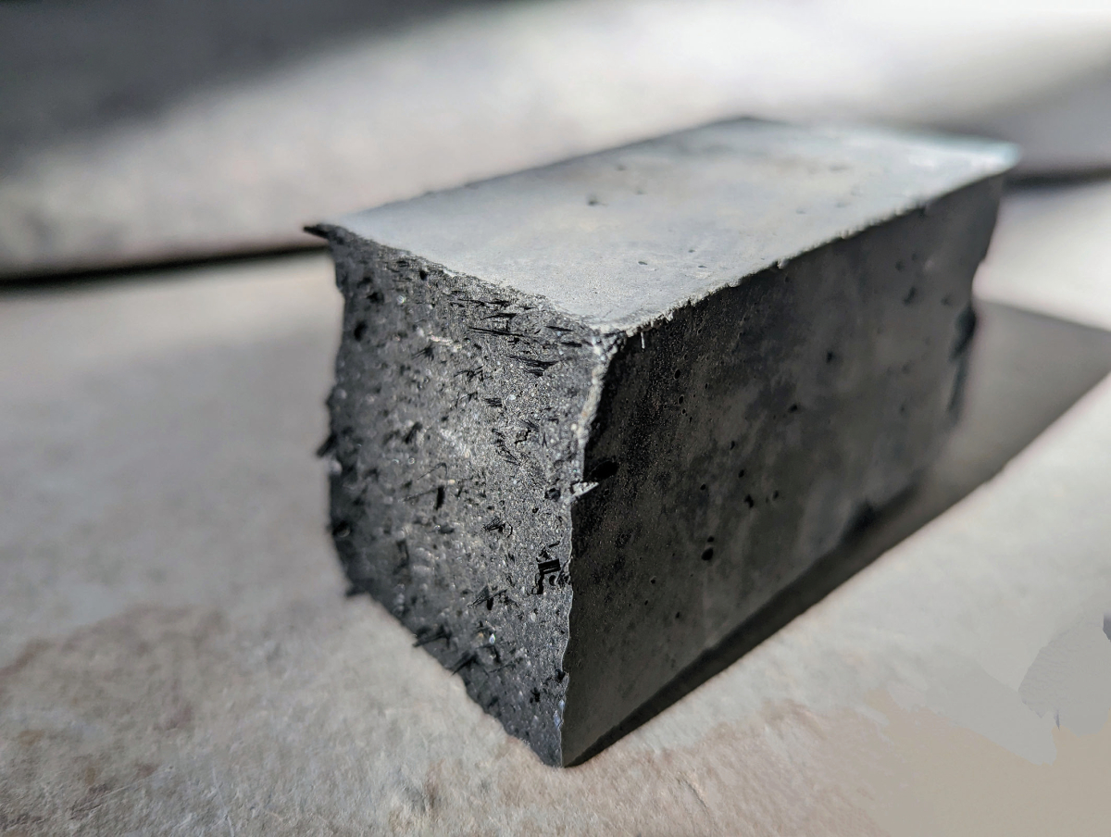
The Problem
High-performance concrete (HPC) is a complex engineered material for construction applications
HPC contains a mixture of conventional concrete materials (water, cement, fine and coarse aggregate) and several supplemental ingredients (blast furnace slag, fly ash, superplasticizer)
Due to its compositional complexity, the properties of HPC are difficult to model
What are the most important factors influencing the strength of HPC?
Can we predict the compressive strength of a concrete sample by its composition and age?

Slide 3

The Data
https://archive.ics.uci.edu/dataset/165/concrete+compressive+strength
1030 entries → 996 after deduplication
8 Features:
Cement, Blast Furnace Slag, Fly Ash, Water, Superplasticizer, Coarse Aggregate, Fine Aggregate (kg/m³)
Age (days)
Target variable: Compressive Strength (MPa)
Supervised learning, regression problem

Slide 4
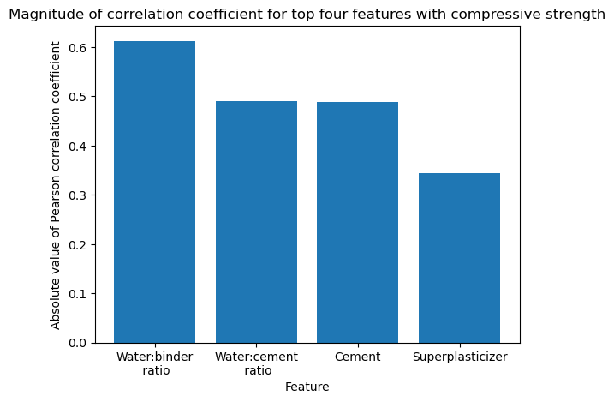
Feature Engineering
Known models suggest the following ratios are potentially important:
Water:Cement
Water:Binder (where binder is the total cement, fly ash, and slag)
Superplasticizer:Binder
Fly ash:Binder
Slag:Binder
Slag+Fly ash:Binder

Slide 5
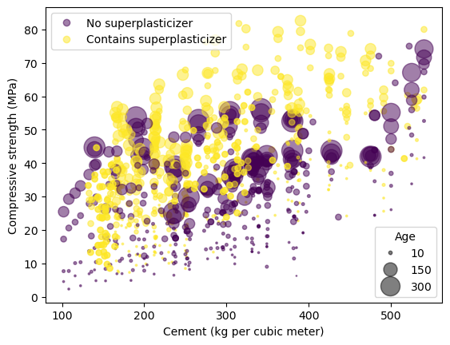
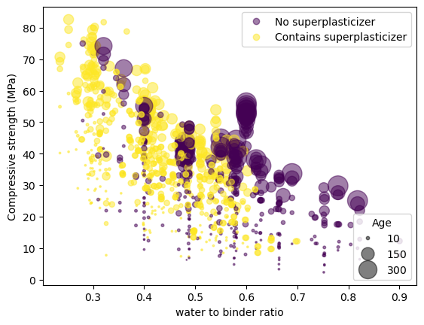
Exploring the Data

Slide 6
Modeling
Preprocessing:
Normalize the data row-wise. I.e. mixture components as fractions of the whole
For ‘Age’ feature, use min-max scaling on the column
Split data into training and testing sets (80/20 split)
The chosen models:
Linear regression
Random Forest
Gradient Boost
Hyperparameter Tuning and evaluation metrics:
5-fold cross-validation
R²
MAE
RMSE

Slide 7
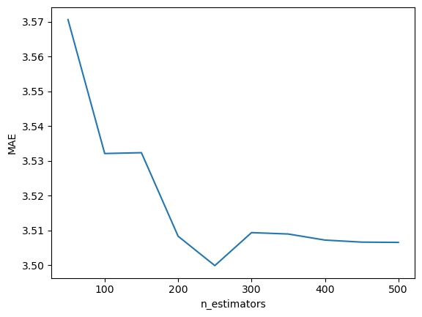
Hyperparameter Tuning
Random Forest:
n_estimators=250
Max_depth=None
min_samples_leaf=1
min_samples_split=2
Gradient Boost:
n_estimators=500
learning_rate=0.2

Slide 8
Comparing the Models
Test set:
Model | R² | MAE | RMSE
Linear Regression | 0.66 | 7.42 | 9.25
Random Forest | 0.92 | 3.32 | 4.52
Gradient Boost | 0.93 | 2.81 | 4.26

Slide 9
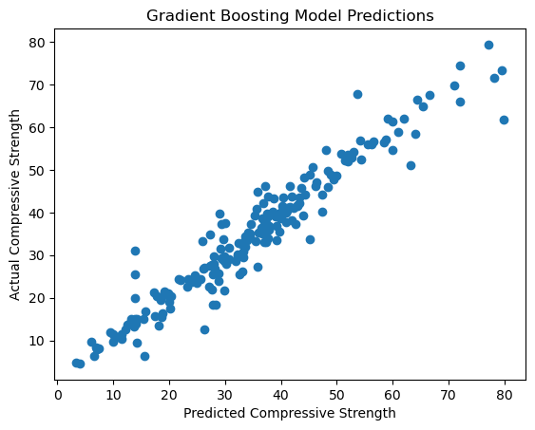
Gradient Boost Predictions

Slide 10
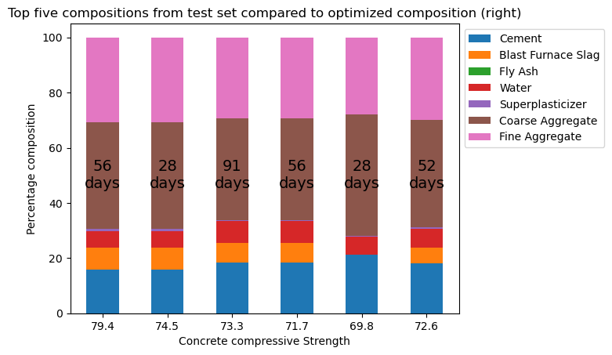
Final Analysis
The optimize module from the scipy library was used to determine a set of feature variables that maximize the target variable (compressive strength) according to the fitted GB model.

Slide 11
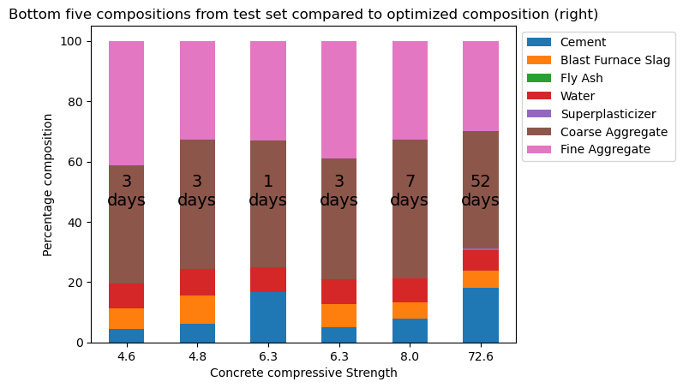
Final Analysis

Slide 12
Conclusions
Of the ML models investigated, Gradient boost performed the best in predicting the compressive strength
Water-cement ratio and age are two of the most important factors in determining compressive strength
A more robust study of concrete effectiveness would require analysis of other properties, i.e tensile strength, durability, thermal resistance.

