Slide 1
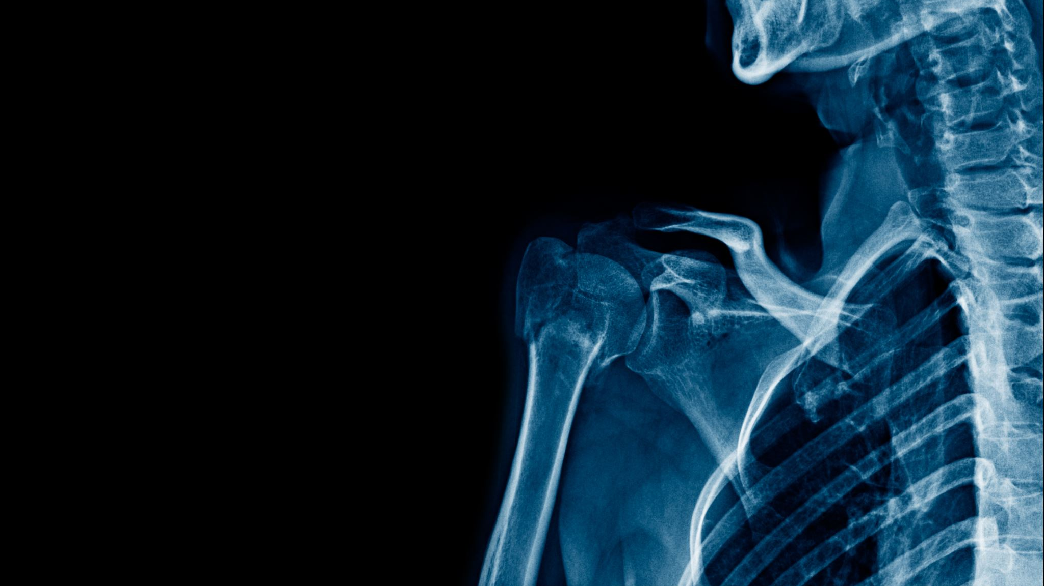
Detecting Pneumonia in Chest X-rays: A Deep Learning Approach for Automated Medical Diagnosis
Adam Philips
Springboard Data Science Capstone Project

Slide 2
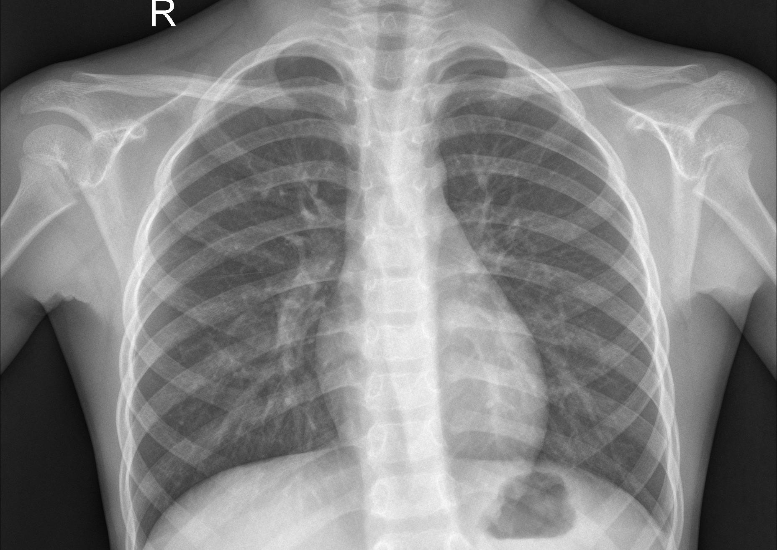
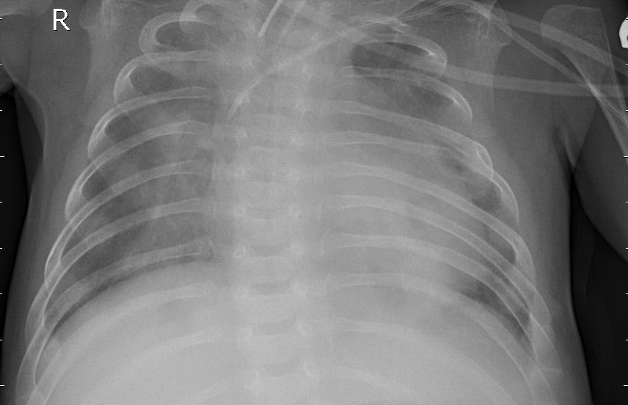
The Problem
Pneumonia is a serious respiratory infection that can be life‑threatening if not diagnosed and treated promptly.
Pneumonia accounts for 14% of all under-5 deaths worldwide
Traditional diagnosis relies heavily on radiologist interpretation of chest X‑ray images.
Automated ML tools can support faster, more consistent diagnosis
Healthy
Pneumonia
Can we develop a deep learning classifier that predicts whether a patient has pneumonia based on their chest X-ray image?

Slide 3
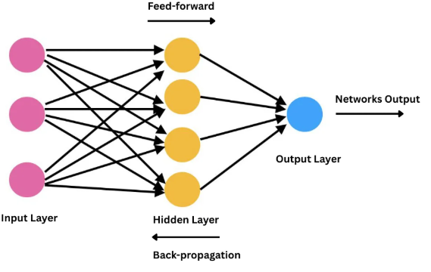
The Problem
Prediction: Normal/Pneumonia
Can we develop a deep learning classifier that predicts whether a patient has pneumonia based on their chest X-ray image?

Slide 4


The Data
https://www.kaggle.com/datasets/paultimothymooney/chest-xray-pneumonia
Over 5000 labeled chest X-ray images
Two classes: Normal and Pneumonia
Pre-split into training and testing sets
Images are in grayscale and vary in size
Class imbalance: More positive cases than negative (74/26 split in training set)
Includes pediatric patients, which may influence model generalization.

Slide 5
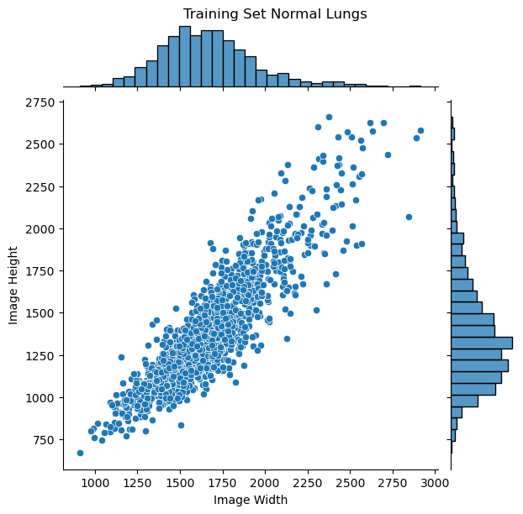
Exploring the Data
Images vary significantly in resolution (height and width).
Will need to resize in preprocessing

Slide 6
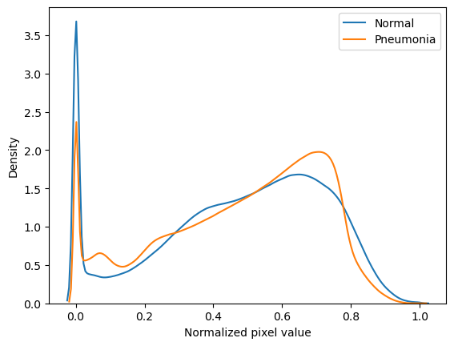
Exploring the Data
Normal X-rays contain more pixels at values close to 0 (black)
Pneumonia X-rays contain more bright pixels

Slide 7
Modeling
Preprocessing:
Resize images to 128x128 pixels and convert to NumPy arrays
Data augmentation: random flip, rotation, zoom, contrast
The chosen models:
Simple, convolution-free neural network (MLP)
Convolutional neural network
Transfer learning model (DenseNet121)
Evaluation metrics:
Recall/Precision/Accuracy
Confusion matrices
Notes:
MLP = Multi-layer perceptron
Emphasis on Recall because we need to minimize false negatives

Slide 8
Comparing the Models
Test set:
Model | Recall | Precision | Accuracy
MLP | 96% | 74% | 76%
CNN | 96% | 85% | 87%
DenseNet121 | 99% | 83% | 87%

Slide 9
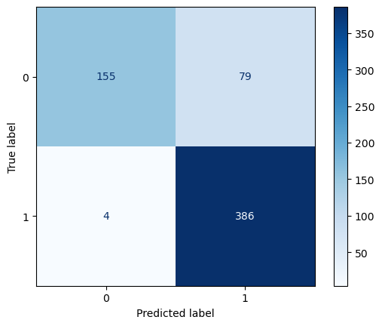
Densenet121 Predictions
Notes:
4 out of 624 predictions were false negatives

Slide 10
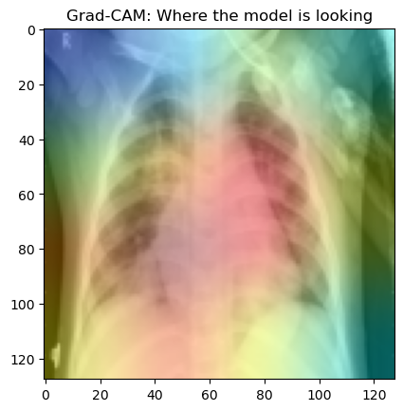
Where is the model looking?
Model focuses on regions consistent with radiological signs of pneumonia
Some attention outside the lungs suggests potential for spurious correlations

Slide 11
Conclusions
DenseNet121 achieved the highest recall, minimizing false negatives — the most important clinical priority.
Data augmentation and preprocessing were essential for generalization.
Interpretability analysis shows the model attends to meaningful lung regions.
Dataset limitations (pediatric, single institution, class imbalance) restrict generalizability.
Future work: external validation, lung segmentation, and expanded datasets.

