Slide 1
Coffee Sales Dashboard (Mar 2024-Mar 2025) User Interaction Guide – Created with Power BI
Last data refresh:
‎‎09 ‎August ‎2025, ‏‎14:44:13
Downloaded at:
Kaggle - ‎05 ‎August ‎2025, ‏‎14:57:09

Slide 2
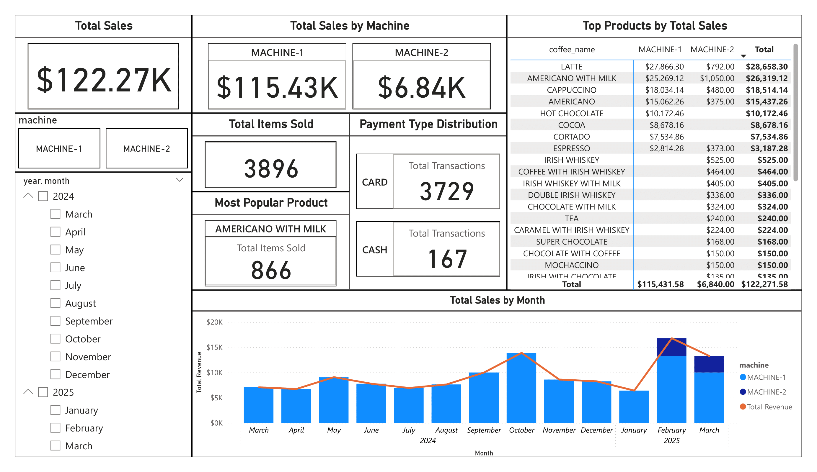

Slide 3

You can filter to view data from a specific machine

Slide 4
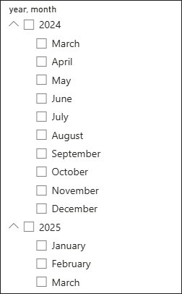
You can filter for each month, or hold CTRL for multiple months

Slide 5
This matrix displays the highest-selling products ranked by their total sales amount.
Scroll down to view the full list of products.
Selecting a product will filter and interact with other visualizations on the dashboard.

Slide 6
