Slide 1
Netflix Shows Dashboard (2008-2021) User Interaction Guide – Created with Power BI
Last data refresh:
29/07/2025 21:51:58 WIB
Downloaded at:
Kaggle - 28/07/‎2025 ‏‎23:31:51 WIB

Slide 2
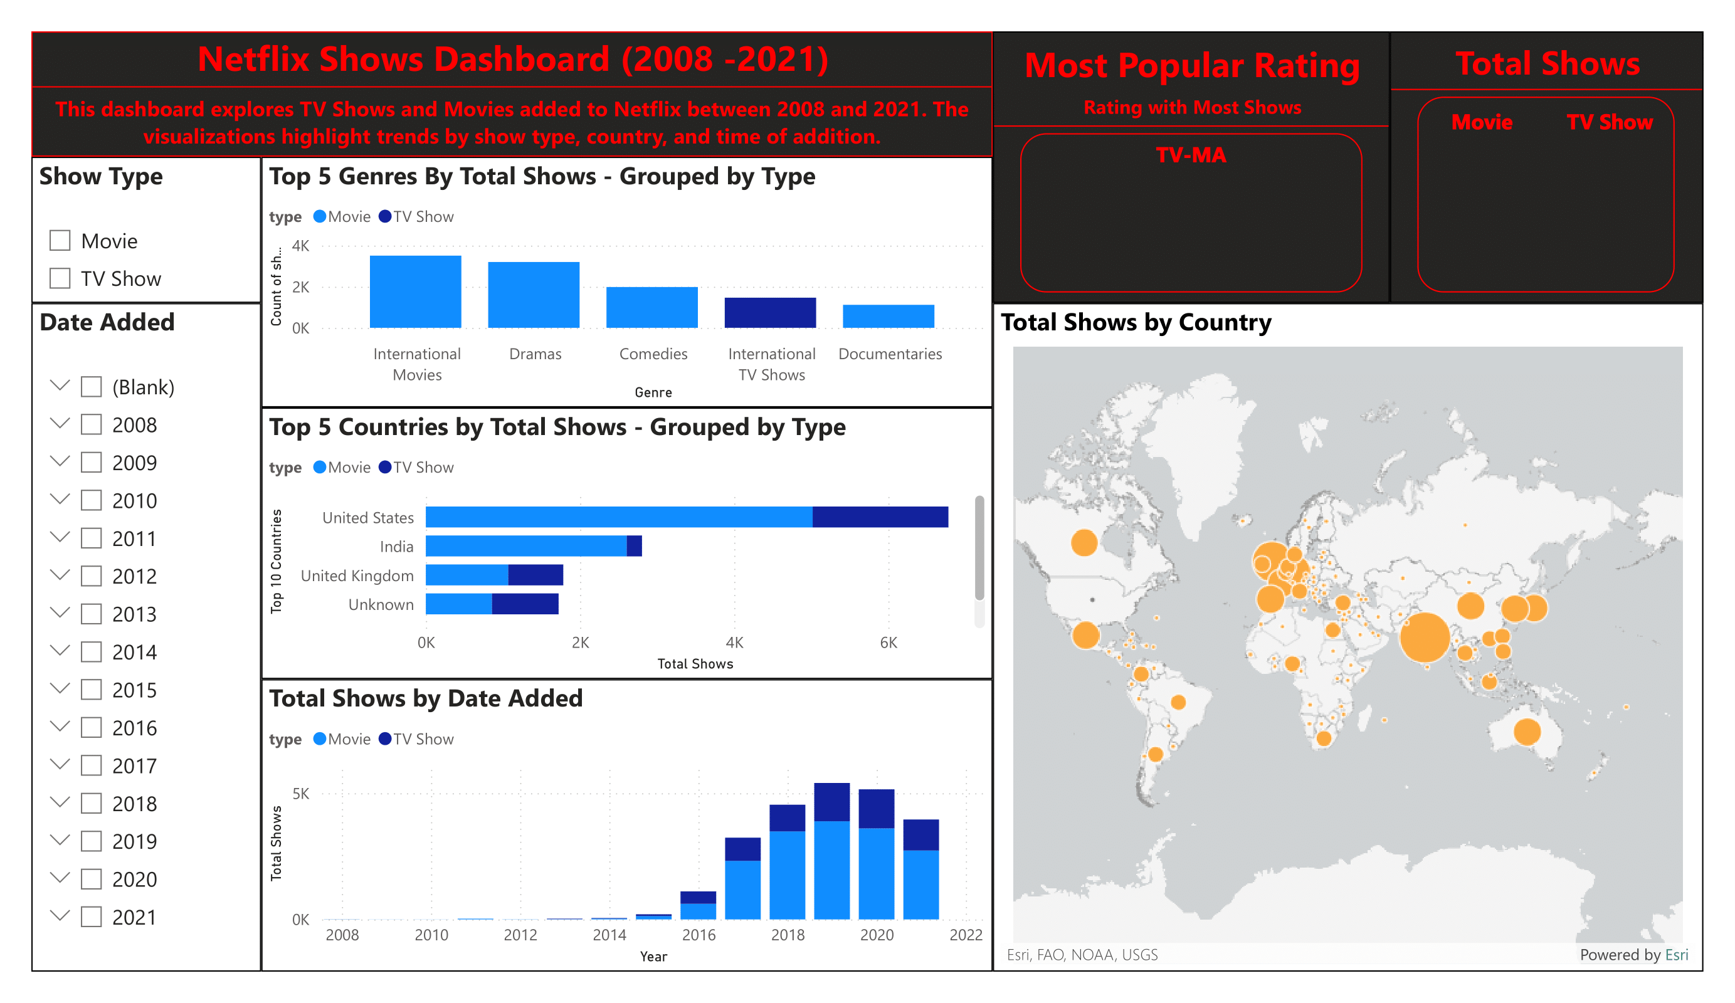

Slide 3

You can filter for each Type of Show

Slide 4
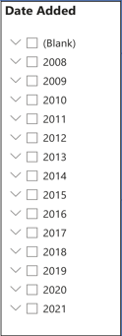
You can filter for each month, or hold CTRL for multiple months

Slide 5
You can hover over the bubbles to see the total number of shows for each country. Click on a bubble to filter the data and view the date added for shows from that country.

Slide 6
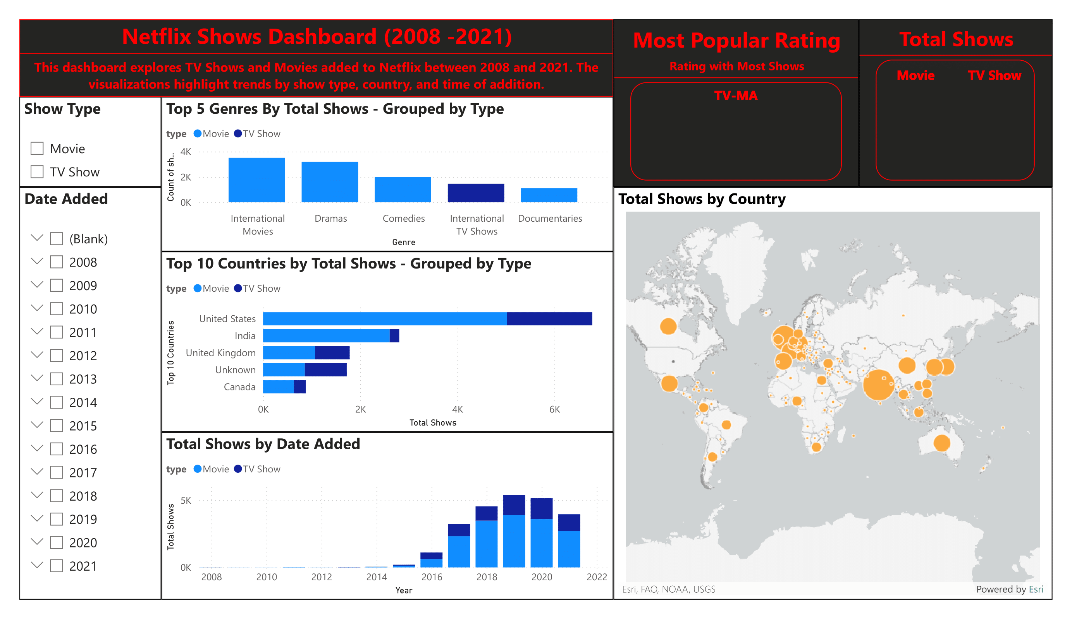
You can hover over the bubbles to see the total number of shows for each country. Click on a bubble to filter the data and view the date added for shows from that country.

Slide 7
