Slide 1
Injuries in czech republic 2022
Adam Řeřicha
2024/25

Slide 2
Where are the data from?
Injuries dataset
NZIP – National health information portal
Ministry of Health of the Czech Republic - Professional guarantor
Population dataset
ČSÚ - Czech statistical office

Slide 3
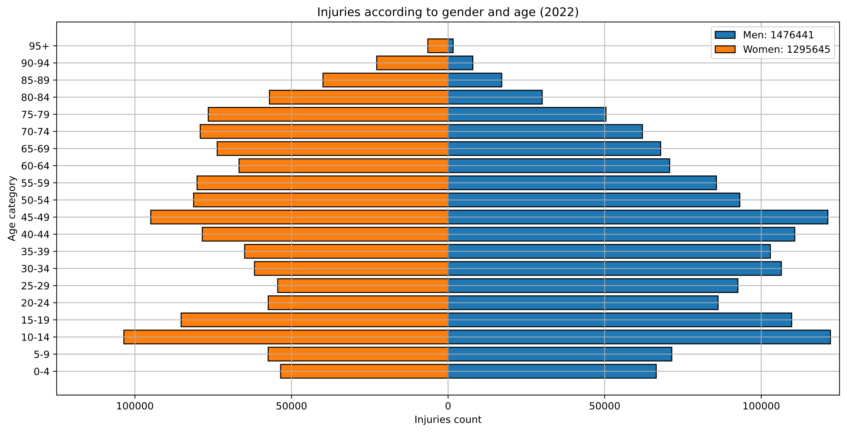
Notes:
More men injuries from the age 0 to 59.
More women injuries from the age 60 to 95+. (Men are probably dead)
Biggest spikes: 10-14, 45-49
Overall more men injuries.

Slide 4
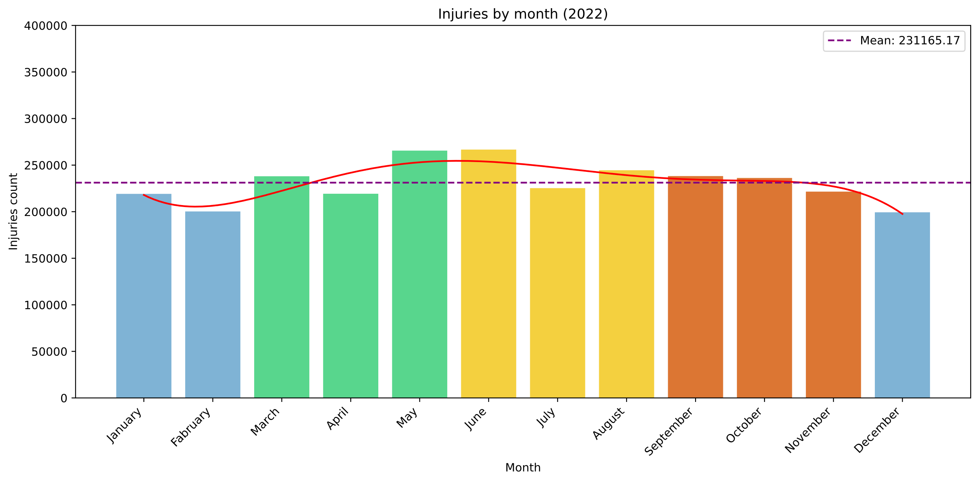
Notes:
Most injuries in May and June. The end of Spring and the beginning of Summer.
Surprising, I would assume that it would be in th emiddle of summer, because of summer vacation.
Least injuries in December.
Probably most of the people stay home because of the cold weather.
Surprising, someone could assume that people would slide on ice and injure them selves.

Slide 5
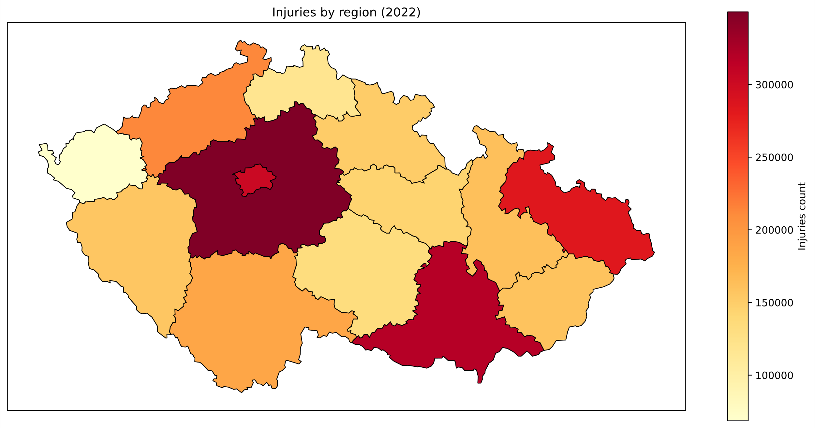
Notes:
Most injuries in regions with the biggest cities: Praha, Středočeský kraj, Jihomoravský kraj, Moravskoslezský kraj
Not that surprising, more people -> more injuries

Slide 6
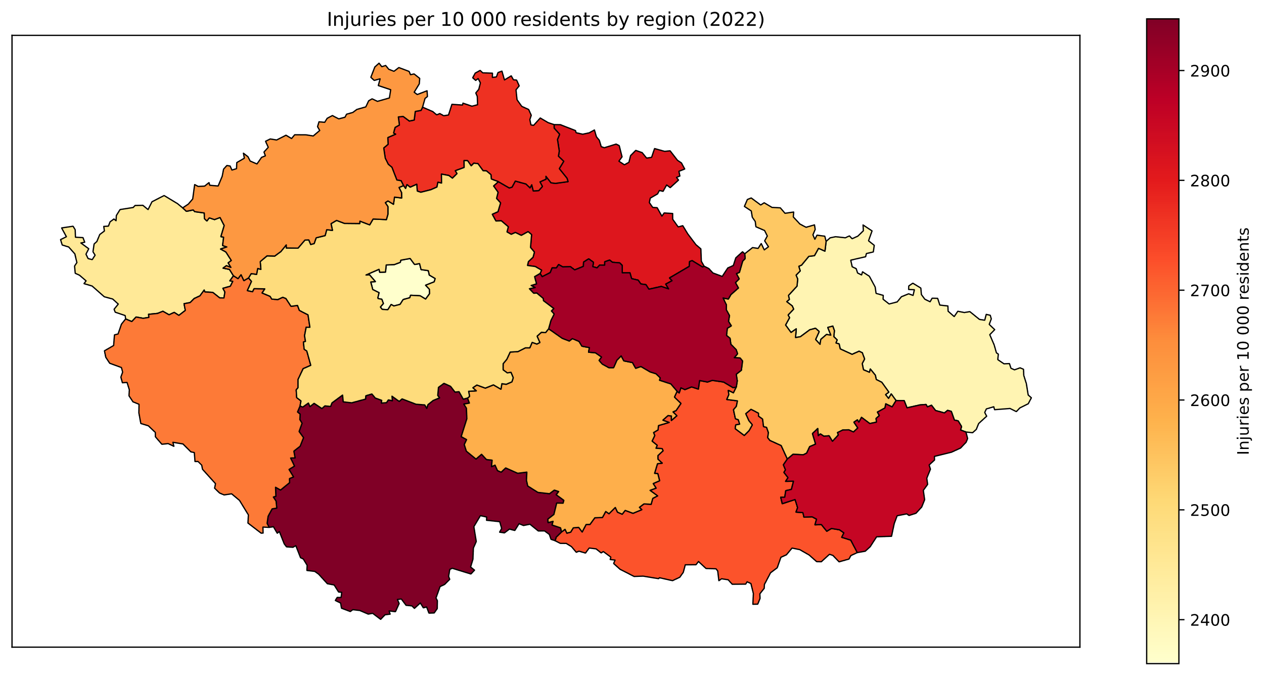
Notes:
Highest accident rate in regions: Jihočeský kraj, Pardubický kraj, Zlínký kraj
Lowest accident rates in regions: Praha, Moravskoslezský kraj, Plzeňský kraj

Slide 7
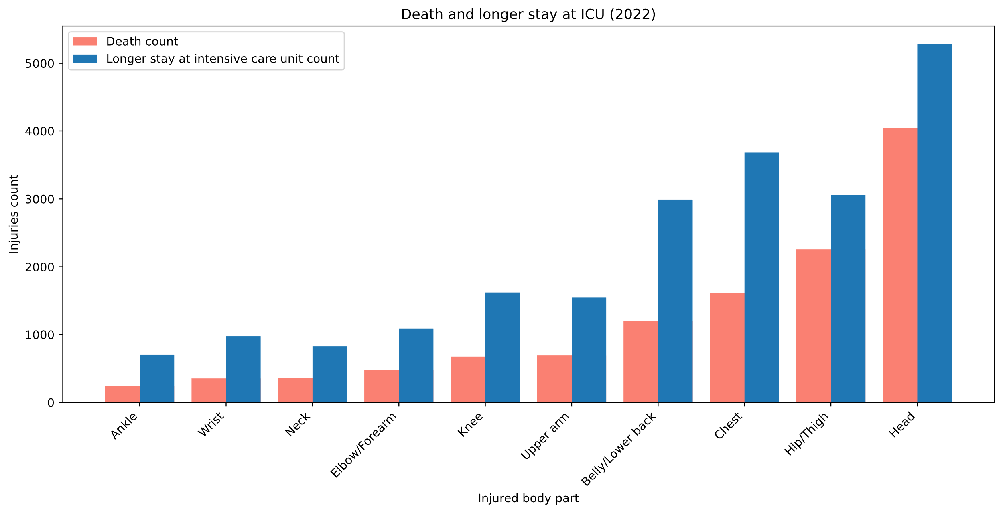
Notes:
Most deaths and longer stays at ICU caused by head injuries.
Second most deaths caused by Hip/Thigh injuries.

Slide 8
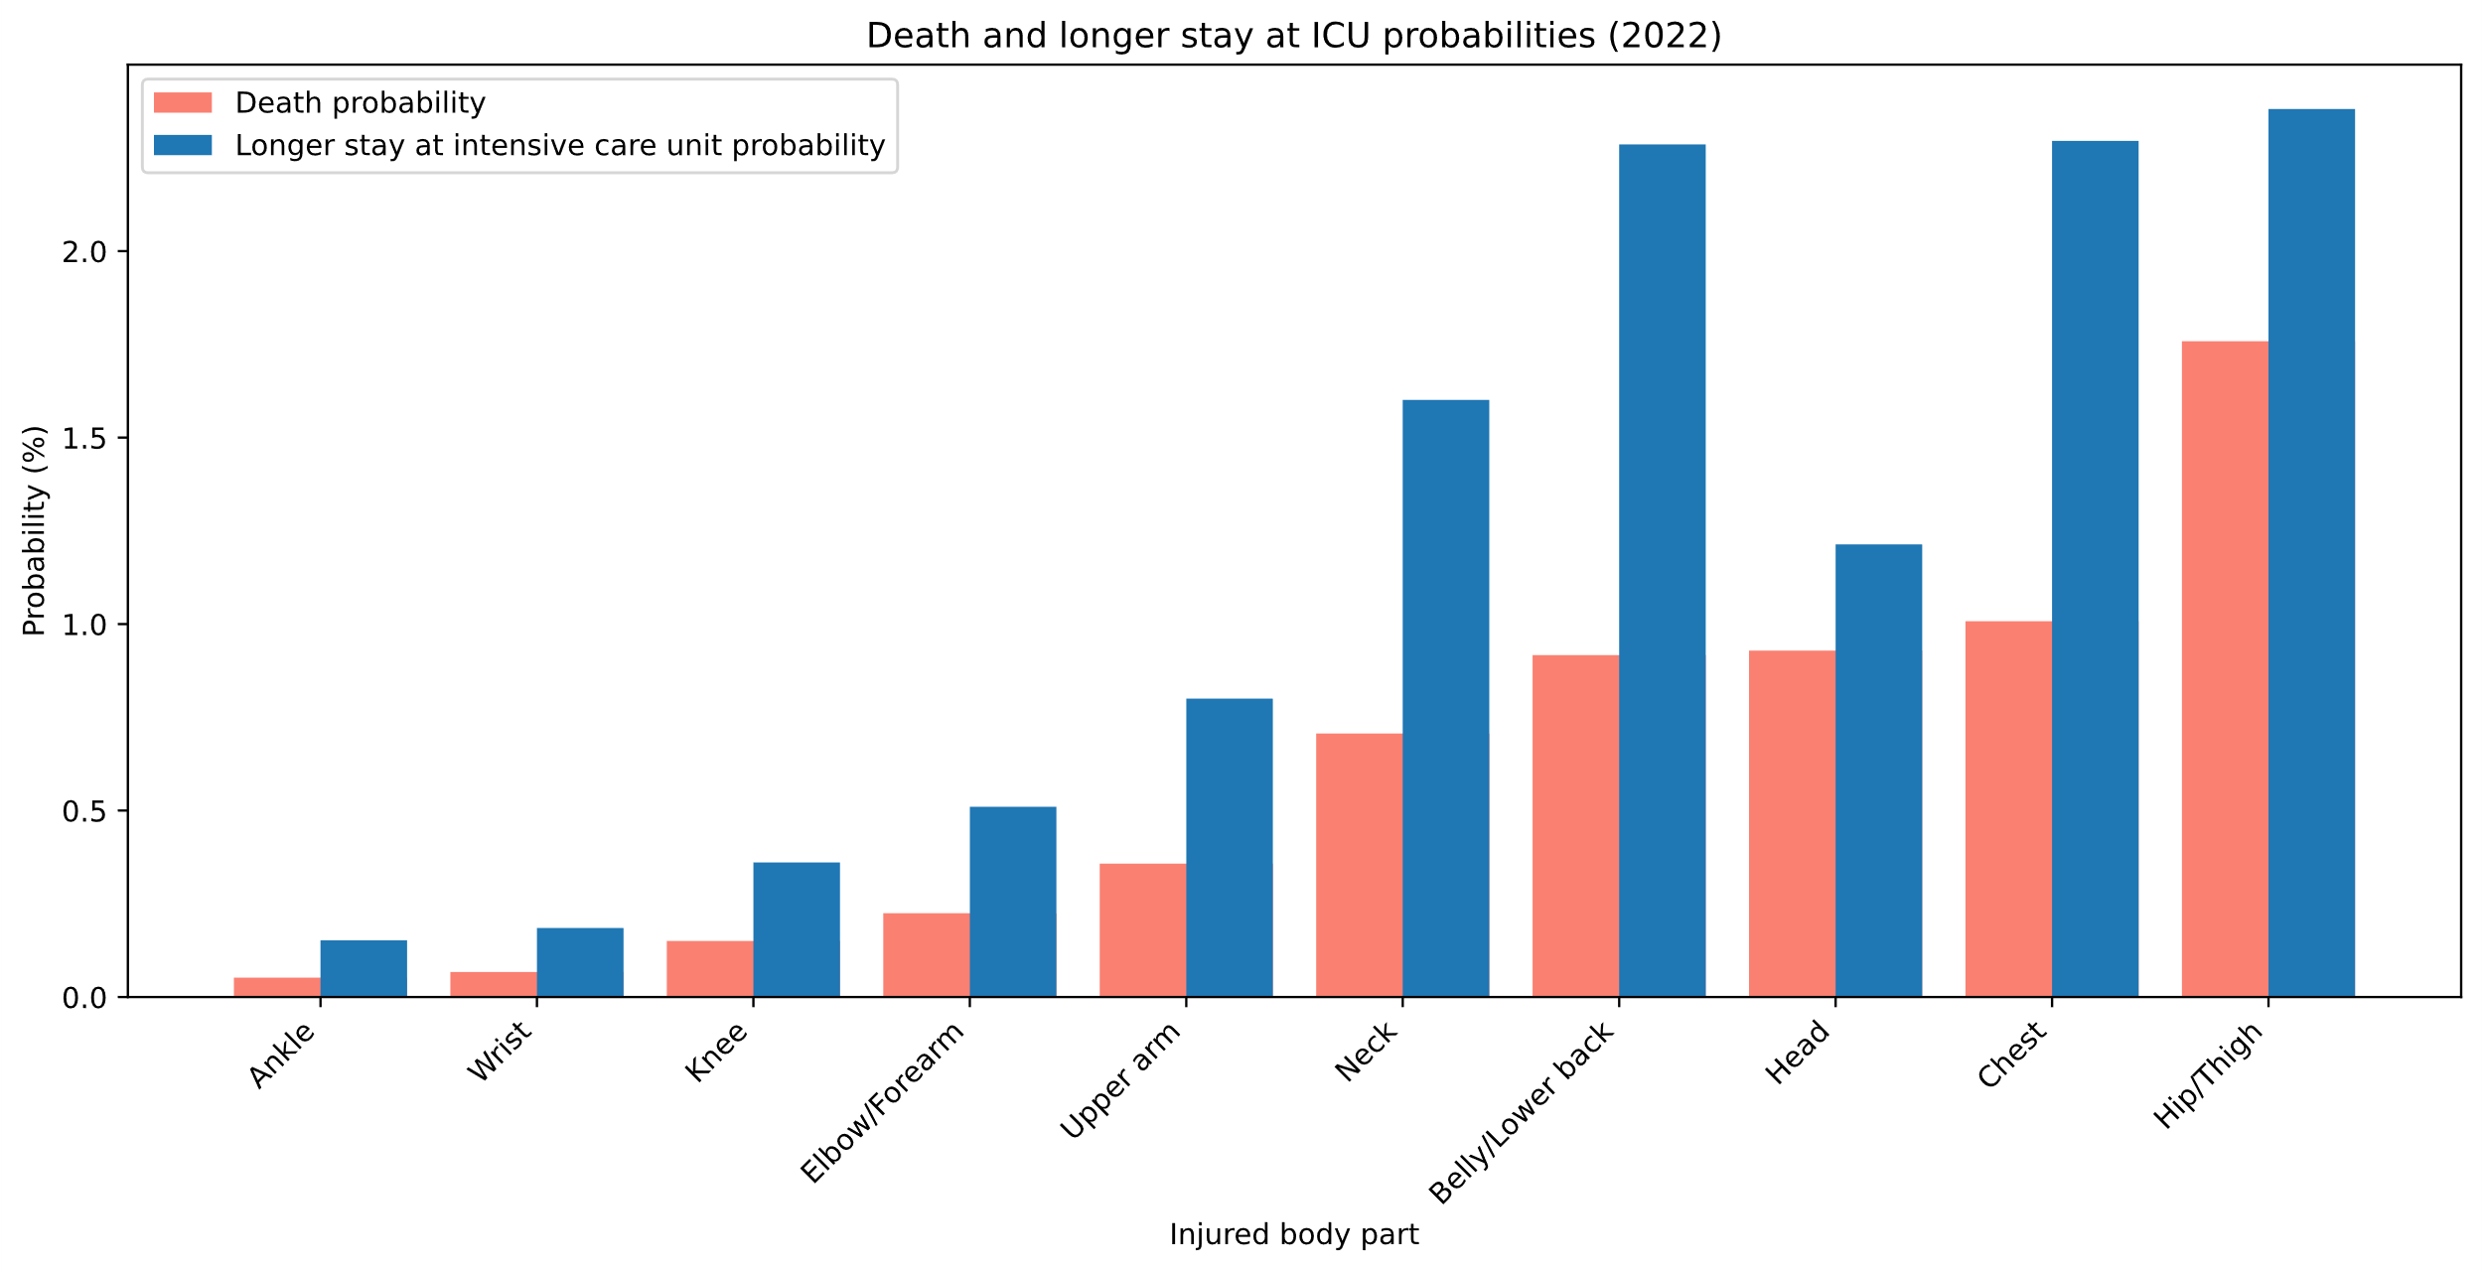
Notes:
The percent of deaths and longer ICU stays is the highest for the Hip/Thigh injuries
The death count was highest for head injuries but the percent of deaths is much lower.

Slide 9
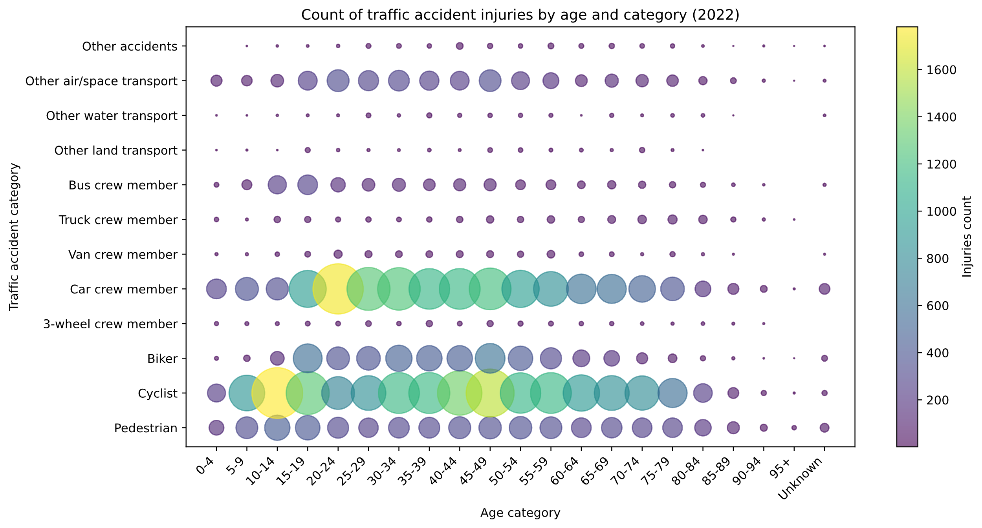
Notes:
Most injured in traffic accidents were cyclists.
Most injuries in cars are from 20-24 . (brand new driver‘s license)
Injuries of young people mostly as cyclists or pedestrians. (they can‘t drive).

Slide 10
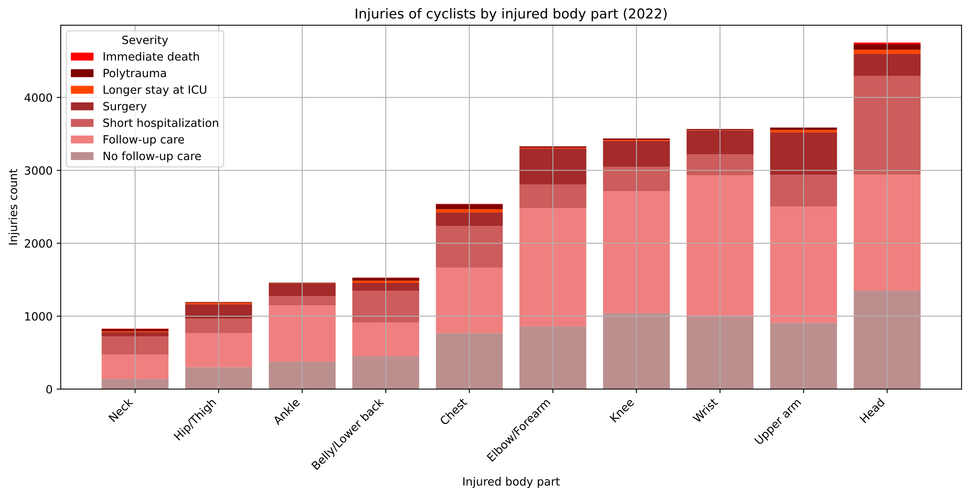
Notes:
Head injuries are the most serious and most frequent on a bike.
Chest injuries lead to longer stay at intensive care unit.

Slide 11
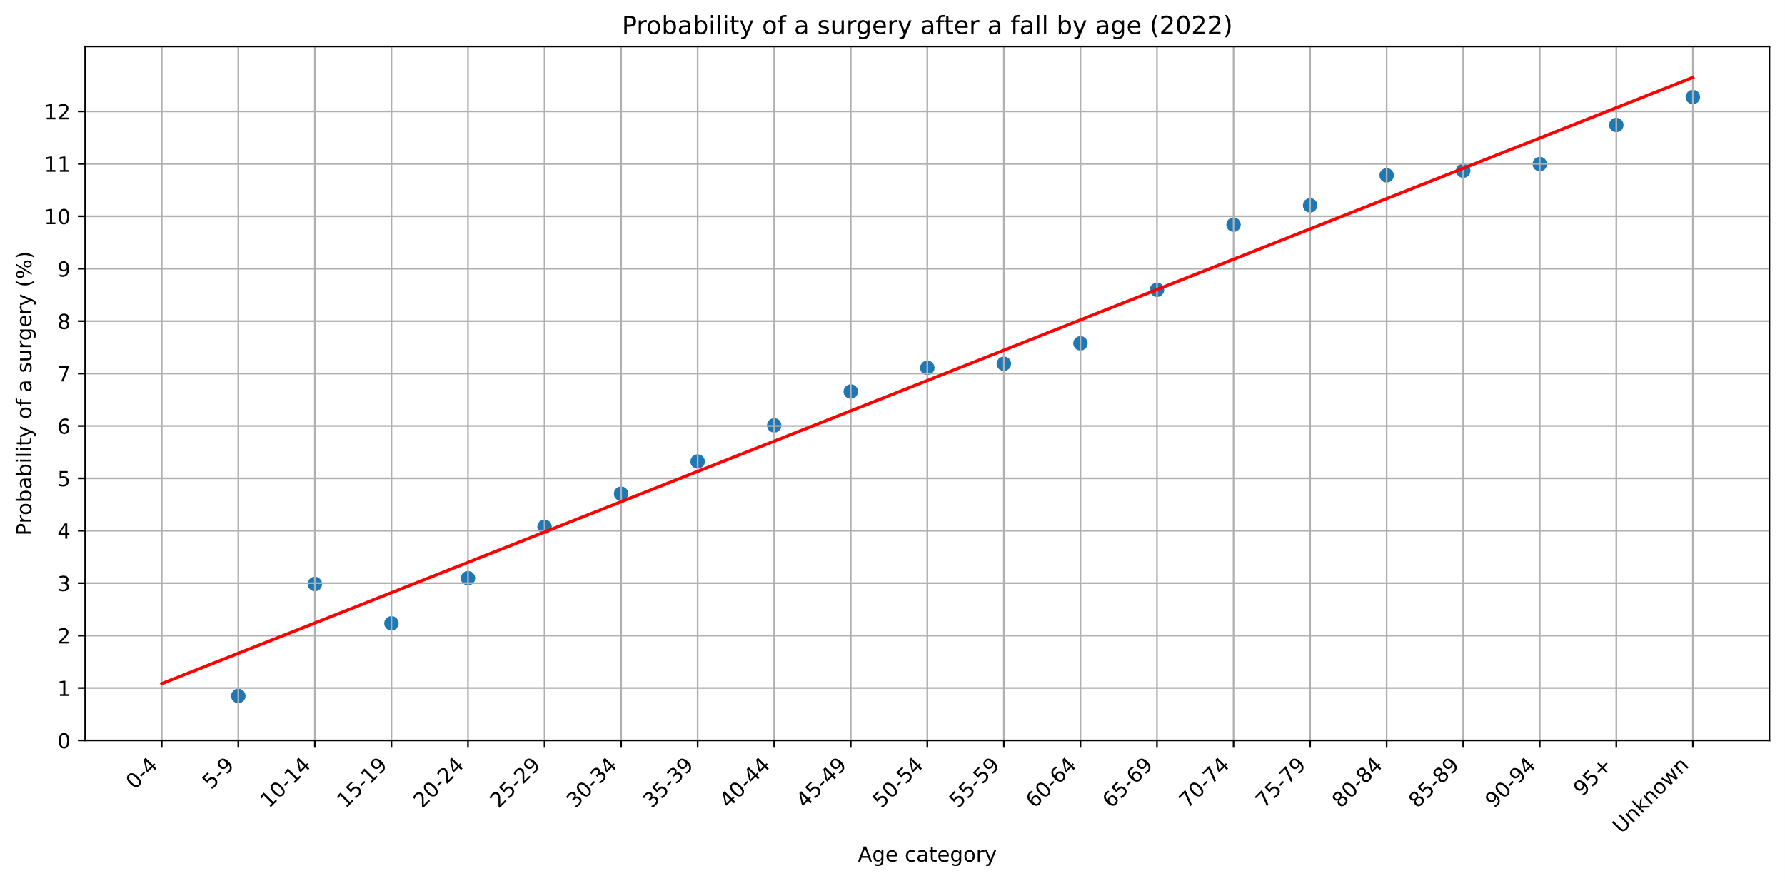
Notes:
The older we are, the higher the probability of surgery after a fall.
Almost linear growth with age.

Slide 12
Summary
Watch out for kids
Be careful in May and June
Be careful in Jihočeský kraj
Don‘t fall when you are old
Wear a helmet on a bike
Notes:
Takeaways

