Slide 1


Realm of the Mad Adam ECS
By Adam Riley

Slide 2

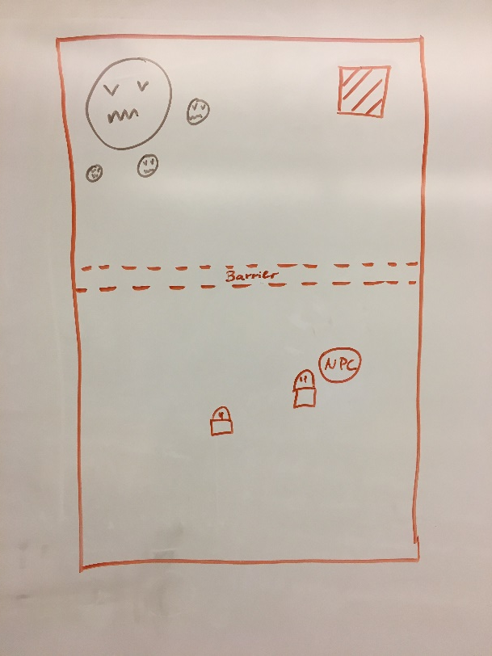
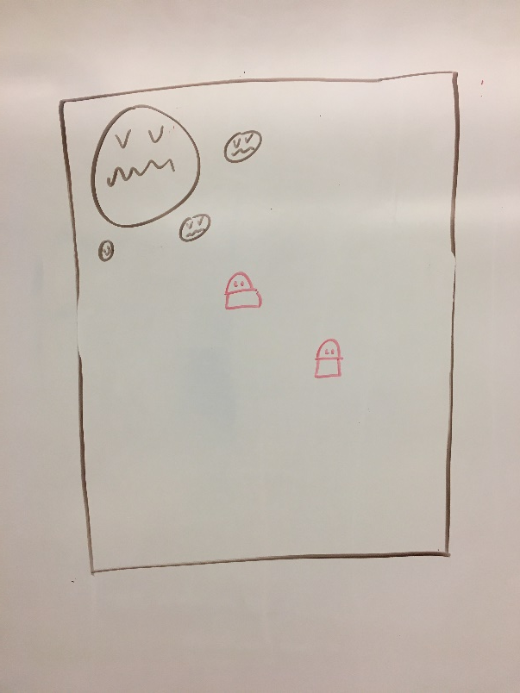
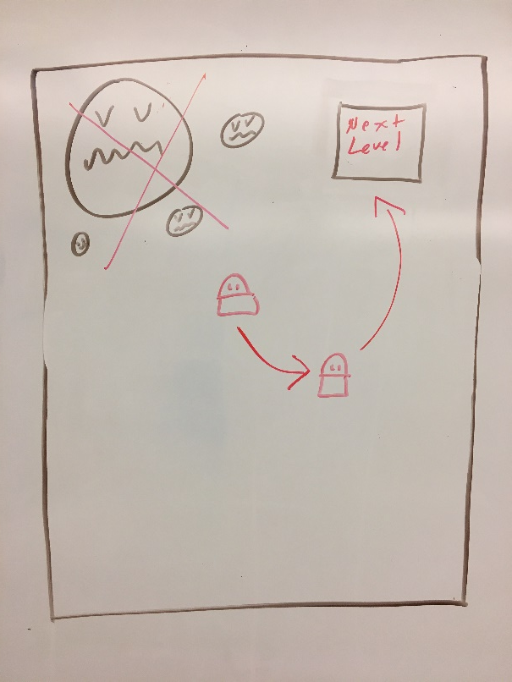
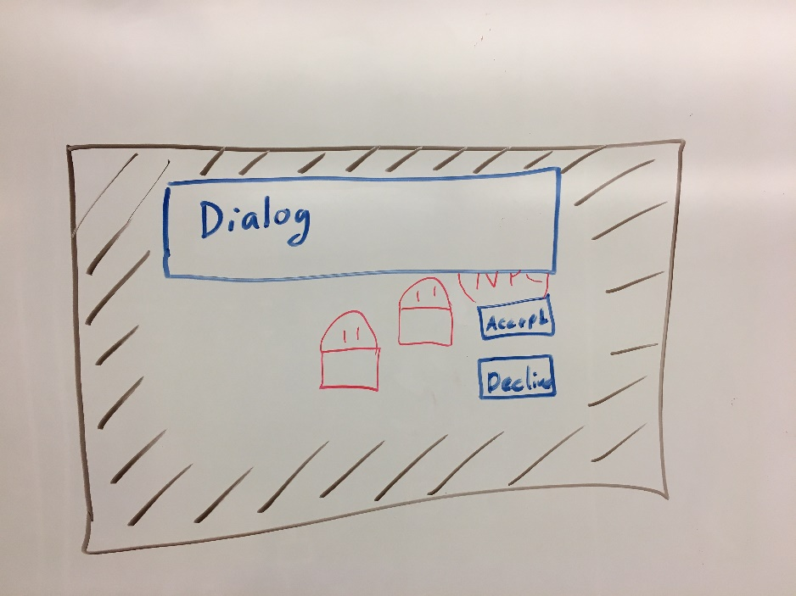
SKIM though proposal

Slide 3
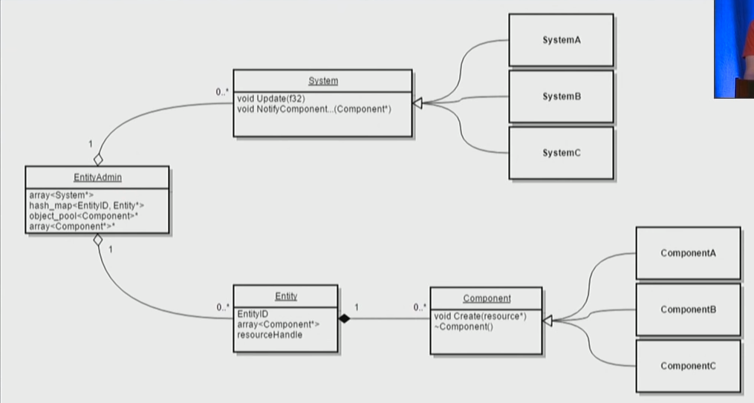
Entity Component System Rules
General Rules:
Components are all managed in one central place
Entities are only comprised of components
Only data entities have are what components it has assigned to them
No inheritance to construct entities
Systems are data driven by the components
Added Rules:
All systems will only do logic, no remembering of state frame by frame
All components will only hold data
Notes:
DON’T go over in depth

Slide 4
Live Demo

Slide 5
Struggles
Getting multiple levels working
Only working on systems that NEED work – battle with self…
Schedule adjustments – more on schedule later
Profiler!!!
Notes:
Getting multiple levels working
Just figuring out how components go together and transfer levels\
Level transferring problems
Only working on systems that NEED work – battle with self…
Schedule adjustments
Profiler!!!

Slide 6
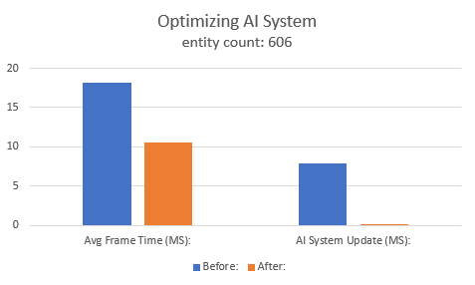
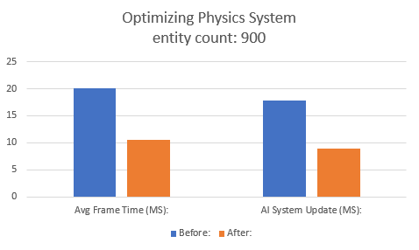
Profiling Gains
Previous max was 600 entities
Current max is 1150 entities
60 FPS is the goal

Slide 7
Schedule
(just move to the schedule….)

Slide 8
My thoughts on ECS
Every good for scaling
DON’T just choose to go ECS - Have a good reason
Harder for gameplay programmer to do their job without wrapper over creation
takes a lot of getting used too and prone to error
Have simple components – single purpose
Cleary define rules
Can easily see how networking and threading can be utilized
POWER!

