Slide 1


Realm of the Mad Adam ECS
By Adam Riley

Slide 2
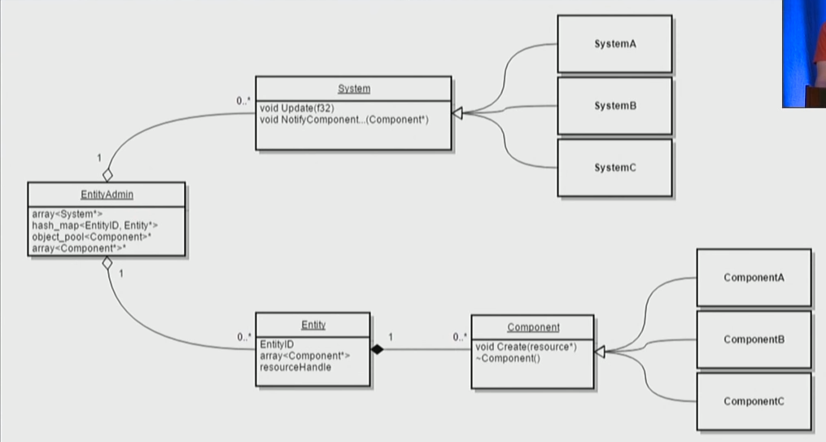
Entity Component System Rules
General Rules:
Components are all managed in one central place
Entities are only comprised of components
Only data entities have are what components it has assigned to them
No inheritance to construct entities
Systems are data driven by the components
Added Rules:
All systems will only do logic, no remembering of state frame by frame
All components will only hold data

Slide 3
Need to break the rules
Maps needed to be independent from each other
Required the split of entities and components between maps
This allowed for maps to use only be affected by entities that are within them

Slide 4
Live Demo

Slide 5
Learns so far
Scalability is greater than object oriented. (option based)
Ability to exclude data that’s not desired instead of ignoring
Big potential for optimization
Many things you COULD do. Must restrain temptation to refactor.
Splitting logic between steps of information gathering instead of full ideas
Example: desired movement, physics movement, and accrual moving.

Slide 6
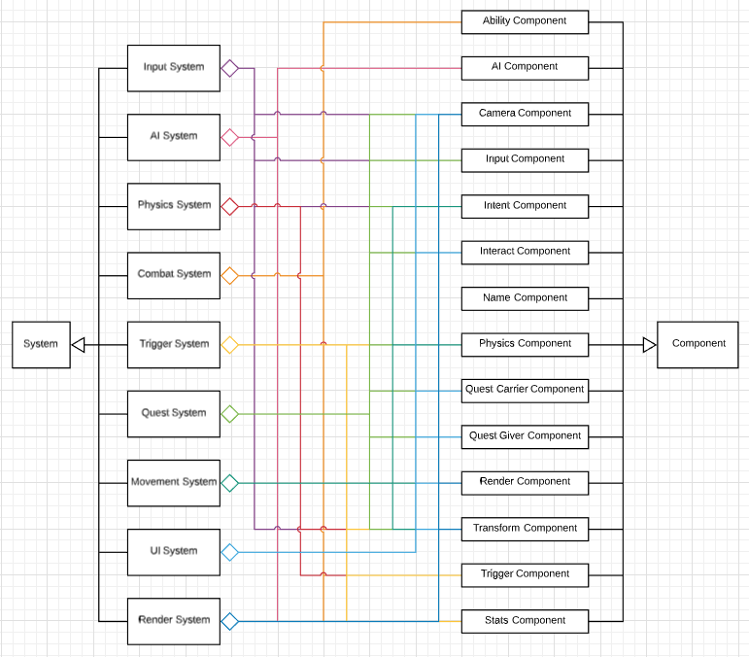
Issues
Complexity
Wanting to treat entities as a type of thing apposed to a generic thing
Example: Player vs AI
Solution: Intent Component
Rendering
System required unless you allow all your systems to be able to draw when they want, creating weird dependencies
How to draw know what to draw: Render Component
Understanding the memory management

Slide 7
Changes that I would try
Add rules for dependencies on components
A heavier entity that held pointers to it’s assigned components
If not, know what index the component exists at instead of all the indexes
Try building the systems to not loop on entities only components
Behavioral Components for AI
Create components that encapsulate a behavior the entity will preform
Threading – next slide

Slide 8
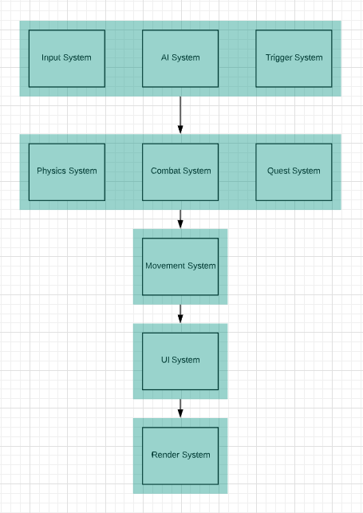
Threading
Because the systems are not reliant of each other, you can create a job for each system easily.
Things to keep track of:
components that are shared between systems
Systems that are reliant on information that another system provides

