Slide 1
Full Stack Development with Javascript
Instructors:
Ms. Amrita Das
Mr. Haseeb Iqbal

Slide 2


Slide 3
Meteor
Install Meteor (https://www.meteor.com/install)
Mac: curl https://install.meteor.com/ | sh
Windows:
chocolaty: @"%SystemRoot%\System32\WindowsPowerShell\v1.0\powershell.exe" -NoProfile -InputFormat None -ExecutionPolicy Bypass -Command "iex ((New-Object System.Net.WebClient).DownloadString('https://chocolatey.org/install.ps1'))" && SET "PATH=%PATH%;%ALLUSERSPROFILE%\chocolatey\bin"
choco install meteor
Meteor create idw_demo
Go to idw_demo folder and type meteor
Meteor add accounts—ui accounts-password

Slide 4
Meteor
Runs on Front End and Back End
Subscriptions for Requests/Response
Uses Web Sockets
Mongo DB
Data Accessible From Client and Server
Mini Mongo
Latency Compensation

Slide 5
Meteor cont.
Client
Jquery
Tracker
Spacebars
Blaze
Minimongo
Session
Server
Connect –http library
Mongo Driver

Slide 6
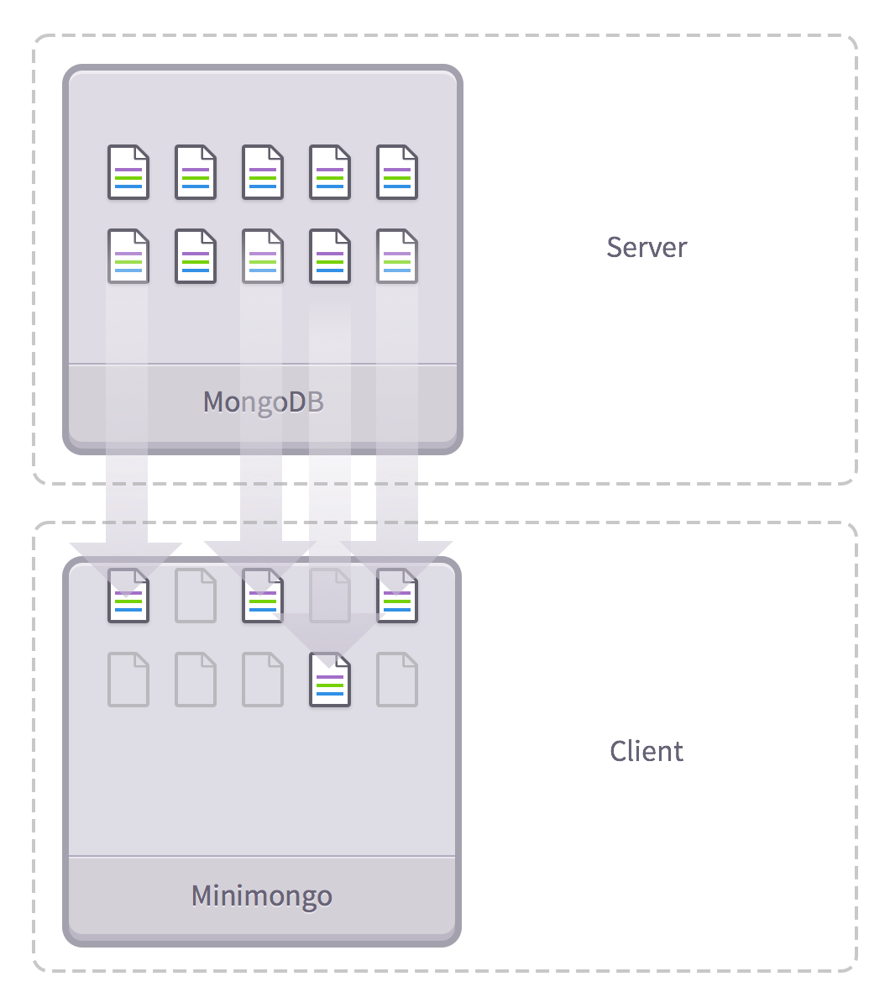

Slide 7
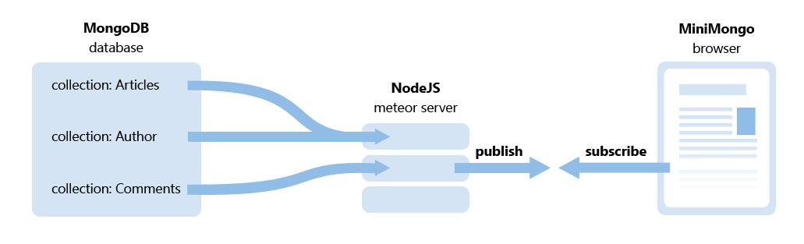

Slide 8
Collection
Product = new Mongo.Collection(‘product’)

Slide 9
Any Question ?

Slide 10
Thank You

