Slide 1
Fuzziverse
Artificial Life through Fuzzy Matrices

Slide 2
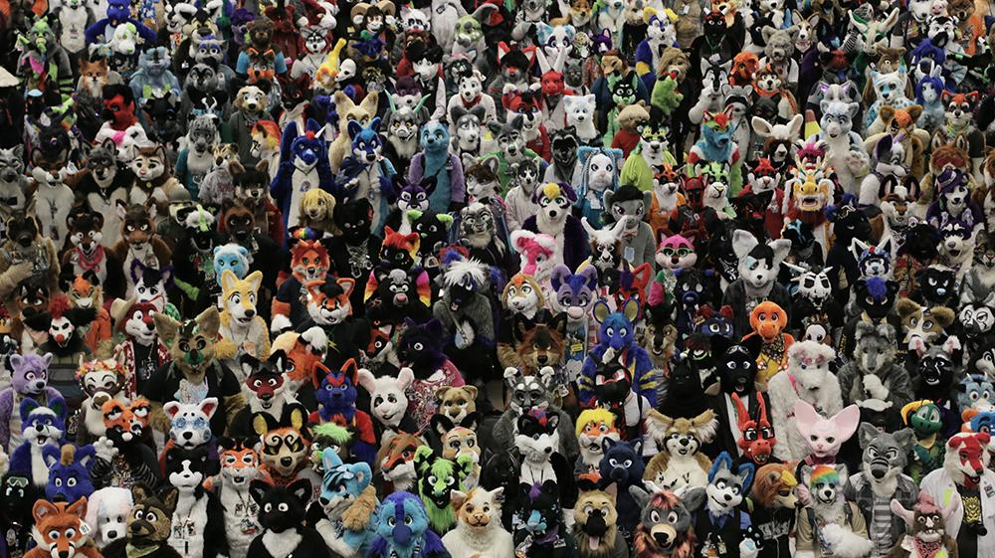
We probably need a new title.

Slide 3
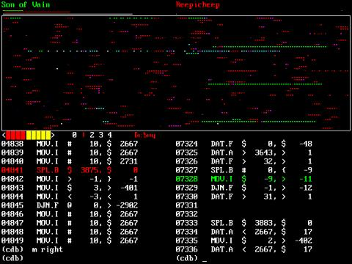
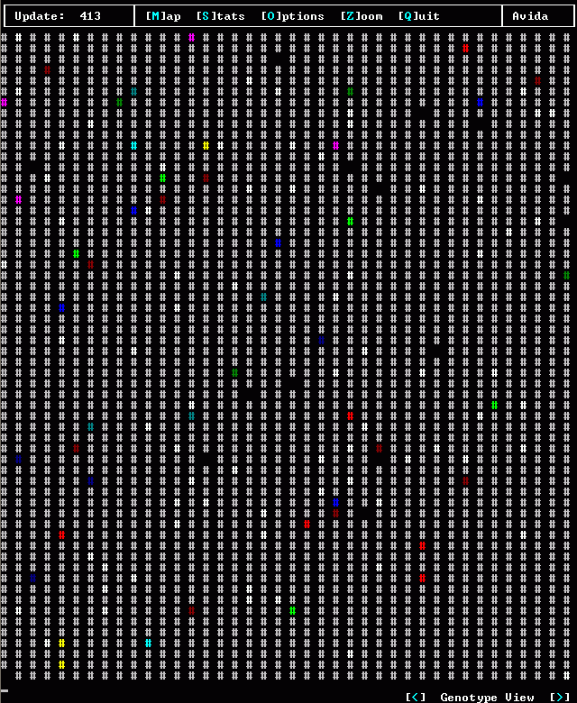
Artificial Life – Prior Work read Introduction to Artificial Life by Christoph Adami
Self-replicating programs
Replicating Cellular Automata
Viruses
Core Wars
Tierra
Avida

Slide 4
Artificial Life – Prior Work read Artificial Life Models in Software by Andrew Adamtzky
3D Creatures
Fitness Function
Framsticks
breve
3D Virtual Creature Evolution
Competitive Ecosystems
Co-evolution
Species

Slide 5
Fuzziverse
I’m interested in ecological niches:
co-evolution
aggressiveness vs passivity
strong vs weak
active vs inactive
aware vs unaware
Secret Sauce is energy cost!
Strength, aggressiveness, activity, and awareness all cost energy.
The Earth is a (more or less) closed energy recycler, with a constant source of negative entropy.
Evolution is more than just race to innovate; it also makes tough decisions and synergizes.
Deterministic experiments – can do data analysis afterwards

