Slide 1
Project Assignment 2
You must exactly follow this template.
Do not change the order and the format.
No background coloring or formatting.
TEAM MANGO
Adam Rodi, Samiksha Gnawali, Suyog Karki

Slide 2
DDL QUERIES
Instructions:
- must include ALL queries listed in Queries.sql
- must follow the exact format provided in the template slide

Slide 3
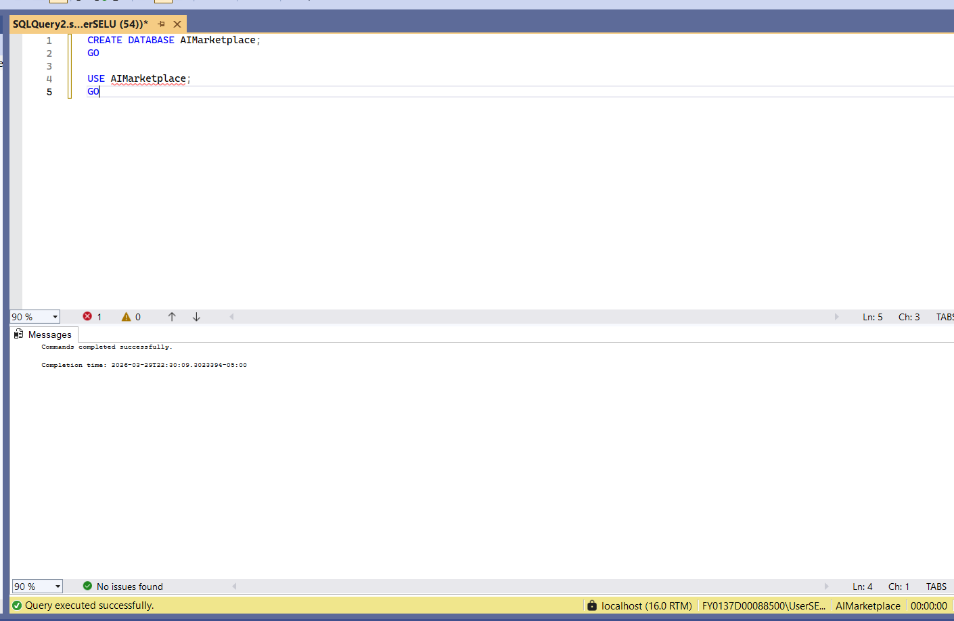
Q#: <Query Name>
Snapshot of the query output:
Description:
Create and select the database
SQL Query: CREATE DATABASE AIMarketplace;
GO
USE AIMarketplace;
GO

Slide 4
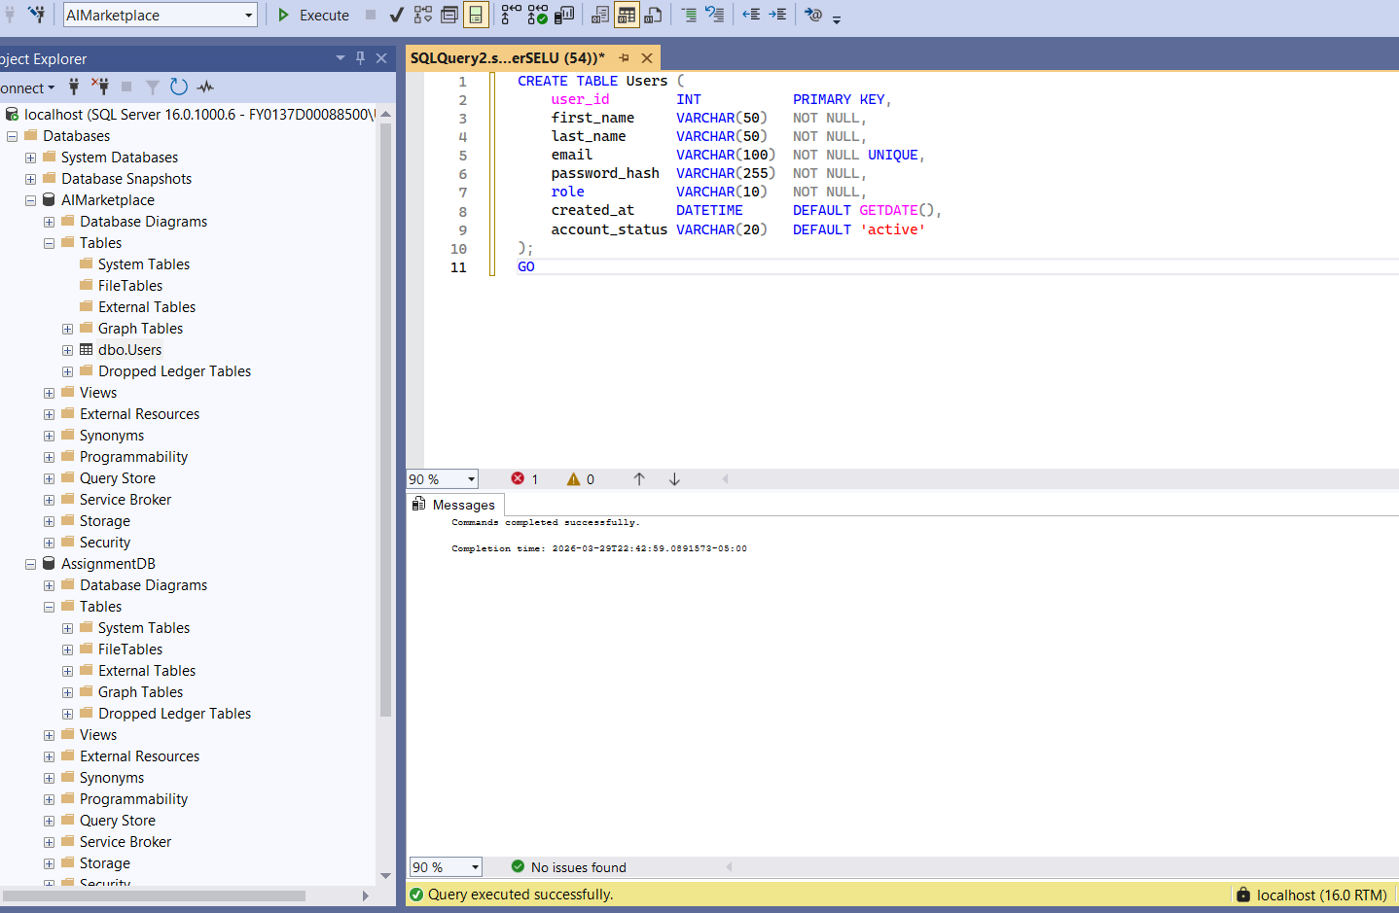
Q#: <Query Name>
Snapshot of the query output:
Description:
Create User for the AI Marketplace Platform.
SQL Query:
CREATE TABLE Users (
user_id INT PRIMARY KEY,
first_name VARCHAR(50) NOT NULL,
last_name VARCHAR(50) NOT NULL,
email VARCHAR(100) NOT NULL UNIQUE,
password_hash VARCHAR(255) NOT NULL,
role VARCHAR(10) NOT NULL,
created_at DATETIME DEFAULT GETDATE(),
account_status VARCHAR(20) DEFAULT 'active'
);
GO

Slide 5
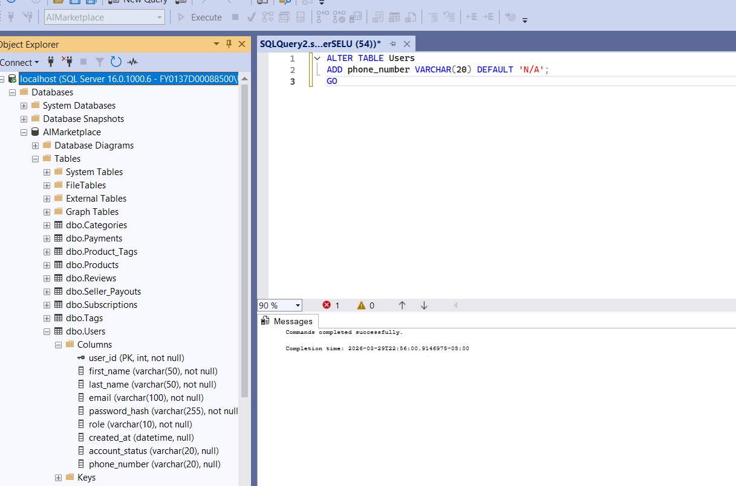
Q#: <Query Name>
Snapshot of the query output:
Description: Alter User table by Adding a phone_number column to store seller contact information on the platform.
SQL Query:
ALTER TABLE Users
ADD phone_number VARCHAR(20) DEFAULT 'N/A';
GO

Slide 6
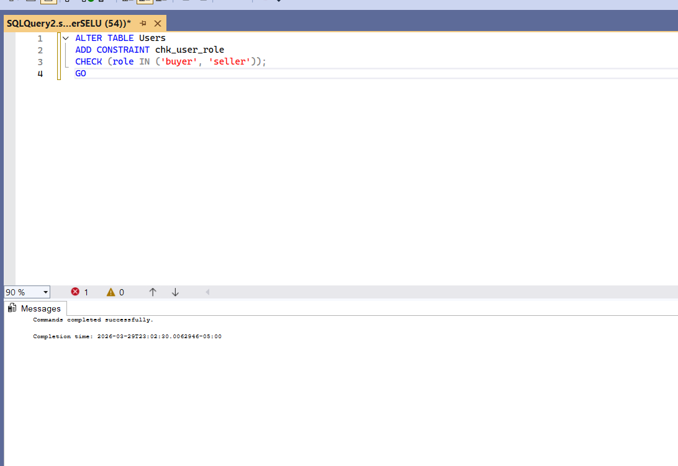
Q#: <Query Name>
Snapshot of the query output:
Description:
Check constraint by ensuring that a user's role can only be assigned as either 'buyer' or 'seller'
SQL Query:
ALTER TABLE Users
ADD CONSTRAINT chk_user_role
CHECK (role IN ('buyer', 'seller'));
GO

Slide 7
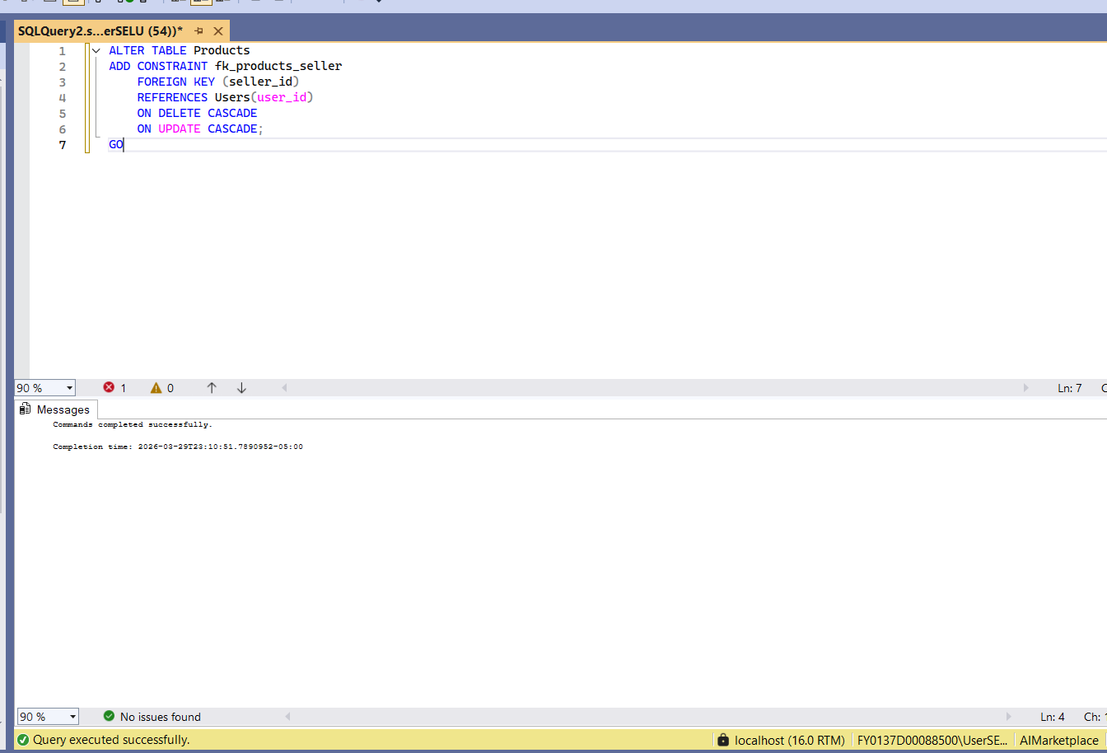
Q#: <Query Name>
Snapshot of the query output:
Description:
Adds a foreign key constraint linking each product to a valid seller in the Users table
SQL Query: ALTER TABLE Products
ADD CONSTRAINT fk_products_seller
FOREIGN KEY (seller_id)
REFERENCES Users(user_id)
ON DELETE CASCADE
ON UPDATE CASCADE;
GO

Slide 8
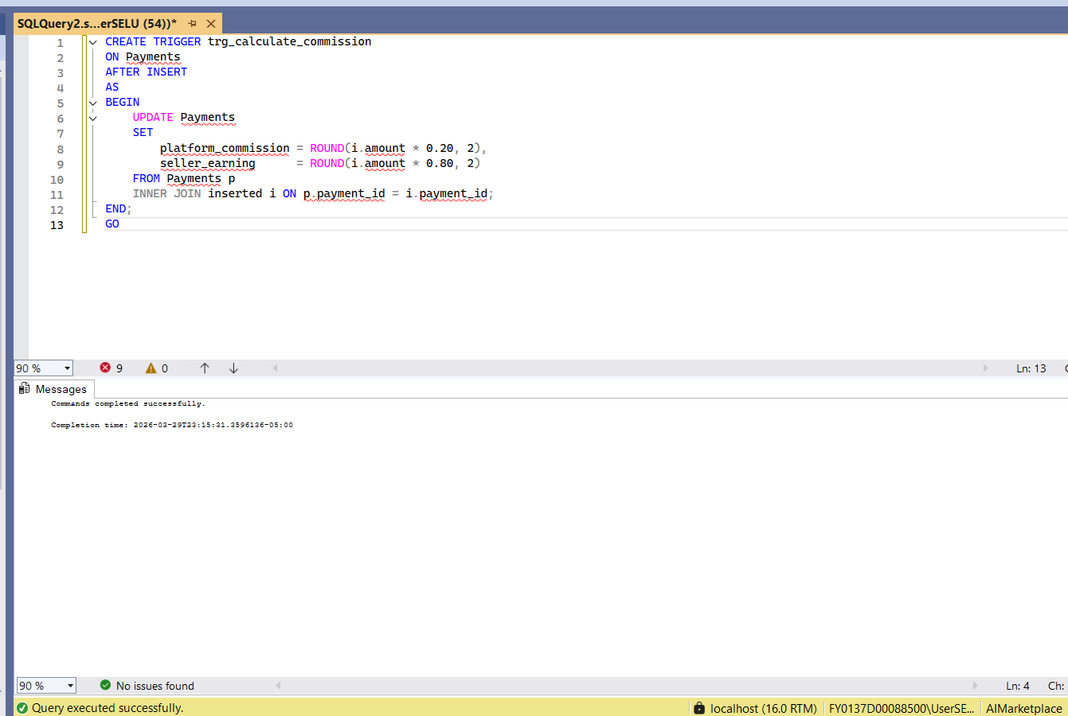
Q#: <Query Name>
Snapshot of the query output:
Description:
Create trigger to calculate the platform commission (20%) and seller earning (80%) whenever a new payment is inserted into the Payments table.
SQL Query:
CREATE TRIGGER trg_calculate_commission
ON Payments
AFTER INSERT
AS
BEGIN
UPDATE Payments
SET
platform_commission = ROUND(i.amount * 0.20, 2),
seller_earning = ROUND(i.amount * 0.80, 2)
FROM Payments p
INNER JOIN inserted i ON p.payment_id = i.payment_id;
END;
GO

Slide 9
DML QUERIES
Instructions:
- must include ALL queries listed in Queries.sql
- must follow the exact format provided in the template slide

Slide 10
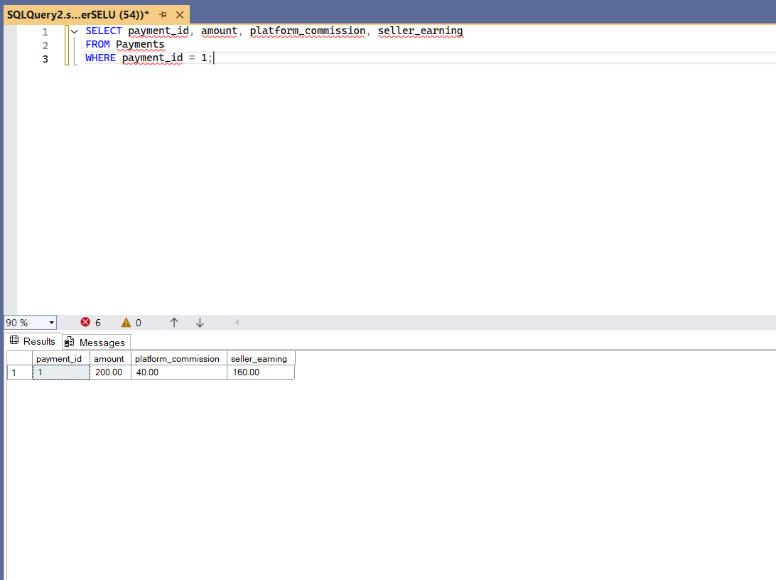
Q#: <Query Name>
Snapshot of the query output:
Description:
test trigger for calculating commission and earnings.
SQL Query:
SELECT payment_id, amount, platform_commission, seller_earning
FROM Payments
WHERE payment_id = 1;

Slide 11
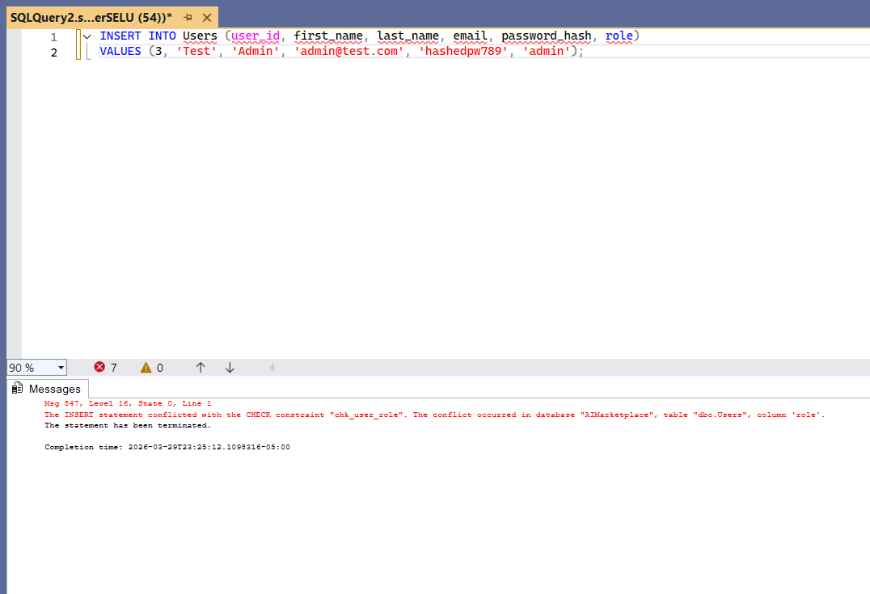
Q#: <Query Name>
Snapshot of the query output:
Description:
Tests constraint by attempting to insert a user with an invalid role, which should be rejected.
SQL Query:
INSERT INTO Users (user_id, first_name, last_name, email, password_hash, role)
VALUES (3, 'Test', 'Admin', 'admin@test.com', 'hashedpw789', 'admin');

Slide 12
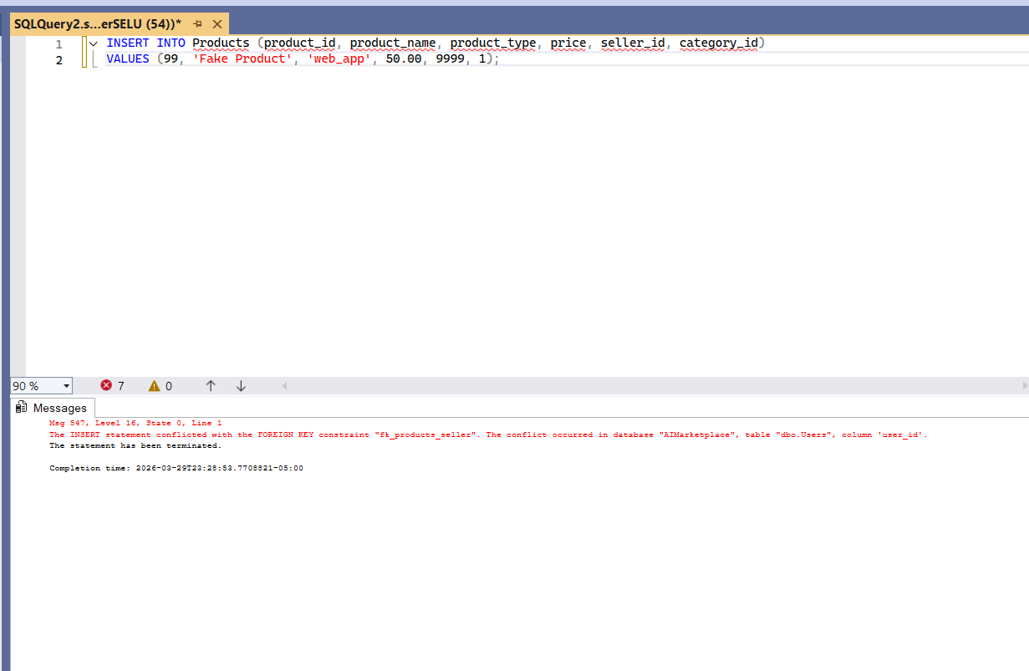
Q#: <Query Name>
Snapshot of the query output:
Description:
Tests constraint by attempting to insert a product with a non-existent seller, which should be rejected.
SQL Query:
INSERT INTO Products (product_id, product_name, product_type, price, seller_id, category_id)
VALUES (99, 'Fake Product', 'web_app', 50.00, 9999, 1);

Slide 13
Credits and References
- SQL Server 2022 Documentation
https://learn.microsoft.com/en-us/sql/sql-server/

