Slide 1
CMPS 4390 PROJECT
You must exactly follow this template.
Do not change the order and the format.
No background coloring or formatting.
Team Mango
Adam Rodi, Samiksha Gnawali, Suyog Karki

Slide 2
TEAM MEMBERS & ROLES
Adam Rodi
Assist with writing DML and DDL queries and creating PowerPoint submissions
Create ERD diagram
Normalization analysis
Samiksha Gnawali
Capture screenshots of query outputs for PowerPoints
Assist with query writing for DDL and DML
SQL review and testing
Suyog Karki
Define FK relations and constraints
Assist with query writing for DDL and DML
Python data generation scripts

Slide 3
DESCRIPTION OF BUSINESS
The business is an online AI Marketplace where external sellers list two types of products: AI-powered web applications that users can access through a browser, and AI API services that developers can integrate into their own software. Buyers subscribe to these products through the platform. The platform manages user accounts, product listings, subscriptions, payments, and commission calculations. The actual AI services are provided externally and the platform only handles listing and billing.
Business operations:
Create, update, and delete user accounts (buyers and sellers)
Sellers create, update, and remove their AI product listings
Buyers create and cancel subscriptions to products.
Calculating the platform’s commission for each payment.
Buyers submit reviews and ratings for products.
Business requirements:
Each product must be owned by exactly one seller.
Each subscription must link one buyer to one product.
Platform commission must be calculated as 20% of each recorded payment.
A buyer may not have more than one active subscription to the same product at any given time.
Each payment must correspond to exactly one subscription.

Slide 4
REFERENTIAL-RELATIONS
FOREIGN TABLE (REFERENCING TABLE) | FOREIGN KEY | REFERENCED TABLE | PRIMARY KEY
Products | seller_id | Users | user_id
Products | category_id | Categories | category_id
Product_Tags | product_id | Products | product_id
Product_Tags | tag_id | Tags | tag_id
Subscriptions | buyer_id | Users | user_id
Subscriptions | product_id | Products | product_id
Payments | subscription_id | Subscriptions | subscription_id
Reviews | product_id | Products | product_id
Reviews | buyer_id | Users | user_id
Seller_Payouts | seller_id | Users | user_id

Slide 5
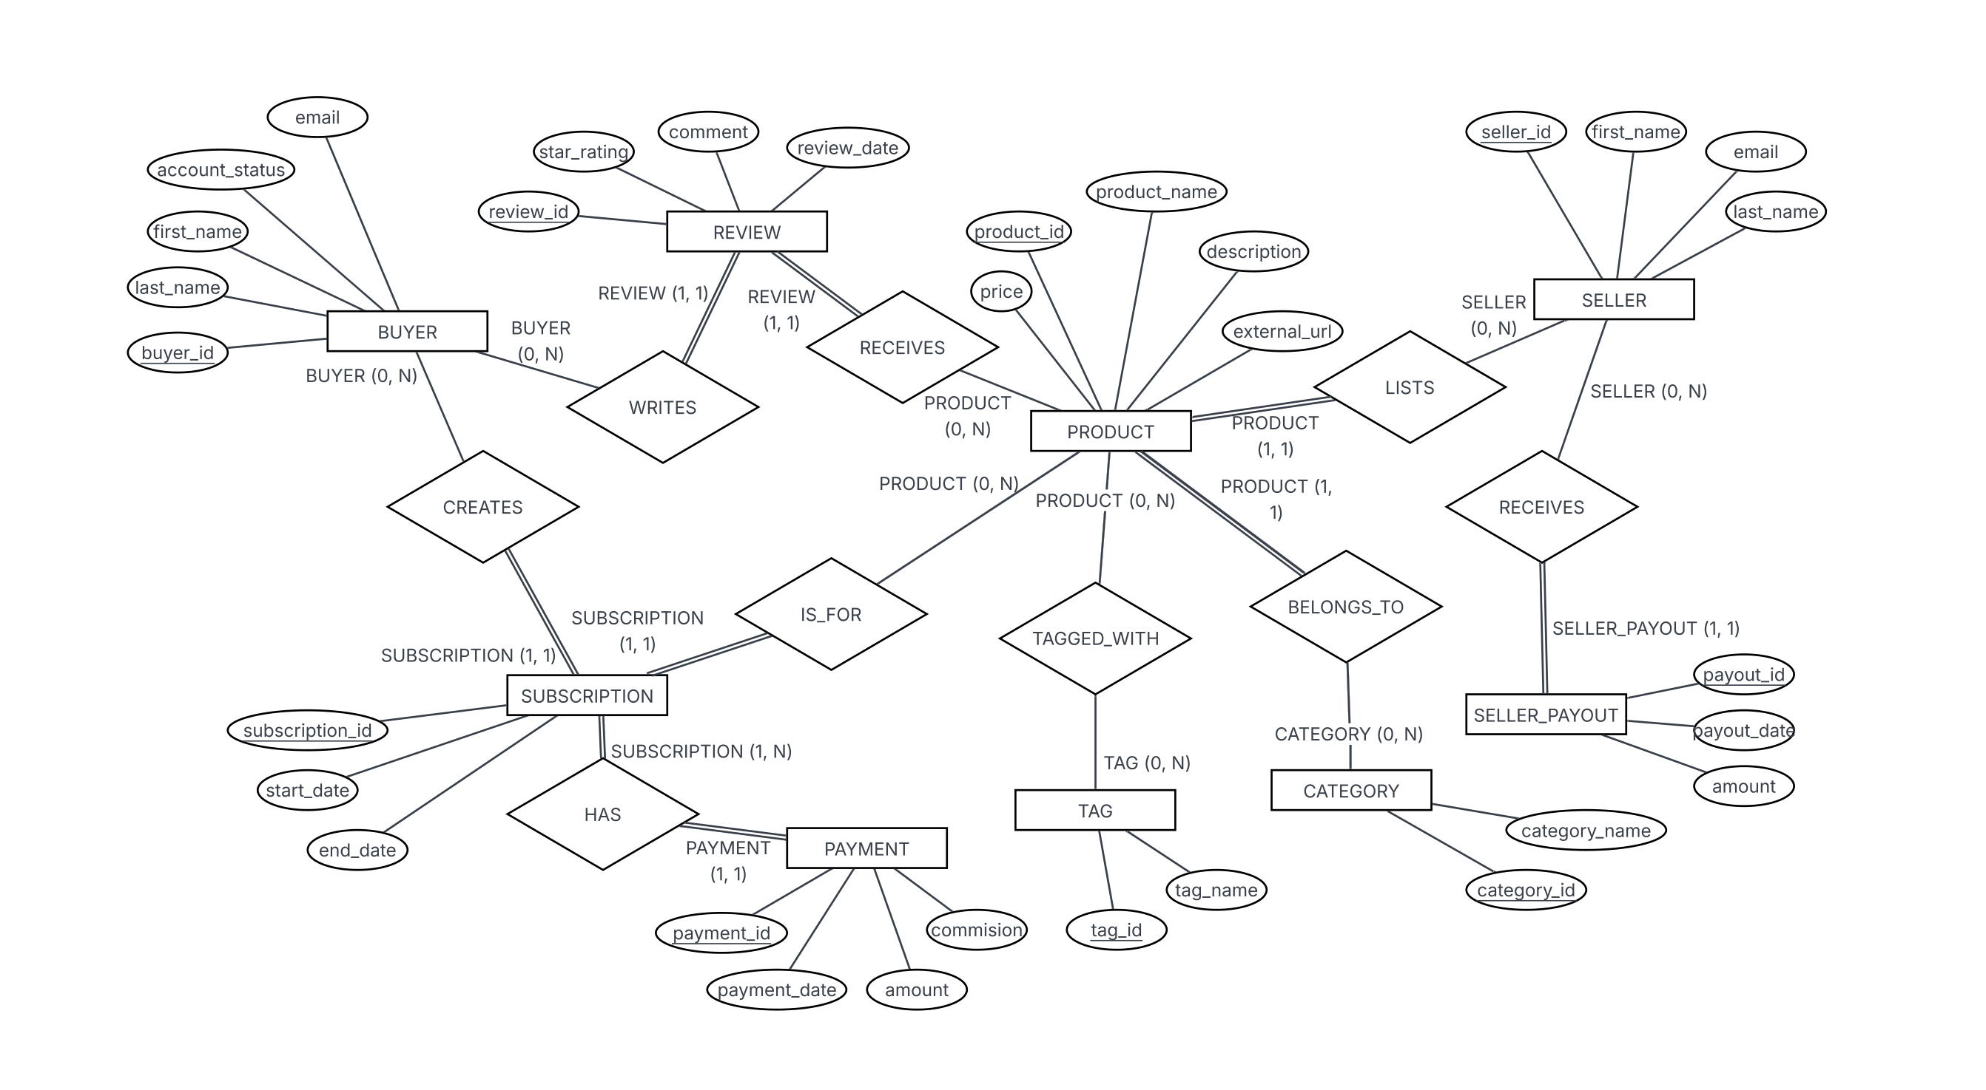
ER-Diagram

Slide 6
DDL QUERIES
Instructions:
- must include ALL queries listed in Queries.sql
- must follow the exact format provided in the template slide

Slide 7
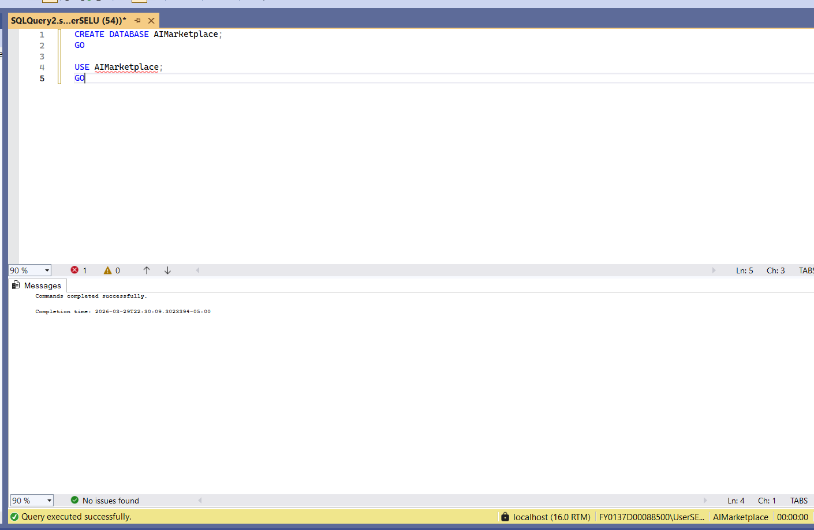
QD1: CREATE TABLE
Snapshot of the query output:
Description:
Create and select the database
SQL Query: CREATE DATABASE AIMarketplace;
GO
USE AIMarketplace;
GO

Slide 8
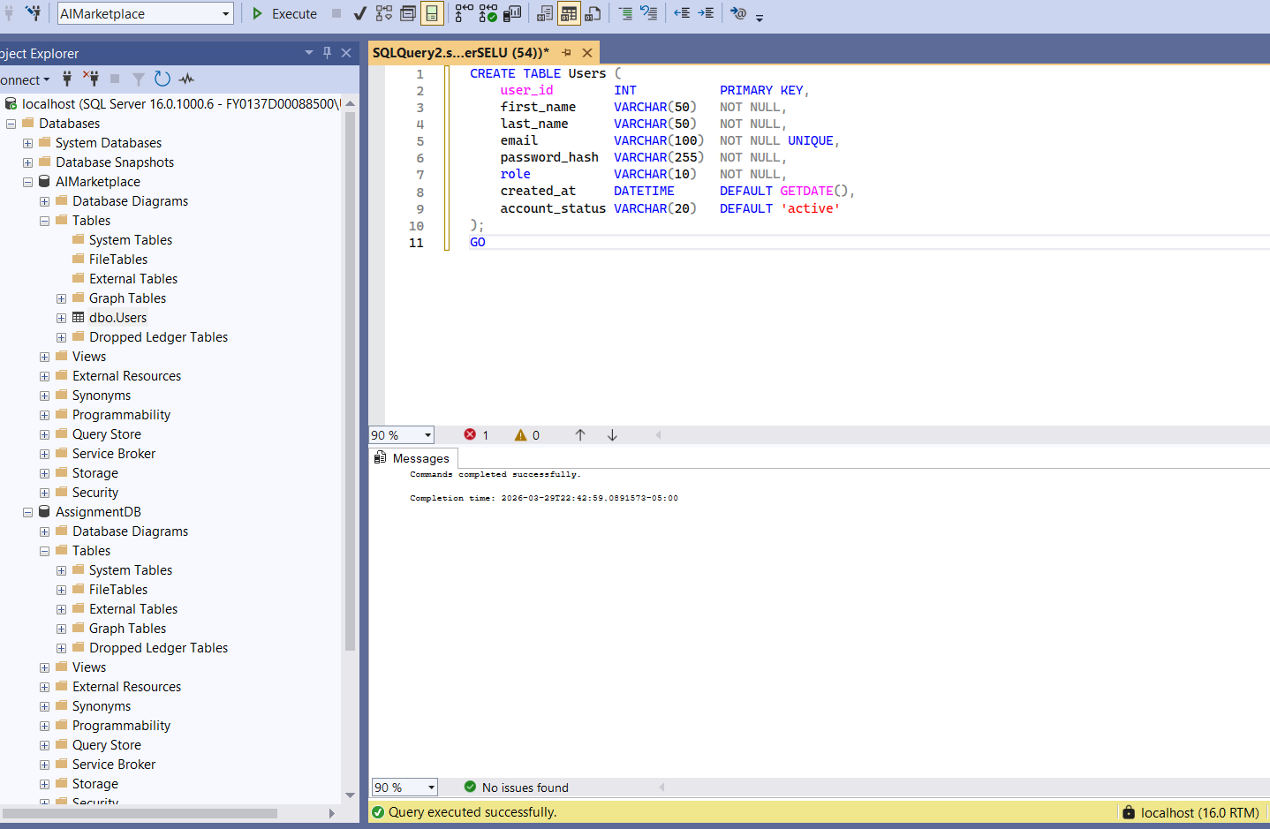
QD1: CREATE TABLE
Snapshot of the query output:
Description:
Create User for the AI Marketplace Platform.
SQL Query:
CREATE TABLE Users (
user_id INT PRIMARY KEY,
first_name VARCHAR(50) NOT NULL,
last_name VARCHAR(50) NOT NULL,
email VARCHAR(100) NOT NULL UNIQUE,
password_hash VARCHAR(255) NOT NULL,
role VARCHAR(10) NOT NULL,
created_at DATETIME DEFAULT GETDATE(),
account_status VARCHAR(20) DEFAULT 'active'
);
GO

Slide 9
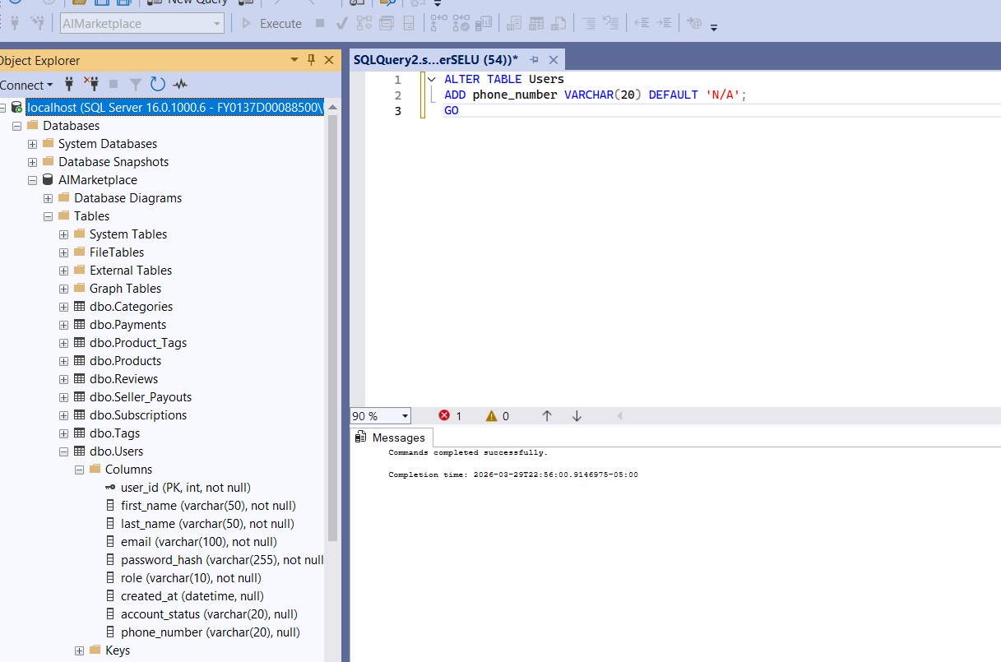
QD2: ALTER TABLE
Snapshot of the query output:
Description: Alter User table by Adding a phone_number column to store seller contact information on the platform.
SQL Query:
ALTER TABLE Users
ADD phone_number VARCHAR(20) DEFAULT 'N/A';
GO

Slide 10
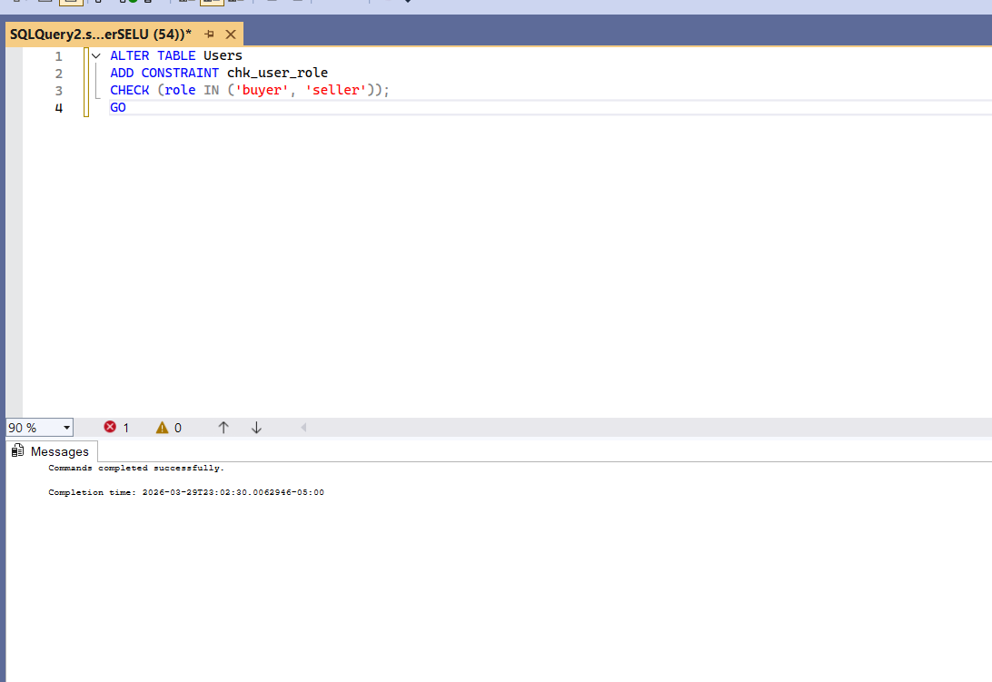
QD3: ADD "CHECK" CONSTRAINT
Snapshot of the query output:
Description:
Check constraint by ensuring that a user's role can only be assigned as either 'buyer' or 'seller'
SQL Query:
ALTER TABLE Users
ADD CONSTRAINT chk_user_role
CHECK (role IN ('buyer', 'seller'));
GO

Slide 11
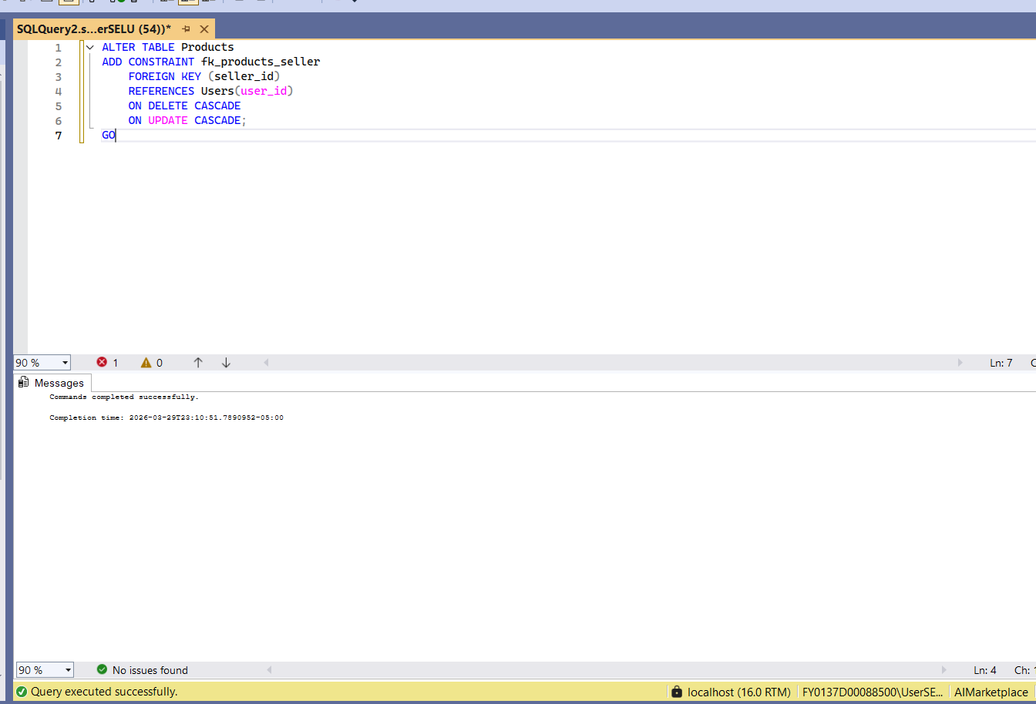
QD4: ADD FK CONSTRAINT(S) TO THE TABLE
Snapshot of the query output:
Description:
Adds a foreign key constraint linking each product to a valid seller in the Users table
SQL Query: ALTER TABLE Products
ADD CONSTRAINT fk_products_seller
FOREIGN KEY (seller_id)
REFERENCES Users(user_id)
ON DELETE CASCADE
ON UPDATE CASCADE;
GO

Slide 12
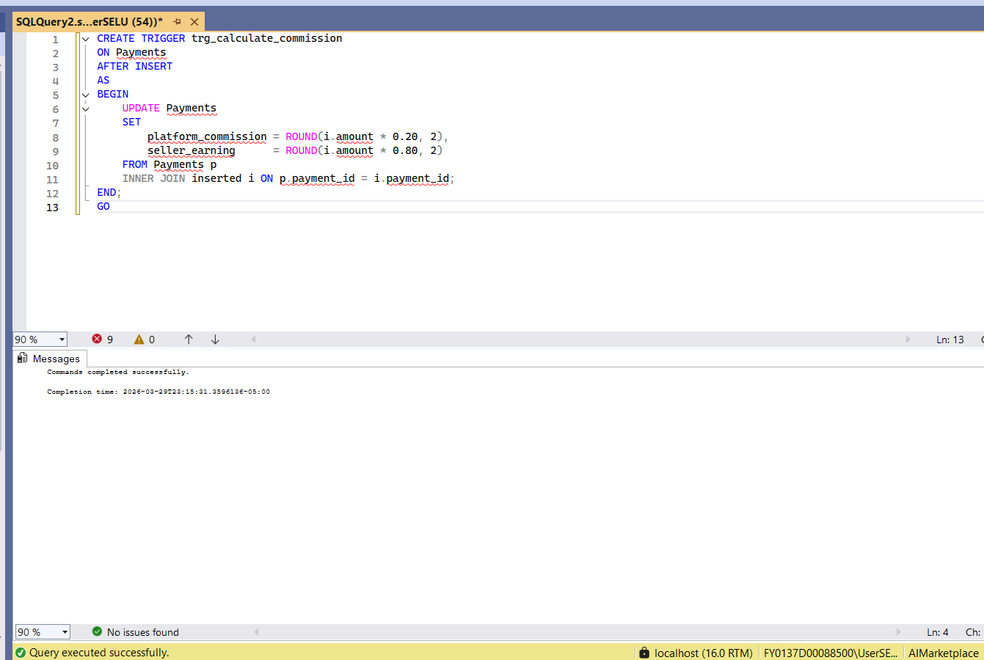
QD5: Create TRIGGER
Snapshot of the query output:
Description:
Create trigger to calculate the platform commission (20%) and seller earning (80%) whenever a new payment is inserted into the Payments table.
SQL Query:
CREATE TRIGGER trg_calculate_commission
ON Payments
AFTER INSERT
AS
BEGIN
UPDATE Payments
SET
platform_commission = ROUND(i.amount * 0.20, 2),
seller_earning = ROUND(i.amount * 0.80, 2)
FROM Payments p
INNER JOIN inserted i ON p.payment_id = i.payment_id;
END;
GO

Slide 13
DML QUERIES
Instructions:
- must include ALL queries listed in Queries.sql
- must follow the exact format provided in the template slide

Slide 14
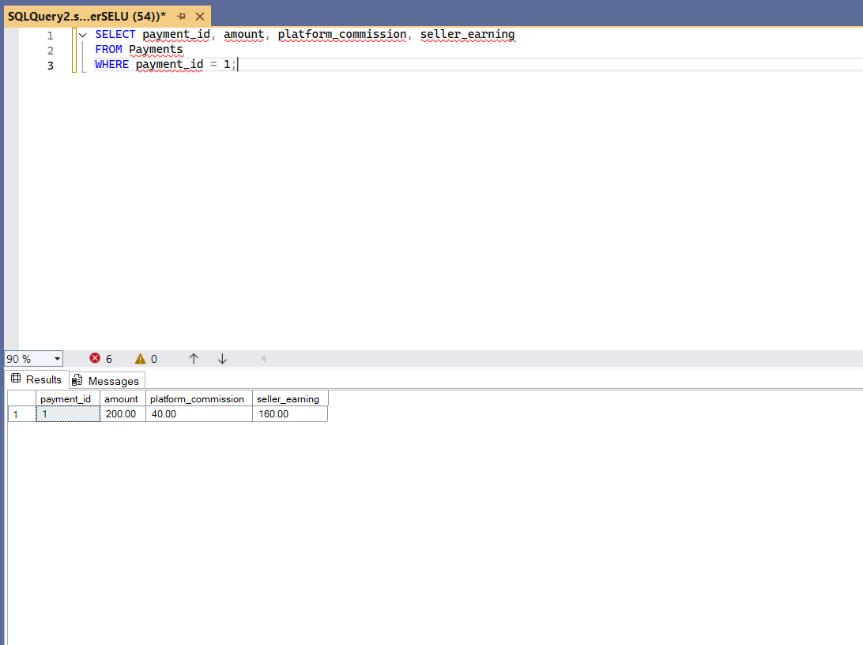
QM1.1: A TEST QUERY FOR THE TRIGGER CREATED in QD5
Snapshot of the query output:
Description:
test trigger for calculating commission and earnings.
SQL Query:
SELECT payment_id, amount, platform_commission, seller_earning
FROM Payments
WHERE payment_id = 1;

Slide 15
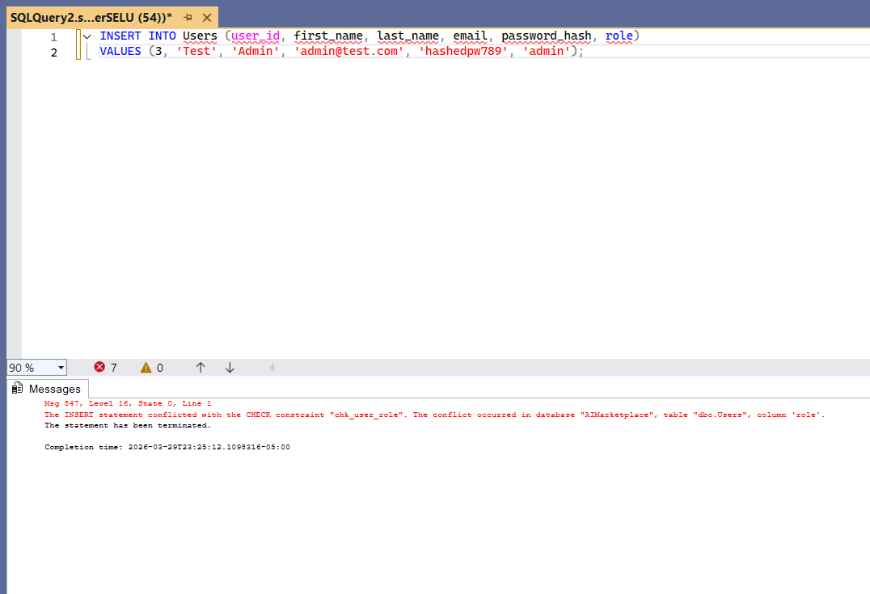
QM1.2: A TEST QUERY FOR THE "CHECK" CONSTRAINT DEFINED in QD3
Snapshot of the query output:
Description:
Tests constraint by attempting to insert a user with an invalid role, which should be rejected.
SQL Query:
INSERT INTO Users (user_id, first_name, last_name, email, password_hash, role)
VALUES (3, 'Test', 'Admin', 'admin@test.com', 'hashedpw789', 'admin');

Slide 16
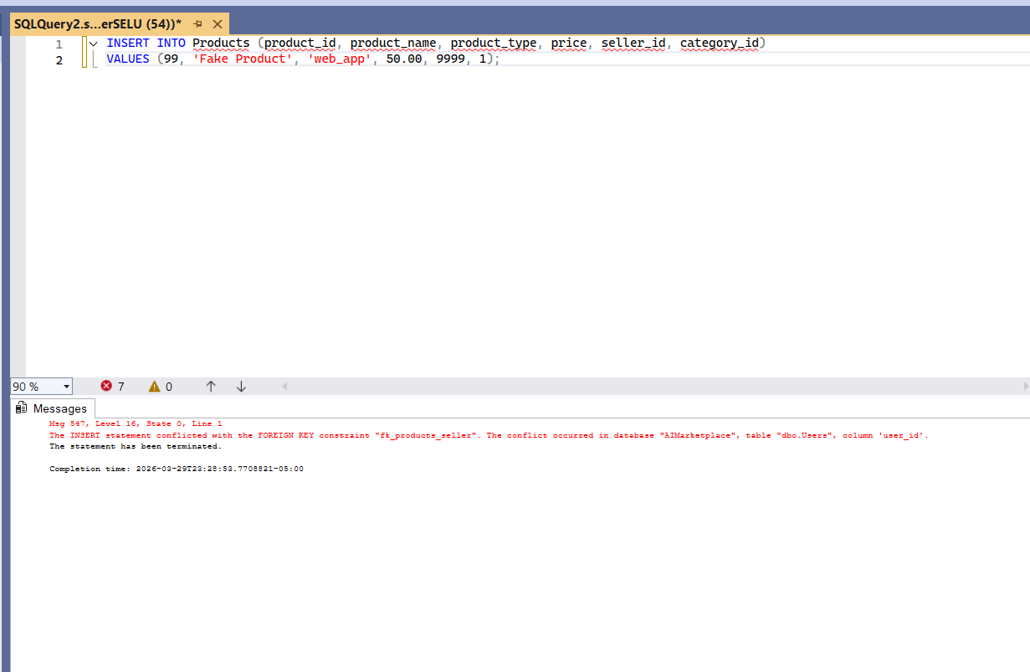
QM1.3: A TEST QUERY FOR THE FK CONSTRAINT DEFINED in QD4
Snapshot of the query output:
Description:
Tests constraint by attempting to insert a product with a non-existent seller, which should be rejected.
SQL Query:
INSERT INTO Products (product_id, product_name, product_type, price, seller_id, category_id)
VALUES (99, 'Fake Product', 'web_app', 50.00, 9999, 1);

Slide 17
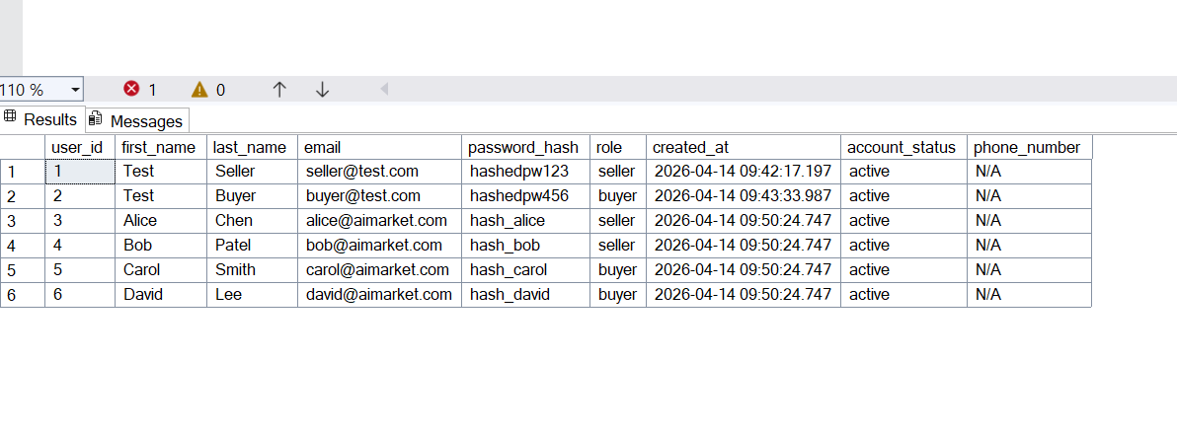
QM2: INSERT DATA
Snapshot of the query output:
Description: Populates the marketplace with additional sellers, buyers, categories, AI products, subscriptions, payments, reviews, tags, and seller payouts to represent a realistic set of platform activity.
SQL Query:
INSERT INTO Users (user_id, first_name, last_name, email, password_hash, role)
VALUES
(3, 'Alice', 'Chen', 'alice@aimarket.com', 'hash_alice', 'seller'),
(4, 'Bob', 'Patel', 'bob@aimarket.com', 'hash_bob', 'seller'),
(5, 'Carol', 'Smith', 'carol@aimarket.com', 'hash_carol', 'buyer'),
(6, 'David', 'Lee', 'david@aimarket.com', 'hash_david', 'buyer');

Slide 18
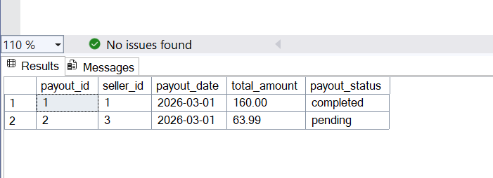
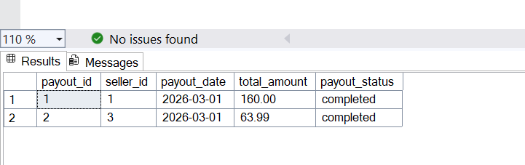
QM3: UPDATE DATA
Snapshot of the query output:
Description:
Marks all pending seller payouts older than 30 days as completed to reflect disbursements that have been successfully processed by the platform.
SQL Query:
UPDATE Seller_Payouts
SET payout_status = 'completed'
WHERE payout_status = 'pending'
AND payout_date <= DATEADD(DAY, -30, GETDATE());

Slide 19
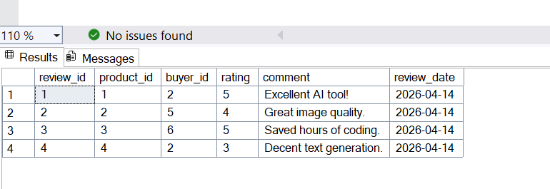
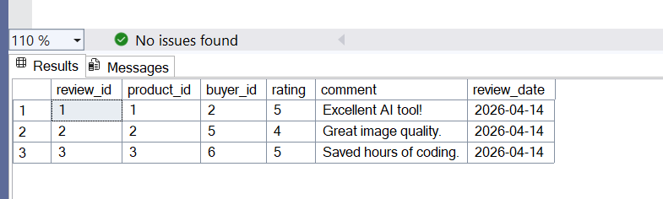
QM4: DELETE DATA
Snapshot of the query output:
Description:
Removes a buyer's review that was submitted in error for a product they did not use long enough to evaluate, maintaining rating accuracy on the platform.
SQL Query:
DELETE FROM Reviews
WHERE review_id = 4;

Slide 20
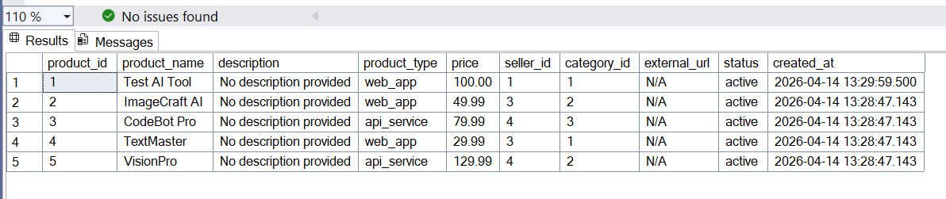
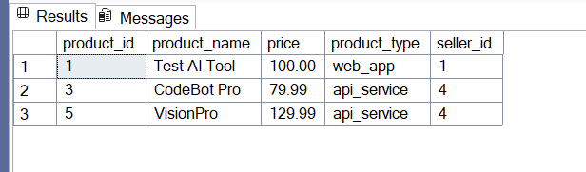
QM5: QUERY DATA WITH WHERE CLAUSE
Snapshot of the query output:
Description:
Retrieves all active products priced above $75 to help buyers browse the platform's premium AI tool offerings.
SQL Query:
SELECT product_id, product_name, price, product_type, seller_id
FROM Products
WHERE price > 75.00
AND status = 'active';

Slide 21
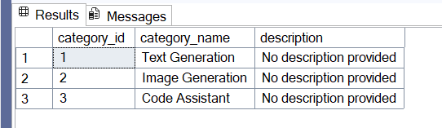
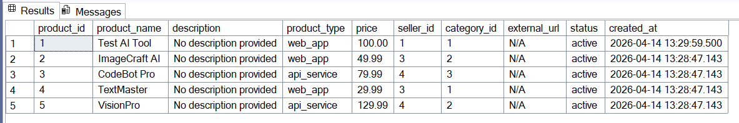
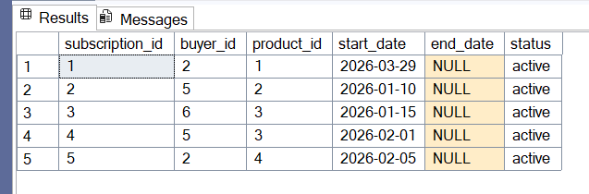
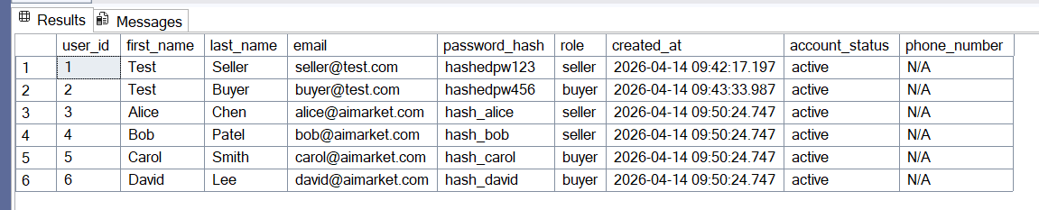
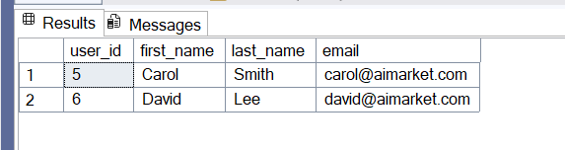
QM6.1: QUERY DATA WITH 'SUB-QUERY IN WHERE CLAUSE'
Snapshot of the query output:
Description:
Retrieves all buyers who hold an active subscription to at least one Code Assistant product to identify the platform's active developer user base.
SQL Query:
SELECT user_id, first_name, last_name, email
FROM Users
WHERE role = 'buyer'
AND user_id IN (
SELECT s.buyer_id
FROM Subscriptions s
JOIN Products p ON s.product_id = p.product_id
JOIN Categories c ON p.category_id = c.category_id
WHERE c.category_name = 'Code Assistant'
AND s.status = 'active'
);

Slide 22
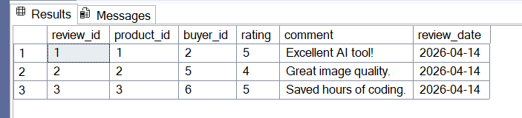
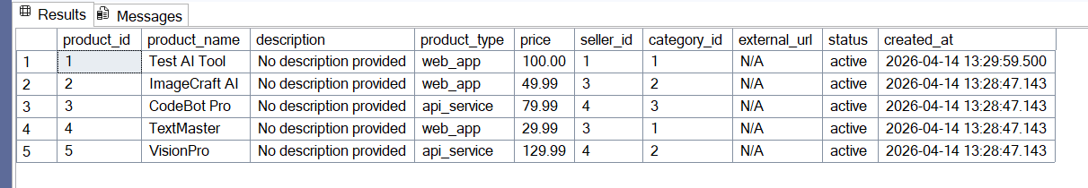
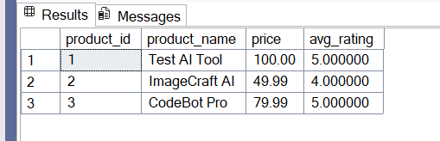
QM6.2: QUERY DATA WITH SUB-QUERY IN FROM CLAUSE
Snapshot of the query output:
Description:
Displays each listed product alongside its average customer rating to help the platform surface high-performing AI tools for its featured section.
SQL Query:
SELECT p.product_id, p.product_name, p.price, avg_r.avg_rating
FROM Products p
JOIN (
SELECT product_id,
ROUND(AVG(CAST(rating AS DECIMAL(5,2))), 2) AS avg_rating
FROM Reviews
GROUP BY product_id
) AS avg_r ON p.product_id = avg_r.product_id;

Slide 23
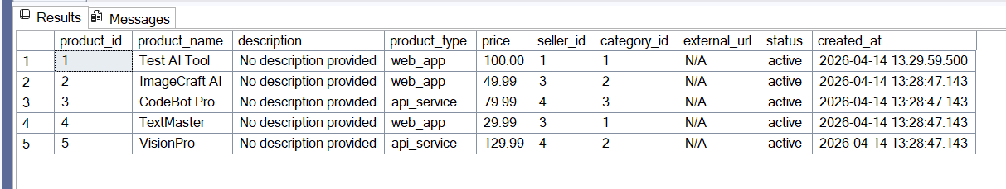
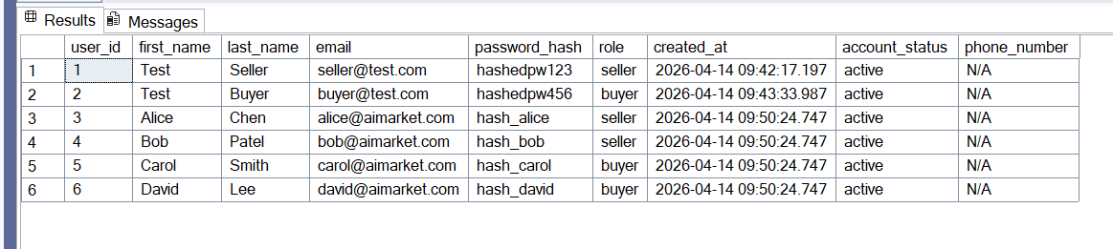
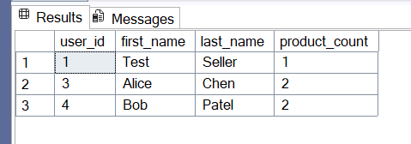
QM6.3: QUERY DATA WITH 'SUB-QUERY IN SELECT CLAUSE'
Snapshot of the query output:
Description:
Lists every seller account alongside the number of AI products they have published, giving the platform a quick view of individual seller activity levels.
SQL Query:
SELECT
u.user_id,
u.first_name,
u.last_name,
(SELECT COUNT(*)
FROM Products p
WHERE p.seller_id = u.user_id) AS product_count
FROM Users u
WHERE u.role = 'seller';

Slide 24
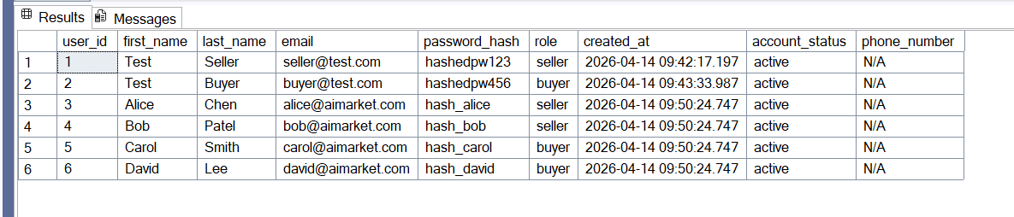
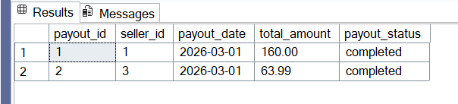
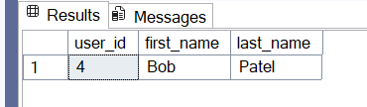
QM7: QUERY DATA WITH EXCEPT
Snapshot of the query output:
Description:
Identifies sellers who have published products but have never received a payout, flagging accounts that may be owed earnings by the platform.
SQL Query:
SELECT u.user_id, u.first_name, u.last_name
FROM Users u
WHERE u.role = 'seller'
EXCEPT
SELECT u.user_id, u.first_name, u.last_name
FROM Users u
JOIN Seller_Payouts sp ON u.user_id = sp.seller_id;

Slide 25
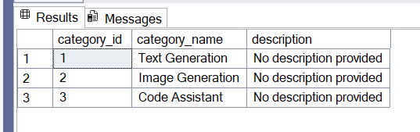
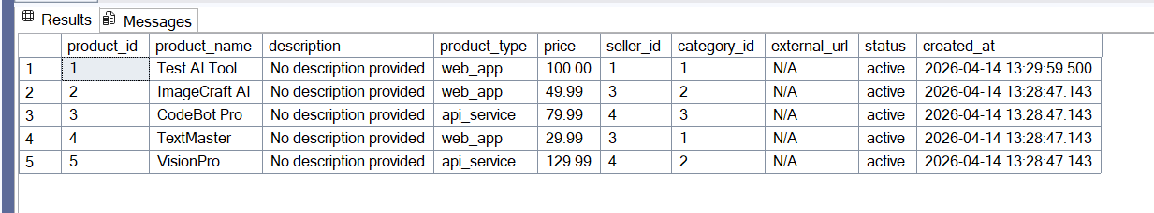
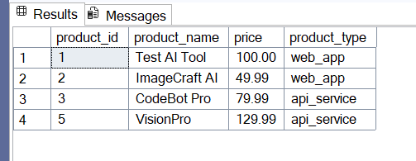
QM8.1: QUERY DATA WITH ANY/SOME
Snapshot of the query output:
Description:
Finds all products priced higher than at least one Text Generation product, helping buyers compare costs against the platform's baseline AI text tools.
SQL Query:
SELECT product_id, product_name, price, product_type
FROM Products
WHERE price > ANY (
SELECT p.price
FROM Products p
JOIN Categories c ON p.category_id = c.category_id
WHERE c.category_name = 'Text Generation'
);

Slide 26
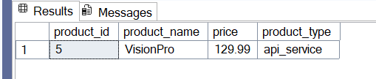
QM8.2: QUERY DATA WITH ALL in front of a sub-query
Snapshot of the query output:
Description:
Retrieves products whose price exceeds every Text Generation product on the platform, identifying the most premium AI tools relative to the text-generation tier.
SQL Query:
SELECT product_id, product_name, price, product_type
FROM Products
WHERE price > ALL (
SELECT p.price
FROM Products p
JOIN Categories c ON p.category_id = c.category_id
WHERE c.category_name = 'Text Generation'
);

Slide 27
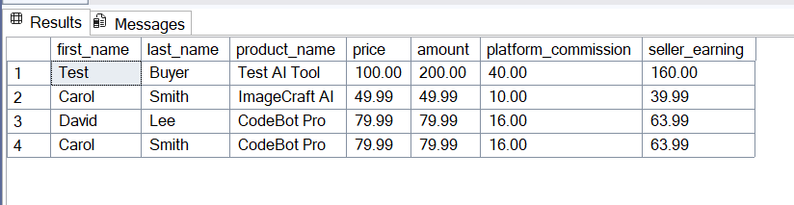
QM9.1: INNER-JOIN-QUERY WITH WHERE CLAUSE
Snapshot of the query output:
Description:
Retrieves each active subscriber's name alongside the product they purchased and the platform's commission split for that payment, giving finance a breakdown of revenue for premium-priced subscriptions.
SQL Query:
SELECT u.first_name, u.last_name,
p.product_name, p.price,
pay.amount, pay.platform_commission, pay.seller_earning
FROM Payments pay
INNER JOIN Subscriptions s ON pay.subscription_id = s.subscription_id
INNER JOIN Users u ON s.buyer_id = u.user_id
INNER JOIN Products p ON s.product_id = p.product_id
WHERE p.price > 30.00
AND s.status = 'active';

Slide 28
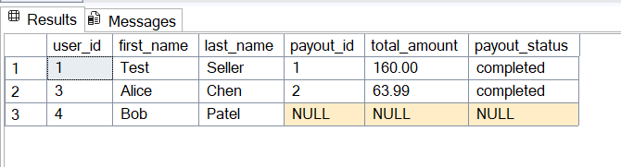
QM9.2: LEFT-OUTER-JOIN-QUERY WITH WHERE CLAUSE
Snapshot of the query output:
Description:
Lists every seller account together with their payout record so the platform can audit which sellers have never received a payout; sellers with no matching payout row appear with NULL in all payout columns.
SQL Query:
SELECT u.user_id, u.first_name, u.last_name,
sp.payout_id, sp.total_amount, sp.payout_status
FROM Users u
LEFT OUTER JOIN Seller_Payouts sp ON u.user_id = sp.seller_id
WHERE u.role = 'seller';

Slide 29
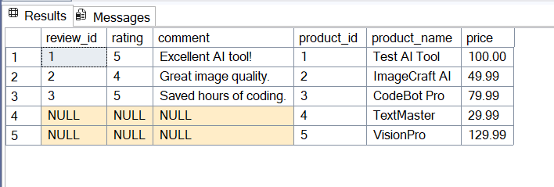
QM9.3: RIGHT-OUTER-JOIN-QUERY WITH WHERE CLAUSE
Snapshot of the query output:
Description:
Displays all active products alongside any reviews they have received so the platform can identify listings with no reviews; products with no reviews appear with NULL in all review columns.
SQL Query:
SELECT r.review_id, r.rating, r.comment,
p.product_id, p.product_name, p.price
FROM Reviews r
RIGHT OUTER JOIN Products p ON r.product_id = p.product_id
WHERE p.status = 'active';

Slide 30
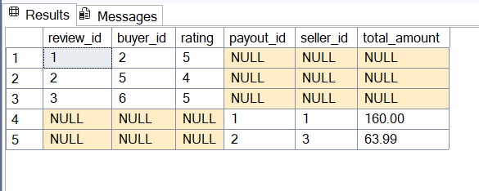
QM9.4: FULL-OUTER-JOIN-QUERY WITH WHERE CLAUSE
Snapshot of the query output:
Description:
Compares buyer review activity against seller payout records to confirm that no single account is simultaneously earning payouts and submitting reviews, ensuring role integrity across all platform users.
SQL Query:
SELECT r.review_id, r.buyer_id, r.rating,
sp.payout_id, sp.seller_id, sp.total_amount
FROM Reviews r
FULL OUTER JOIN Seller_Payouts sp ON r.buyer_id = sp.seller_id
WHERE r.review_id IS NOT NULL OR sp.payout_id IS NOT NULL;

Slide 31
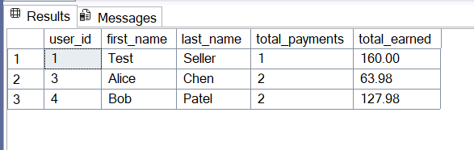
QM10.1: AGGREGATION-JOIN-QUERY WITH GROUP BY & HAVING
Snapshot of the query output:
Description:
Calculates total earnings and payment count per seller to identify high-performing sellers who have collectively earned more than $50 in seller earnings, helping the platform prioritize support and promotional resources.
SQL Query:
SELECT u.user_id, u.first_name, u.last_name,
COUNT(pay.payment_id) AS total_payments,
SUM(pay.seller_earning) AS total_earned
FROM Users u
JOIN Products p ON u.user_id = p.seller_id
JOIN Subscriptions s ON p.product_id = s.product_id
JOIN Payments pay ON s.subscription_id = pay.subscription_id
WHERE u.role = 'seller'
GROUP BY u.user_id, u.first_name, u.last_name
HAVING SUM(pay.seller_earning) > 50.00;

Slide 32
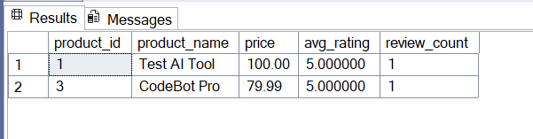
QM10.2: AGGREGATION-JOIN-QUERY WITH SUB-QUERY
Snapshot of the query output:
Description:
Surfaces products whose average customer rating exceeds the platform-wide average rating, giving the marketplace's featured-products algorithm a list of objectively above-average AI tools.
SQL Query:
SELECT p.product_id, p.product_name, p.price,
product_avg.avg_rating,
product_avg.review_count
FROM Products p
JOIN (
SELECT product_id,
ROUND(AVG(CAST(rating AS DECIMAL(5,2))), 2) AS avg_rating,
COUNT(*) AS review_count
FROM Reviews
GROUP BY product_id
) AS product_avg ON p.product_id = product_avg.product_id
WHERE product_avg.avg_rating > (
SELECT AVG(CAST(rating AS DECIMAL(5,2)))
FROM Reviews
);

Slide 33
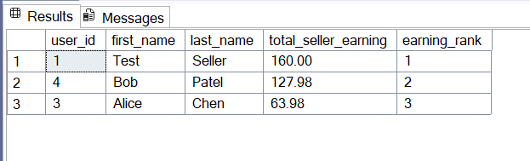
QM11: WITH-QUERY
Snapshot of the query output:
Description:
Uses a CTE to rank sellers by total earnings so the platform can identify top contributors for tiered incentive payouts.
SQL Query:
WITH SellerRevenue AS (
SELECT u.user_id, u.first_name, u.last_name,
SUM(pay.seller_earning) AS total_seller_earning
FROM Users u
JOIN Products p ON u.user_id = p.seller_id
JOIN Subscriptions s ON p.product_id = s.product_id
JOIN Payments pay ON s.subscription_id = pay.subscription_id
WHERE u.role = 'seller'
GROUP BY u.user_id, u.first_name, u.last_name
)
SELECT user_id, first_name, last_name,
total_seller_earning,
RANK() OVER (ORDER BY total_seller_earning DESC) AS earning_rank
FROM SellerRevenue;

Slide 34
ANALYSIS OF DATA
Discuss Functional Dependencies

Slide 35
2NF
For 2NF, we looked at a Product_Tag_Details table that used a composite key made of product_id and tag_id. This table had partial dependencies because product_name, seller_id, and category_id depended only on product_id, while tag_name depended only on tag_id. These attributes did not depend on the whole composite key, so the table violated 2NF.
To normalize it, we moved product-specific attributes into the Products table and tag-specific attributes into the Tags table. Then we kept Product_Tags as a bridge table with only product_id and tag_id to preserve the many-to-many relationship between products and tags.
Full Dependency:
{product_id, tag_id} → {}
Partial Dependency:
{product_id}→ {product_name, seller_id, category_id}
{tag_id}→ {tag_name}
PRODUCT_TAG_DETAILS
Product_id | Tag_id | Product_name | Seller_id | Category_id | Tag_name
101 | 1 | AI Resume Builder | 10 | 2 | NLP
101 | 2 | AI Resume Builder | 10 | 2 | Productivity
102 | 1 | Code Review Bot | 11 | 3 | NLP
PRODUCTS
TAGS
PRODUCT_TAGS
Product_id | Product_name | seller_id | Category_id
101 | AI Resume Builder | 10 | 2
102 | Code Review Bot | 11 | 3
Tag_id | Tag_name
1 | NLP
2 | Productivity
Product_id | Tag_id
101 | 1
101 | 2
102 | 1

Slide 36
3NF
For 3NF, we used a simplified Payment_Details table to show a transitive dependency. Before normalization, the table stored payment information and product information together. The primary key was payment_id. Since payment_id identifies the payment row, it determines product_id. Then product_id determines product_name.
To apply 3NF, we separated the product information from the payment information. The Payments table keeps payment-specific data such as payment_id, product_id, and amount. The Products table stores product-specific data such as product_id and product_name. This removes repeated product names from the payment table and keeps non-key attributes dependent on the key instead of another non-key attribute.
Transitive FD: {payment_id} → {product_id} → {product_name}
PAYMENTS
Payment_id | Product_id | amount
501 | 101 | 20.00
502 | 102 | 35.00
503 | 101 | 20.00
PAYMENT_DETAILS
Payment_id | Product_id | Product_name | amount
501 | 101 | AI Resume Builder | 20.00
502 | 102 | Code Review Bot | 35.00
503 | 101 | AI Resume Builder | 20.00
PRODUCTS
Product_id | Product_name
101 | AI Resume Builder
102 | Code Review Bot

Slide 37
ANALYSIS OF DATA
Discuss Possible Anomalies and Remedies
Instructions:
Provide some sample tuples of your database to discuss possible anomaly issues related to data insertion, update, delete anomalies existing in your database. If does not exist, then add some sample tuples to your tables in your database so that an insertion, an update, and a delete anomaly exist.
Propose remedies with some examples for anomalies existing in the database.

Slide 38
Update Anomaly
Products
If Vendor V1 changes their email, both rows must be updated. If only one row is updated, the same vendor will have two different emails.
ProductID | ProductName | VendorID | VendorEmail
P1 | ChatBot | V1 | vendor@gmail.com
P2 | ImageBot | V1 | vendor@gmail.com

Slide 39
Remedy for the Update Anomaly
Example Illustration:
Explanation:
Store the vendor email once in the Vendors table. Products only store VendorID. Now the email only needs to be updated in one place.
Vendors
VendorID | VendorEmail
V1 | new@gmail.com
Products
ProductID | ProductName | VendorID
P1 | ChatBot | V1
P2 | ImageBot | V1

Slide 40
Insertion Anomaly
Products
ProductID | ProductName | VendorID
P1 | ChatBot | V1
P2 | ImageBot | V2
If the tuple
ProductID | ProductName | VendorID
P3 | StudyBot | V3
Vendors
VendorID | VendorEmail
V1 | vendor@email.com
V2 | seller@email.com
Inserted into Products table,
then the insertions fails. We must insert V3 in the vendors table first. The product depends on a matching vendor record.

Slide 41
Remedy for the Insertion Anomaly
Example Illustration:
Explanation:
Insert the new vendor first, then insert the product that references that vendor. This keeps the relationship valid and prevents orphan product records.
Vendors
VendorID | VendorEmail
V1 | new@gmail.com
V3 | newVendor@gmail.com
Step 1: insert new vendor
Products
ProductID | ProductName | VendorID
P1 | ChatBot | V1
P2 | ImageBot | V2
P3 | StudyBot | V3
Step 2: insert new product

Slide 42
Deletion Anomaly
If the tuple
Products
ProductID | ProductName | VendorID
P1 | ChatBot | V1
P2 | ImageBot | V2
VendorID | VendorEmail
V1 | vendor@email.com
Is deleted
Then product P1 still references it. This creates an invalid reference because the product points to a vendor that no longer exists
Vendors
VendorID | VendorEmail
V1 | vendor@email.com
V2 | seller@email.com

Slide 43
Remedy for the Deletion Anomaly
Example Illustration:
Explanation:
The remedy is to enforce a foreign key between Products.VendorID and Vendors.VendorID. The database should prevent deleting VendorID V1 while products still reference it.
Products
ProductID | ProductName | VendorID
P1 | ChatBot | V1
P2 | ImageBot | V2
Vendors
FK
VendorID | VendorEmail
V1 | vendor@email.com
V2 | seller@email.com

Slide 44
Credits and References
- SQL Server 2022 Documentation
https://learn.microsoft.com/en-us/sql/sql-server/

