Slide 1
Project Assignment 2
You must exactly follow this template.
Do not change the order and the format.
No background coloring or formatting.
TEAM MANGO
Adam Rodi, Samiksha Gnawali, Suyog Karki

Slide 2
DDL QUERIES
Instructions:
- must include ALL queries listed in Queries.sql
- must follow the exact format provided in the template slide

Slide 3
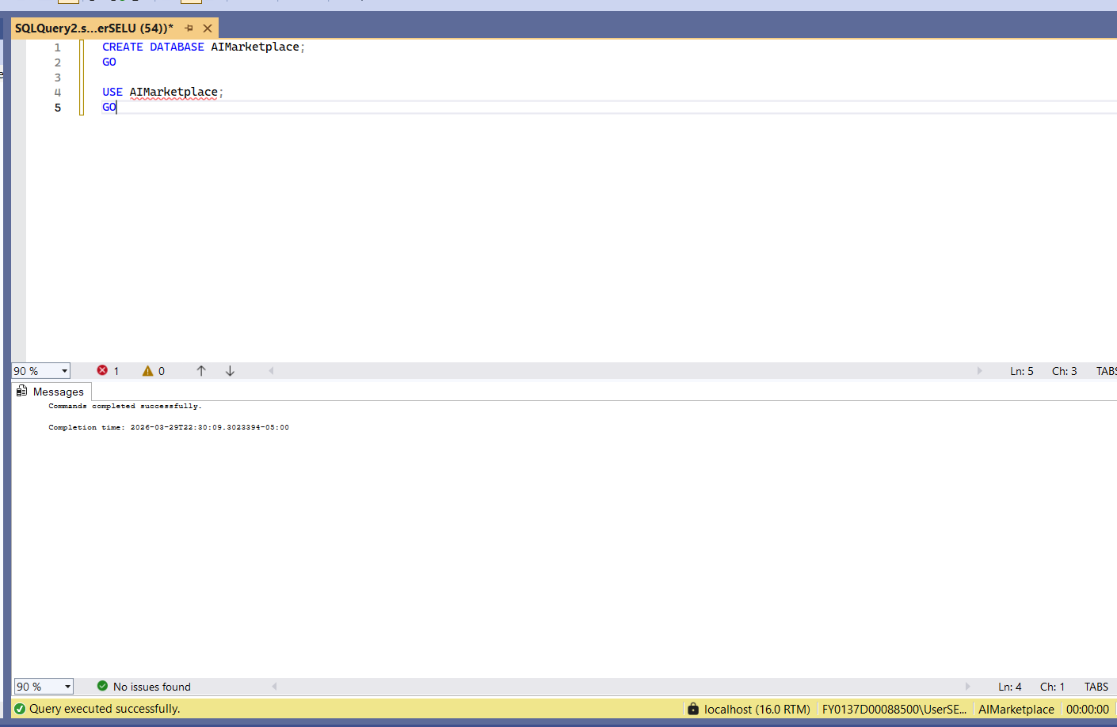
QD1: CREATE TABLE
Snapshot of the query output:
Description:
Create and select the database
SQL Query: CREATE DATABASE AIMarketplace;
GO
USE AIMarketplace;
GO

Slide 4
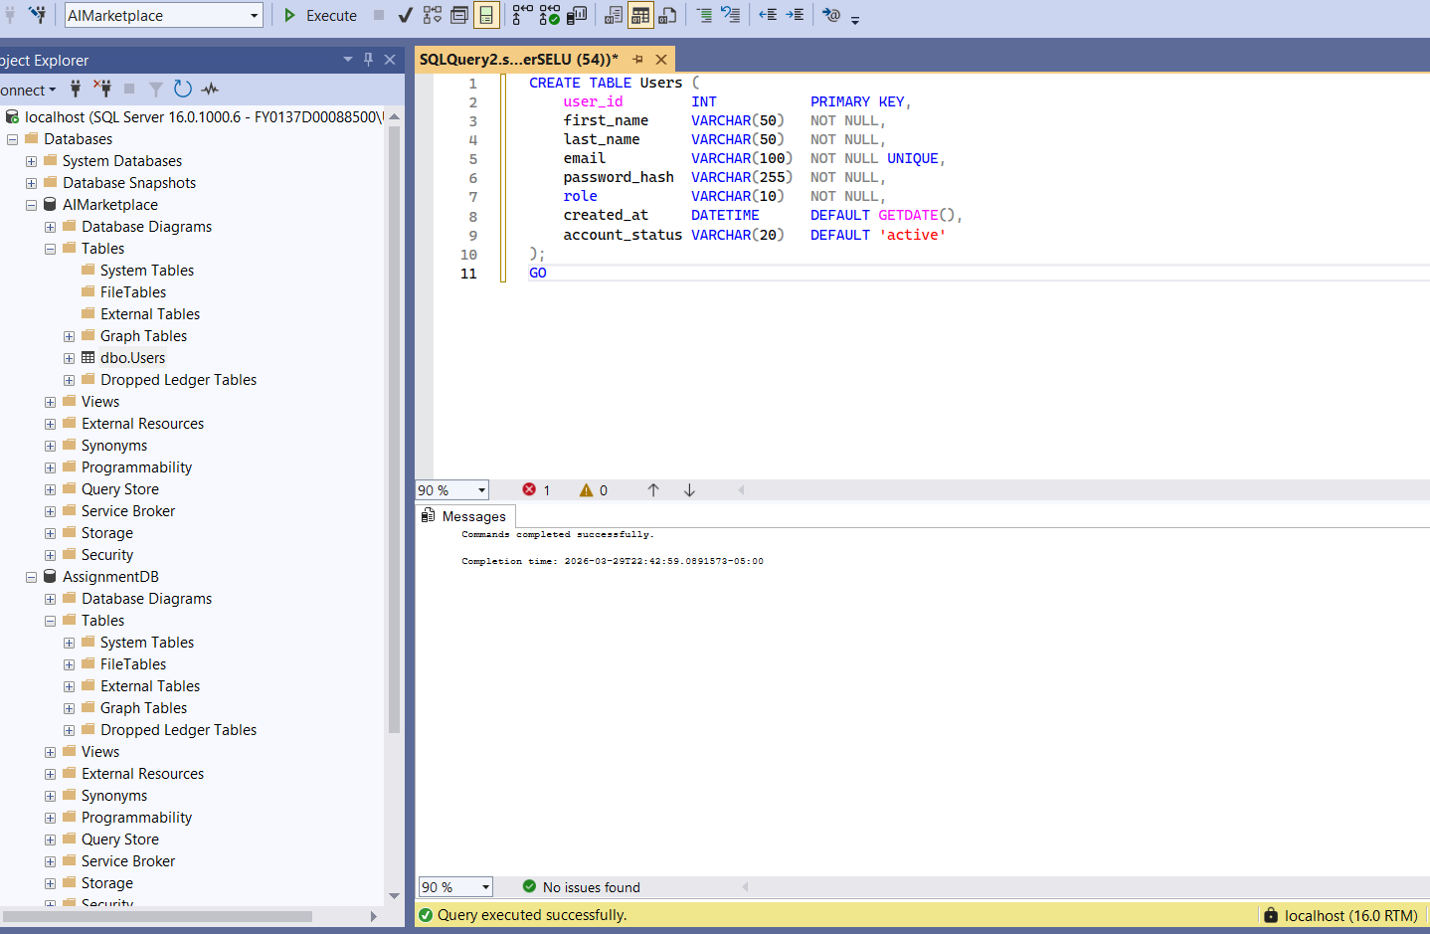
QD1: CREATE TABLE
Snapshot of the query output:
Description:
Create User for the AI Marketplace Platform.
SQL Query:
CREATE TABLE Users (
user_id INT PRIMARY KEY,
first_name VARCHAR(50) NOT NULL,
last_name VARCHAR(50) NOT NULL,
email VARCHAR(100) NOT NULL UNIQUE,
password_hash VARCHAR(255) NOT NULL,
role VARCHAR(10) NOT NULL,
created_at DATETIME DEFAULT GETDATE(),
account_status VARCHAR(20) DEFAULT 'active'
);
GO

Slide 5
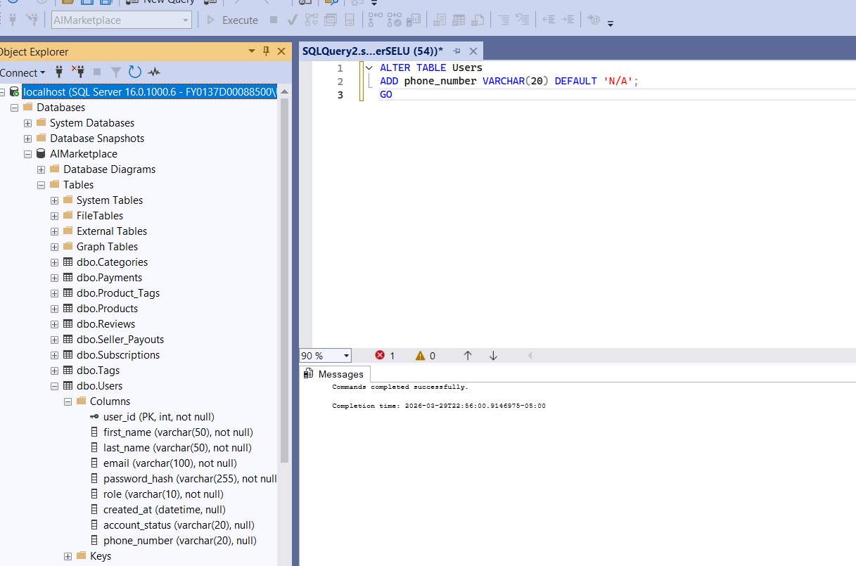
QD2: ALTER TABLE
Snapshot of the query output:
Description: Alter User table by Adding a phone_number column to store seller contact information on the platform.
SQL Query:
ALTER TABLE Users
ADD phone_number VARCHAR(20) DEFAULT 'N/A';
GO

Slide 6
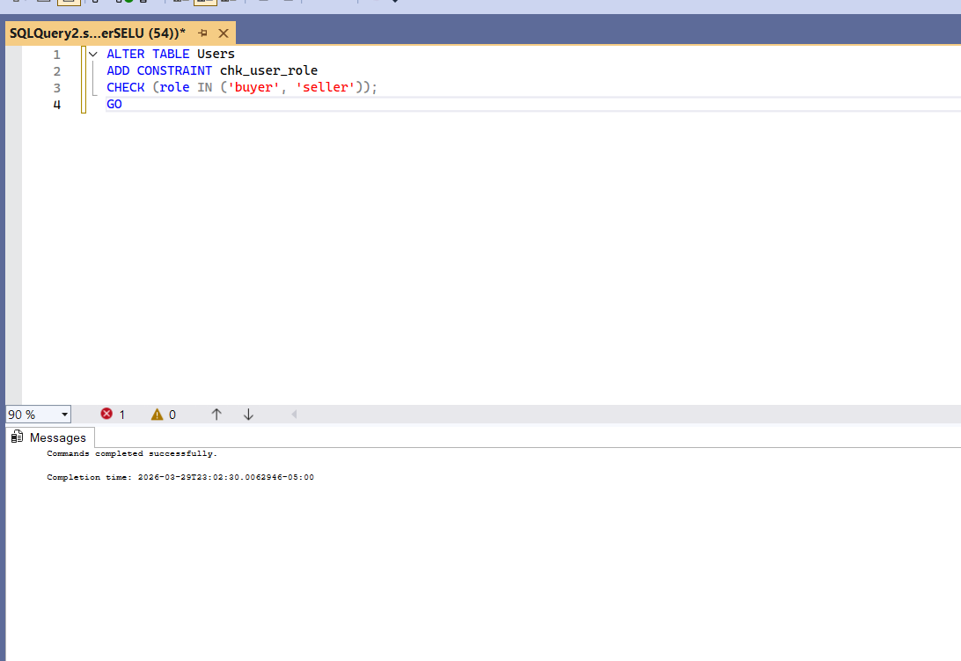
QD3: ADD "CHECK" CONSTRAINT
Snapshot of the query output:
Description:
Check constraint by ensuring that a user's role can only be assigned as either 'buyer' or 'seller'
SQL Query:
ALTER TABLE Users
ADD CONSTRAINT chk_user_role
CHECK (role IN ('buyer', 'seller'));
GO

Slide 7
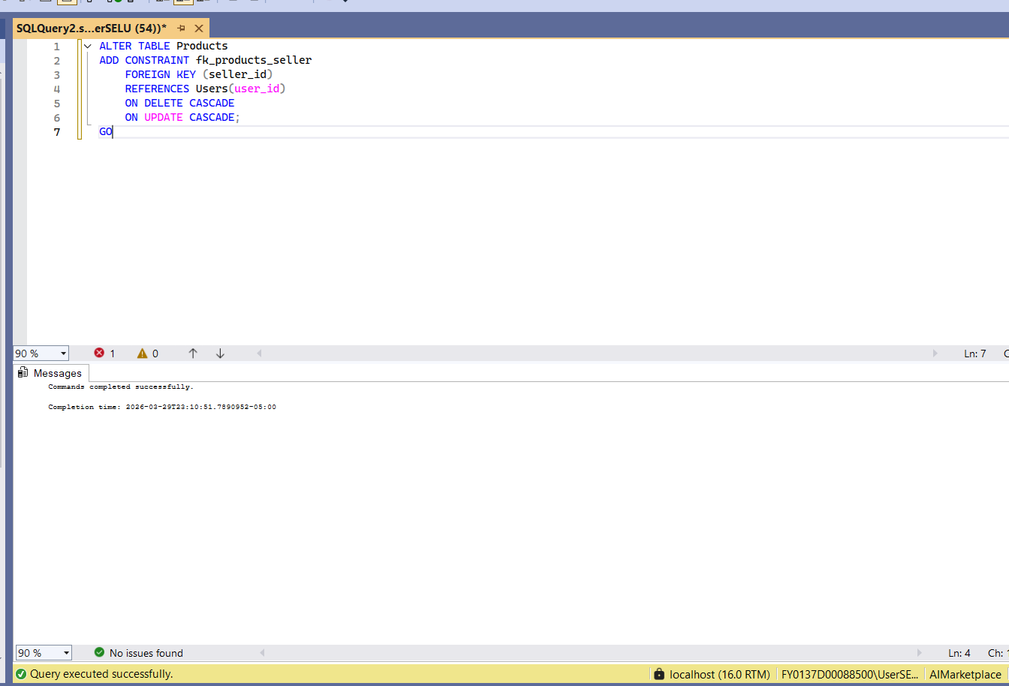
QD4: ADD FK CONSTRAINT(S) TO THE TABLE
Snapshot of the query output:
Description:
Adds a foreign key constraint linking each product to a valid seller in the Users table
SQL Query: ALTER TABLE Products
ADD CONSTRAINT fk_products_seller
FOREIGN KEY (seller_id)
REFERENCES Users(user_id)
ON DELETE CASCADE
ON UPDATE CASCADE;
GO

Slide 8
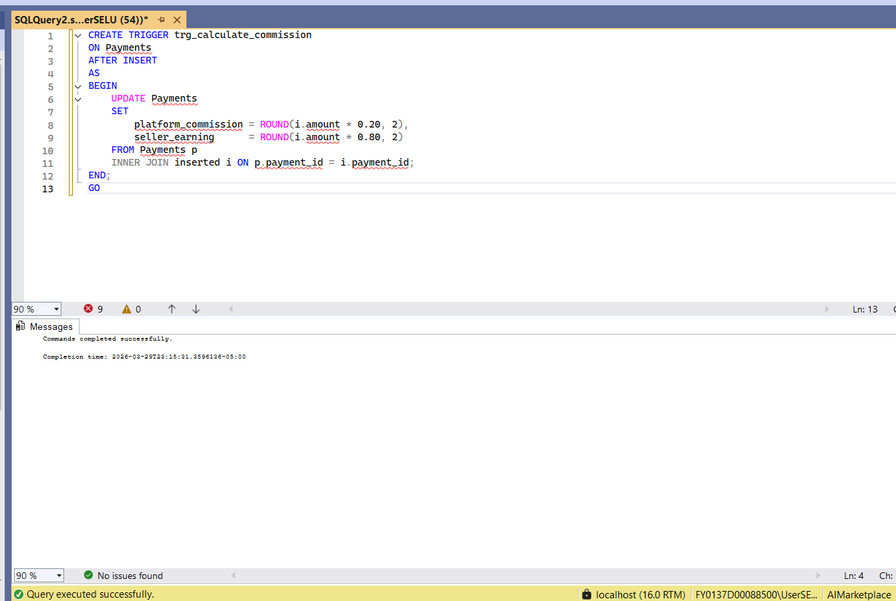
QD5: Create TRIGGER
Snapshot of the query output:
Description:
Create trigger to calculate the platform commission (20%) and seller earning (80%) whenever a new payment is inserted into the Payments table.
SQL Query:
CREATE TRIGGER trg_calculate_commission
ON Payments
AFTER INSERT
AS
BEGIN
UPDATE Payments
SET
platform_commission = ROUND(i.amount * 0.20, 2),
seller_earning = ROUND(i.amount * 0.80, 2)
FROM Payments p
INNER JOIN inserted i ON p.payment_id = i.payment_id;
END;
GO

Slide 9
DML QUERIES
Instructions:
- must include ALL queries listed in Queries.sql
- must follow the exact format provided in the template slide

Slide 10
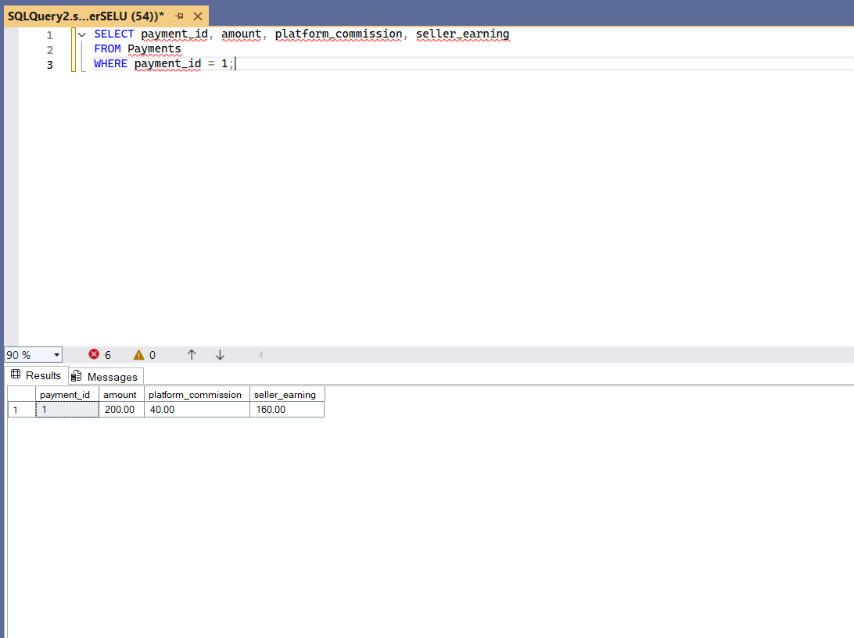
QM1.1: A TEST QUERY FOR THE TRIGGER CREATED in QD5
Snapshot of the query output:
Description:
test trigger for calculating commission and earnings.
SQL Query:
SELECT payment_id, amount, platform_commission, seller_earning
FROM Payments
WHERE payment_id = 1;

Slide 11
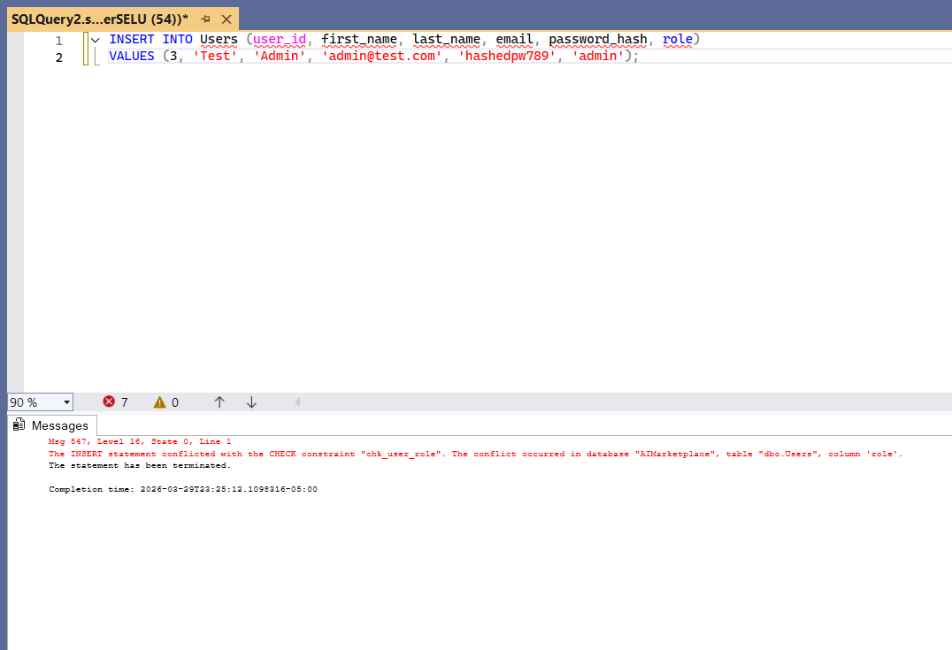
QM1.2: A TEST QUERY FOR THE "CHECK" CONSTRAINT DEFINED in QD3
Snapshot of the query output:
Description:
Tests constraint by attempting to insert a user with an invalid role, which should be rejected.
SQL Query:
INSERT INTO Users (user_id, first_name, last_name, email, password_hash, role)
VALUES (3, 'Test', 'Admin', 'admin@test.com', 'hashedpw789', 'admin');

Slide 12
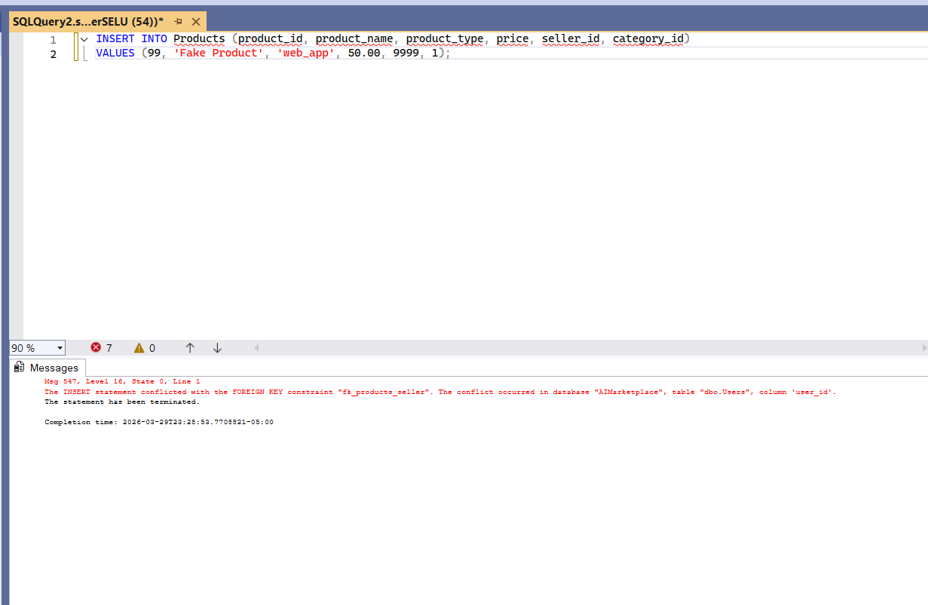
QM1.3: A TEST QUERY FOR THE FK CONSTRAINT DEFINED in QD4
Snapshot of the query output:
Description:
Tests constraint by attempting to insert a product with a non-existent seller, which should be rejected.
SQL Query:
INSERT INTO Products (product_id, product_name, product_type, price, seller_id, category_id)
VALUES (99, 'Fake Product', 'web_app', 50.00, 9999, 1);

Slide 13
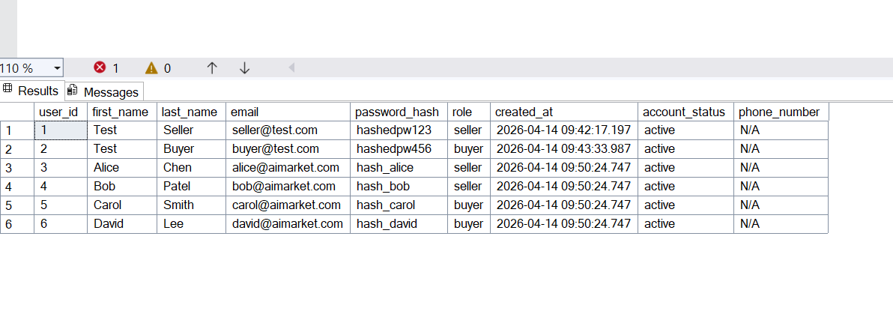
QM2: INSERT DATA
Snapshot of the query output:
Description: Populates the marketplace with additional sellers, buyers, categories, AI products, subscriptions, payments, reviews, tags, and seller payouts to represent a realistic set of platform activity.
SQL Query:
INSERT INTO Users (user_id, first_name, last_name, email, password_hash, role)
VALUES
(3, 'Alice', 'Chen', 'alice@aimarket.com', 'hash_alice', 'seller'),
(4, 'Bob', 'Patel', 'bob@aimarket.com', 'hash_bob', 'seller'),
(5, 'Carol', 'Smith', 'carol@aimarket.com', 'hash_carol', 'buyer'),
(6, 'David', 'Lee', 'david@aimarket.com', 'hash_david', 'buyer');

Slide 14
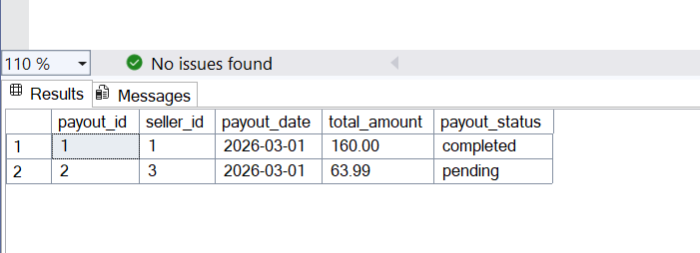
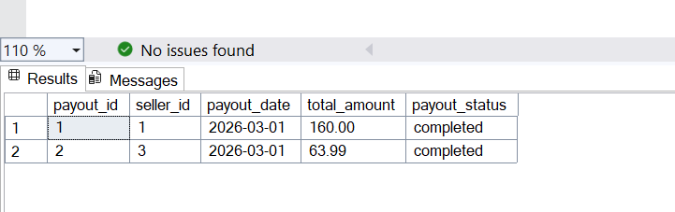
QM3: UPDATE DATA
Snapshot of the query output:
Description:
Marks all pending seller payouts older than 30 days as completed to reflect disbursements that have been successfully processed by the platform.
SQL Query:
UPDATE Seller_Payouts
SET payout_status = 'completed'
WHERE payout_status = 'pending'
AND payout_date <= DATEADD(DAY, -30, GETDATE());

Slide 15
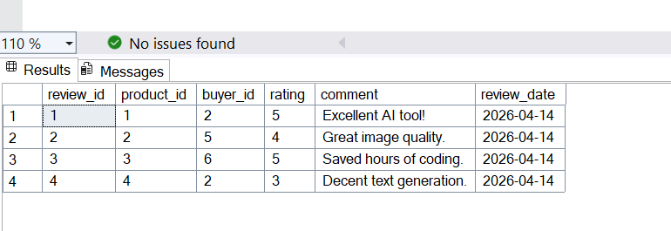
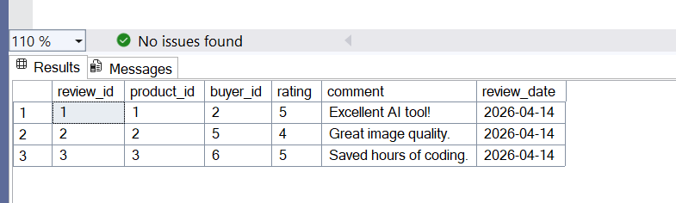
QM4: DELETE DATA
Snapshot of the query output:
Description:
Removes a buyer's review that was submitted in error for a product they did not use long enough to evaluate, maintaining rating accuracy on the platform.
SQL Query:
DELETE FROM Reviews
WHERE review_id = 4;

Slide 16
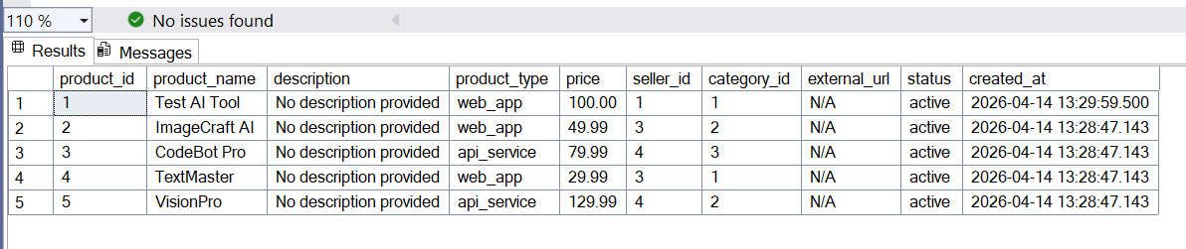
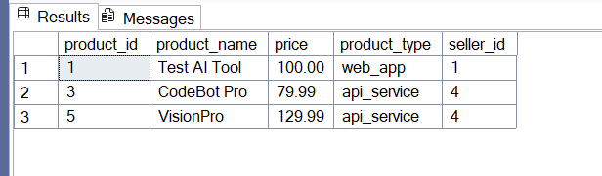
QM5: QUERY DATA WITH WHERE CLAUSE
Snapshot of the query output:
Description:
Retrieves all active products priced above $75 to help buyers browse the platform's premium AI tool offerings.
SQL Query:
SELECT product_id, product_name, price, product_type, seller_id
FROM Products
WHERE price > 75.00
AND status = 'active';

Slide 17
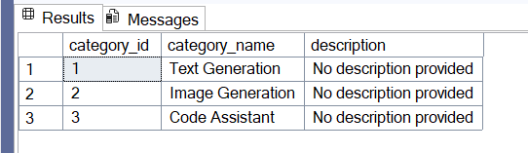
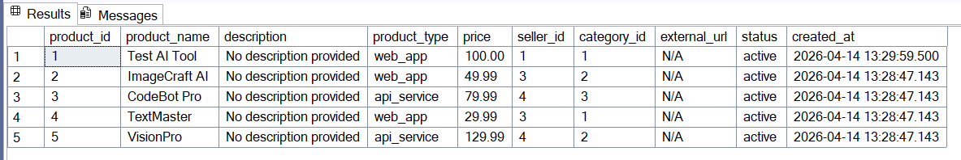
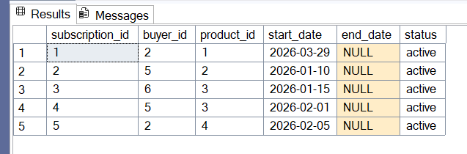
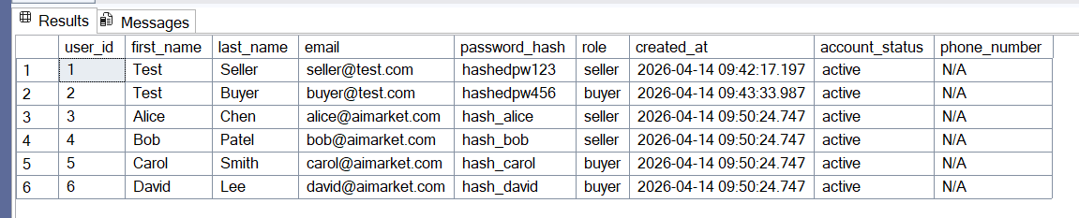
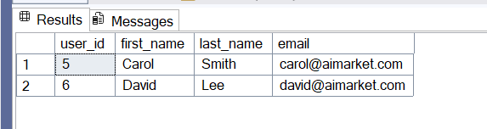
QM6.1: QUERY DATA WITH 'SUB-QUERY IN WHERE CLAUSE'
Snapshot of the query output:
Description:
Retrieves all buyers who hold an active subscription to at least one Code Assistant product to identify the platform's active developer user base.
SQL Query:
SELECT user_id, first_name, last_name, email
FROM Users
WHERE role = 'buyer'
AND user_id IN (
SELECT s.buyer_id
FROM Subscriptions s
JOIN Products p ON s.product_id = p.product_id
JOIN Categories c ON p.category_id = c.category_id
WHERE c.category_name = 'Code Assistant'
AND s.status = 'active'
);

Slide 18
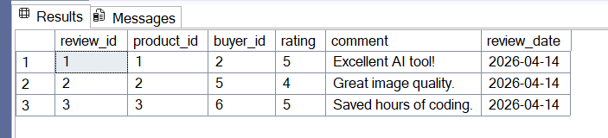
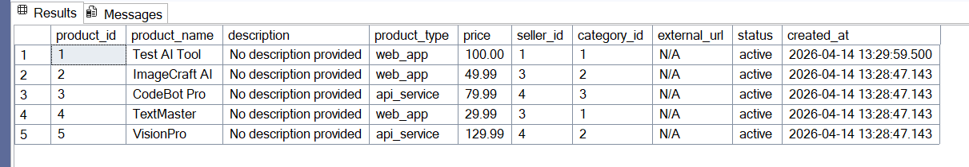
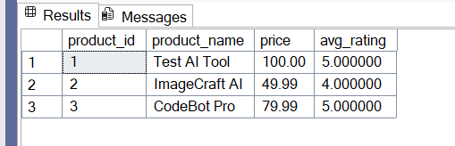
QM6.2: QUERY DATA WITH SUB-QUERY IN FROM CLAUSE
Snapshot of the query output:
Description:
Displays each listed product alongside its average customer rating to help the platform surface high-performing AI tools for its featured section.
SQL Query:
SELECT p.product_id, p.product_name, p.price, avg_r.avg_rating
FROM Products p
JOIN (
SELECT product_id,
ROUND(AVG(CAST(rating AS DECIMAL(5,2))), 2) AS avg_rating
FROM Reviews
GROUP BY product_id
) AS avg_r ON p.product_id = avg_r.product_id;

Slide 19
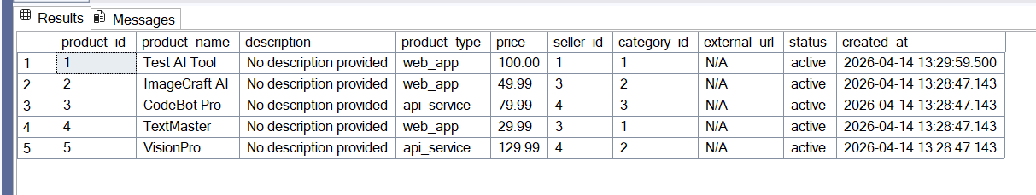
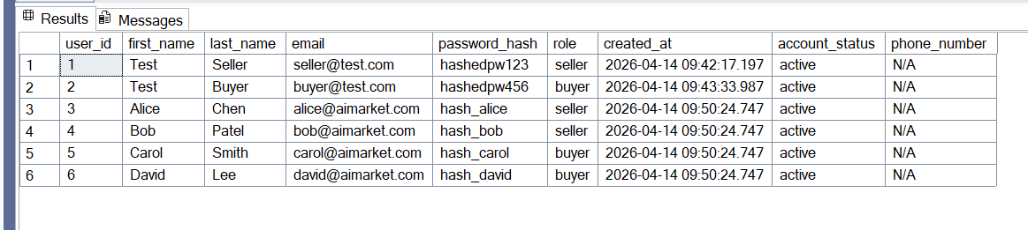
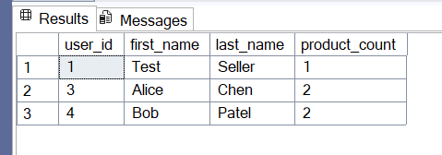
QM6.3: QUERY DATA WITH 'SUB-QUERY IN SELECT CLAUSE'
Snapshot of the query output:
Description:
Lists every seller account alongside the number of AI products they have published, giving the platform a quick view of individual seller activity levels.
SQL Query:
SELECT
u.user_id,
u.first_name,
u.last_name,
(SELECT COUNT(*)
FROM Products p
WHERE p.seller_id = u.user_id) AS product_count
FROM Users u
WHERE u.role = 'seller';

Slide 20
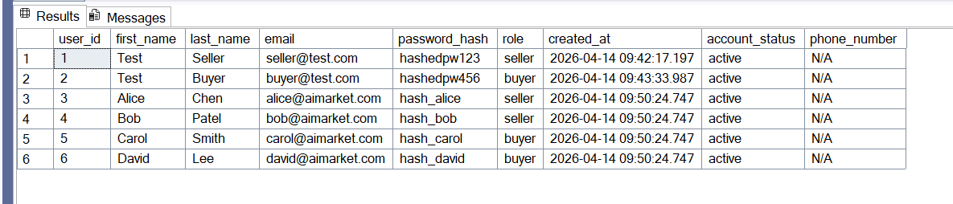
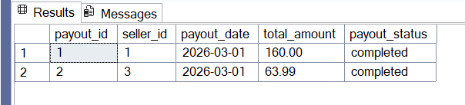
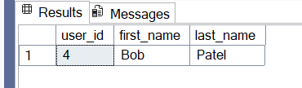
QM7: QUERY DATA WITH EXCEPT
Snapshot of the query output:
Description:
Identifies sellers who have published products but have never received a payout, flagging accounts that may be owed earnings by the platform.
SQL Query:
SELECT u.user_id, u.first_name, u.last_name
FROM Users u
WHERE u.role = 'seller'
EXCEPT
SELECT u.user_id, u.first_name, u.last_name
FROM Users u
JOIN Seller_Payouts sp ON u.user_id = sp.seller_id;

Slide 21
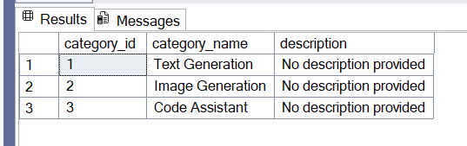
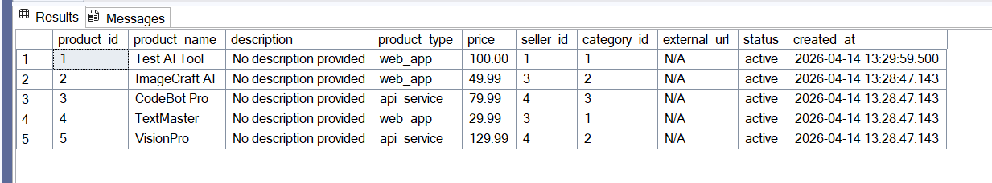
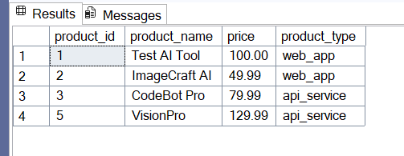
QM8.1: QUERY DATA WITH ANY/SOME
Snapshot of the query output:
Description:
Finds all products priced higher than at least one Text Generation product, helping buyers compare costs against the platform's baseline AI text tools.
SQL Query:
SELECT product_id, product_name, price, product_type
FROM Products
WHERE price > ANY (
SELECT p.price
FROM Products p
JOIN Categories c ON p.category_id = c.category_id
WHERE c.category_name = 'Text Generation'
);

Slide 22
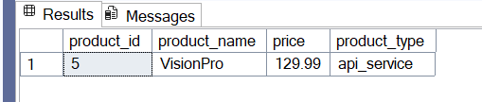
QM8.2: QUERY DATA WITH ALL in front of a sub-query
Snapshot of the query output:
Description:
Retrieves products whose price exceeds every Text Generation product on the platform, identifying the most premium AI tools relative to the text-generation tier.
SQL Query:
SELECT product_id, product_name, price, product_type
FROM Products
WHERE price > ALL (
SELECT p.price
FROM Products p
JOIN Categories c ON p.category_id = c.category_id
WHERE c.category_name = 'Text Generation'
);

Slide 23
QM9.1: INNER-JOIN-QUERY WITH WHERE CLAUSE
Snapshot of the query output:
Description:
Retrieves each active subscriber's name alongside the product they purchased and the platform's commission split for that payment, giving finance a breakdown of revenue for premium-priced subscriptions.
SQL Query:
SELECT u.first_name, u.last_name,
p.product_name, p.price,
pay.amount, pay.platform_commission, pay.seller_earning
FROM Payments pay
INNER JOIN Subscriptions s ON pay.subscription_id = s.subscription_id
INNER JOIN Users u ON s.buyer_id = u.user_id
INNER JOIN Products p ON s.product_id = p.product_id
WHERE p.price > 30.00
AND s.status = 'active';

Slide 24
QM9.2: LEFT-OUTER-JOIN-QUERY WITH WHERE CLAUSE
Snapshot of the query output:
Description:
Lists every seller account together with their payout record so the platform can audit which sellers have never received a payout; sellers with no matching payout row appear with NULL in all payout columns.
SQL Query:
SELECT u.user_id, u.first_name, u.last_name,
sp.payout_id, sp.total_amount, sp.payout_status
FROM Users u
LEFT OUTER JOIN Seller_Payouts sp ON u.user_id = sp.seller_id
WHERE u.role = 'seller';

Slide 25
QM9.3: RIGHT-OUTER-JOIN-QUERY WITH WHERE CLAUSE
Snapshot of the query output:
Description:
Displays all active products alongside any reviews they have received so the platform can identify listings with no reviews; products with no reviews appear with NULL in all review columns.
SQL Query:
SELECT r.review_id, r.rating, r.comment,
p.product_id, p.product_name, p.price
FROM Reviews r
RIGHT OUTER JOIN Products p ON r.product_id = p.product_id
WHERE p.status = 'active';

Slide 26
QM9.4: FULL-OUTER-JOIN-QUERY WITH WHERE CLAUSE
Snapshot of the query output:
Description:
Compares buyer review activity against seller payout records to confirm that no single account is simultaneously earning payouts and submitting reviews, ensuring role integrity across all platform users.
SQL Query:
SELECT r.review_id, r.buyer_id, r.rating,
sp.payout_id, sp.seller_id, sp.total_amount
FROM Reviews r
FULL OUTER JOIN Seller_Payouts sp ON r.buyer_id = sp.seller_id
WHERE r.review_id IS NOT NULL OR sp.payout_id IS NOT NULL;

Slide 27
QM10.1: AGGREGATION-JOIN-QUERY WITH GROUP BY & HAVING
Snapshot of the query output:
Description:
Calculates total earnings and payment count per seller to identify high-performing sellers who have collectively earned more than $50 in seller earnings, helping the platform prioritize support and promotional resources.
SQL Query:
SELECT u.user_id, u.first_name, u.last_name,
COUNT(pay.payment_id) AS total_payments,
SUM(pay.seller_earning) AS total_earned
FROM Users u
JOIN Products p ON u.user_id = p.seller_id
JOIN Subscriptions s ON p.product_id = s.product_id
JOIN Payments pay ON s.subscription_id = pay.subscription_id
WHERE u.role = 'seller'
GROUP BY u.user_id, u.first_name, u.last_name
HAVING SUM(pay.seller_earning) > 50.00;

Slide 28
QM10.2: AGGREGATION-JOIN-QUERY WITH SUB-QUERY
Snapshot of the query output:
Description:
Surfaces products whose average customer rating exceeds the platform-wide average rating, giving the marketplace's featured-products algorithm a list of objectively above-average AI tools.
SQL Query:
SELECT p.product_id, p.product_name, p.price,
product_avg.avg_rating,
product_avg.review_count
FROM Products p
JOIN (
SELECT product_id,
ROUND(AVG(CAST(rating AS DECIMAL(5,2))), 2) AS avg_rating,
COUNT(*) AS review_count
FROM Reviews
GROUP BY product_id
) AS product_avg ON p.product_id = product_avg.product_id
WHERE product_avg.avg_rating > (
SELECT AVG(CAST(rating AS DECIMAL(5,2)))
FROM Reviews
);

Slide 29
QM11: WITH-QUERY
Snapshot of the query output:
Description:
Uses a CTE to rank sellers by total earnings so the platform can identify top contributors for tiered incentive payouts.
SQL Query:
WITH SellerRevenue AS (
SELECT u.user_id, u.first_name, u.last_name,
SUM(pay.seller_earning) AS total_seller_earning
FROM Users u
JOIN Products p ON u.user_id = p.seller_id
JOIN Subscriptions s ON p.product_id = s.product_id
JOIN Payments pay ON s.subscription_id = pay.subscription_id
WHERE u.role = 'seller'
GROUP BY u.user_id, u.first_name, u.last_name
)
SELECT user_id, first_name, last_name,
total_seller_earning,
RANK() OVER (ORDER BY total_seller_earning DESC) AS earning_rank
FROM SellerRevenue;

Slide 30
Credits and References
- SQL Server 2022 Documentation
https://learn.microsoft.com/en-us/sql/sql-server/

