Slide 1

What is git?

Slide 2


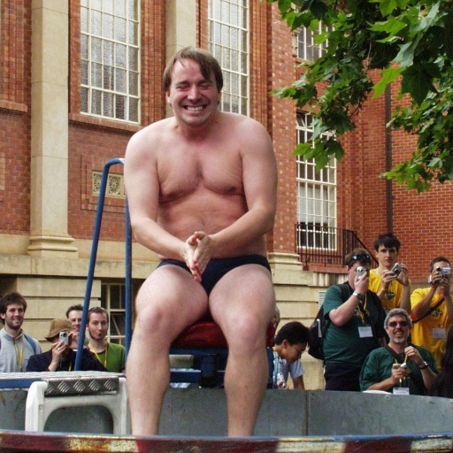
History of git

Slide 3





Other open source VCS

Slide 4
3 Core VCS functions
1. Storing Content
2. Tracking changes to content and merge metadata
3. Distributing content and history among collaborators

Slide 5
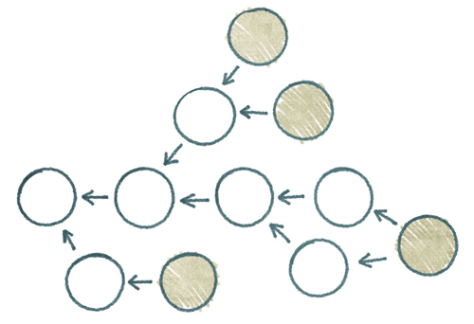
Directed Acyclic Graphs

Slide 6

Toolkit

Slide 7
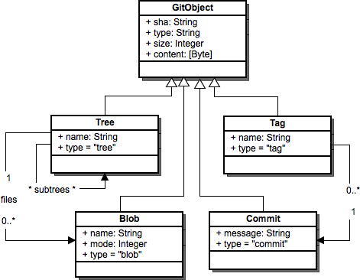
Object Database

Slide 8
