Slide 1
Mechanics of Model Training

Slide 2
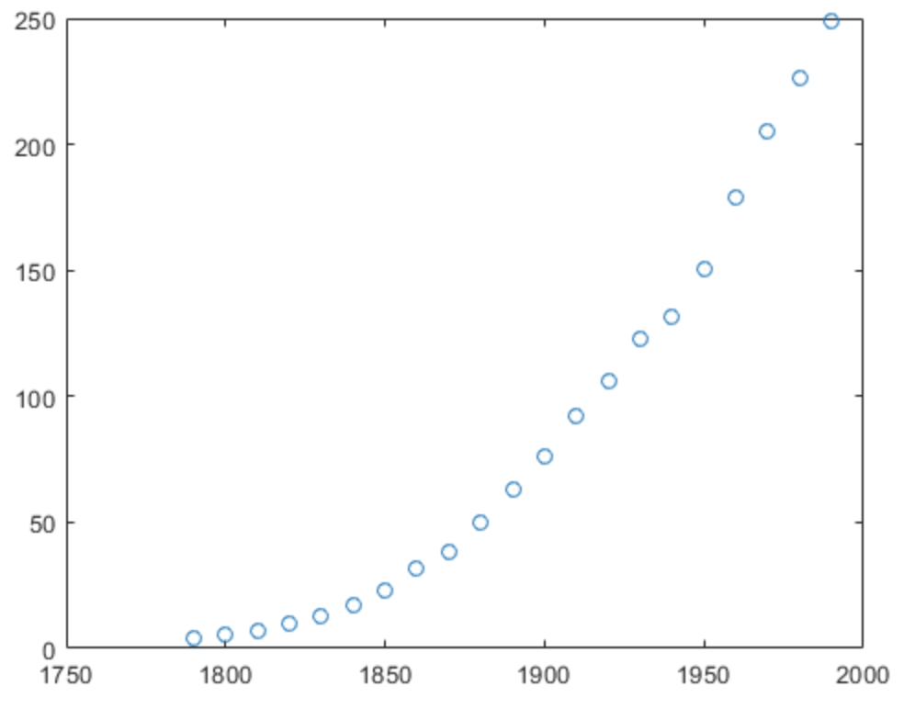
Model fitting is algorithm teaching
US Population

Slide 3
y=ax + b
US Population

Slide 4
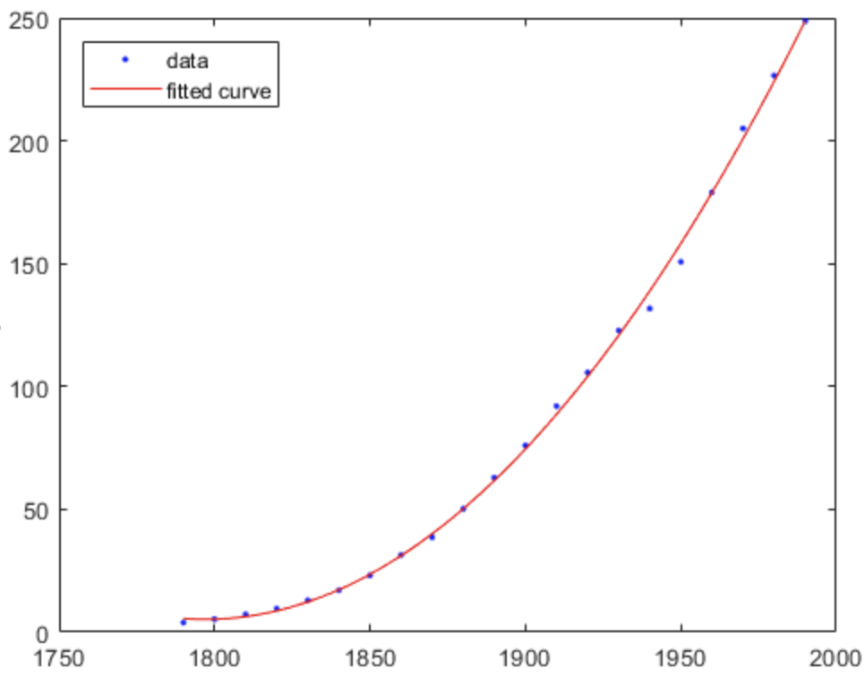
y=ax + bx² + cx³ + dx⁴ + ex⁵ + fx⁶ + g
US Population
Much better fit to the data!

Slide 5
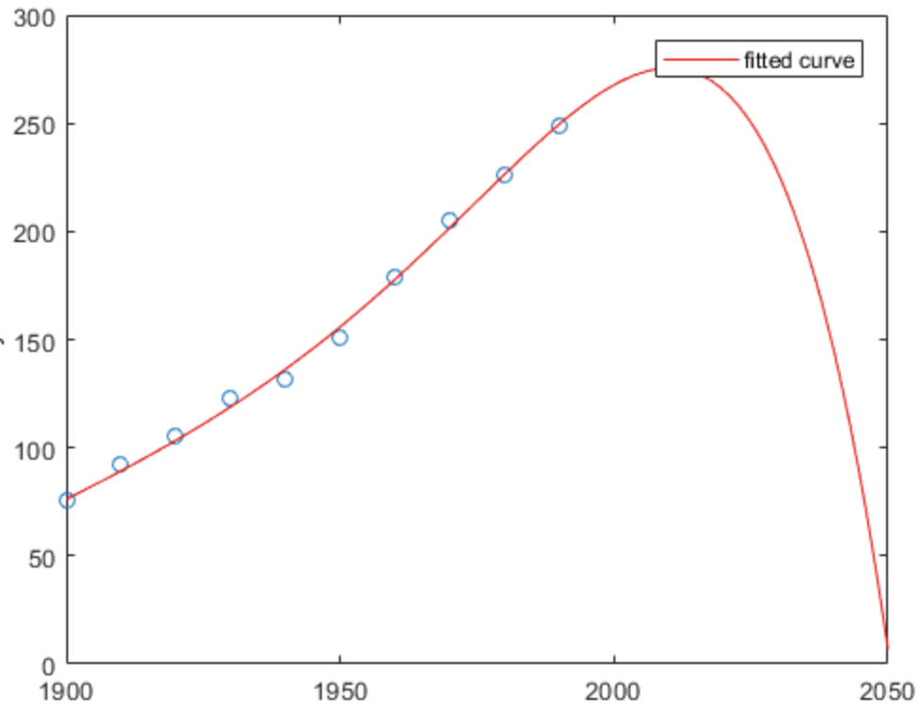
y=ax + bx² + cx³ + dx⁴ + ex⁵ + fx⁶ + g
US Population
Whoops! Guess there is an apocalypse

Slide 6
Generalization to new data is the only part that matters with AI
How you develop the model is as important and there are standards in the field

Slide 7
Predictive performance is evaluated in test data
Split the data
Training
Testing

Slide 8
y = mx + b
Learn m and b
Test m and b
Training
Testing

Slide 9
Why?
We care about the generalizability of any solution
Error = 1.7
Error = 5.9

Slide 10
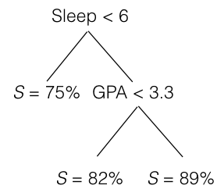
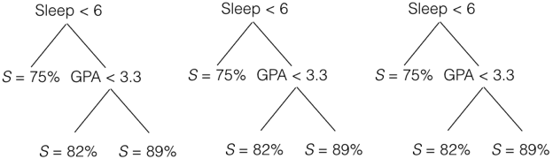
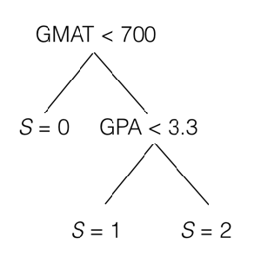
Why?
Algorithms can be tuned — must make sure it generalizes
Random Forests
or
Your choice

Slide 11
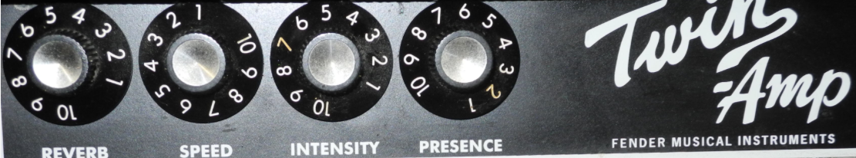
Every ML/AI solution has one
or more tunable “knobs”

Slide 12
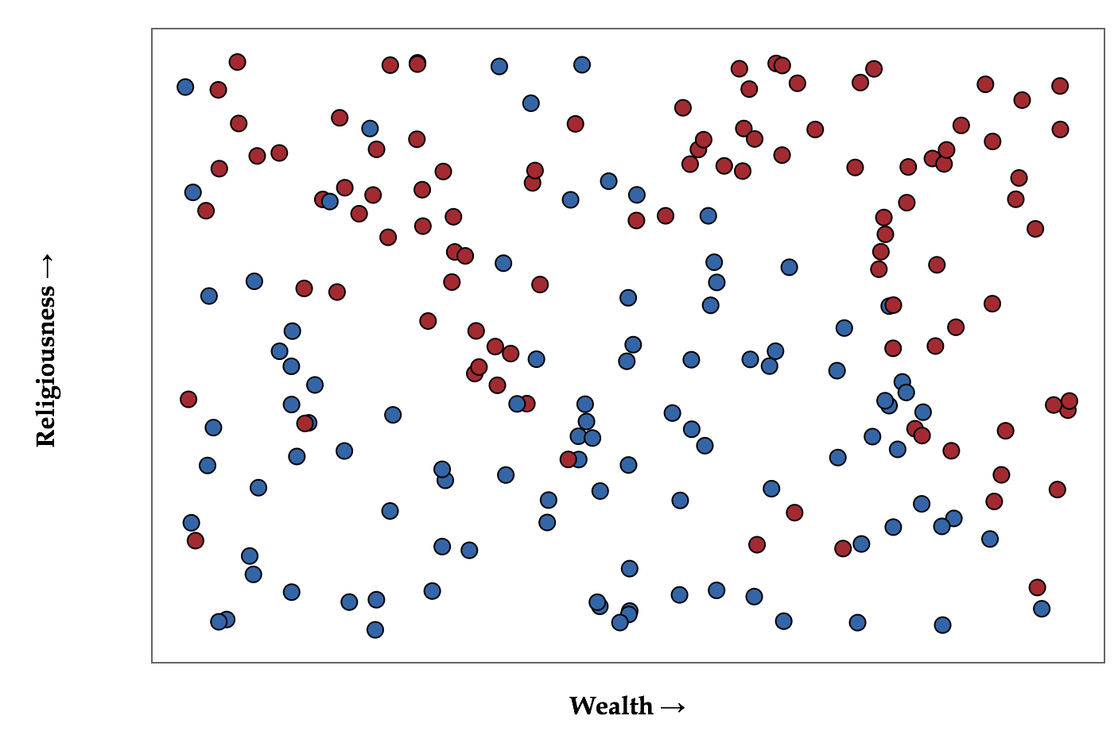
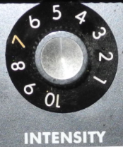
Want to predict political party from religiousness and wealth
Use a simple algorithm k nearest neighbors
Ask closest k neighbors what they are,
you will be whatever the majority is
k is our knob
http://scott.fortmann-roe.com/docs/BiasVariance.html

Slide 13
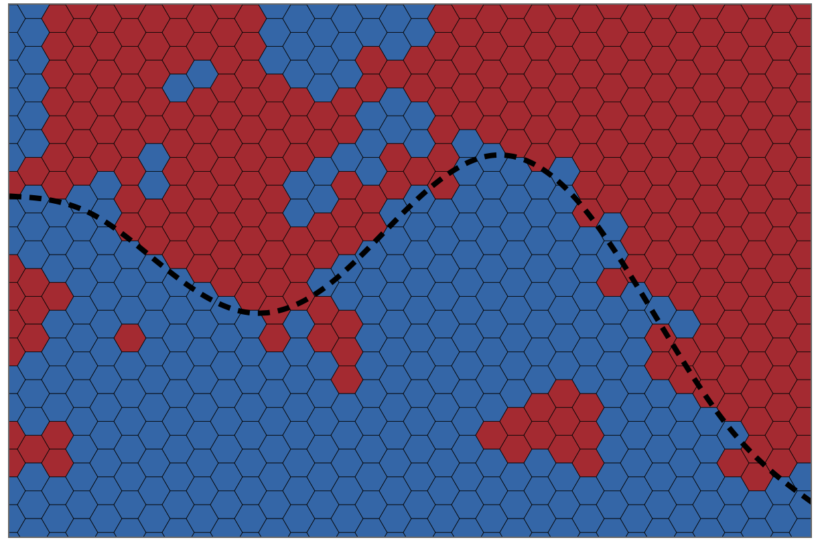
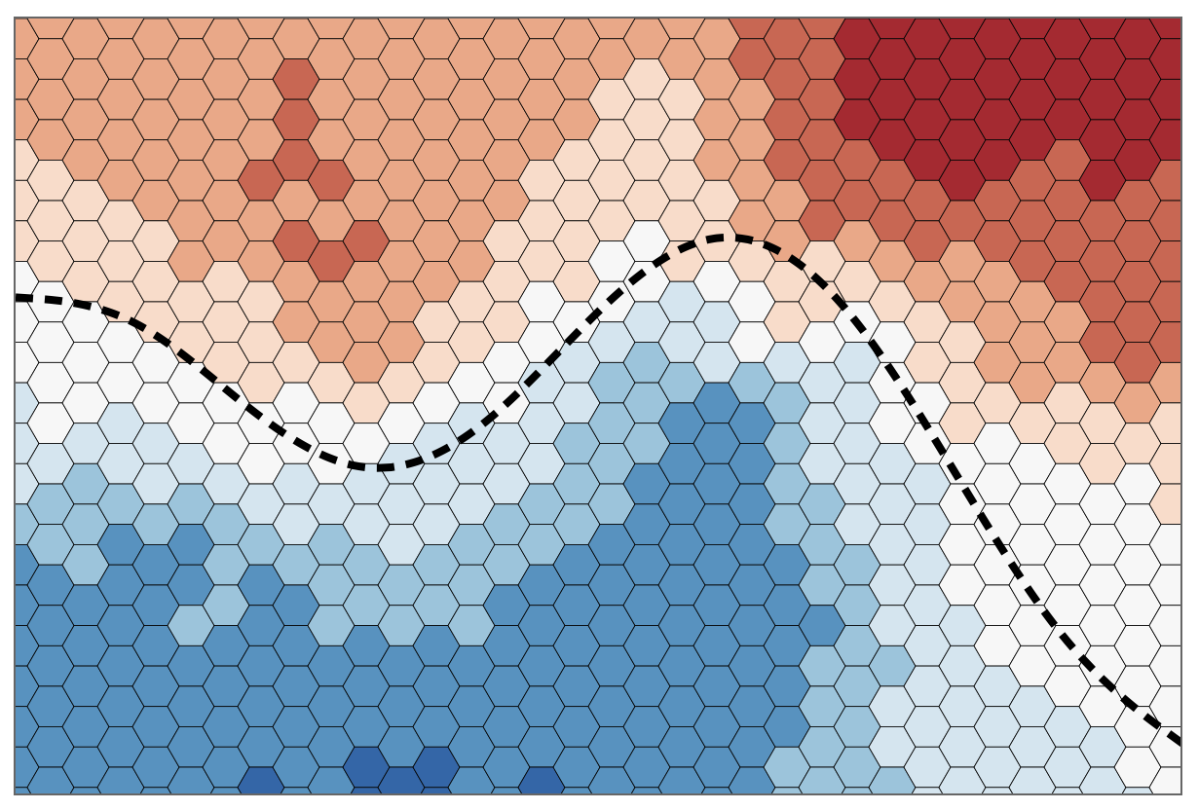
Or make some mistakes,
but be more general
You could perfectly predict
what you see

Slide 14
You could perfectly predict
what you see
Or make some mistakes,
but be more general
low bias
high variance
high bias
low variance
Over-explaining
observed data
Under-explaining
observed data

Slide 15
bias - learning the wrong thing because the machine
doesn’t consider enough about the data
high bias = under-fitting
variance - highly sensitive to fluctuations in the data
high variance = over-fitting

Slide 16
There is a inescapable tradeoff between bias and variance
bias
variance
Absolute Error = Bias² + Variance + Noise

Slide 17
Standard approach to data and testing
Training (70-80% of data)
Testing (20-30% of data)

Slide 18
More principled approach
Training (60% of data)
Testing (20% of data)
Validation (20% of data)
Model Training
Evaluate model once

Slide 19
More principled approach
or k-fold
cross-validation
Validation (20% of data)
Model Training
Evaluate model once

Slide 20
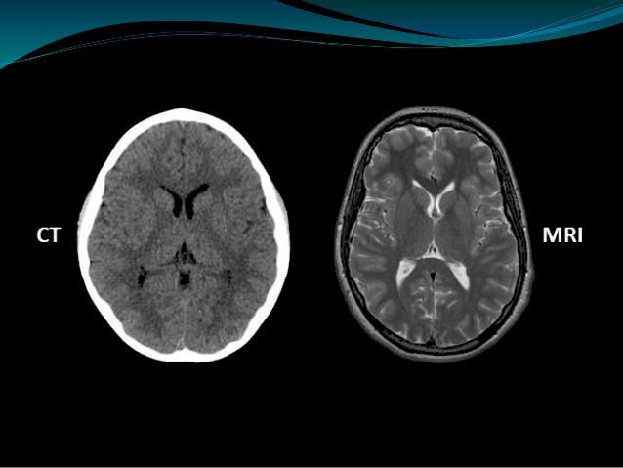
So is it all about numbers and metrics?
Human accuracy:
88%
Human accuracy:
52%
Is an ML solution that is 90% accurate for one problem…
…better than an ML solution that is 70% accurate for a different problem?

Slide 21
AI performance really only matters
in comparison to human performance
and scaling/amount of time the task takes

