Slide 1

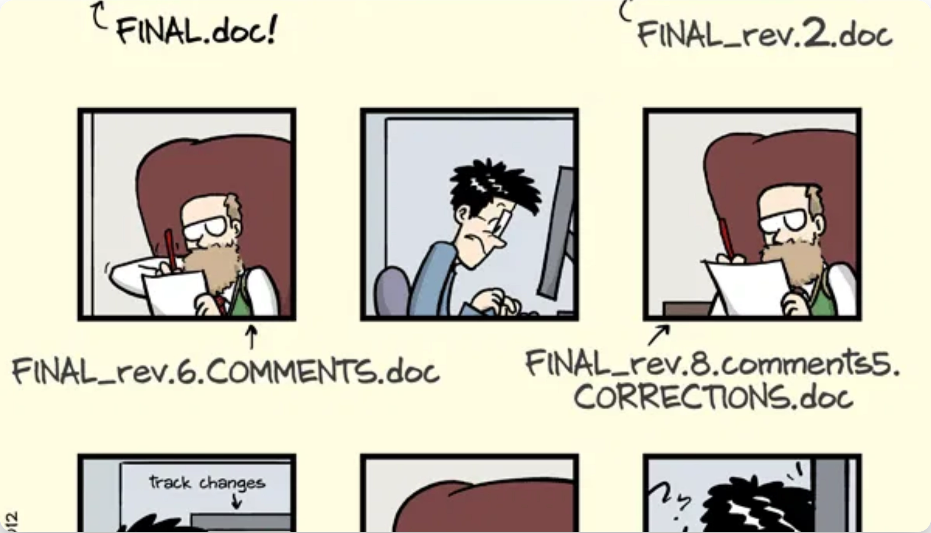
Git & Version Control
Your Time-Traveling Code Companion!

Slide 2
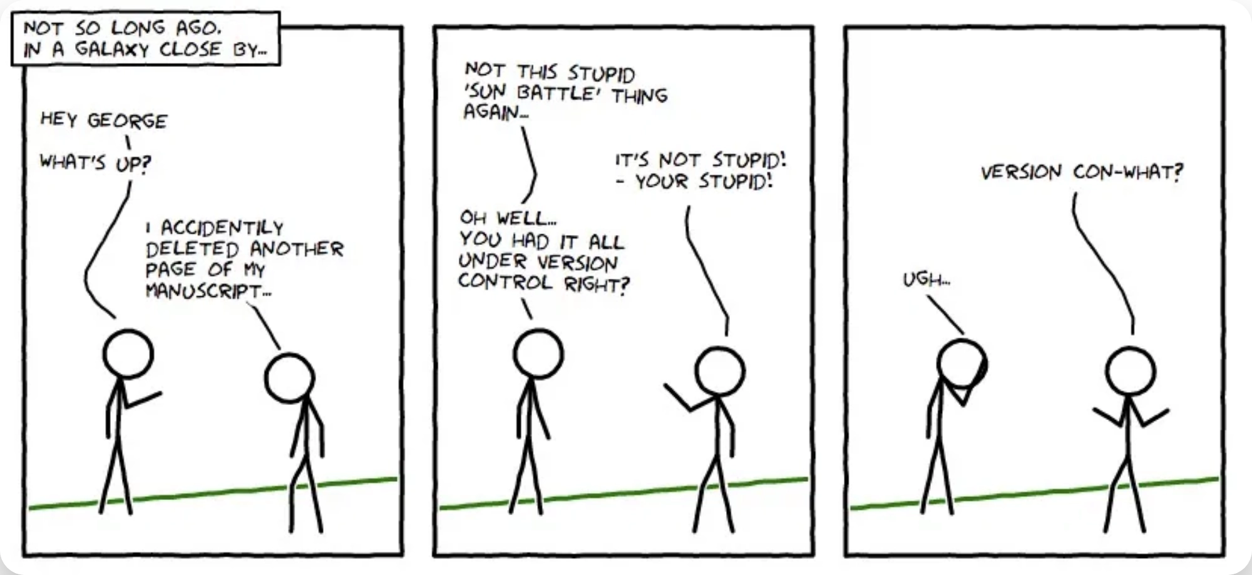

What is Version Control?
Version control is a
system that records changes
to files
over time so you can recall specific versions later.
Think of it like
saving different drafts
of a document,
but for code!
Never lose work
Track who made changes and when
Easily revert to previous versions

Slide 3
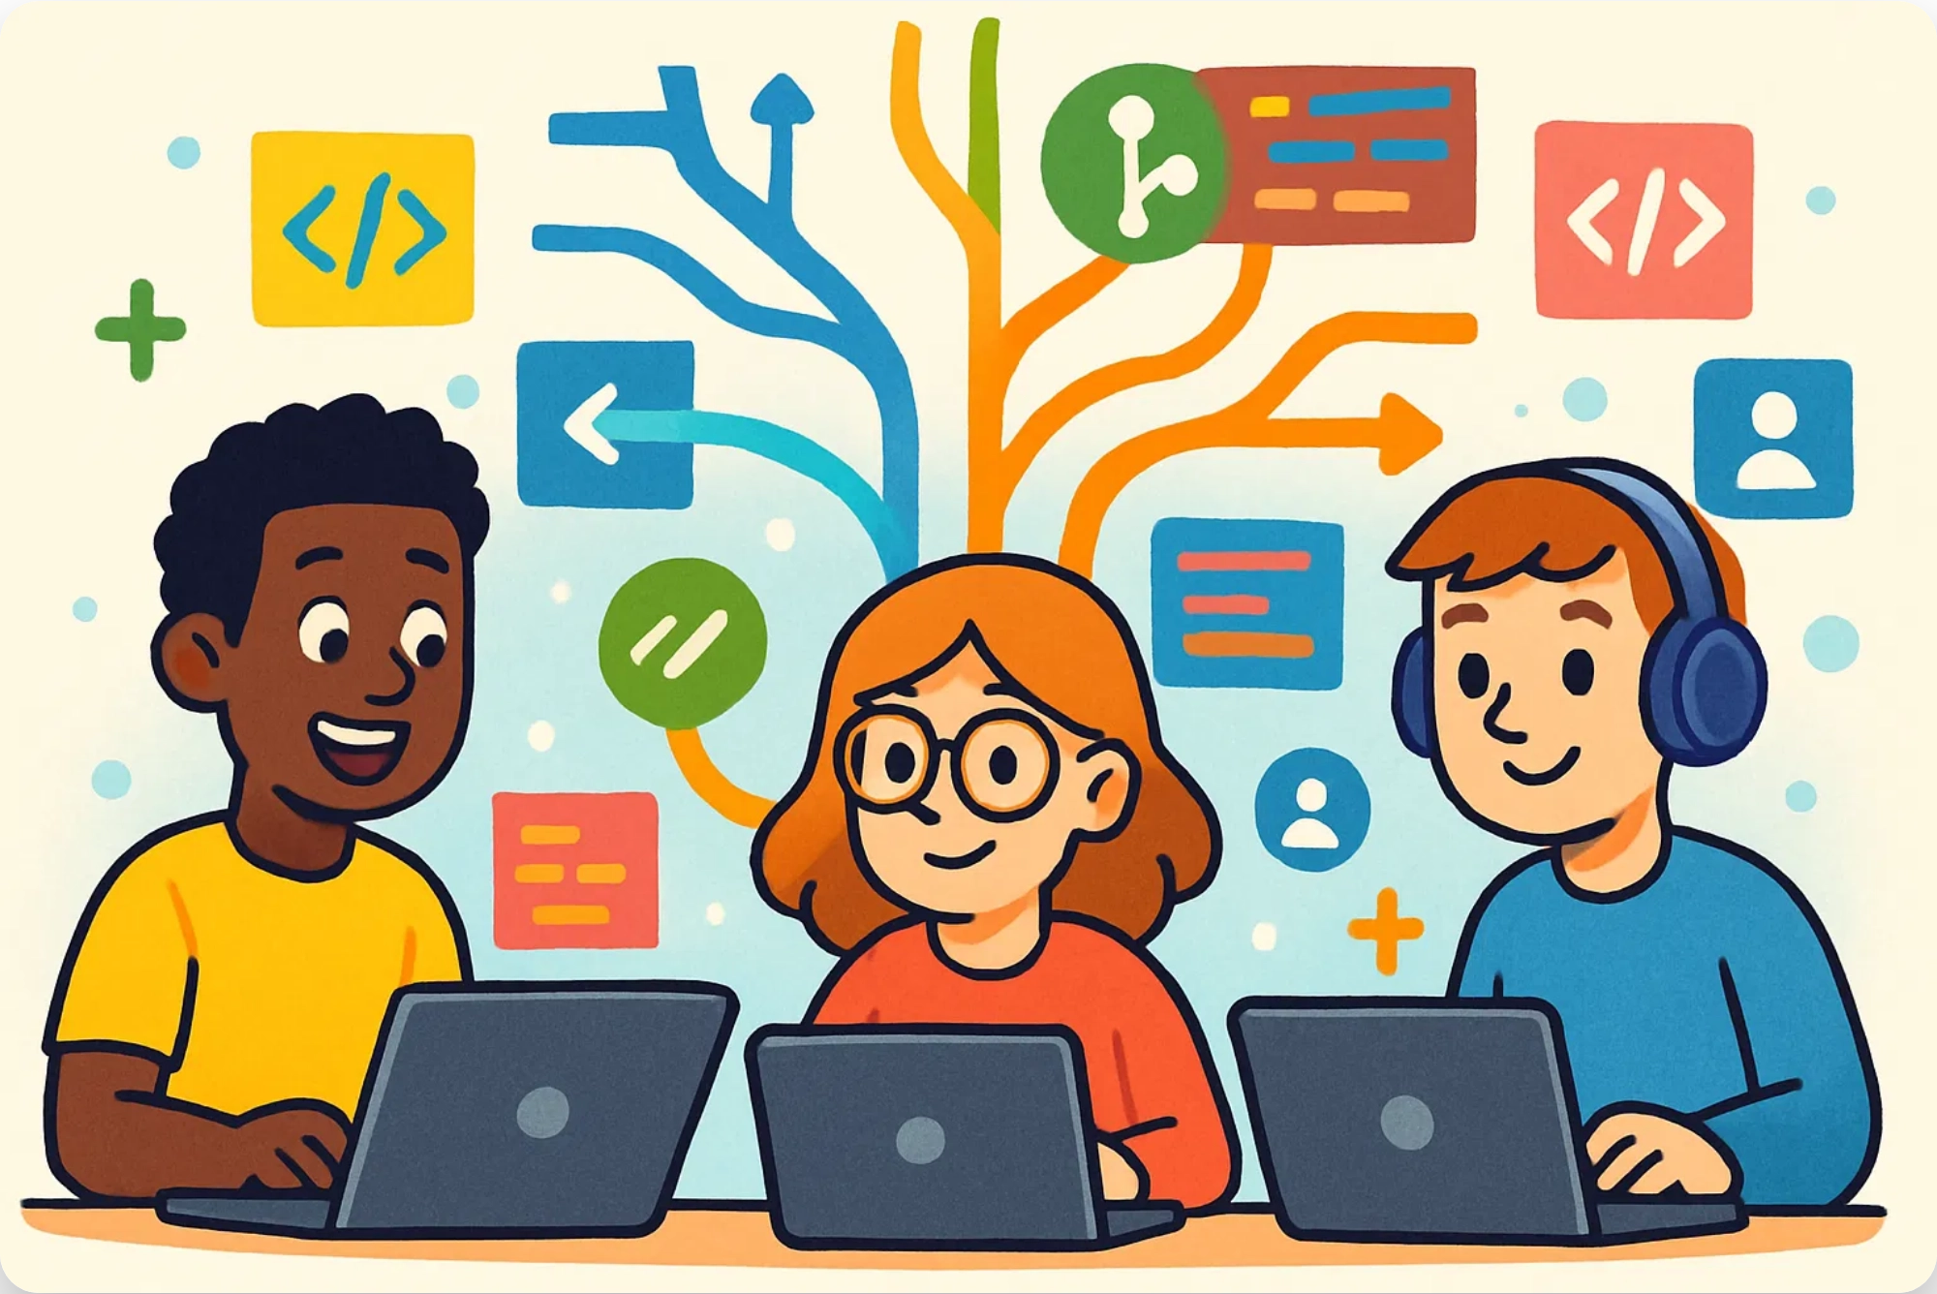
Why Do We Need Version Control?
Collaboration
Multiple people working on the same project
History
Who changed what, when, and why
Experimentation
Branching out without breaking the main project
Disaster Recovery
Oops! Revert to a working state

Slide 4

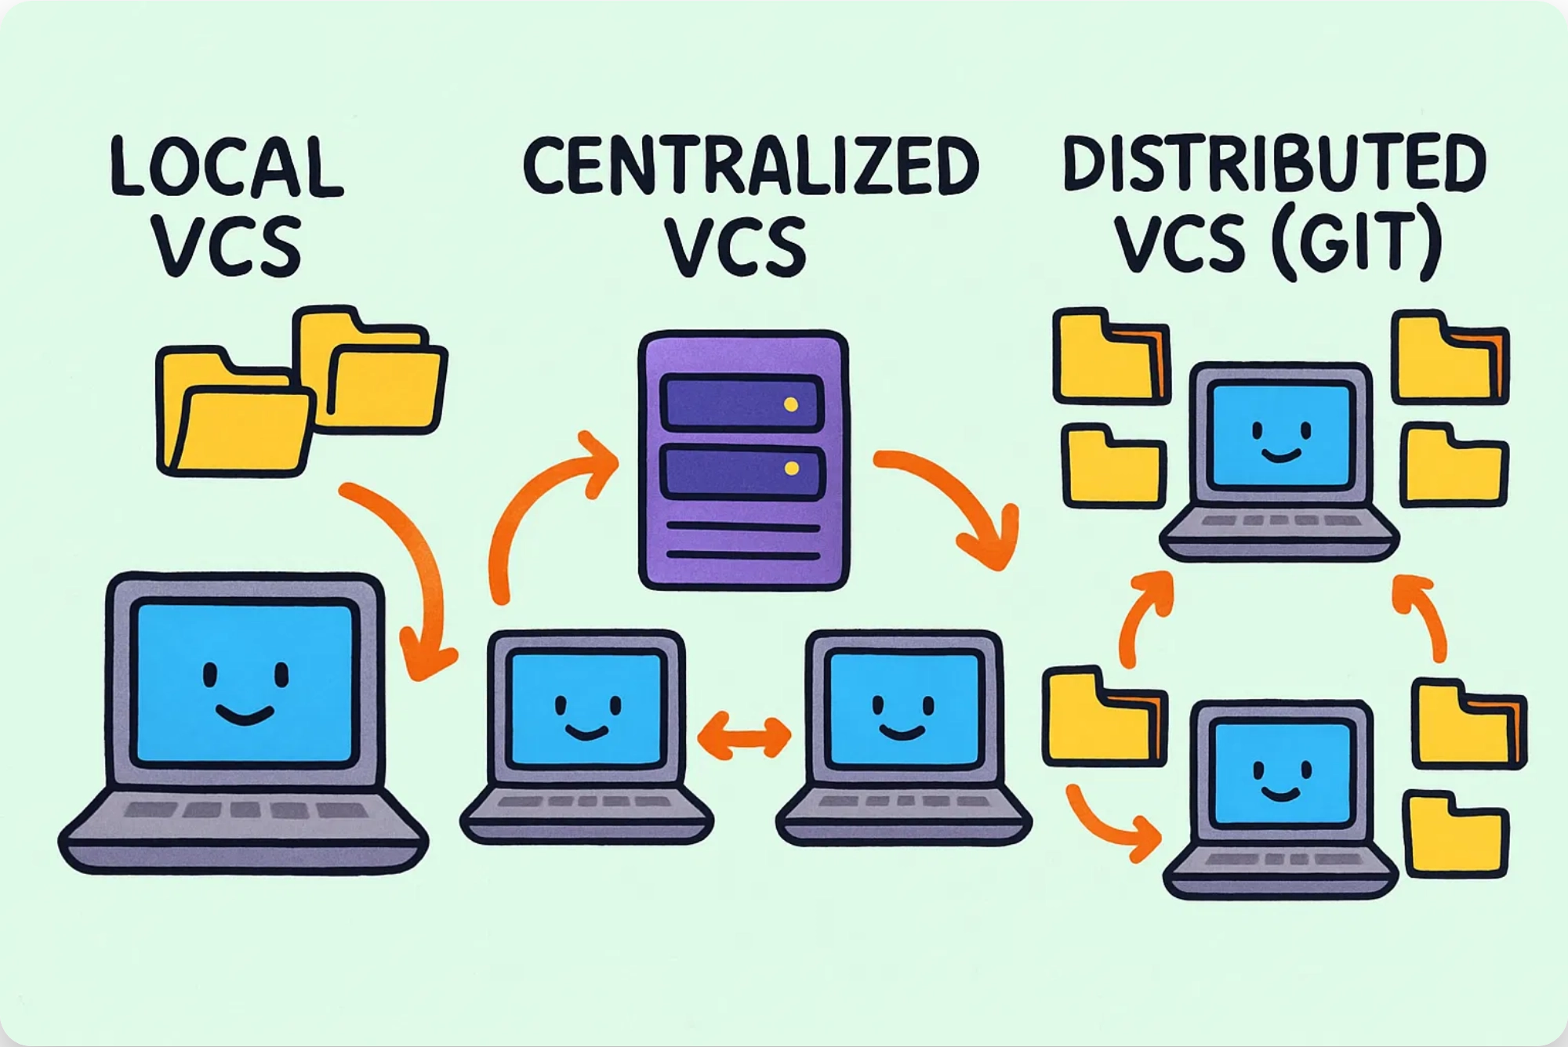

Types of Version Control Systems
Local VCS
Simple database on your local computer that tracks changes to files
Centralized VCS
Single server contains all versioned files, and clients check out files from that central place (e.g., SVN)
Distributed VCS (Git)
Clients fully mirror the repository, including its complete history, creating multiple backups
Git is a
distributed
version control system

Slide 5
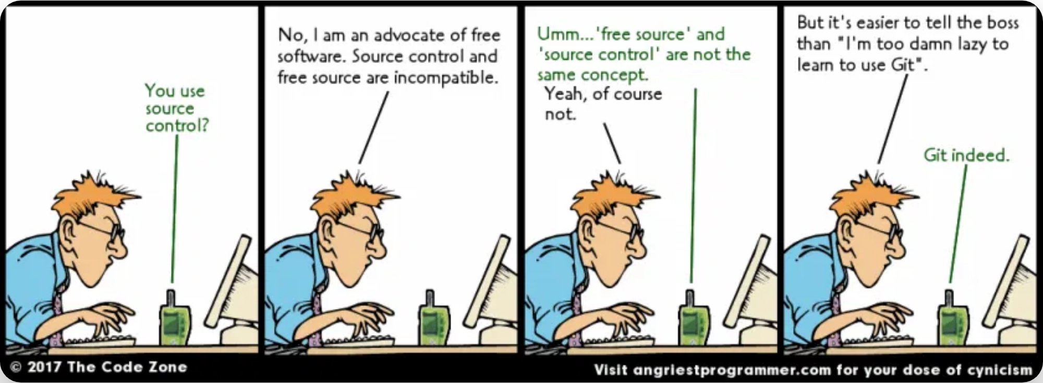





What is Git?
Git is a
distributed version control system
designed for
speed, data integrity, and support for distributed, non-
linear workflows.
Fast & efficient
Supports non-linear development
Enables distributed collaboration
Ensures data integrity
Created by Linus Torvalds in 2005 for Linux kernel development

Slide 6
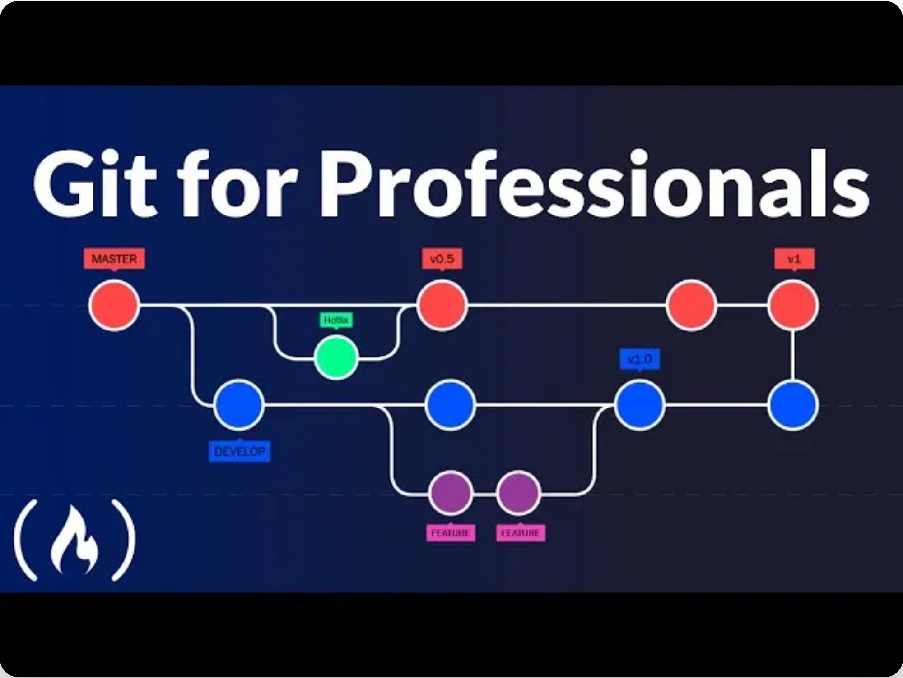




Git Key Concepts
Repository (Repo)
The project folder with all its history
Commit
A snapshot of your changes at a specific point in time
Branch
An independent line of development
Merge
Combining changes from different branches

Slide 7
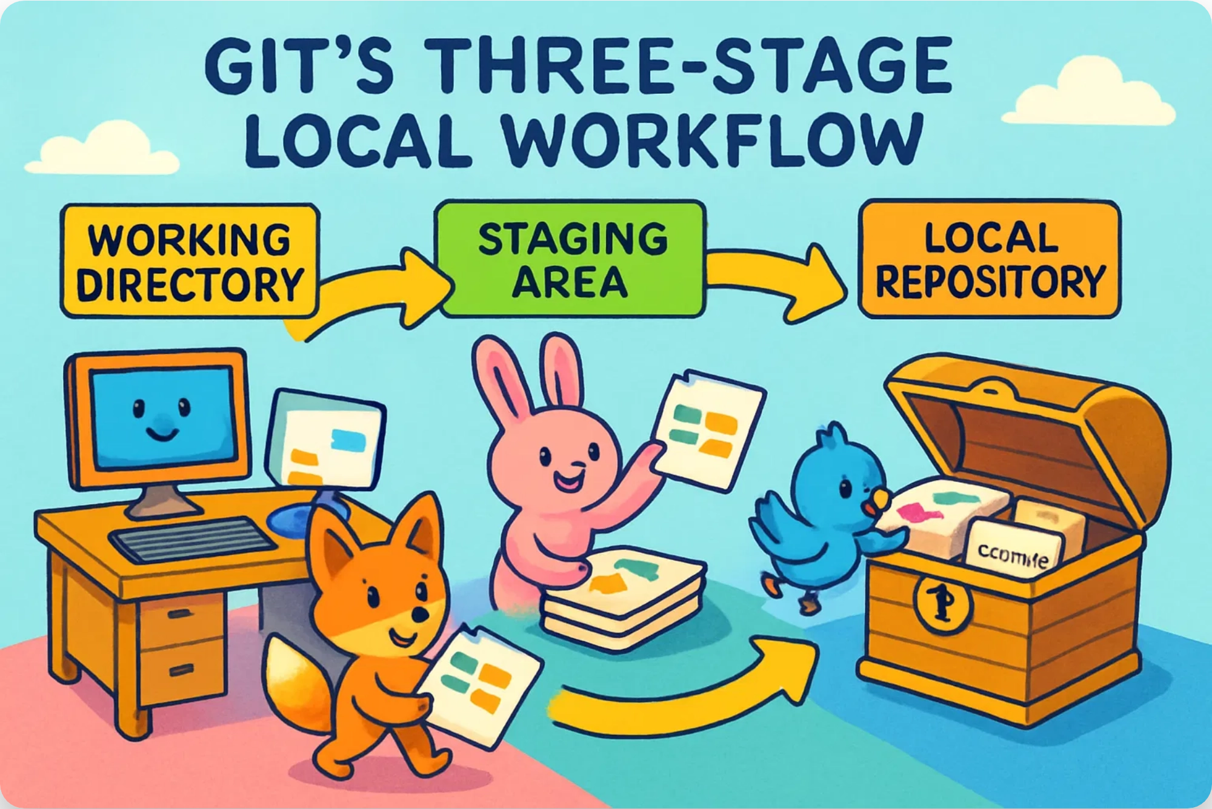
Git Workflow: Local
1
Working Directory
Where you make changes to your files
$ git status
2
Staging Area (Index)
Preparing changes for a commit
$ git add file.txt
3
Local Repository
Storing committed changes on your machine
$ git commit -m "Add new feature"

Slide 8

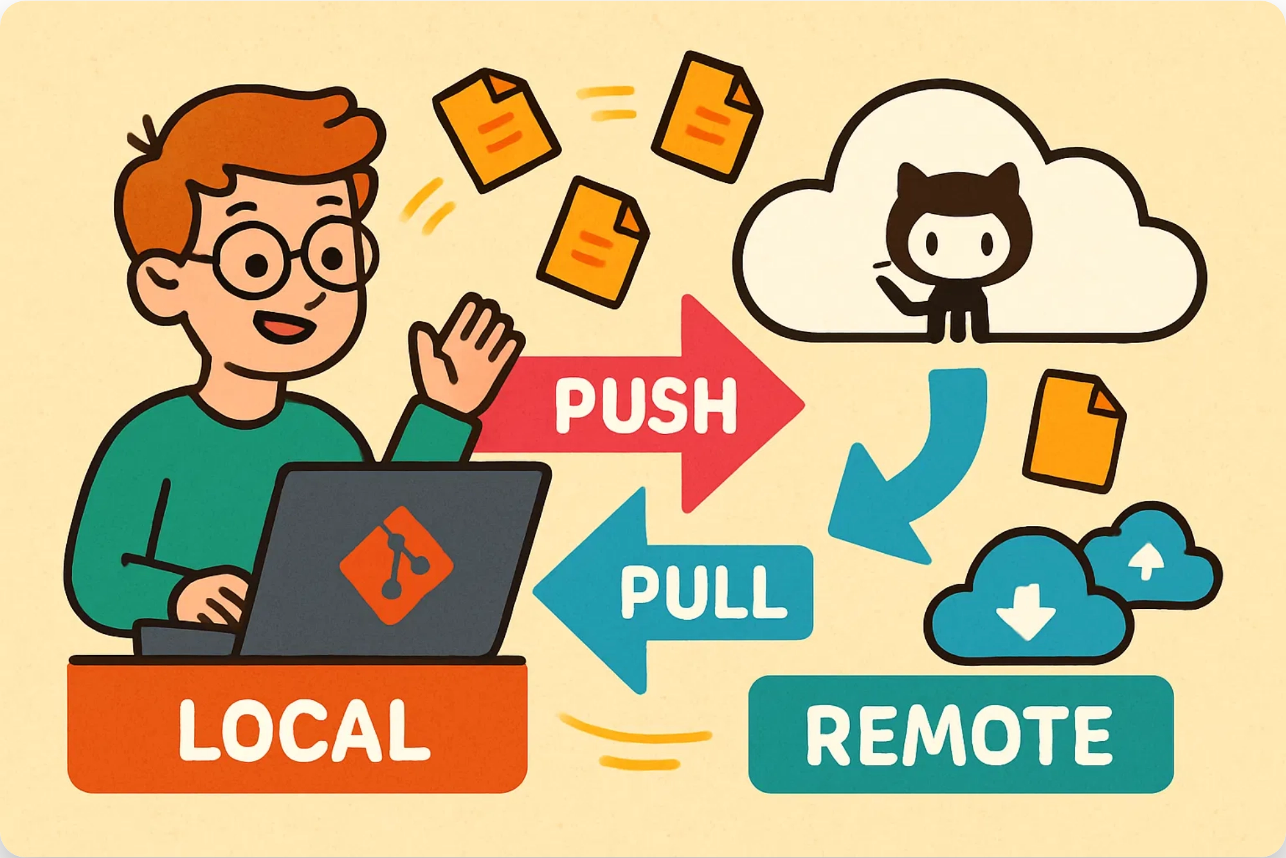


Git Workflow: Remote
Push
Sending your local commits to the remote repository
$ git push origin main
Pull
Fetching and merging changes from the remote repository
$ git pull origin main
Clone
Creating a local copy of a remote repository
$ git clone https://github.com/user/repo.git

Slide 9

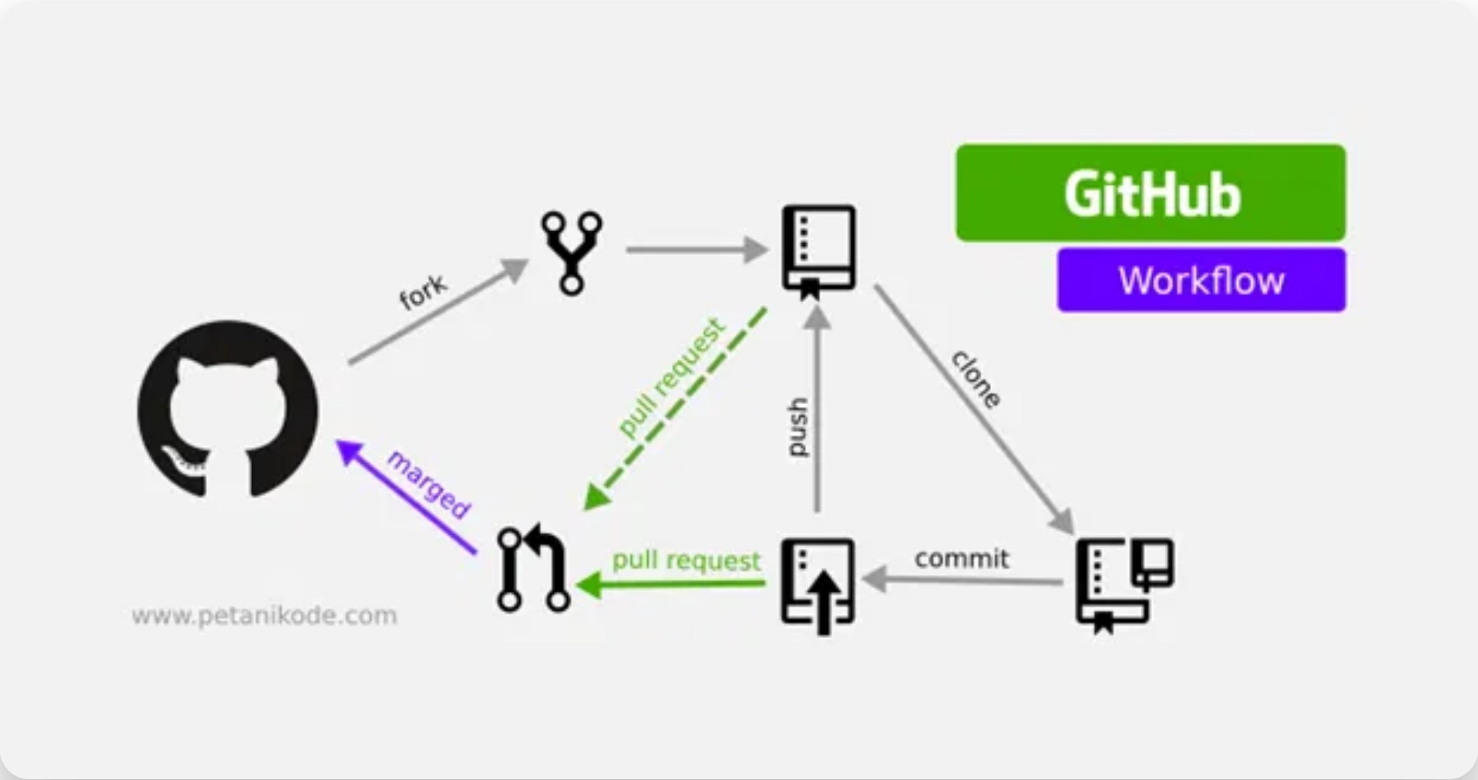


Fun with Git!
Collaboration Made Easy
Work with teammates anywhere in the world without stepping on each other's toes
$ git branch feature-awesome
Experiment Without Fear
Try wild ideas in separate branches without breaking your main code
$ git checkout -b crazy-experiment
Undo Mistakes Like a Superhero
Accidentally broke everything? No problem! Git has your back
$ git reset --hard HEAD~1

Slide 10





What is GitHub?
GitHub is a
cloud-based platform
for hosting and
collaborating on Git repositories.
Think of it as a
social network for code
where
developers can work together on projects from
anywhere in the world.
100+ million developers
400+ million repositories
90% of Fortune 100
Largest open source community

Slide 11
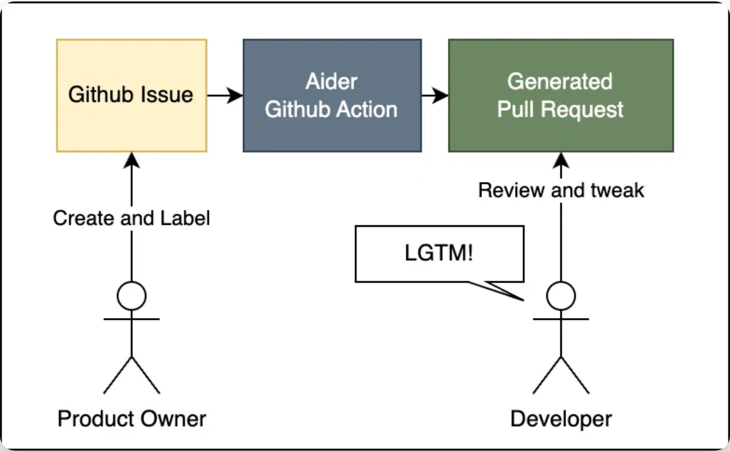
GitHub Features
Pull Requests
Propose changes, request code reviews, and discuss modifications before merging
Issues
Track bugs, feature requests, and tasks with customizable labels and milestones
Project Boards
Organize and prioritize work with Kanban-style boards
GitHub Actions
Automate workflows, testing, and deployment directly from your repository

Slide 12
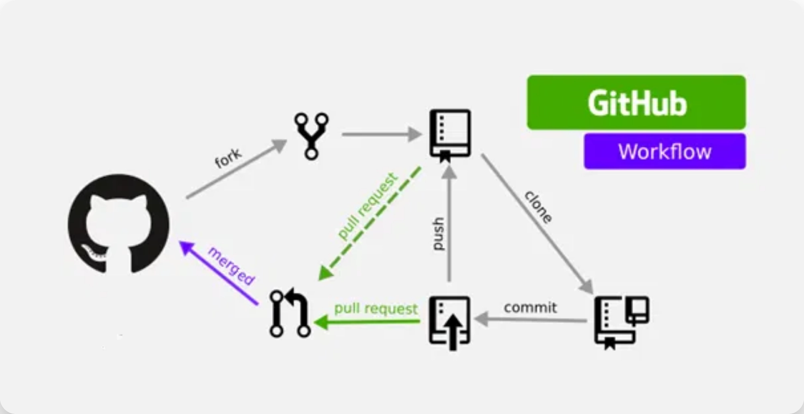
Forking Projects on GitHub
A
fork
is a personal copy of another user's repository
that lives on your GitHub account.
1
Fork the Repository
Click the "Fork" button on a GitHub repository
2
Clone Your Fork
Download your fork to your local machine
$ git clone https://github.com/YOUR-USERNAME/REPO-NAME.git
3
Make Changes & Push
Modify code and push to your fork
$ git push origin main
4
Create Pull Request
Submit changes to the original repository

Slide 13
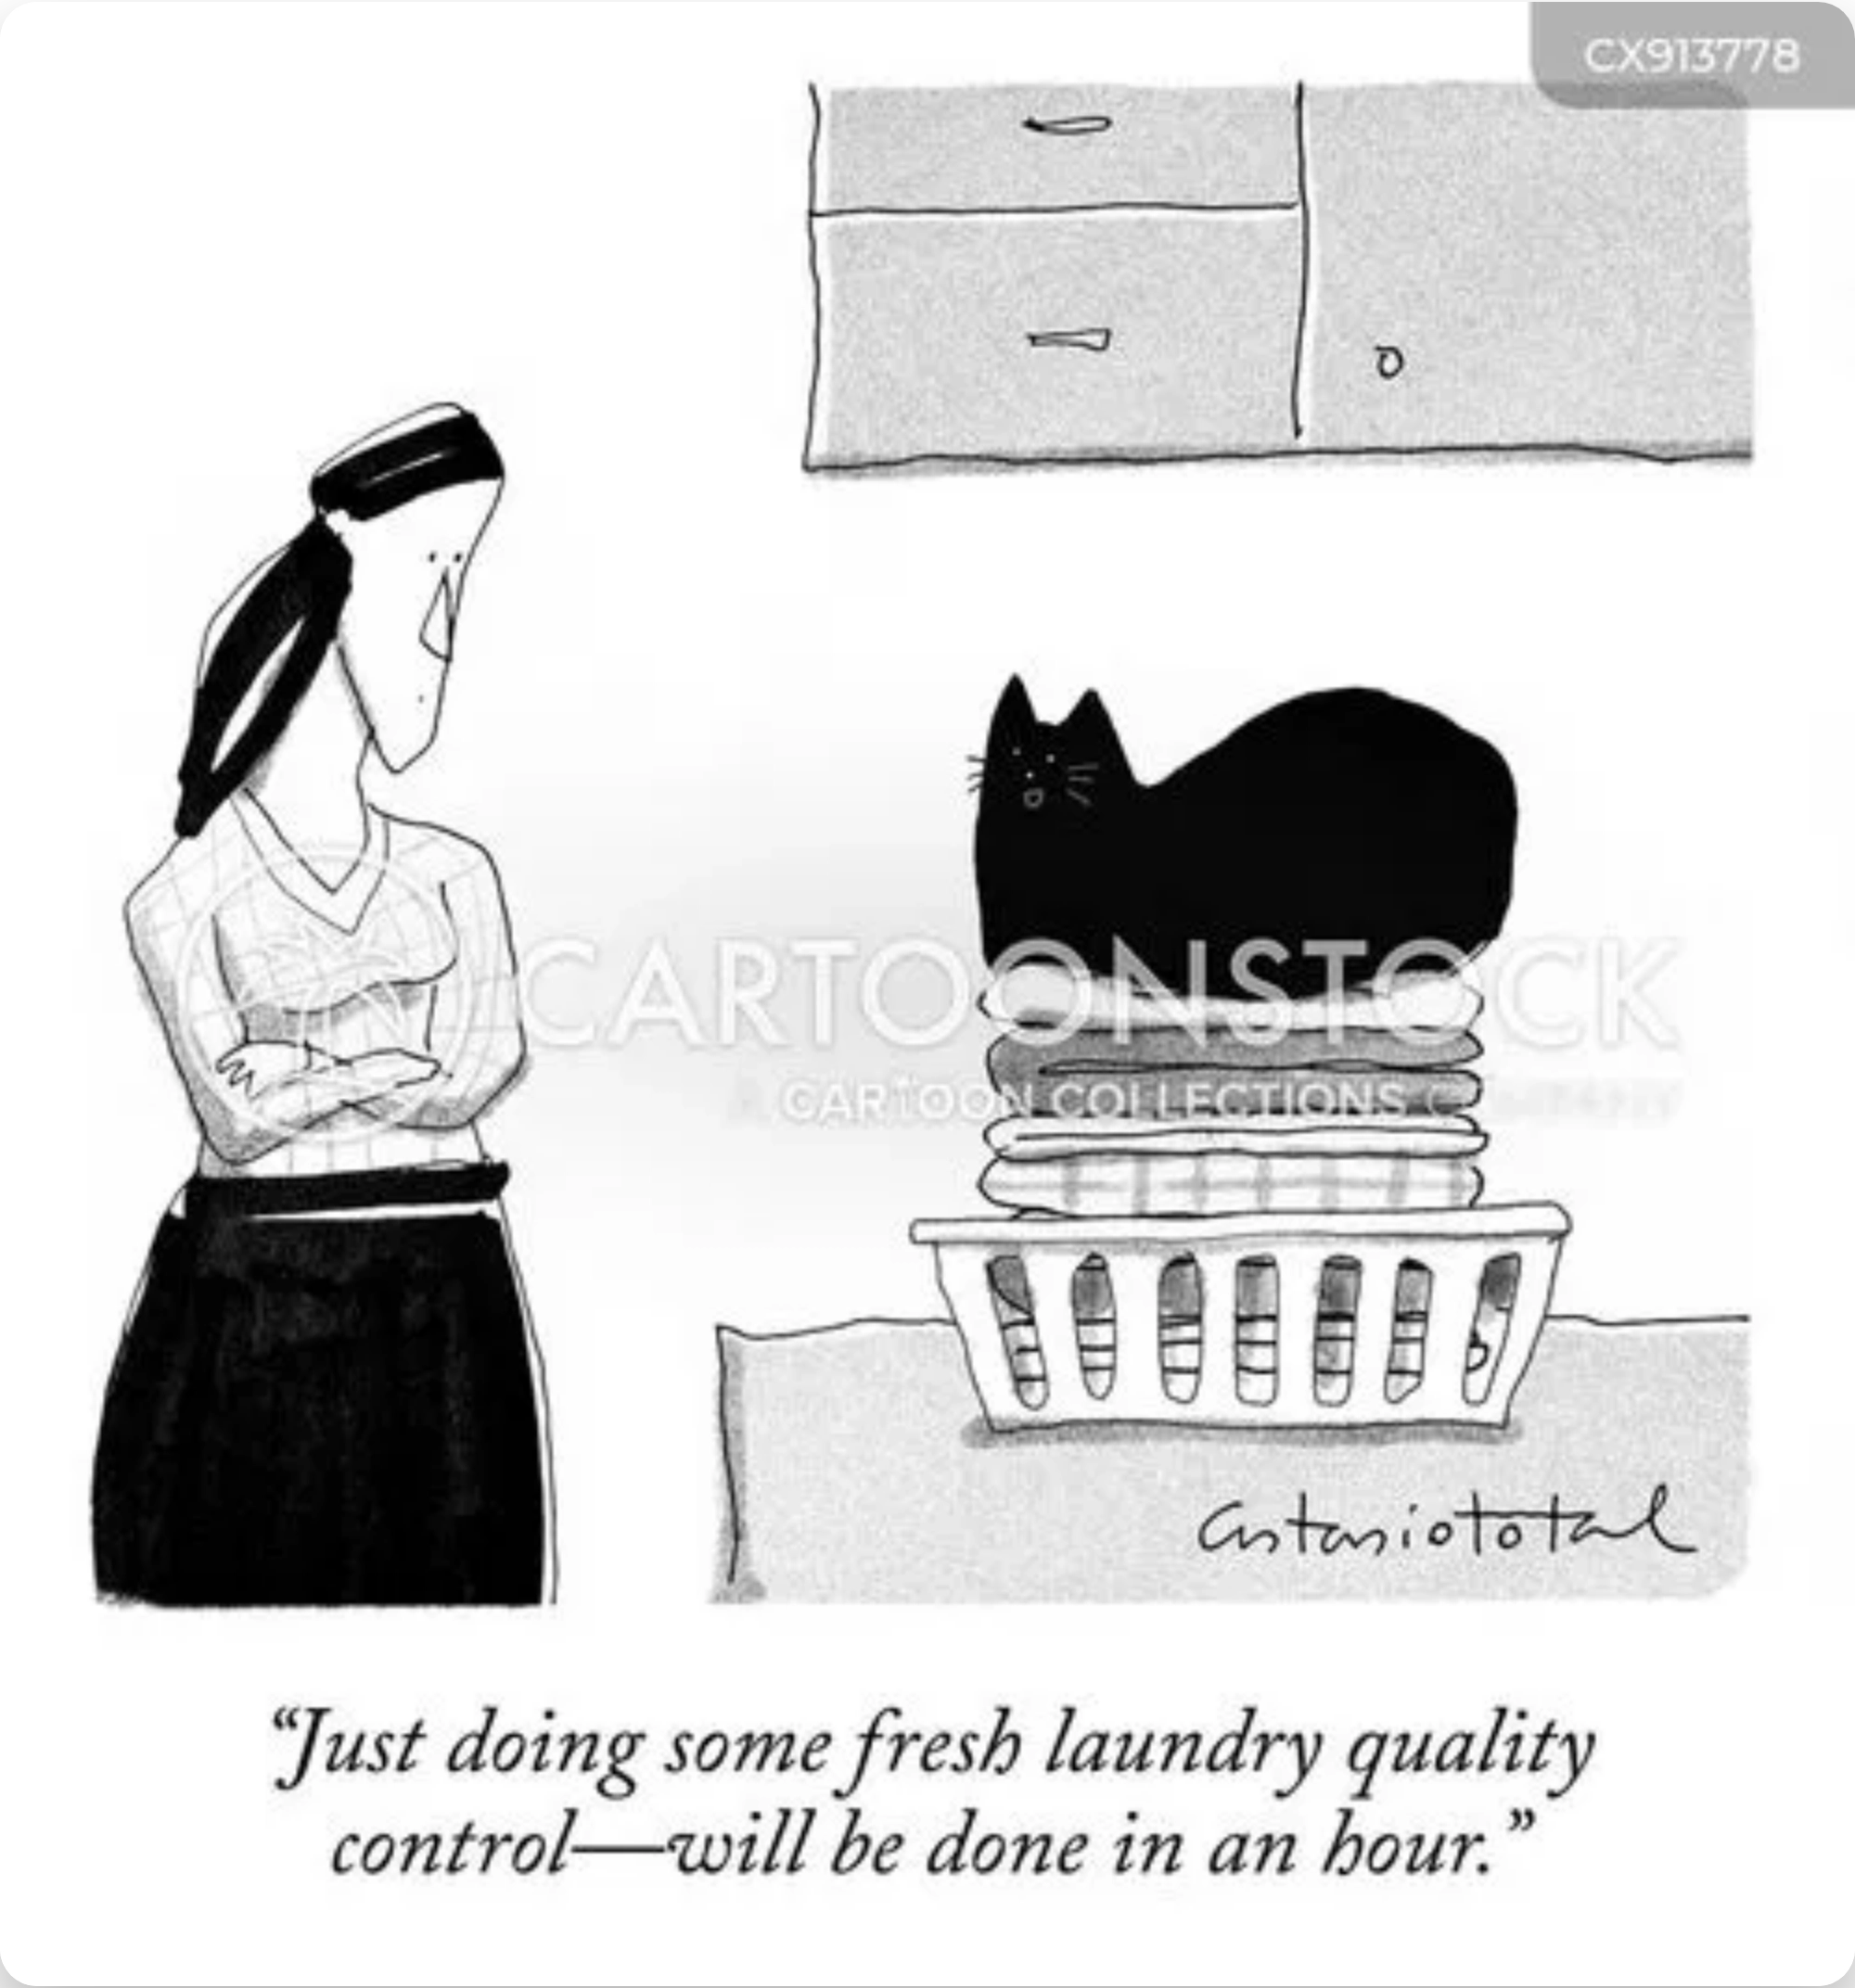




Summary & Next Steps
Git is a powerful distributed version control system
It helps you track changes, collaborate, and maintain code quality
Understanding the workflow makes Git much easier to use
Learn More:
git-scm.com - Official Git documentation
learngitbranching.js.org - Interactive tutorials
YouTube: "Git & GitHub Crash Course"

