Slide 1


Jupyter Notebook
Your Interactive Data Playground!
Explore, Code, Document, Share

Slide 2

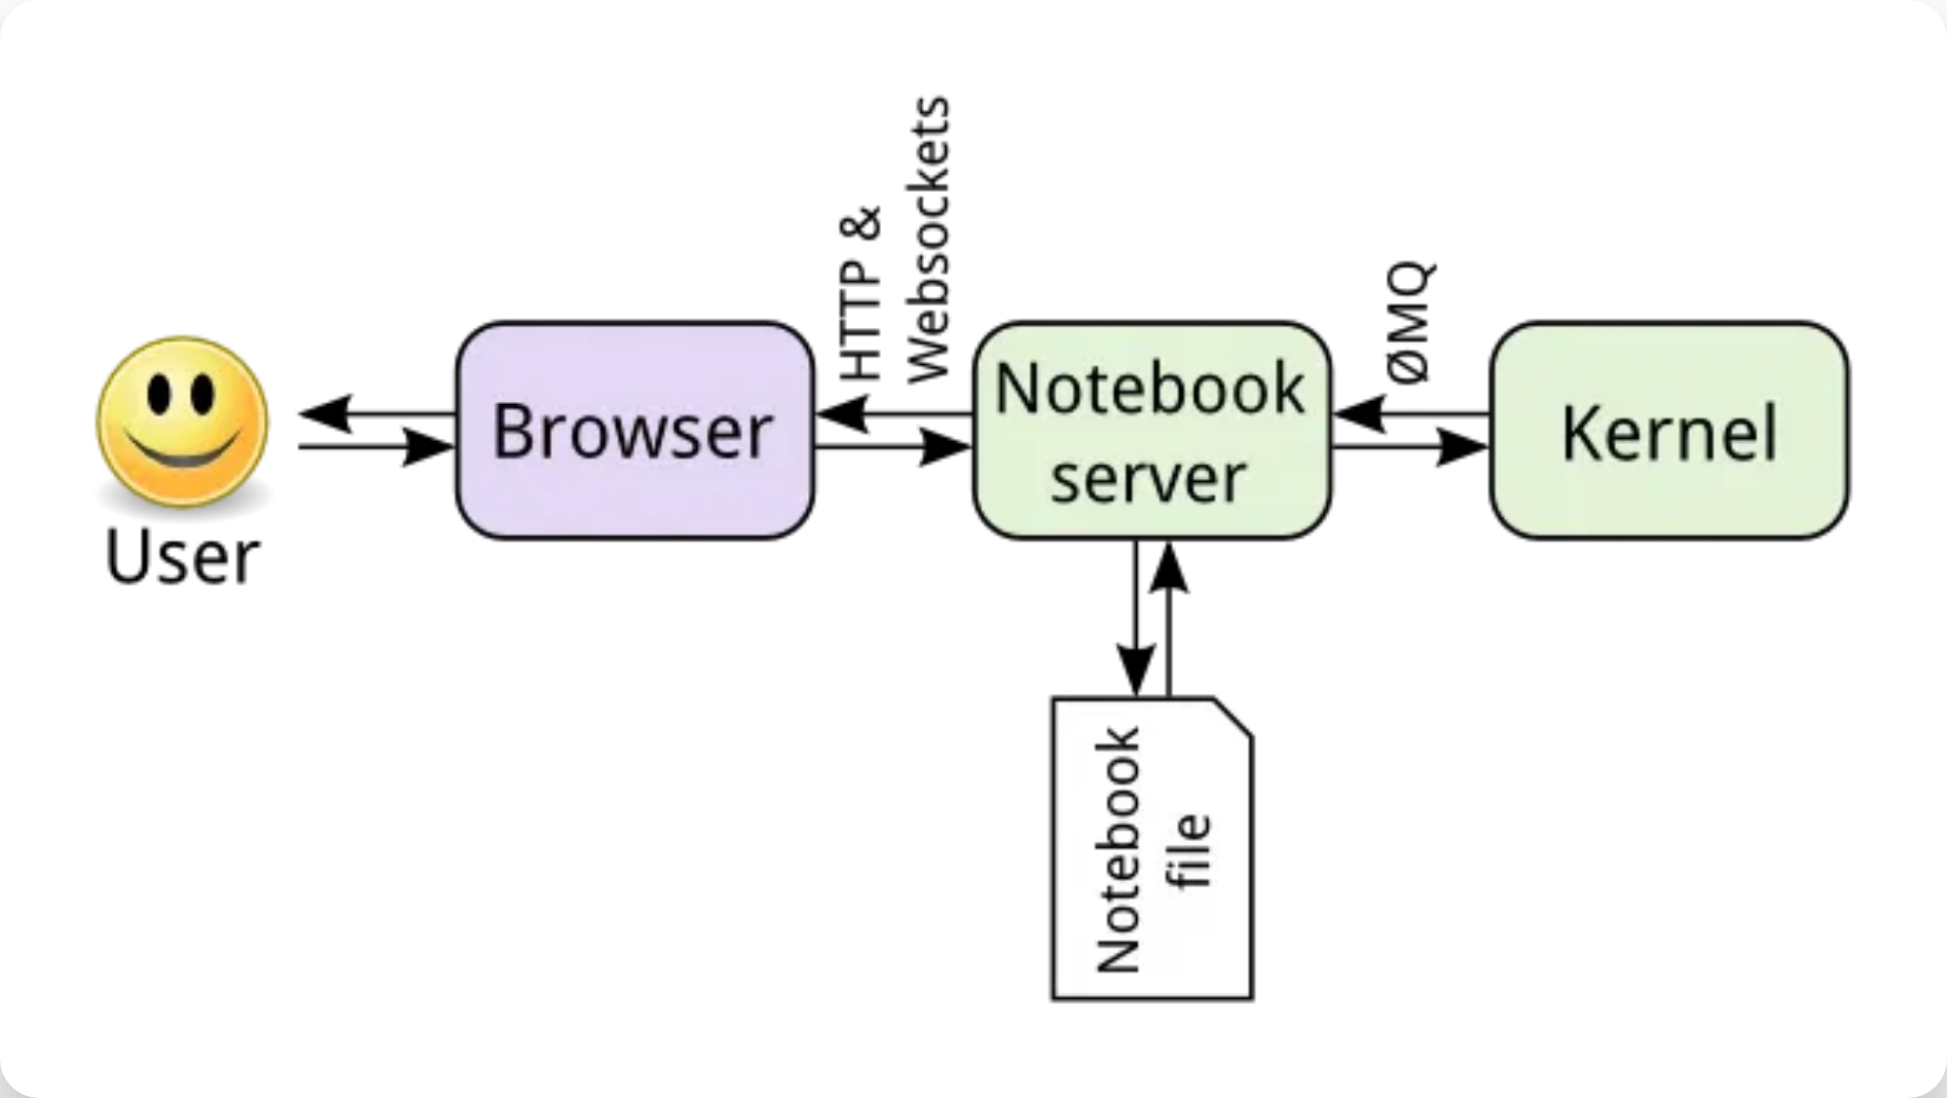



What is Jupyter Notebook?
Jupyter Notebook is an
interactive web application
for
creating and sharing computational documents.
Web Application:
Browser-based interface for coding
and documentation
Kernel:
Computational engine that executes code
(Python, R, Julia, etc.)
Notebook Documents:
Files with .ipynb extension
that contain code, text, and visualizations

Slide 3
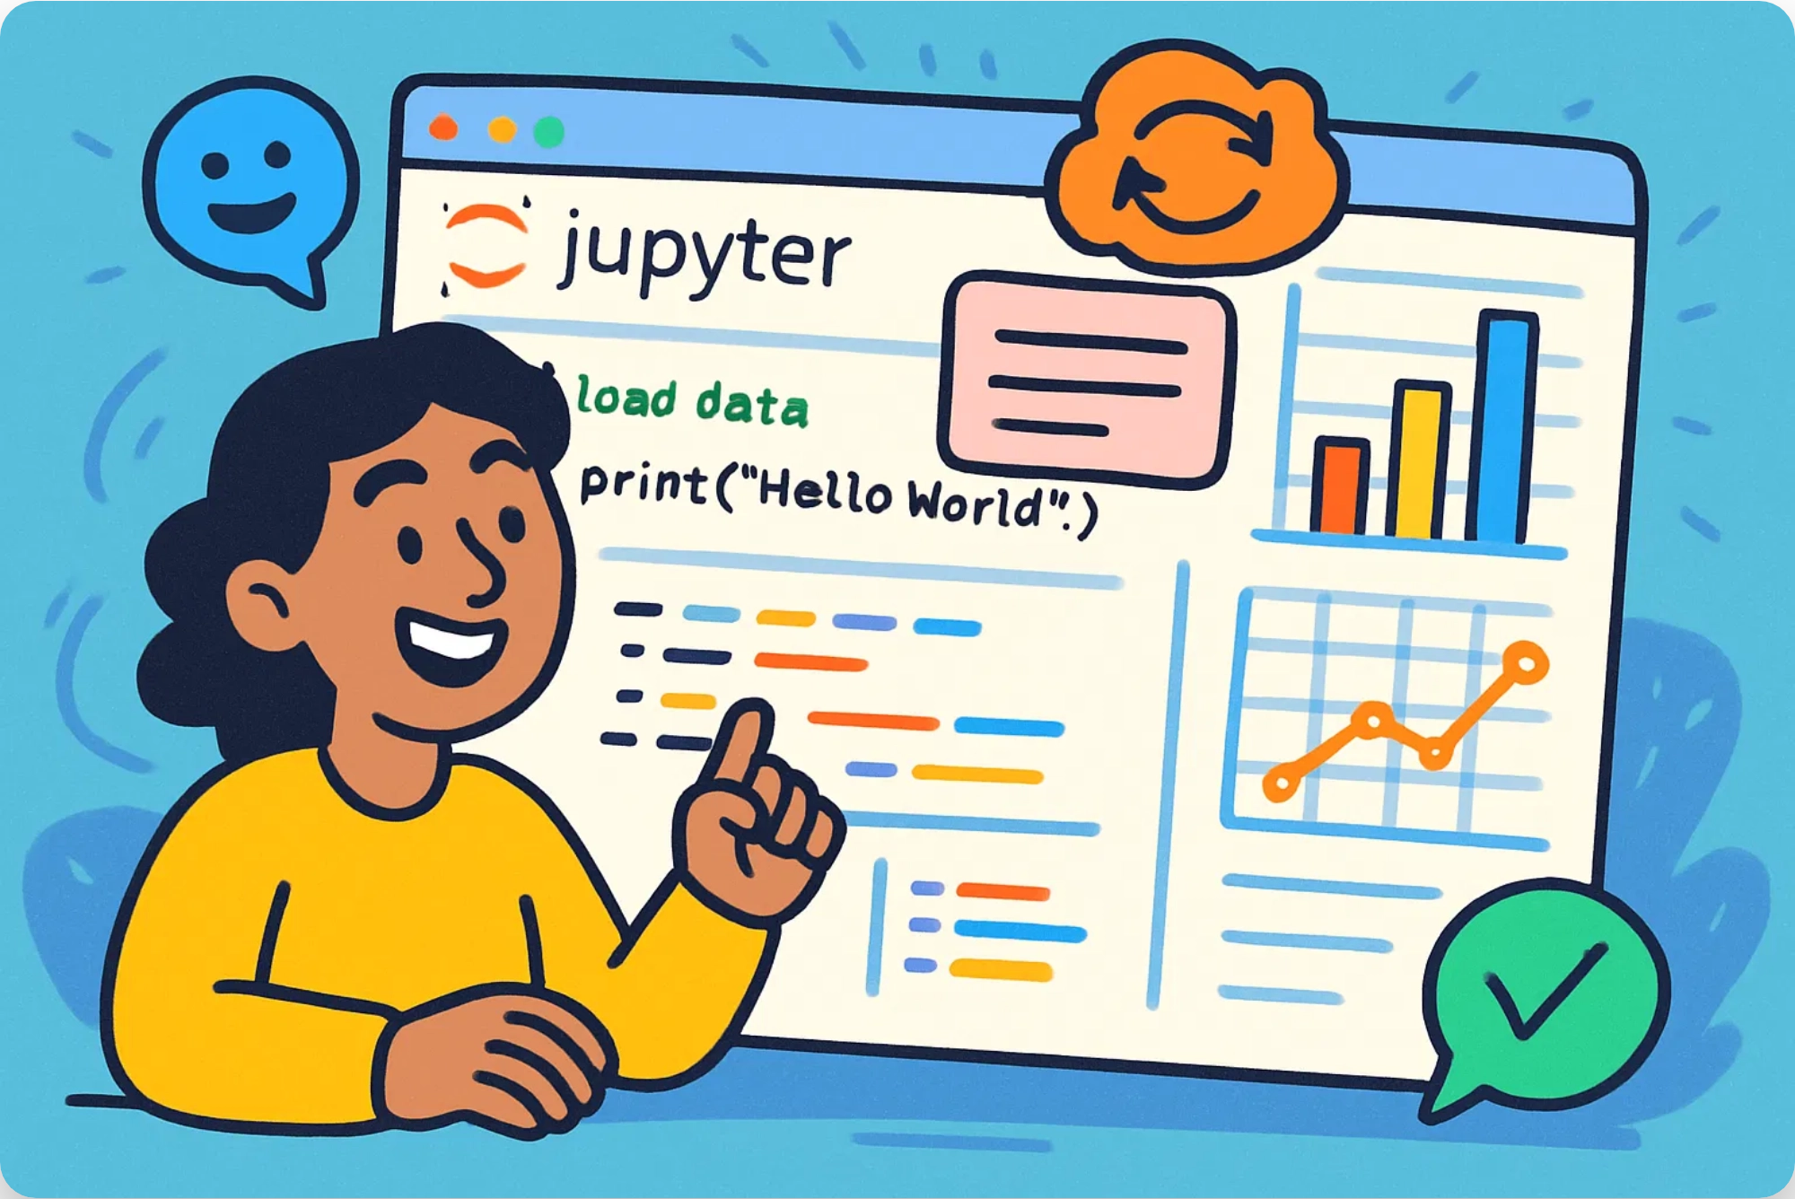





Why Use Jupyter Notebook?
Interactive Computing
Run code cell by cell, see results immediately
Reproducibility
Share executable code and narrative in one document
Data Exploration
Visualize data and iterate on analysis quickly
Documentation
Rich text formatting with Markdown support
Collaboration
Easy to share and collaborate with others

Slide 4

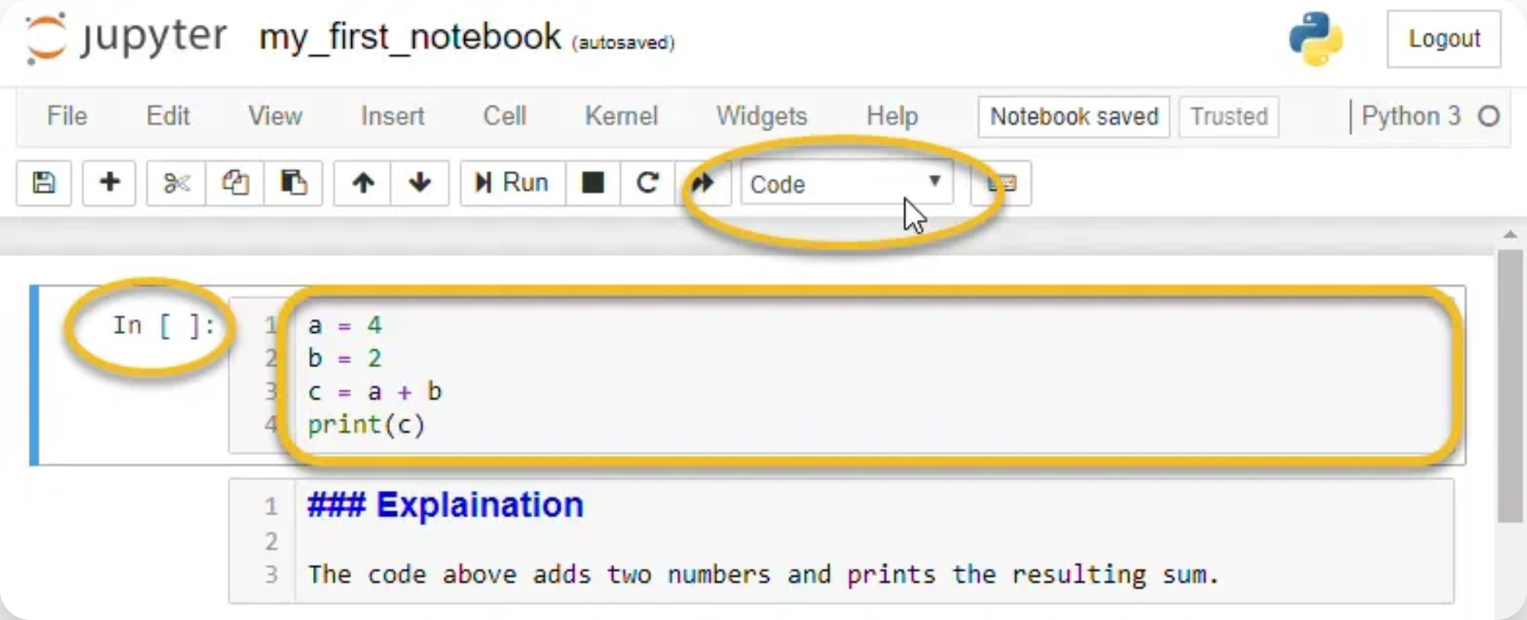
Anatomy of a Notebook: Cells
Code Cells
Write and execute code in various languages
import pandas as pd
Markdown Cells
Rich text formatting with headings, lists, links, and images
# Heading\n**Bold** *Italic*
Raw Cells
Unformatted text that passes through unmodified
Plain text content

Slide 5
Basic Usage
1
Launch Jupyter Notebook
Open terminal and run:
jupyter notebook
2
Create or Open a Notebook
Click "New" > "Python 3" or select an existing .ipynb file
3
Run Cells
Select a cell and press:
Shift+Enter (run & move to next cell)
Ctrl+Enter (run & stay in same cell)
Command Mode (Blue)
Edit Mode (Green)
Press
Esc
to enter
Press
Enter
to enter
Navigate between cells
Edit cell content

Slide 6
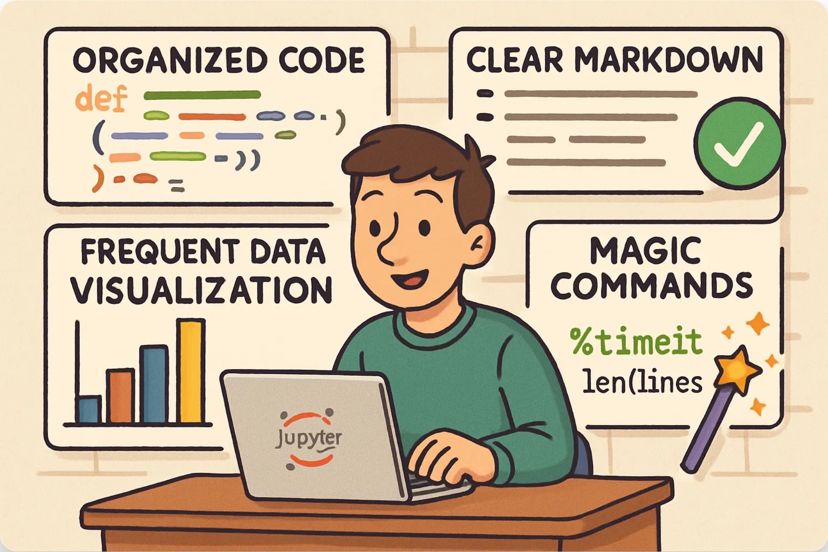
Essential Keyboard Shortcuts
Command Mode (Press Esc to enter)
A
Insert cell above
B
Insert cell below
D, D
Delete selected cell
M
Change to Markdown
Y
Change to Code
Z
Undo cell deletion
Edit Mode (Press Enter to enter)
Shift+Enter
Run cell, select below
Ctrl+Enter
Run cell
Alt+Enter
Run cell, insert below
Tab
Code completion
Shift+Tab
Show tooltip

Slide 7






Tips for Effective Use
Organize with Markdown
Use headings to structure your notebook
Document Your Code
Add comments and docstrings for clarity
Visualize Frequently
Create plots to understand your data better
Use Magic Commands
Leverage special commands for enhanced functionality
%matplotlib inline, %timeit, %who
Clean Up Output
Clear unnecessary outputs to improve readability

Slide 8




Summary & Next Steps
Jupyter Notebook provides a powerful environment for interactive computing, data exploration, and sharing your work.
Interactive code execution with immediate feedback
Rich documentation with Markdown support
Seamless integration of code, text, and visualizations
Ready to Start?
Install Jupyter:
pip install notebook
Launch with:
jupyter notebook
Explore the extensive documentation at jupyter.org

