Slide 1



Python Packages
Building Blocks of Reusable Code
Understanding Structure, Creation, and Distribution

Slide 2

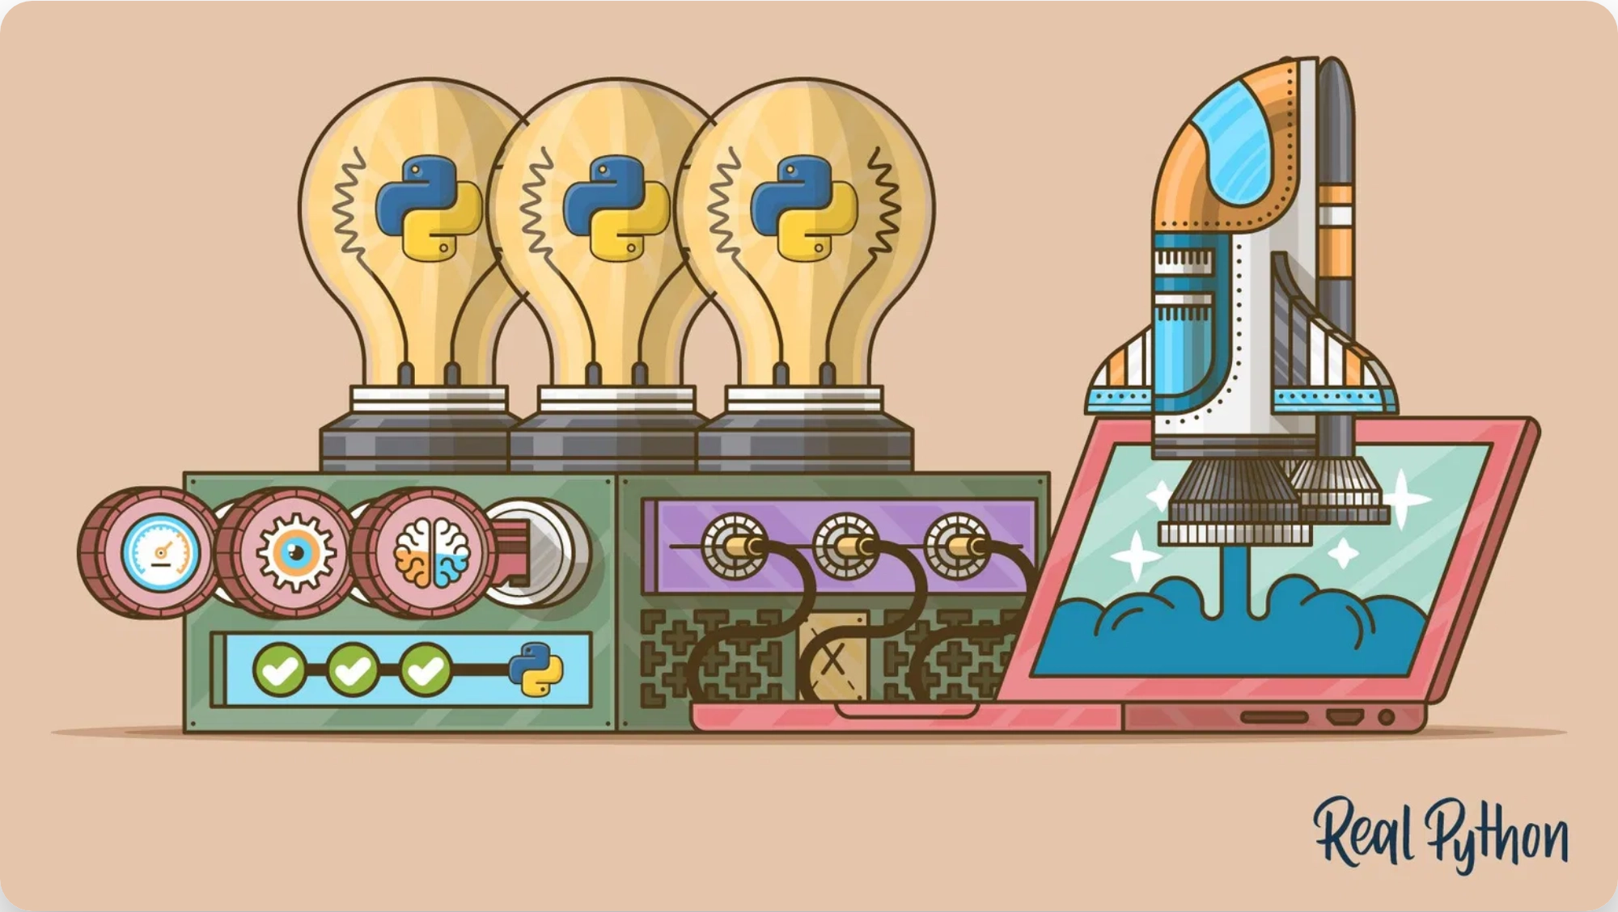


What is a Python Package?
A Python package is a
collection of related modules
organized in a directory hierarchy that provides a way
to structure and organize Python code.
Modularity:
Break down complex code into
manageable, reusable components
Reusability:
Share code across projects and with the
community
Distribution:
Package code for easy installation via pip
Namespace:
Avoid naming conflicts with other
modules

Slide 3

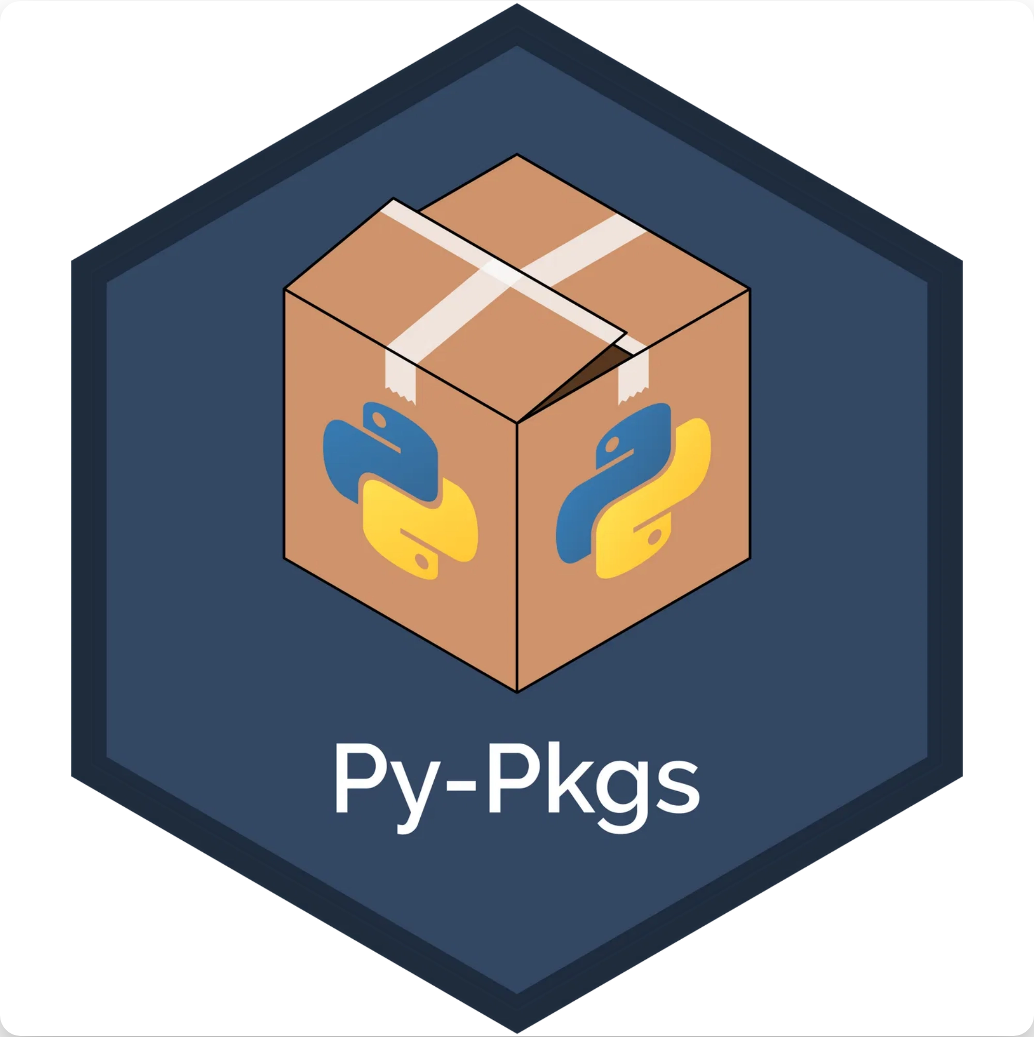
Modules vs. Packages
Module
Package
A single Python file (.py)
A directory containing multiple modules
Contains functions, classes, and variables
Contains an
file and other modules
__init__.py
# helpers.py
my_package/
def greet(name):
├── __init__.py
return f"Hello,
├── module1.py
{name}!"
└── module2.py
Import with:
Import with:
import my_package.module1
import helpers

Slide 4

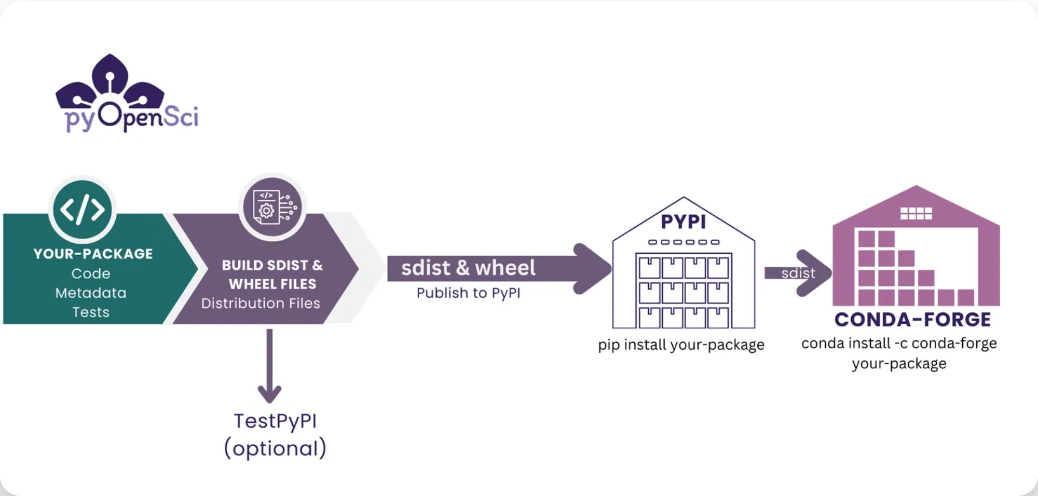

Python Package Structure
my_package/
├──
__init__.py
├──
module1.py
├──
module2.py
├──
subpackage/
│ ├──
__init__.py
│ └──
module3.py
├──
setup.py
or
pyproject.toml
├──
README.md
├──
LICENSE
└──
tests/
Root directory:
Contains the package and distribution files
__init__.py:
Makes Python treat directories as packages
setup.py/pyproject.toml:
Package metadata and build
configuration

Slide 5

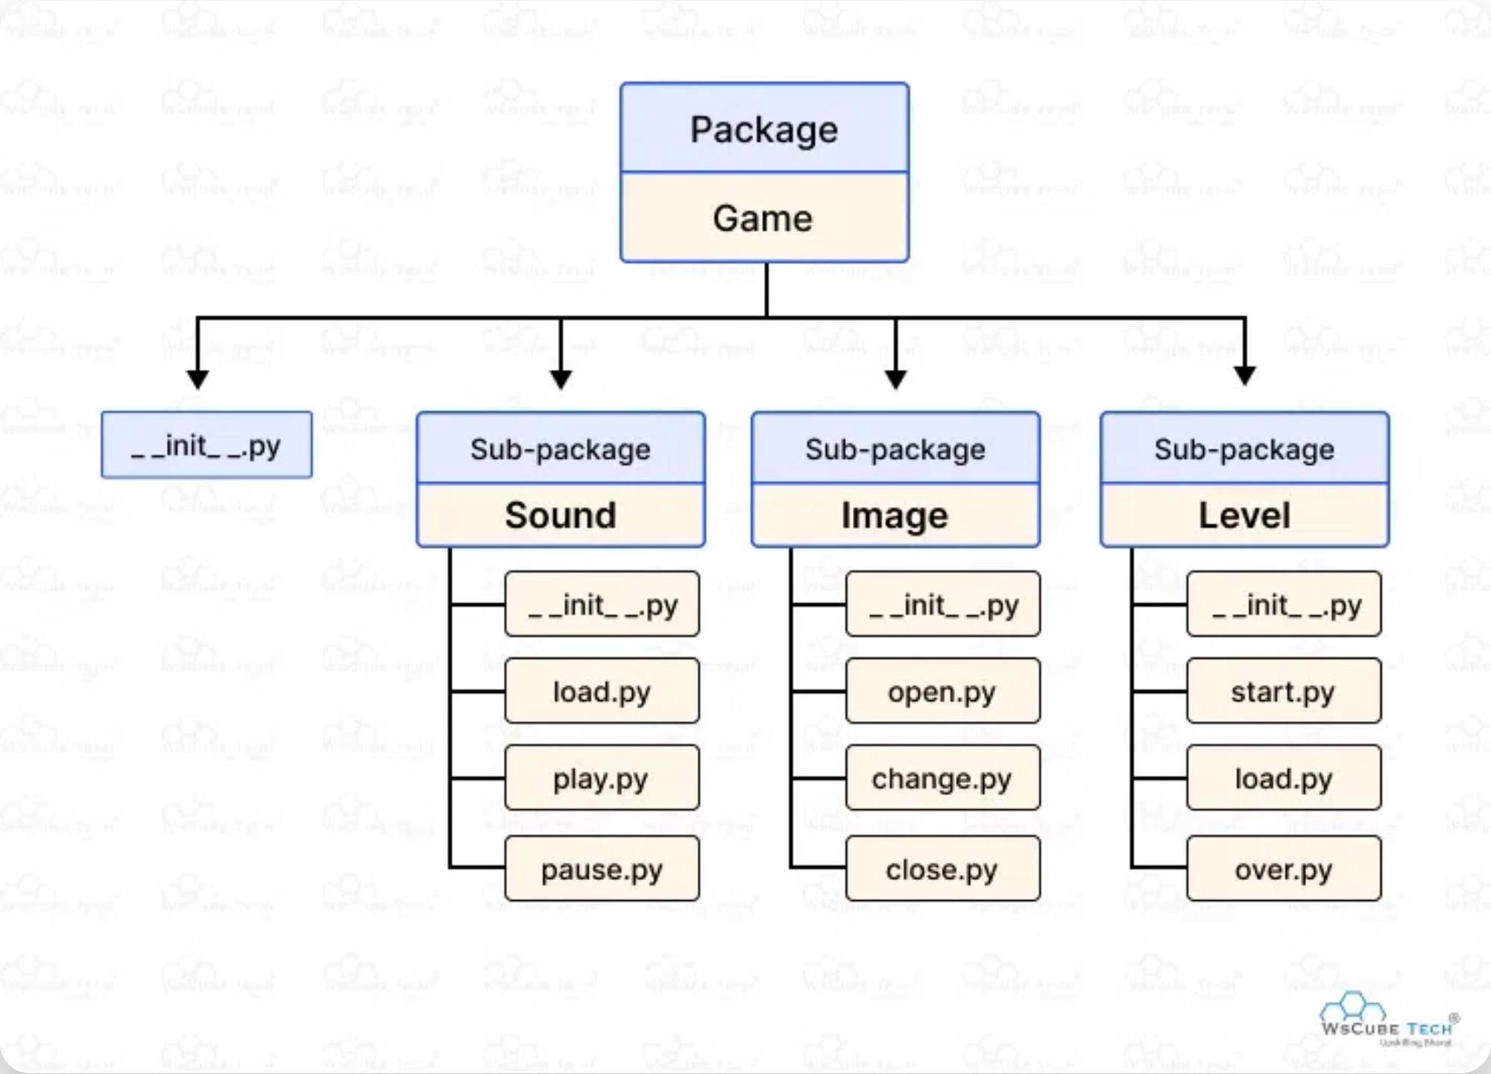
Key Files Explained
__init__.py
Makes Python treat directories as packages; can be empty or contain initialization code
setup.py / pyproject.toml
Defines package metadata, dependencies, and build instructions for distribution
README.md
Documentation with package overview, installation instructions, and usage examples
LICENSE
Specifies terms of use, distribution, and modification (e.g., MIT, GPL, Apache)

Slide 6
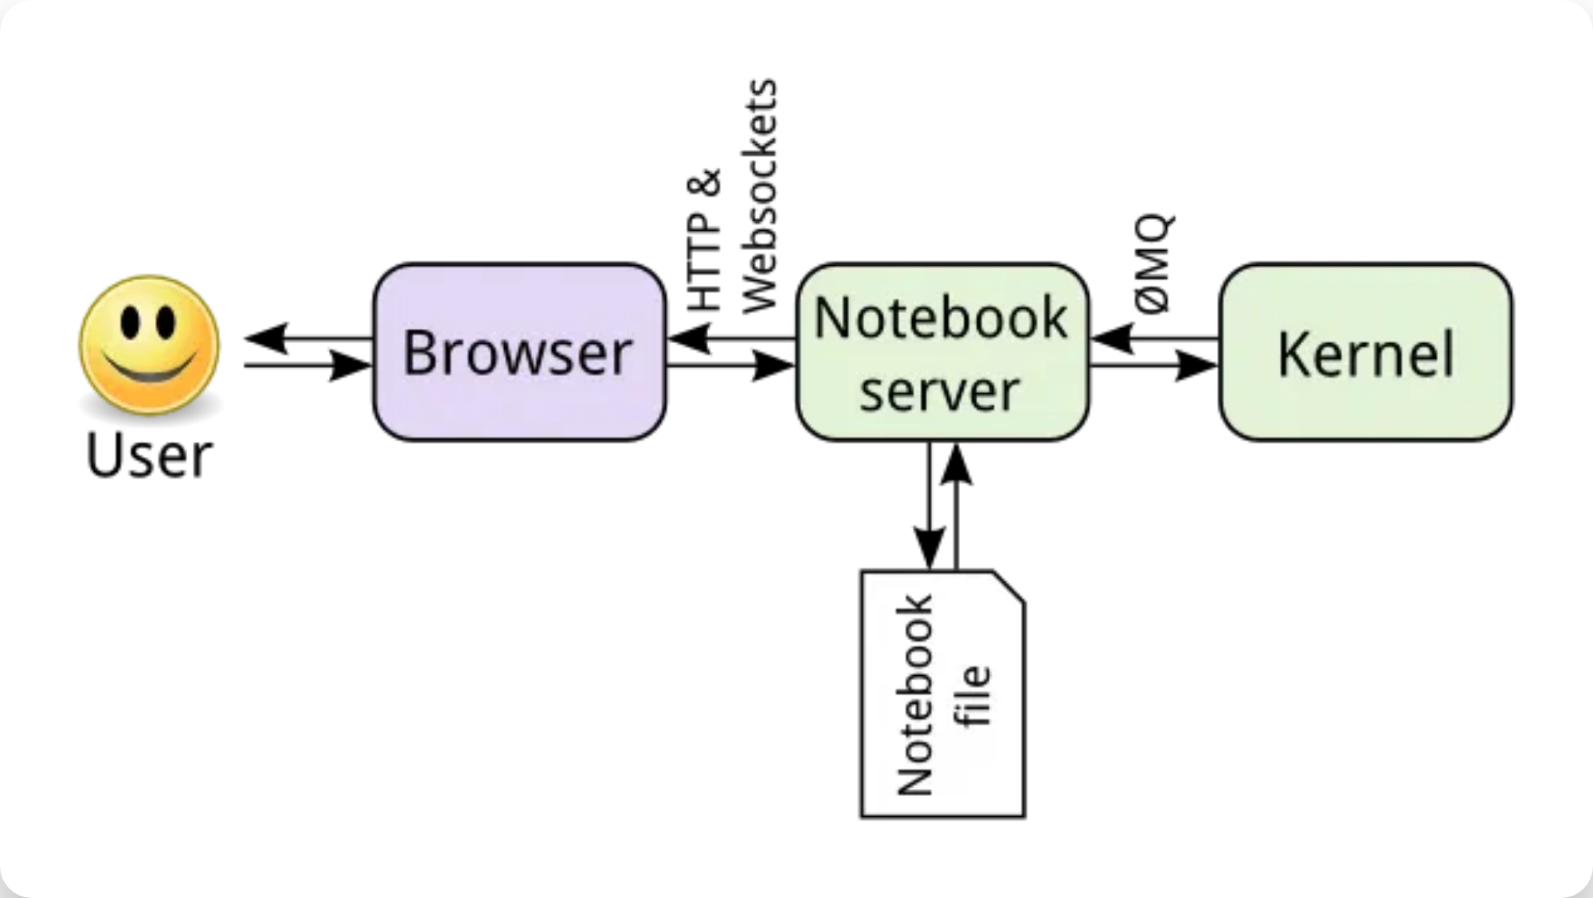
Creating a Simple Package
1
Create Project Directory
Make a directory for your package
$ mkdir my_package
2
Add __init__.py
Create an empty file or add initialization code
$ touch my_package/__init__.py
3
Add Modules
Create Python files with your functionality
# my_package/greetings.py
def say_hello(name="World"):
return f"Hello, {name}!"
4
Create setup.py
Define package metadata
from setuptools import setup, find_packages
setup(name="my_package", version="0.1.0", packages=find_packages())
5
Install Locally
Install your package for development
$ pip install -e .

Slide 7

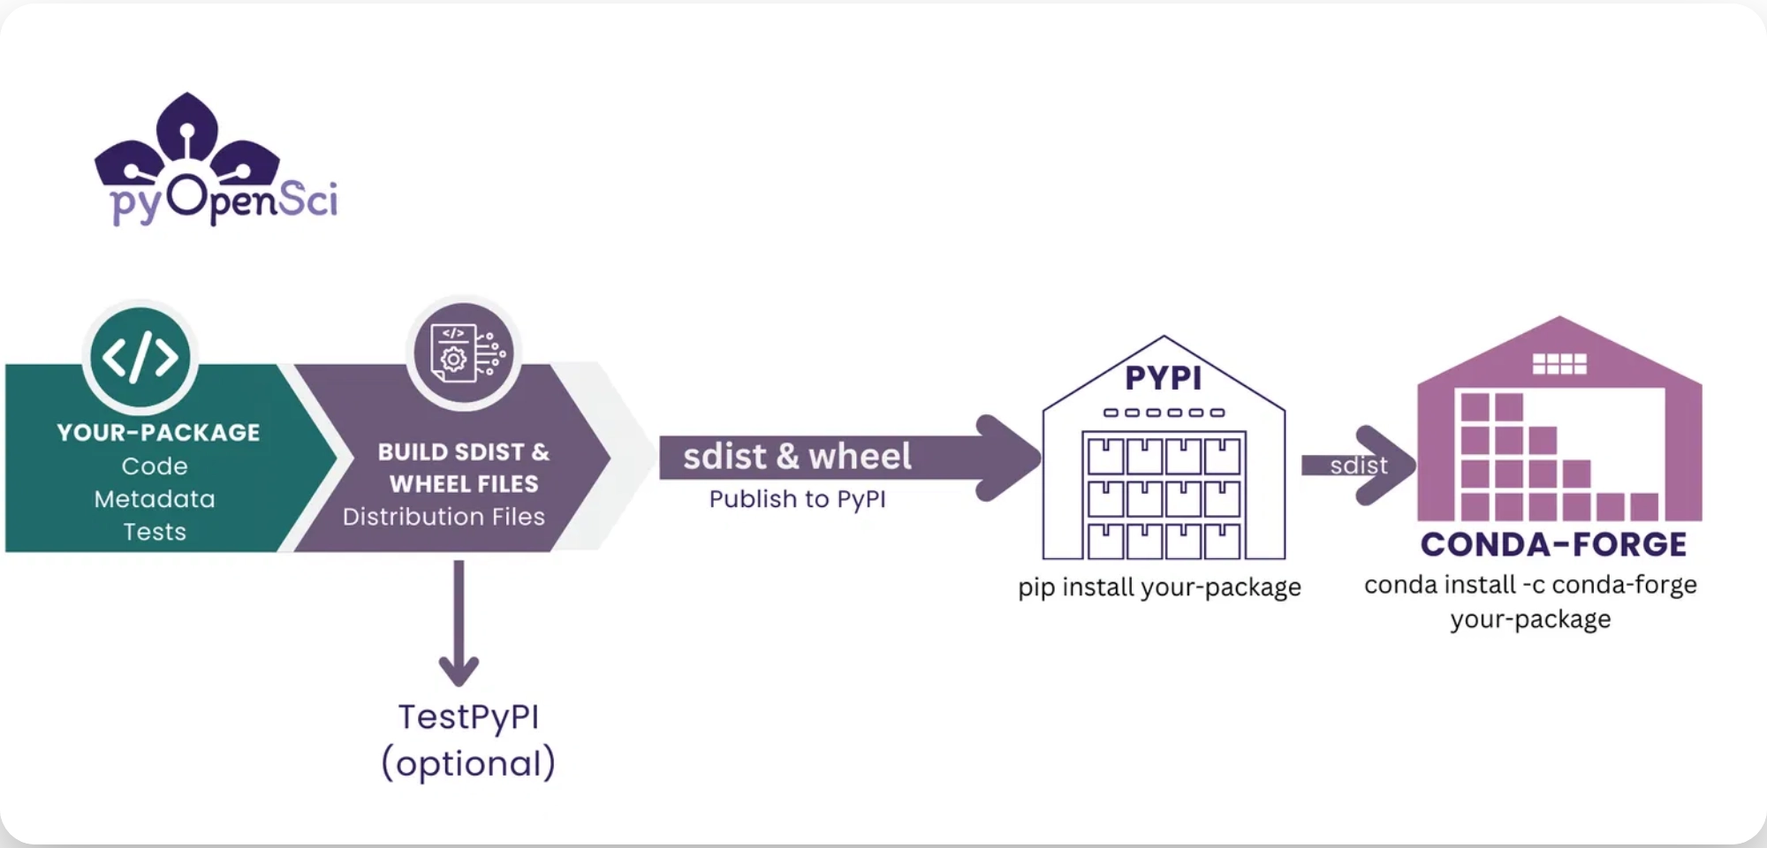
Distributing Your Package
1
Build Distribution Files
Create source distribution and wheel files
python -m build
# Or traditional method
python setup.py sdist bdist_wheel
2
Upload to PyPI
Share your package with the Python community
twine upload dist/*
3
Installation by Users
Anyone can now install your package
pip install your-package
Note:
Consider using TestPyPI first to verify your
package works correctly.

Slide 8
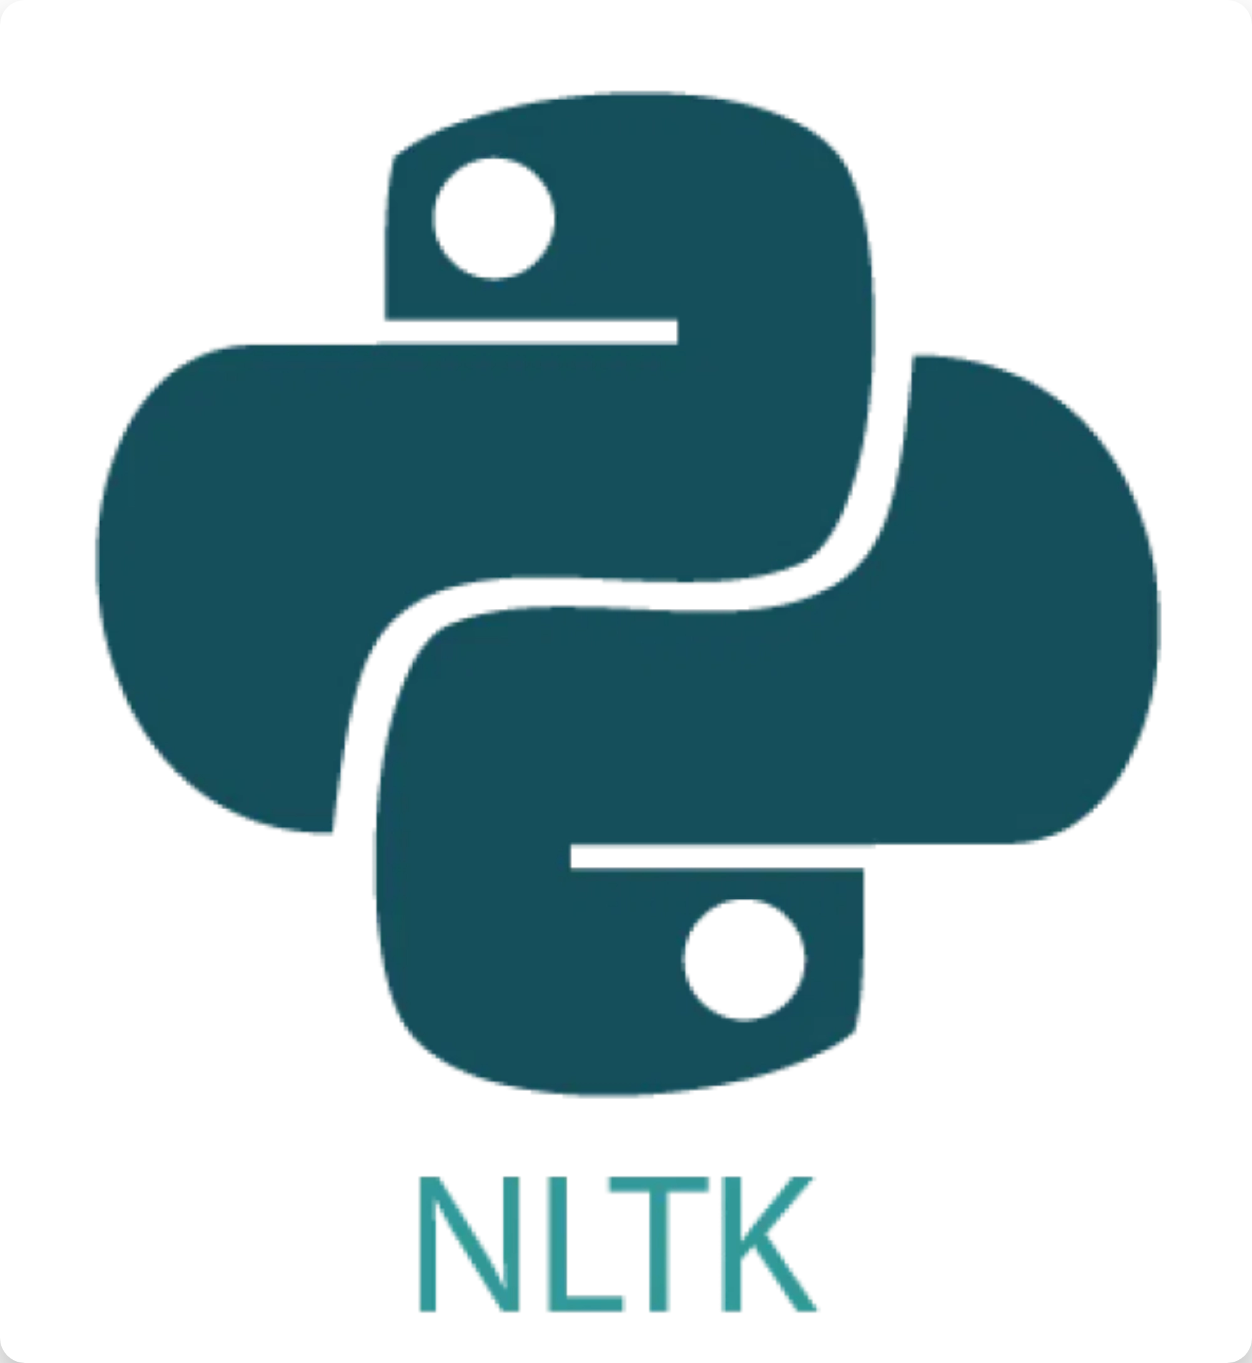

What is NLTK?
NLTK (Natural Language Toolkit)
is a leading platform
for building Python programs to work with human
language data.
Comprehensive Library:
Provides tools for text
processing, classification, tokenization, stemming,
tagging, parsing, and semantic reasoning
Rich Resources:
Access to over 50 corpora and lexical
resources like WordNet
Educational Focus:
Designed for teaching, research,
and practical applications in computational linguistics
Python Integration:
Seamlessly works with other
Python libraries and frameworks

Slide 9


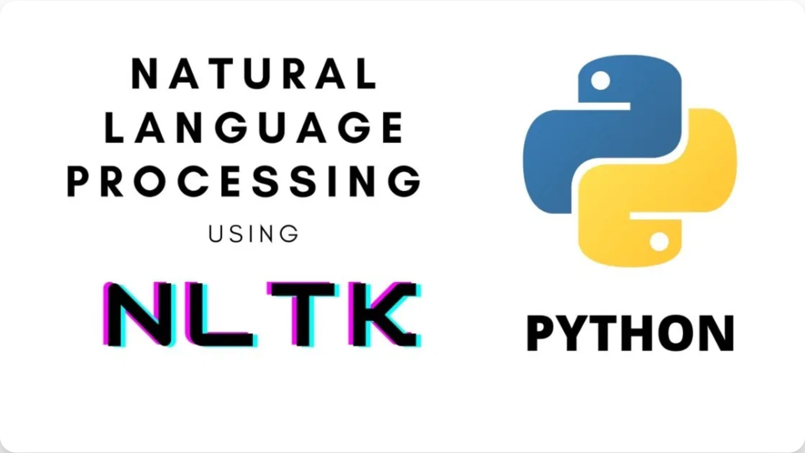

Key Features of NLTK
NLTK provides a comprehensive suite of tools for natural language processing tasks:
Tokenization
Stop Word Filtering
Split text into words, sentences, or other meaningful units
Remove common words that don't add significant meaning
Stemming & Lemmatization
Part-of-Speech Tagging
Identify grammatical parts of speech in text
Reduce words to their root or base forms
Named Entity Recognition
Text Classification
Categorize text by sentiment, topic, or other criteria
Identify named entities like people, organizations, locations

Slide 10

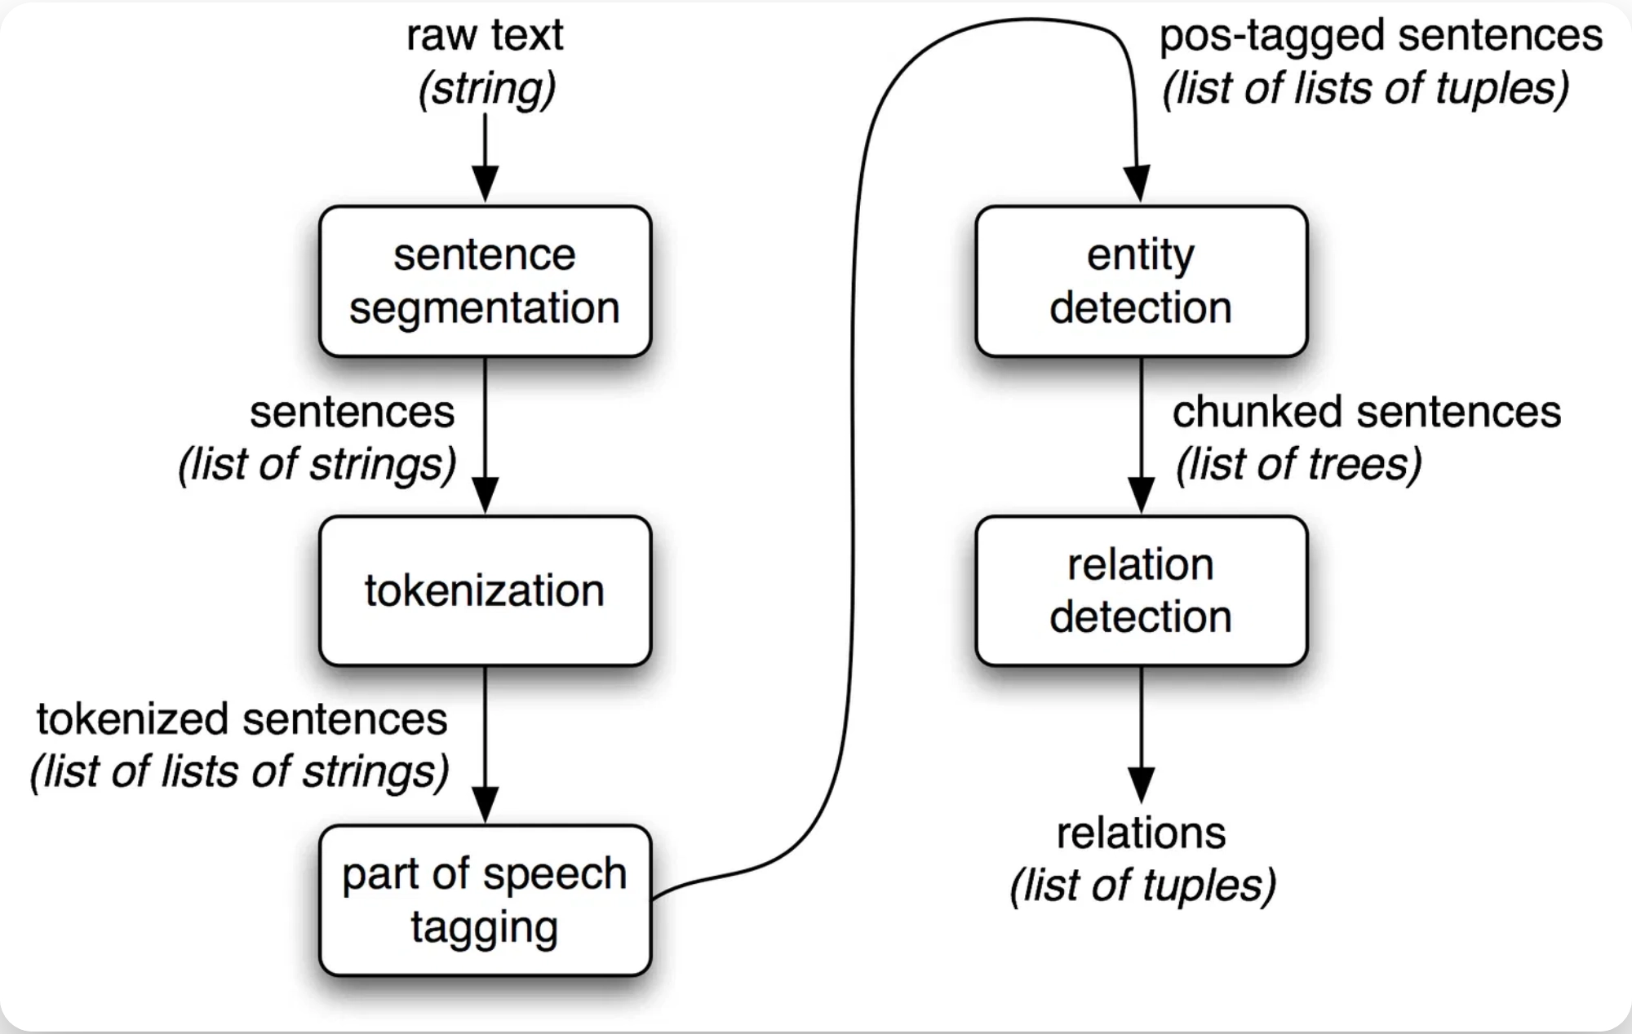
NLTK Text Processing Pipeline
NLTK provides a structured workflow for processing natural language:
1
Tokenization
Split text into sentences and words
tokens = nltk.word_tokenize(text)
2
Normalization
Convert to lowercase, remove punctuation, filter stop words
filtered = [w for w in tokens if w not in stopwords]
3
Stemming/Lemmatization
Reduce words to their base forms
lemmatized = [lemmatizer.lemmatize(w) for w in filtered]
4
POS Tagging
Identify parts of speech
tagged = nltk.pos_tag(lemmatized)
5
Named Entity Recognition
Identify entities like people, organizations, locations
entities = nltk.ne_chunk(tagged)

Slide 11

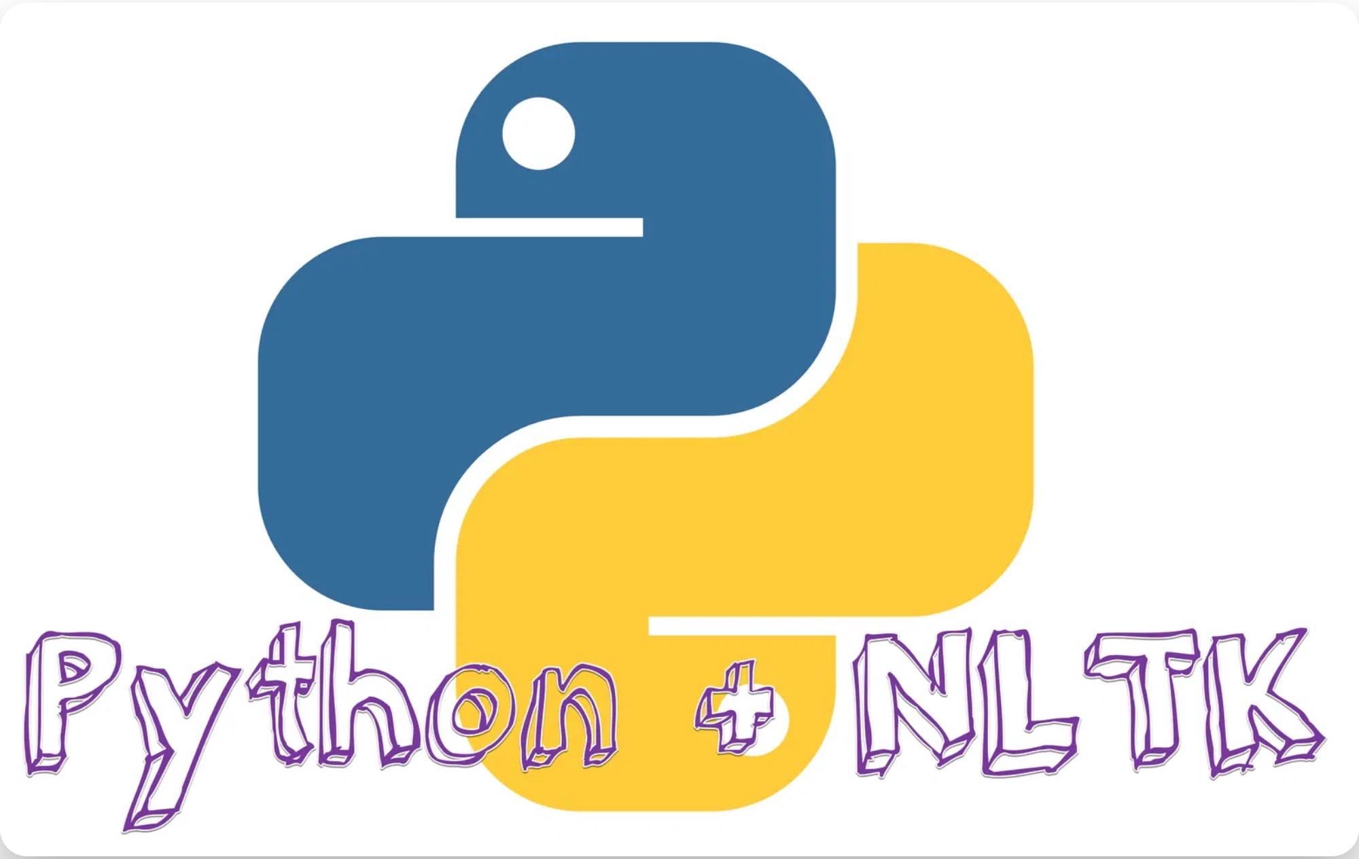
Using NLTK in Python
Install NLTK:
pip install nltk
Download necessary data:
nltk.download('punkt')
# Import necessary modules
import
nltk
from
nltk.tokenize
import
word_tokenize, sent_tokenize
from
nltk.corpus
import
stopwords
from
nltk.stem
import
WordNetLemmatizer
# Sample text
text =
"NLTK is a powerful library for natural language
processing in Python."
# Tokenize into sentences
sentences = sent_tokenize(text)
print
(sentences)
# Tokenize into words
words = word_tokenize(text)
print
(words)
# Filter stop words
stop_words =
set
(stopwords.words(
'english'
))
filtered_words = [w
for
w
in
words
if
w.lower()
not in
stop_words]
print
(filtered_words)

Slide 12

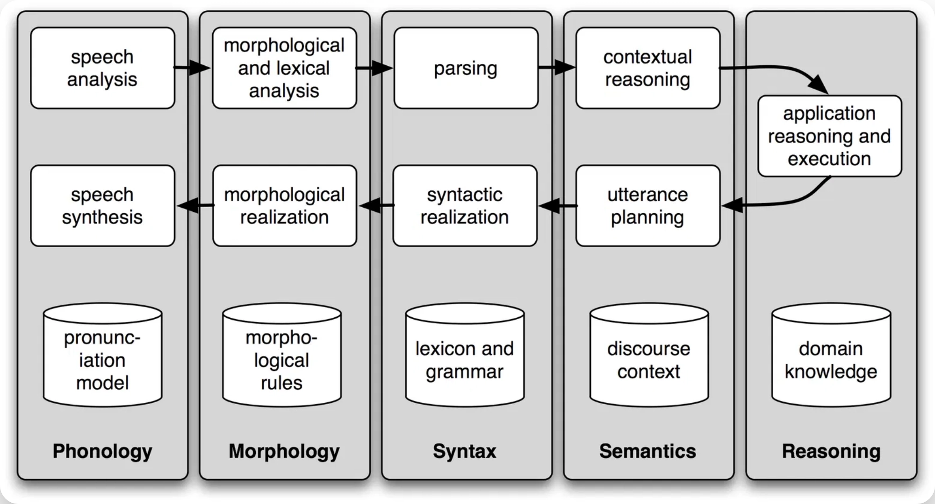
NLTK Applications
NLTK enables a wide range of natural language processing applications:
Sentiment Analysis
Chatbots
Determine the sentiment or emotion in text, useful for social media monitoring and customer feedback analysis
Build conversational interfaces that can understand and respond to natural language queries
Text Summarization
Machine Translation
Create concise summaries of longer texts, extracting key information automatically
Assist in language translation tasks by providing linguistic analysis and processing
Information Extraction
Spell Checking
Pull structured information from unstructured text, such as names, dates, and events
Identify and correct spelling and grammar errors in text documents

