Slide 1
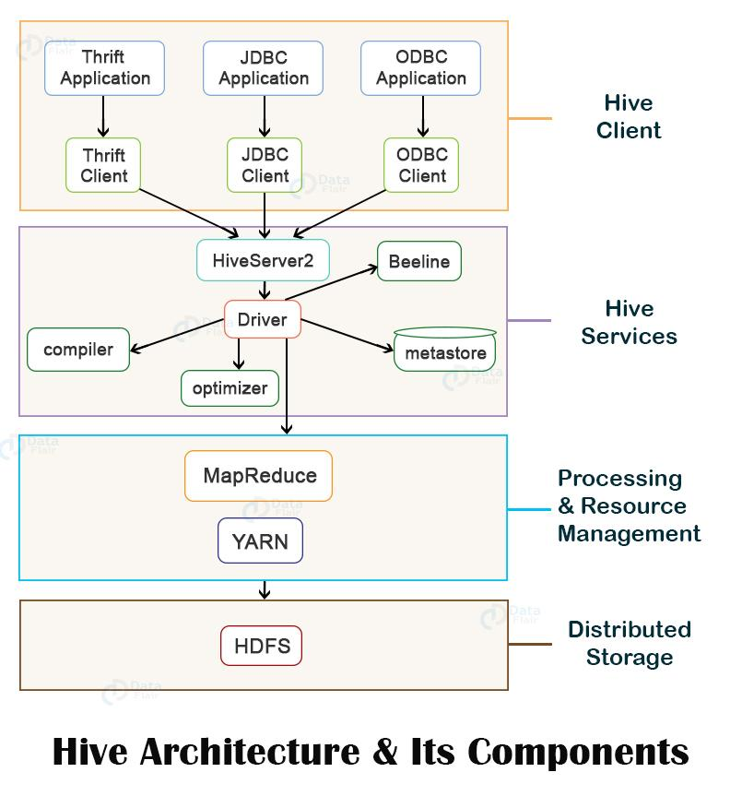
Hive Architecture (Hive Summary)

Slide 2
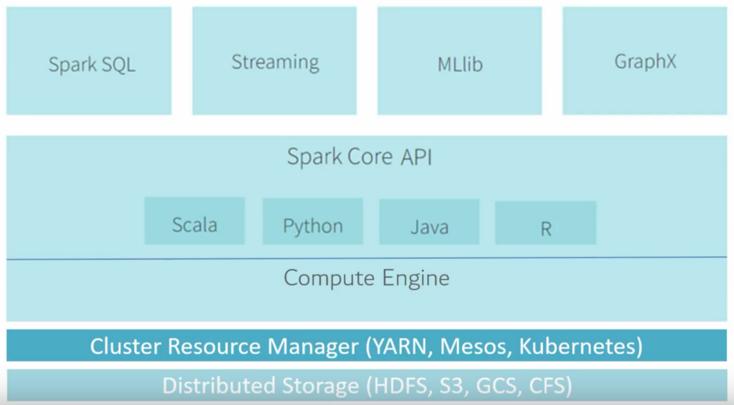
Spark Architecture(Spark summary)

Slide 3
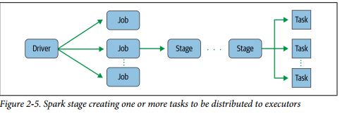
Spark Jobs

Slide 4
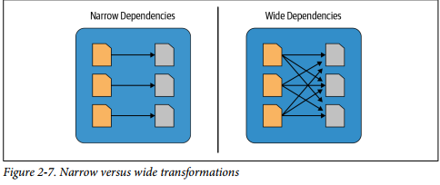
Narrow vs Wide Transformations

Slide 5
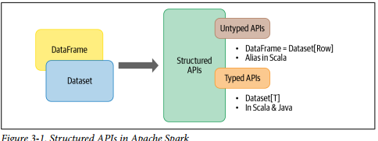
Structured APIs in Spark

Slide 6
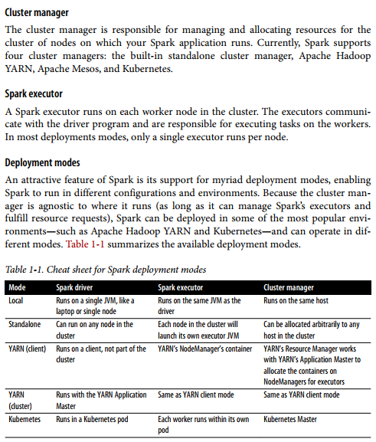

Slide 7
Sources:
Title: Learning Spark: Lightning-fast Data Analytics Authors: Jules S. Damji, Brooke Wenig, Tathagata Das, Denny Lee Publisher: O'Reilly Media, 2020 ISBN 1492050040, 9781492050049 Length 373 pages, 2nd ed

