Slide 1

PhraseForge
Team 13: Diya Roshan Sanghvi
Adam Shoaib Kareem Sab
Aditi Pandey
Harshitha Karur
Dhwanil Parimalsinh Vashi

Slide 2
Table of contents
01
02
03
04
05
06
Parser and Compiler
About the Language
Flow of the Program
Interpreter and Runtime
Demo and Test Programs
Limitations and Future Work

Slide 3
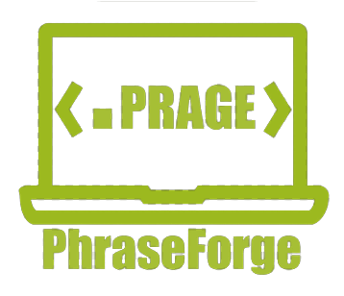
01
About the Language
Language Name: PhraseForge
Language Extension: .prage
Programming Paradigm: Imperative
Tools used: ANTLR and Java

Slide 4
Language Features
Data Types
Assignment Operator
Logical Operator
quant (1,2,3…)
logic (on, off)
phrase
->
$& analogous to logical AND
$| analogous to logical OR
$! analogous to logical NOT
Comparison Operator
Arithmetic Operator
$> analogous to ‘>’ operator
$< analogous to ‘<’ operator
$>= analogous to ‘>=’ operator
$<= analogous to ‘<=’ operator
$== analogous to ‘==’ operator
$!= analogous to ‘!=’ operator
+ : Addition
- : Subtraction
* : Multiplication
/ : Division

Slide 5
Language Features cont.
Ternary Operator
Conditional Blocks
condition ?? exp1 :: exp2
test (cond) { } forge-test
routeTest (cond) { } forge-routeTest
route { } forge-route
Unary Operators
Increment (++var or var++)
Decrement (--var or var--)
Standard Output
reveal( @phrase@, quantVar, logicVar)
Iteration Blocks
Comments
while (cond) { } forge-while
for ( varIni ;; cond ;; expr ) { } forge-for
for in the range (var ;; range ) { } forge-for
%^% comment %^%

Slide 6
Language Features cont.
Symbols
Identifiers
;;
{ , }
( , )
@
??
::
%^%
a-Z or A-Z or _
a-Z or A-Z or (0-9) or _
Reserved Keywords
quant, logic, phrase, reveal, test, route, routeTest, forge-test, forge-route, forge-routeTest, while, forge-while, for, forge-for, on, off, pf_launch, pf_abort

Slide 7
Grammar
SER502-Spring2023-Team13
doc
RailDiagramsPhraseForge.html

Slide 8
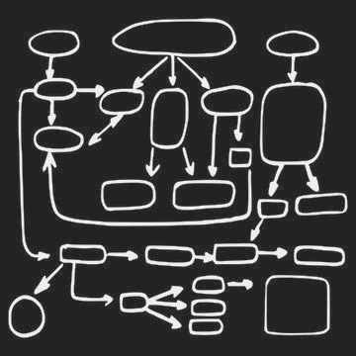
02
Flow of the Program

Slide 9
Flow of the Program
PhraseForge Program
(.prage)
ANTLR
(Lexical Analyzer)
Tokens
Parse Tree
PhraseForge
Output
(.pge)
Interpreter
Intermediate Code
(.pra)

Slide 10
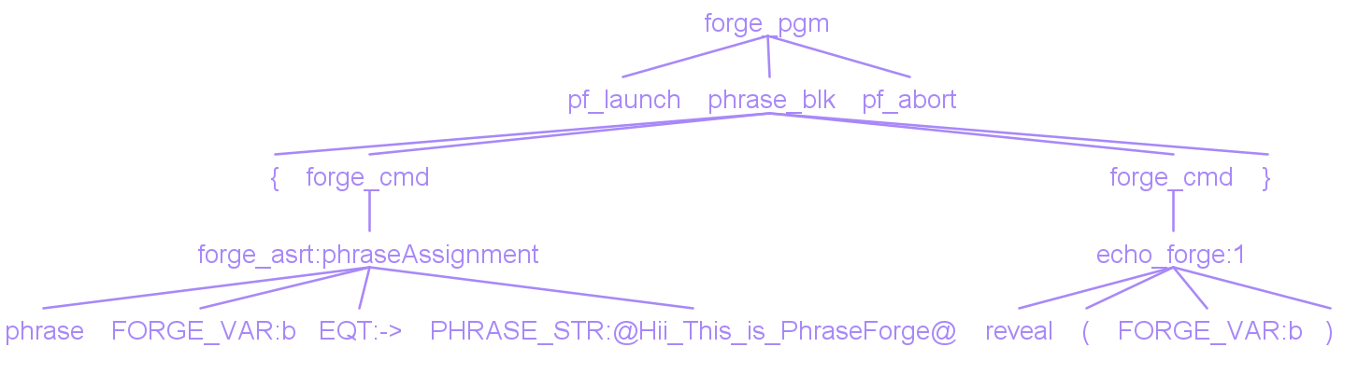
Program Flow with Sample Code
PARSE TREE :
(START) CODE :
pf_launch
{
phrase b -> @Hii_This_is_PhraseForge@
reveal(b)
}
pf_abort
INTERMEDIATE CODE :
LOAD ACC @Hii_This_is_PhraseForge@
LOAD b ACC
ECHO b
(END) OUTPUT :
Hii_This_is_PhraseForge

Slide 11
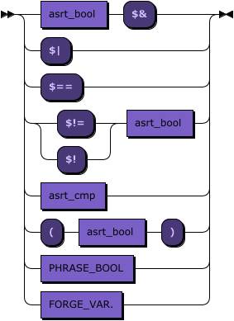
03
Lexical Analyser and Compiler

Slide 12
Lexical Analyzer
The lexical analyzer plays an important role in analyzing the source code with the extension during the compilation and interpretation phase.
The lexical analyzer scans the file's characters and converts them into tokens that the programming language can understand.
These tokens, which include keywords, identifiers, operators, literals, and special characters, are generated based on predefined rules and patterns and are stored in a list in the order they are parsed.
The lexical analyzer has been implemented using ANTLR.

Slide 13
Parse Tree and Compiler
The parser plays a crucial role in the compilation or interpretation process of the programming language. It aims to verify that the source code complies with all syntax rules specified by the language.
It reads tokens from the list generated by the lexical analyzer one at a time, and once all tokens have been parsed, constructs a parse tree representing the grammatical structure of the code. It prepares an intermediate file with .pra extension.
After this, the tree is passed to the compiler that generates appropriate 3 or 4 word instructions. We used Java to build our compiler.

Slide 14
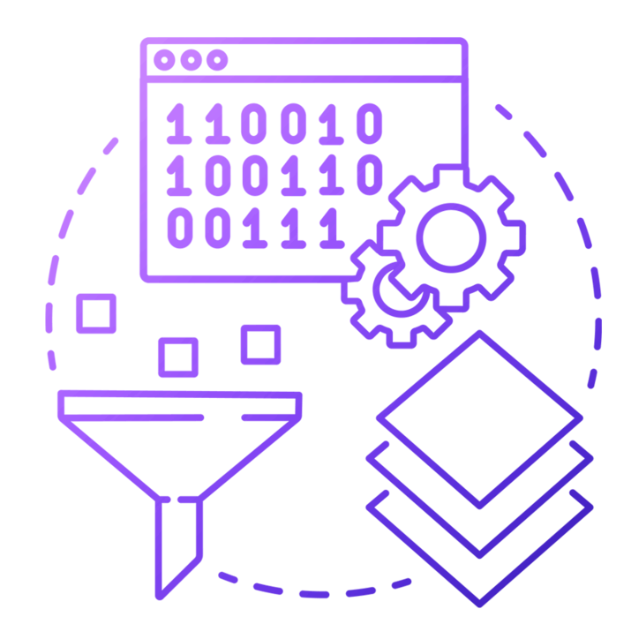
04
Interpreter and Runtime

Slide 15

Interpreter
The interpreter utilizes the intermediate code produced to ensure that the code is semantically valid, checking for proper variable usage, type matching, and other language-specific constraints.
Java was used to create an
interpreter and the runtime
environment for our language.

Slide 16

05
Demo and Test Programs

Slide 17
Demonstration of the Language
Github link : https://github.com/adamshoaib/SER502-Spring2023-Team13
Basic arithmetic operations on ‘quant’ data type - (addition, subtraction, multiplication and division)
Logical operations on ‘logic’ data type -(Logical NOT, AND and OR)
Ternary operation on ‘quant’ data type
Programs to show for and while loop functions
Programs to show test, route and testRoute functions (if-else statements)

Slide 18
Logical and comparison operations
Source code:
pf_launch
{
quant p -> 10
quant f -> 20
quant h -> f - p
quant k -> p
test(h $== k)
{
reveal(@h_equalTo_k@)
}
routeTest(h $!= k)
{
reveal(@h_notEqualTo_k@)
}
forge-routeTest
forge-test
logic t -> on
logic f -> off
test(t $| f)
{
reveal(@tOrf_is_true@)
}
forge-test
logic g -> on
g -> $!g
reveal(g)
}
pf_abort
Output:
Compile time: No of lines in intermediate code - 57
Compiled Successfully!
Intermediate Code saved at data/boolean.pra
Output:
h_equalTo_k
tOrf_is_true
off
Process finished with exit code 0

Slide 19
Ternary Operator
Source code:
pf_launch
{
reveal(@greater_number_is@)
quant a -> 1234567
quant b -> 2334551
quant c -> (a $> b) ?? a :: b
reveal(c)
}
pf_abort
Output:
Compile time: No of lines in intermediate code - 22
Compiled Successfully!
Intermediate Code saved at data/ternaryOperator.pra
Output:
greater_number_is
2334551
Process finished with exit code 0

Slide 20
Fibonacci
Source code:
pf_launch{
quant term1 -> 0
quant term2 -> 1
quant i
quant nextterm
quant x -> 6
reveal(@fibonacci_terms@)
for (i-> 1 ;; i $<=x ;; i++){
reveal(term1)
nextterm -> term1 + term2
term1 -> term2
term2 -> nextterm
}
forge-for
}
pf_abort
Output:
Compile time: No of lines in intermediate code - 39
Compiled Successfully!
Intermediate Code saved at data/fibonacci.pra
Output:
fibonacci_terms
0
1
1
2
3
5
Process finished with exit code 0

Slide 21
Test Route (if-else) statements
Source code:
pf_launch
{
quant a -> 11
quant b -> 22
quant c -> 33
test((a $> b) $& (a $> c))
{
reveal(a)
}
routeTest ((b $> a) $& (b $> c))
{
reveal(b)
}
forge-routeTest
route
{
reveal(c)
}
forge-route
forge-test
}
pf_abort
Output:
Compile time: No of lines in intermediate code - 47
Compiled Successfully!
Intermediate Code saved at data/test_route_routeTest.pra
Output:
33
Process finished with exit code 0

Slide 22
Even number
Source code:
pf_launch
{
quant a -> 4
while(a $> 0)
{
%^% expression to check reminder when divided by 2 %^%
test( a - (2 * (a/2)) $== 0){
reveal(@even_number@,a)
}
route{
reveal(@odd_number@,a)
}
forge-route
forge-test
a -> a-1
}
forge-while
}
pf_abort
Output:
Compile time: No of lines in intermediate code - 46
Compiled Successfully!
Intermediate Code saved at data/evenNumberWhile.pra
Output:
even_number
4
odd_number
3
even_number
2
odd_number
1
Process finished with exit code 0

Slide 23

06
Limitations and Future Work

Slide 24

Limitations
Due to the Antlr generated parser’s incapability to recognize white spaces our strings are not capable of containing white spaces.
Cannot perform string
operations.
There is no support for multiple
variable declarations in a single
line instruction.
There are no complex data
structures supported.
It supports only 3 data types as of now.

Slide 25

Future Work
Work on parser so it can recognise white space as a legitimate token.
Add string manipulation support
Support for multiple variable
declarations in a single line.
Complex data structures support.
More data types.

Slide 26
Thank You!

