Slide 1

chaplin.ai
Speak Without a Voice 🗣️
AGENT ARCHITECTURE · WORKSHOP PITCH
Chaplin AI
Adam & Jonathan
Notes:
Chaplin.ai — an AI agent that gives ventilated patients their voice back. Reliable communication, not just lip-reading.

Slide 2
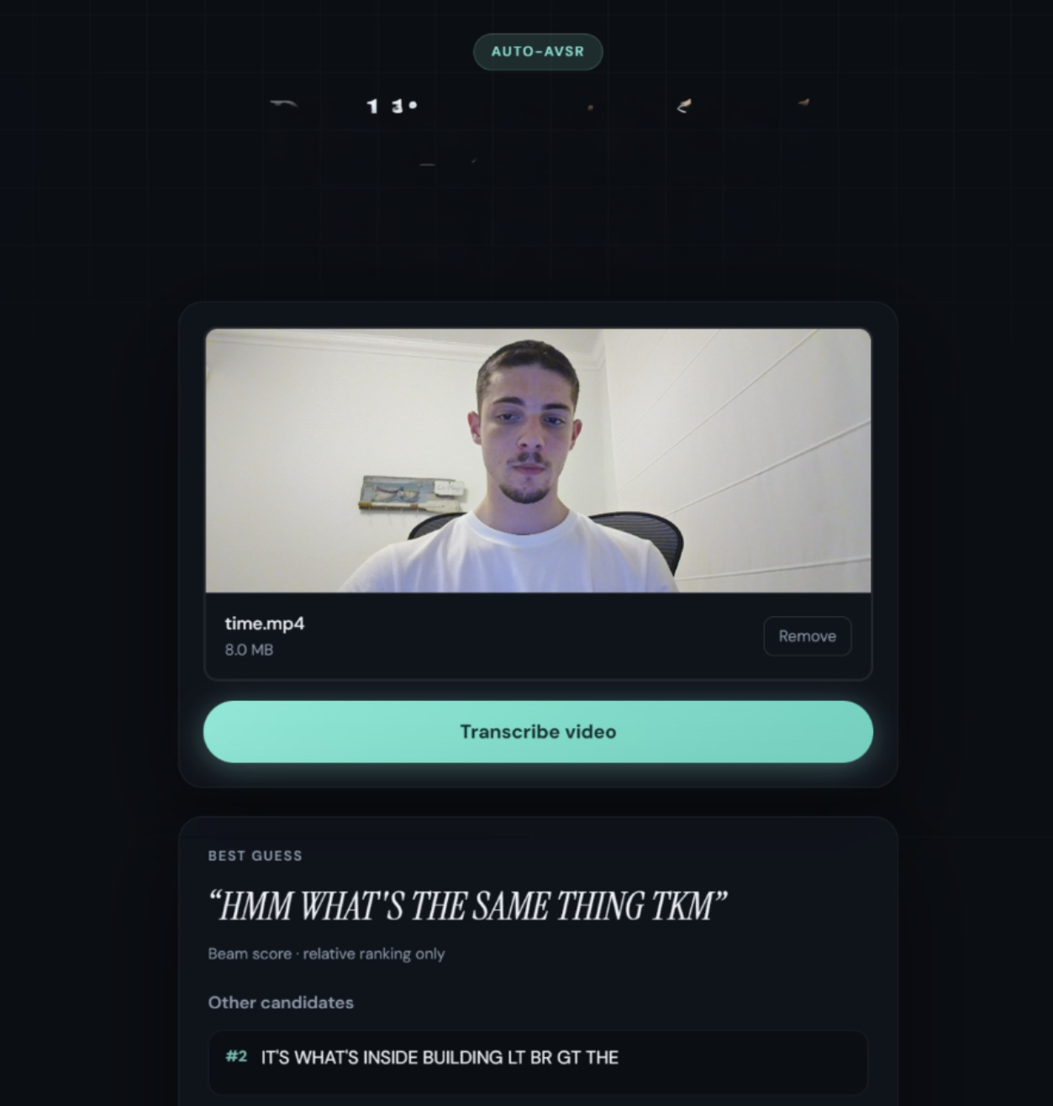
01 THE PROBLEM
I said: “What are you doing here ?”
Awake. Aware. Silent. 🤐
Millions of ventilated patients around the world unable to communicate effectively
🧠 Can't reason
🔁 Can't act
Current tools in market? Confidently wrong. ⚠️
Lip reading models hallucinate, produce
Poor results.
👤 No context
Notes:
Millions of ventilated/intubated patients are conscious but can't speak. The tools that should help hallucinate confidently — and a wrong sentence is worse than silence. Three root causes: can't reason, no context, can't act.

Slide 3
02 THE AGENT
Make it think. 💡
An agent. Not a model.
RELIABILITY OVER COVERAGE
01
02
03
REASON 🧠
REFLECT 🔍
ACT ⚡
Correct VSR model
Check its own draft.
Fix — or ask.
Notes:
We stopped making the model guess harder and made it think. Chaplin.ai is a lip-reading AGENT — reliability over coverage. Three jobs: reason (lips to a fluent sentence), reflect (critique its own draft), act (fix once, or ask). When unsure it asks instead of asserting.

Slide 4

03 ARCHITECTURE
A reflection agent. 🔄
ReAct agent
Draft. Critique. Speak.
ToolInvoker
🛠️ phone call, SMS
🧠 📋
fan out
VSR
lips → text
Generate
Corrects VSR prediction
Reflect
critic
RETURN
Speak
🗣️ their voice
🧠 📋
🧠 📋
unsure? ask first 🙋
REVISE · N = 1
🧠 short-term memory 📋 patient's background
Reflect returns action · issues · edit_rules
Notes:
Architecture: a reflection agent. VSR -> Generate (one LLM drafts) -> Reflect (LLM critic). It either RETURNs (speak it) or REVISEs once — N=1 — by looping back into the SAME Generate with edit_rules, then speaks, or asks if still unsure. Everything grounded in per-word VSR confidence. Reflect returns three fields: action (RETURN/REVISE), issues (type/span/description), edit_rules (what to fix).

Slide 5
03 ARCHITECTURE
Example:
“what are you doing here”
VSR PREDICTS
“whats are yours going tkmmm”
GENERATE · DRAFT
“what are your doing here?”
REFLECT · FINAL
“what are you doing here”
VSR
lips → text
Generate
Corrects VSR prediction
Reflect
critic
RETURN
Speak
🗣️ their voice
🧠 📋
🧠 📋
unsure? ask first 🙋
REVISE · N = 1
🧠 short-term memory 📋 patient's background
Reflect returns action · issues · edit_rules
Notes:
Architecture: a reflection agent. VSR -> Generate (one LLM drafts) -> Reflect (LLM critic). It either RETURNs (speak it) or REVISEs once — N=1 — by looping back into the SAME Generate with edit_rules, then speaks, or asks if still unsure. Everything grounded in per-word VSR confidence. Reflect returns three fields: action (RETURN/REVISE), issues (type/span/description), edit_rules (what to fix).

Slide 6
04 WHY REFLECTOR WORKS
Not random. 🎯
We tested it with LLM corrector. Two consistent failures:
WE SAW
WE SAW
Drifted 🌀
Unreasonable 🤔
Off from the lips.
A sentence grammatically incorrect.
Reflector fixes
Reflector fixes
Notes:
Why reflection? We evaluated an LLM correcting the VSR output. Its mistakes were exactly two kinds: it drifted (semantically far from what was seen on the lips) or got unreasonable (implausible sentences). The two issue types — UNCERTAIN_SPAN and VISUAL_ALIGNMENT — are aimed straight at those.

Slide 7
05 WHY IT MATTERS
A voice — given back. ❤️
🛏️ The patient
🩺 The clinician
👪 The family
“I'm in pain.” Heard.
Understanding patient.
No more guessing.
Their voice, again.
The sentences that matter. ✅
Notes:
Impact: the patient is understood in seconds; the clinician acts on real words, not a letter-board guessing game; the family hears them again, in a voice that sounds like them. Not open-ended chat — the handful of sentences that matter, gotten right.

Slide 8
chaplin.ai
Speak Without a Voice
No one misheard. 🙌
Chaplin AI
Thank you · Adam & Jonathan
Notes:
Close: reliability over coverage — an agent built so no one is ever misheard. Thank you.

