Slide 1

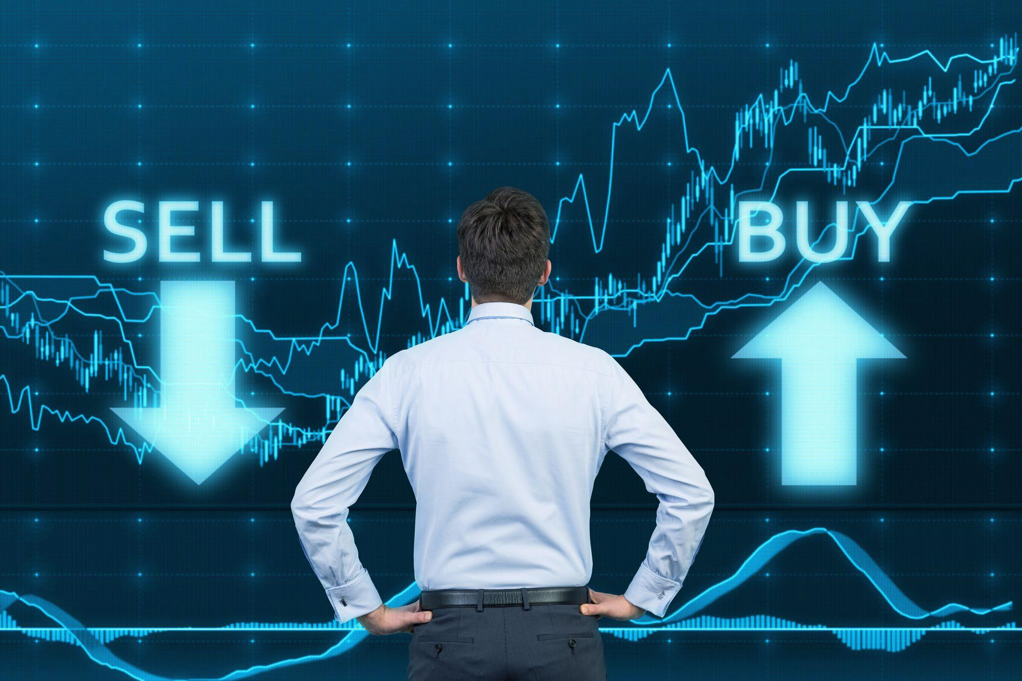

Python ML
Stock Forecaster
By: Adam Siwiec
Dr. Bin Liu - MIST 493B Intro to AI/ML - Final Project

Slide 2
Overview
predict.py
Holds logic for our Machine Learning model.
Stock data is pulled from yfinance library.
This is an unofficial Yahoo Finance API, the data is compiled by web scraping.
The official Yahoo Finance API was decommissioned May 15th, 2017.
https://pypi.org/project/yfinance/
Pandas and Numpy are used to organize data.
MatPlotLib is used to create graphs.
predict_test.py
Allows users to use the ML model without writing python code.
Takes in tickers from the user and appends them to the prediction list.
Allows the user to enter an amount of days to predict in the future.
Prompts the user with an option to save the their plot image as well as their forecasted data to a .csv file.

Slide 3
Is it accurate?
No. You cannot predict the stock market and how people will react.
It can be accurate in identifying past trends. Although, it’s hard to predict something as volatile as the stock market with certainty.
It seems to think past rare trends will repeat.
Gamestop
Tesla
Apple
If we were able to implement an algorithm into our model that predicts how the human mind will react with certainty, then this model would be accurate.
Fun, engaging way to learn how to handle times series data with Python ML.

Slide 4
predict.py

Slide 5

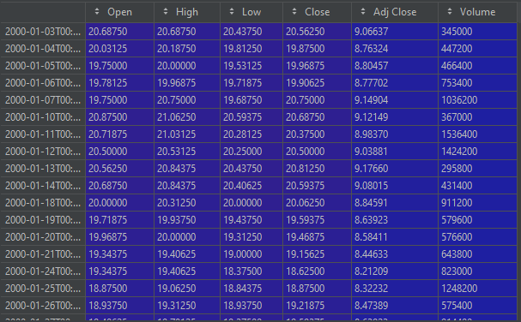
Pull Data
This data that we pull from yfinance is raw and not formatted properly for our Machine Learning model.
The variable ‘data’ is a pandas dataframe with the following columns.

Slide 6
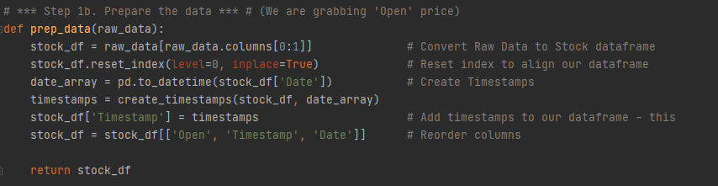
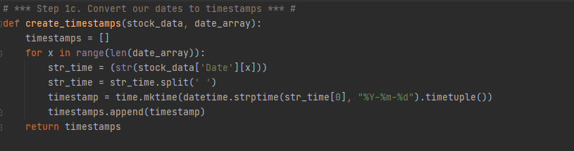
Prepare Data
This function takes in the raw dataframe extracted from yfinance and prepares it for use with our model.
In order to use time series data in AI/ML, you must convert your dates into timestamps.
Our prepared dataset will be consisted of Open Price, Timestamp, and Date.

Slide 7
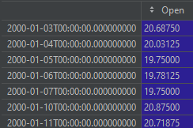
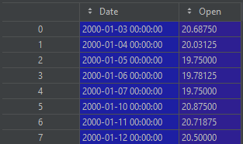
Why prep?
‘stock_df.reset_index’ is an important step in preparing our model.
Timestamps are essential to synchronize data points over a period of time.
The Date column does not have a title.
Before reset_index:
After reset:
2. We need an index column.

Slide 8
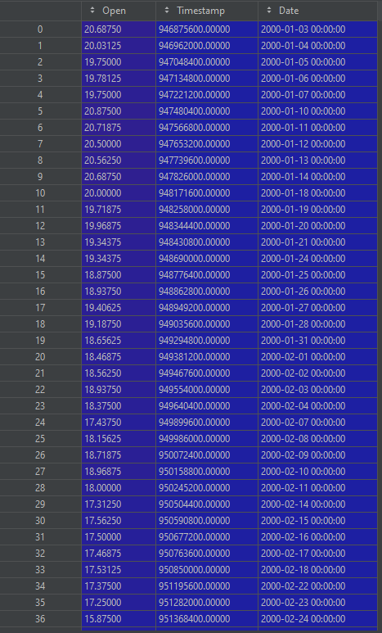
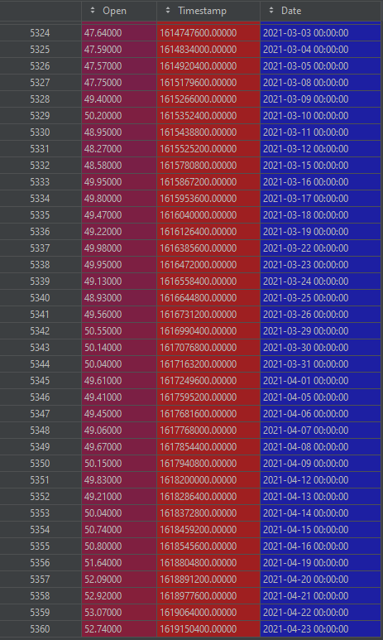
Peek Data
Beginning
End
Dates are stored in this dataframe along with the timestamp.
The dates are used to label our line plot.
Our model uses historical stock data going back to the year 2000.

Slide 9
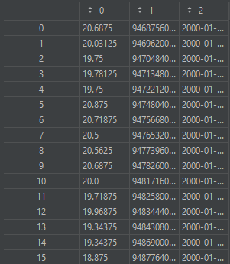
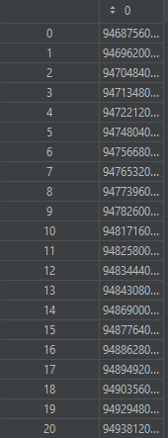
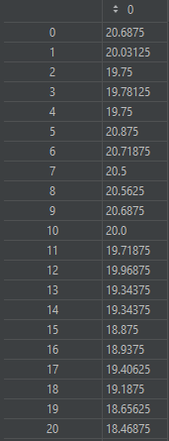
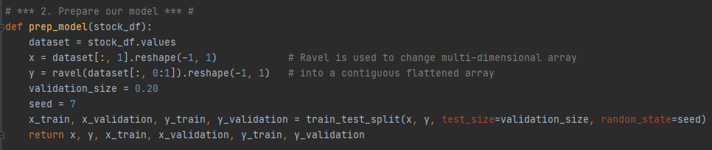
Prepare Model
x
y
‘stock_df.values’ turns our pandas dataframe into a numpy array.
x = timestamps
y = price
We are holding back 20% of our data as a validation set.
random_state = 7
Set to integer = train_test returns consistent results between executions
Set to none = train_test returns different results for each execution.
Peek at data after reshaping
Reshape our dataset
**we passed in the stock_df dataframe from the previous slide

Slide 10
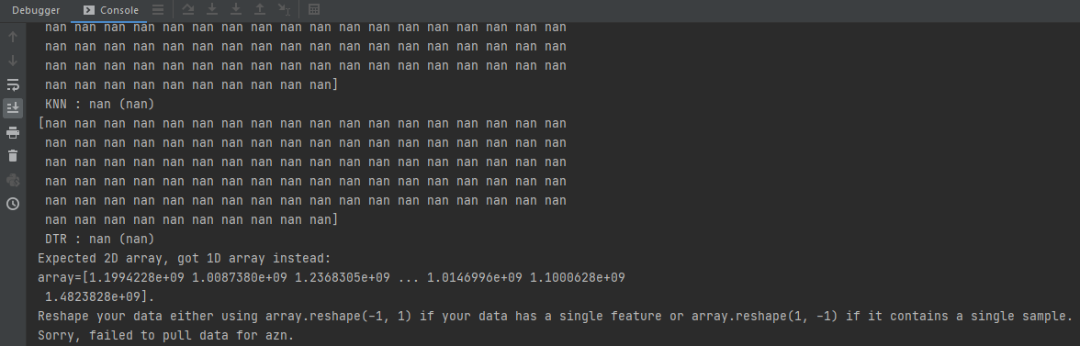
Why reshape?
x before reshaping
y before reshaping
Error code if we don’t reshape
Since both x & y are a “single feature” we used (-1,1) to reshape them.
“Reshape your data either using array.reshape(-1, 1) if your data has a single feature or array.reshape(1, -1) if it contains a single sample.” - The Python Gods

Slide 11
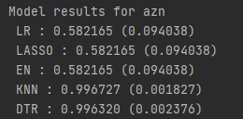
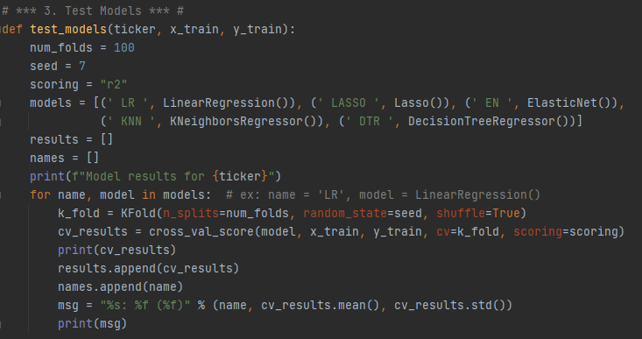
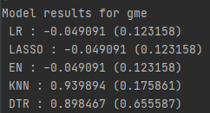
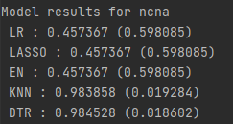
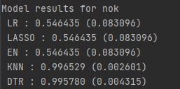
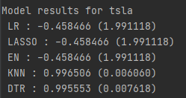
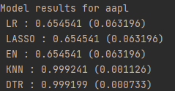
Test Models
Example Results: (cross-validation)
MEAN (SD)
As you can see from the example results, KNeighborsRegressor (KNN) and DecisionTreeRegressor (DTR) appear to be the best models for our dataset.
However, this does not mean that our predictions will be accurate. We must look at metrics such as:
Mean Sq. Error
R-squared
Adjusted R-Squared. (not built into sklearn)

Slide 12
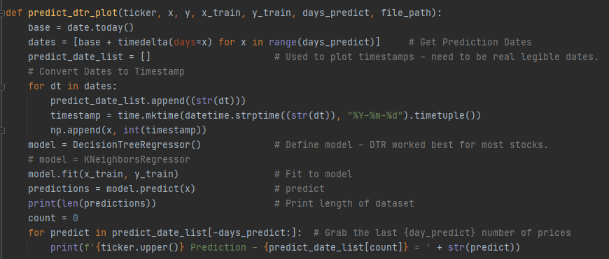
Predict Part 1 - Decision Tree Regressor

Slide 13
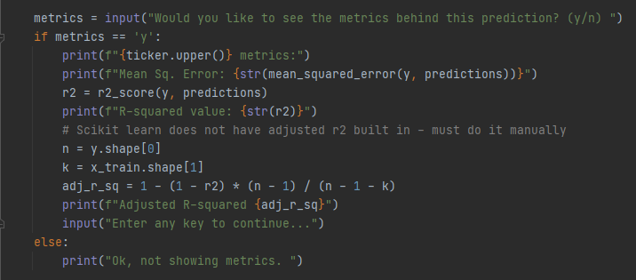
Predict Part 2- Metrics

Slide 14
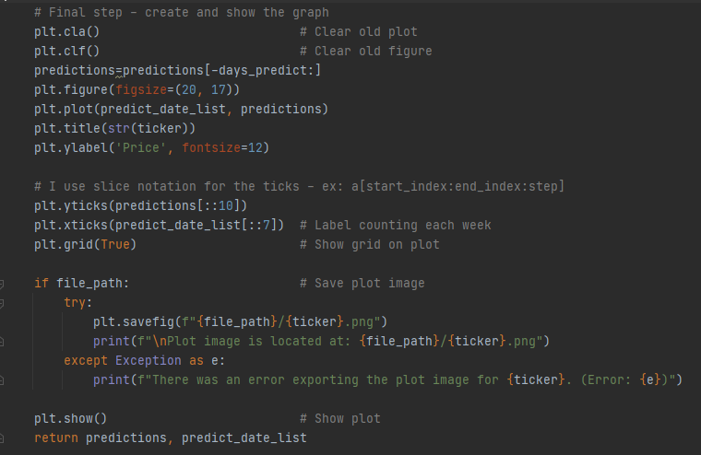
Predict Part 3 - Graph

Slide 15
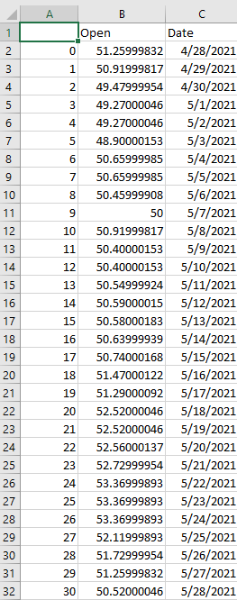
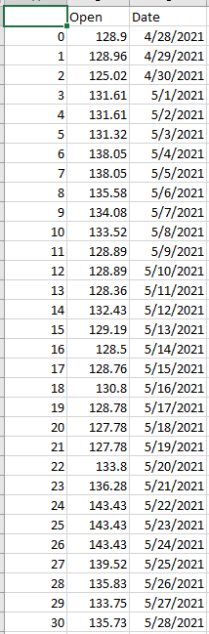
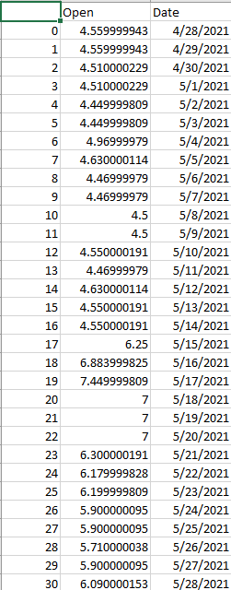
Predictions - Peek 1
**The predict_test.py Python script will prompt you to choose a location to save your .csv predictions as well as the image of your plot - demonstration at end.
AZN
AAPL
NCNA
Are these predictions accurate? Let’s take a look at our metrics on the next slide.
Steady trend? Up then down?
Almost two dollars up in 30 days?

Slide 16
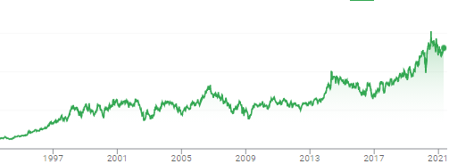


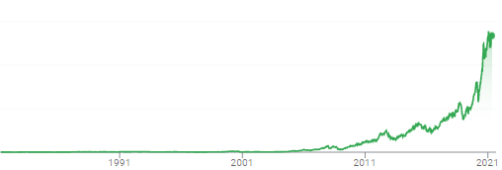

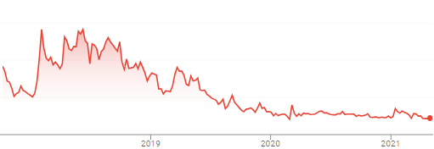
Predictions - Metrics 1
AZN
$50
AZN has long steady history - Lower RMSE at 4.4%
$5
AAPL has a bit higher RMSE at 14.6% - due to long history of slow growth and recent volatility?
$130
AAPL
$0.30
Short history - relatively stable recently - more narrow price range - average RMSE
$25
NCNA
$5

Slide 17

Predictions - Interpreting Metrics
The R² value is not a useful metric for time series data.
Time series data (e.g. Timestamps) tend to be friendly toward our R² value and not a great metric for our model.
https://stats.stackexchange.com/questions/101546/what-is-the-problem-with-using-r-squared-in-time-series-models - detailed explanation of R² flaws with Time Series data.
Root Mean Sq. Error (RSME) is useful for our predictions - according to Ifeoma Ojialor in an article on www.towardsdatascience.com, an acceptable RMSE for time series data of this nature is between 0.00-0.25. ¹
https://towardsdatascience.com/performing-a-time-series-analysis-on-the-aapl-stock-index-3655da9612ff

Slide 18
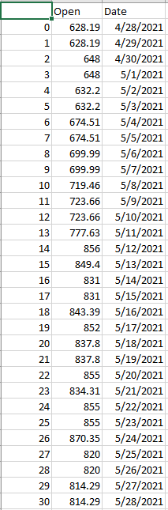
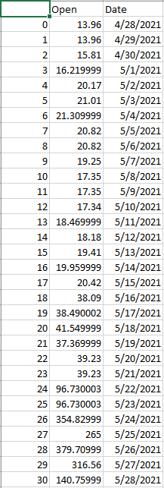
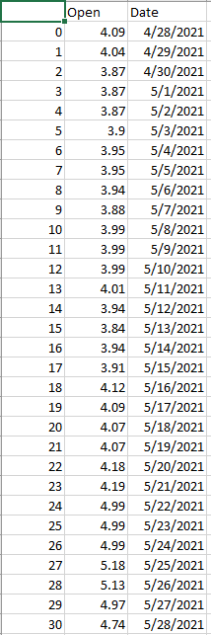
Predictions - Peek 2
GME
NOKIA
TSLA
Let’s take a look at Tesla and two “meme stocks”; Gamestop and Nokia.
These stocks have a recent history of volatility - will our model be able to predict them with accuracy?
Our range of predictions for GME spans from $13.96 to almost $380.
Our model seems to think Tesla’s exponential rise will continue.
The question is - will our model/metrics pick up on this volatility?

Slide 19
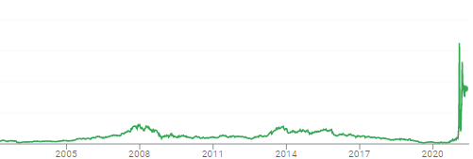

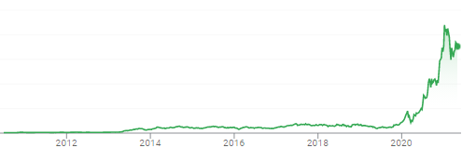

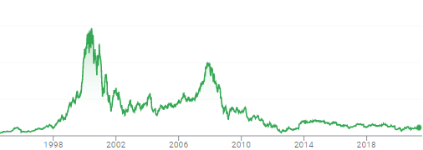

Predictions - Metrics 2
Gametop has a high Mean Sq. Error - due to recent volatility - our model does not predict this stock with certainty.
GME
$350
$30
$800
Tesla also has a high Mean Sq. Error - due to its shorter history and wider range of price volatility
TSLA
$40
Nokia has long bumpy history but a relatively low Mean Sq. Error - seems like model is less certain in predicting stocks with a wide price range.
$55
NOK
$4

Slide 20
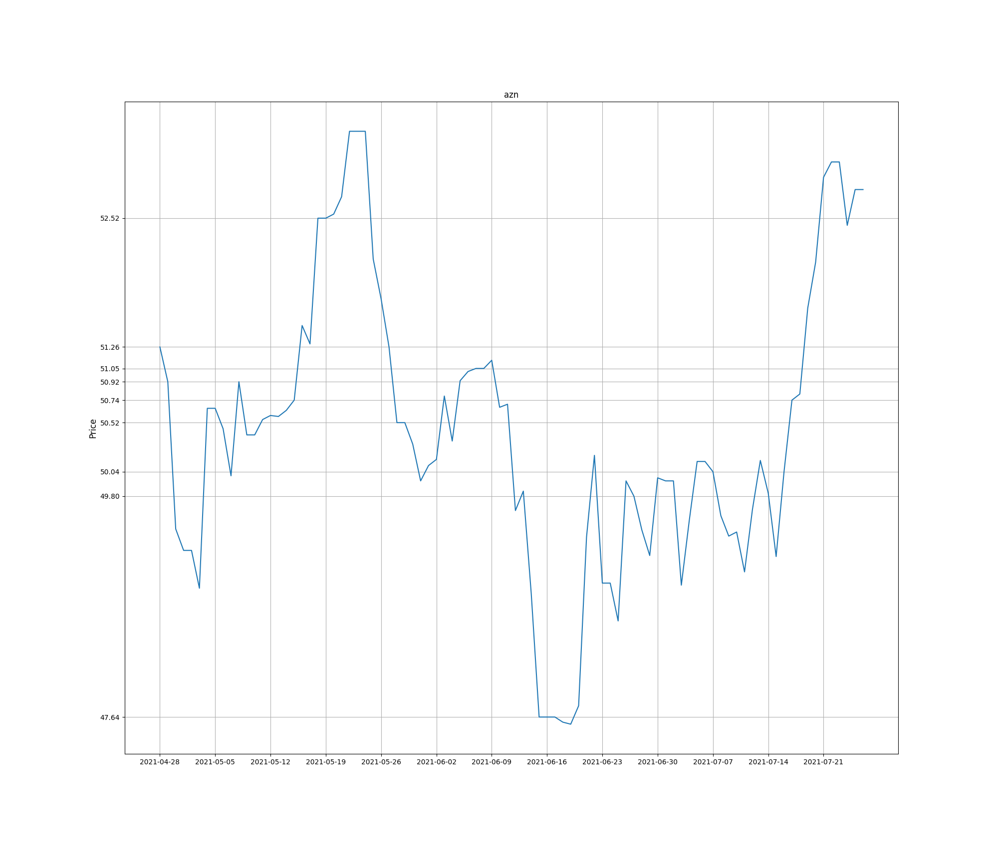
Plot - AZN
NOK
** All plots were created using MatPlotLib
https://matplotlib.org/stable/contents.html

Slide 21
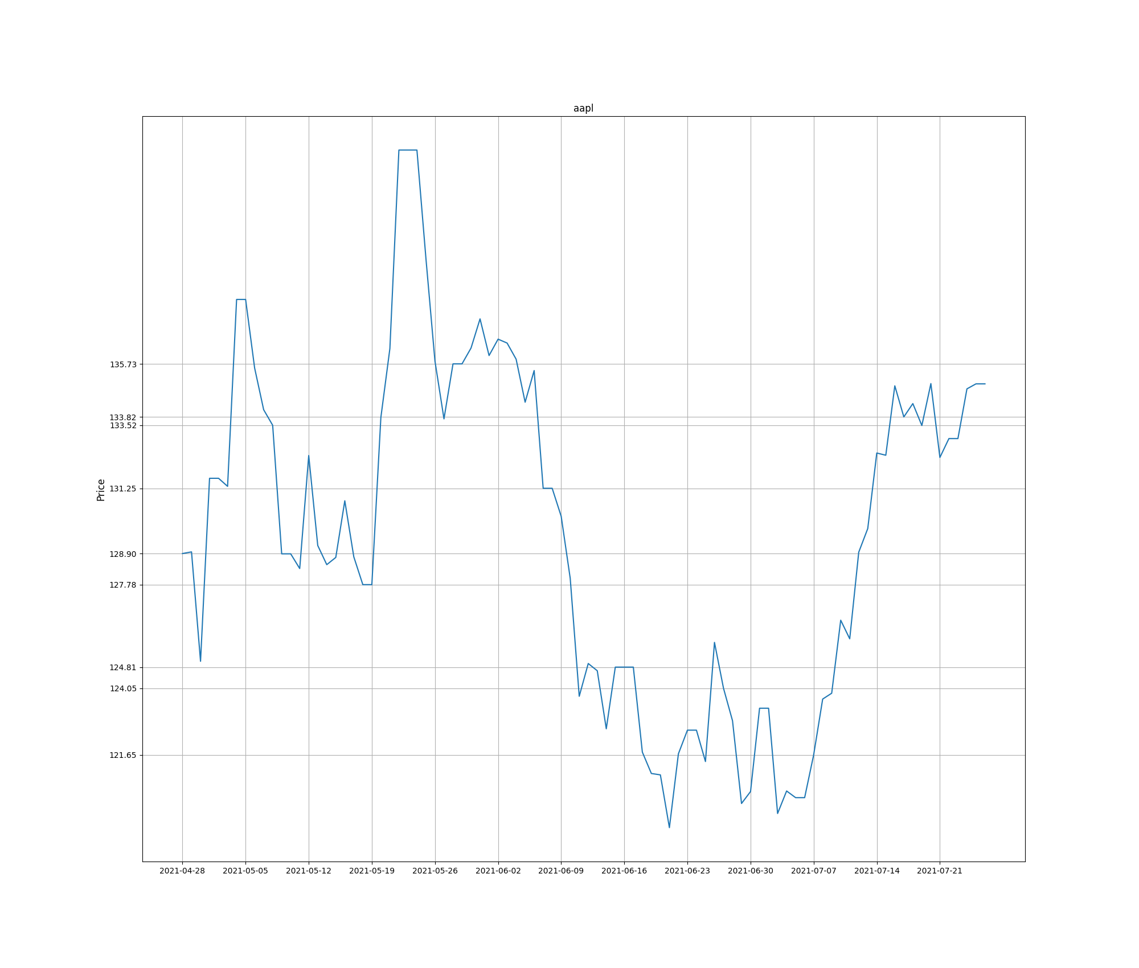
Plot - AAPL

Slide 22
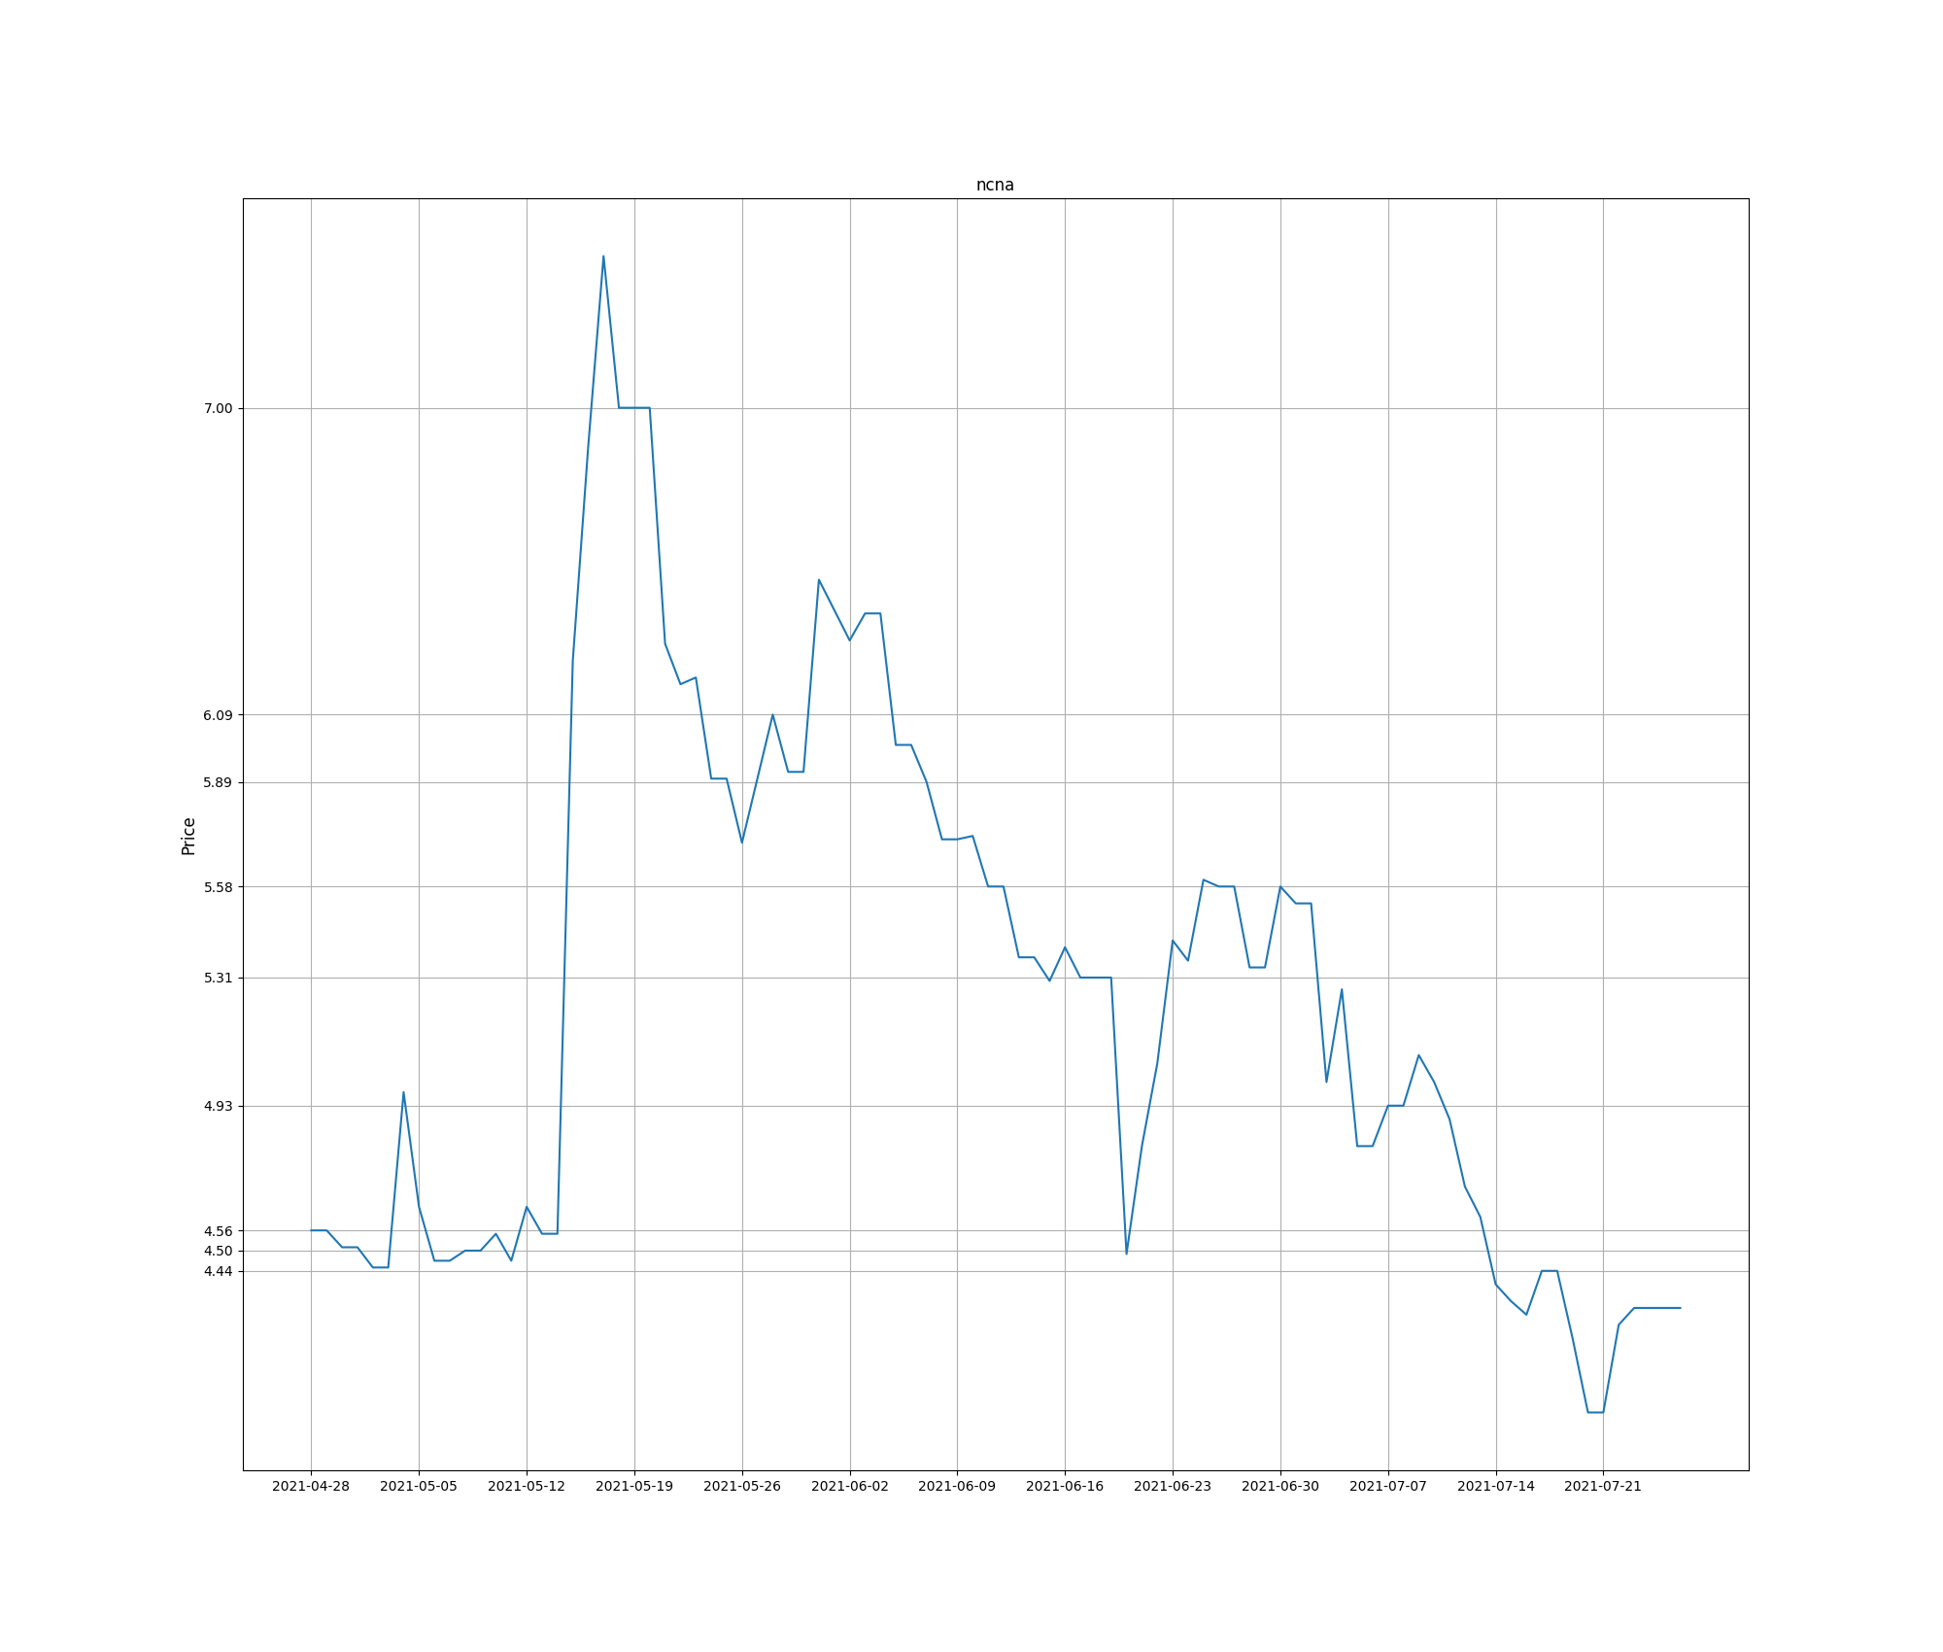
Plot - NCNA
NOK

Slide 23
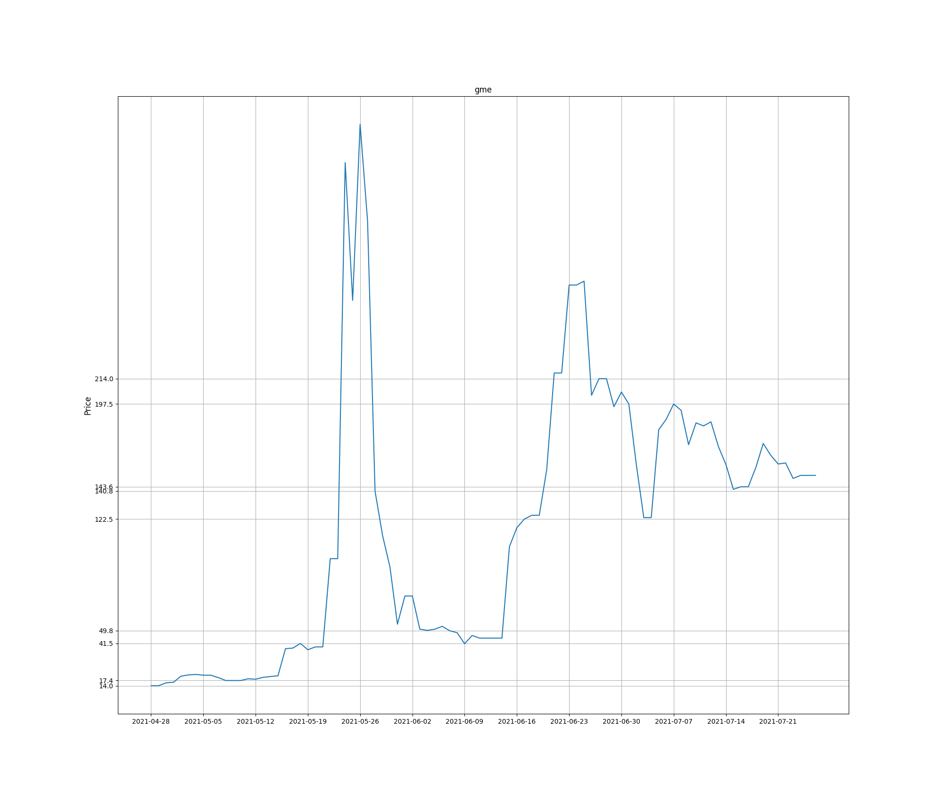
Plot - GME
NOK

Slide 24
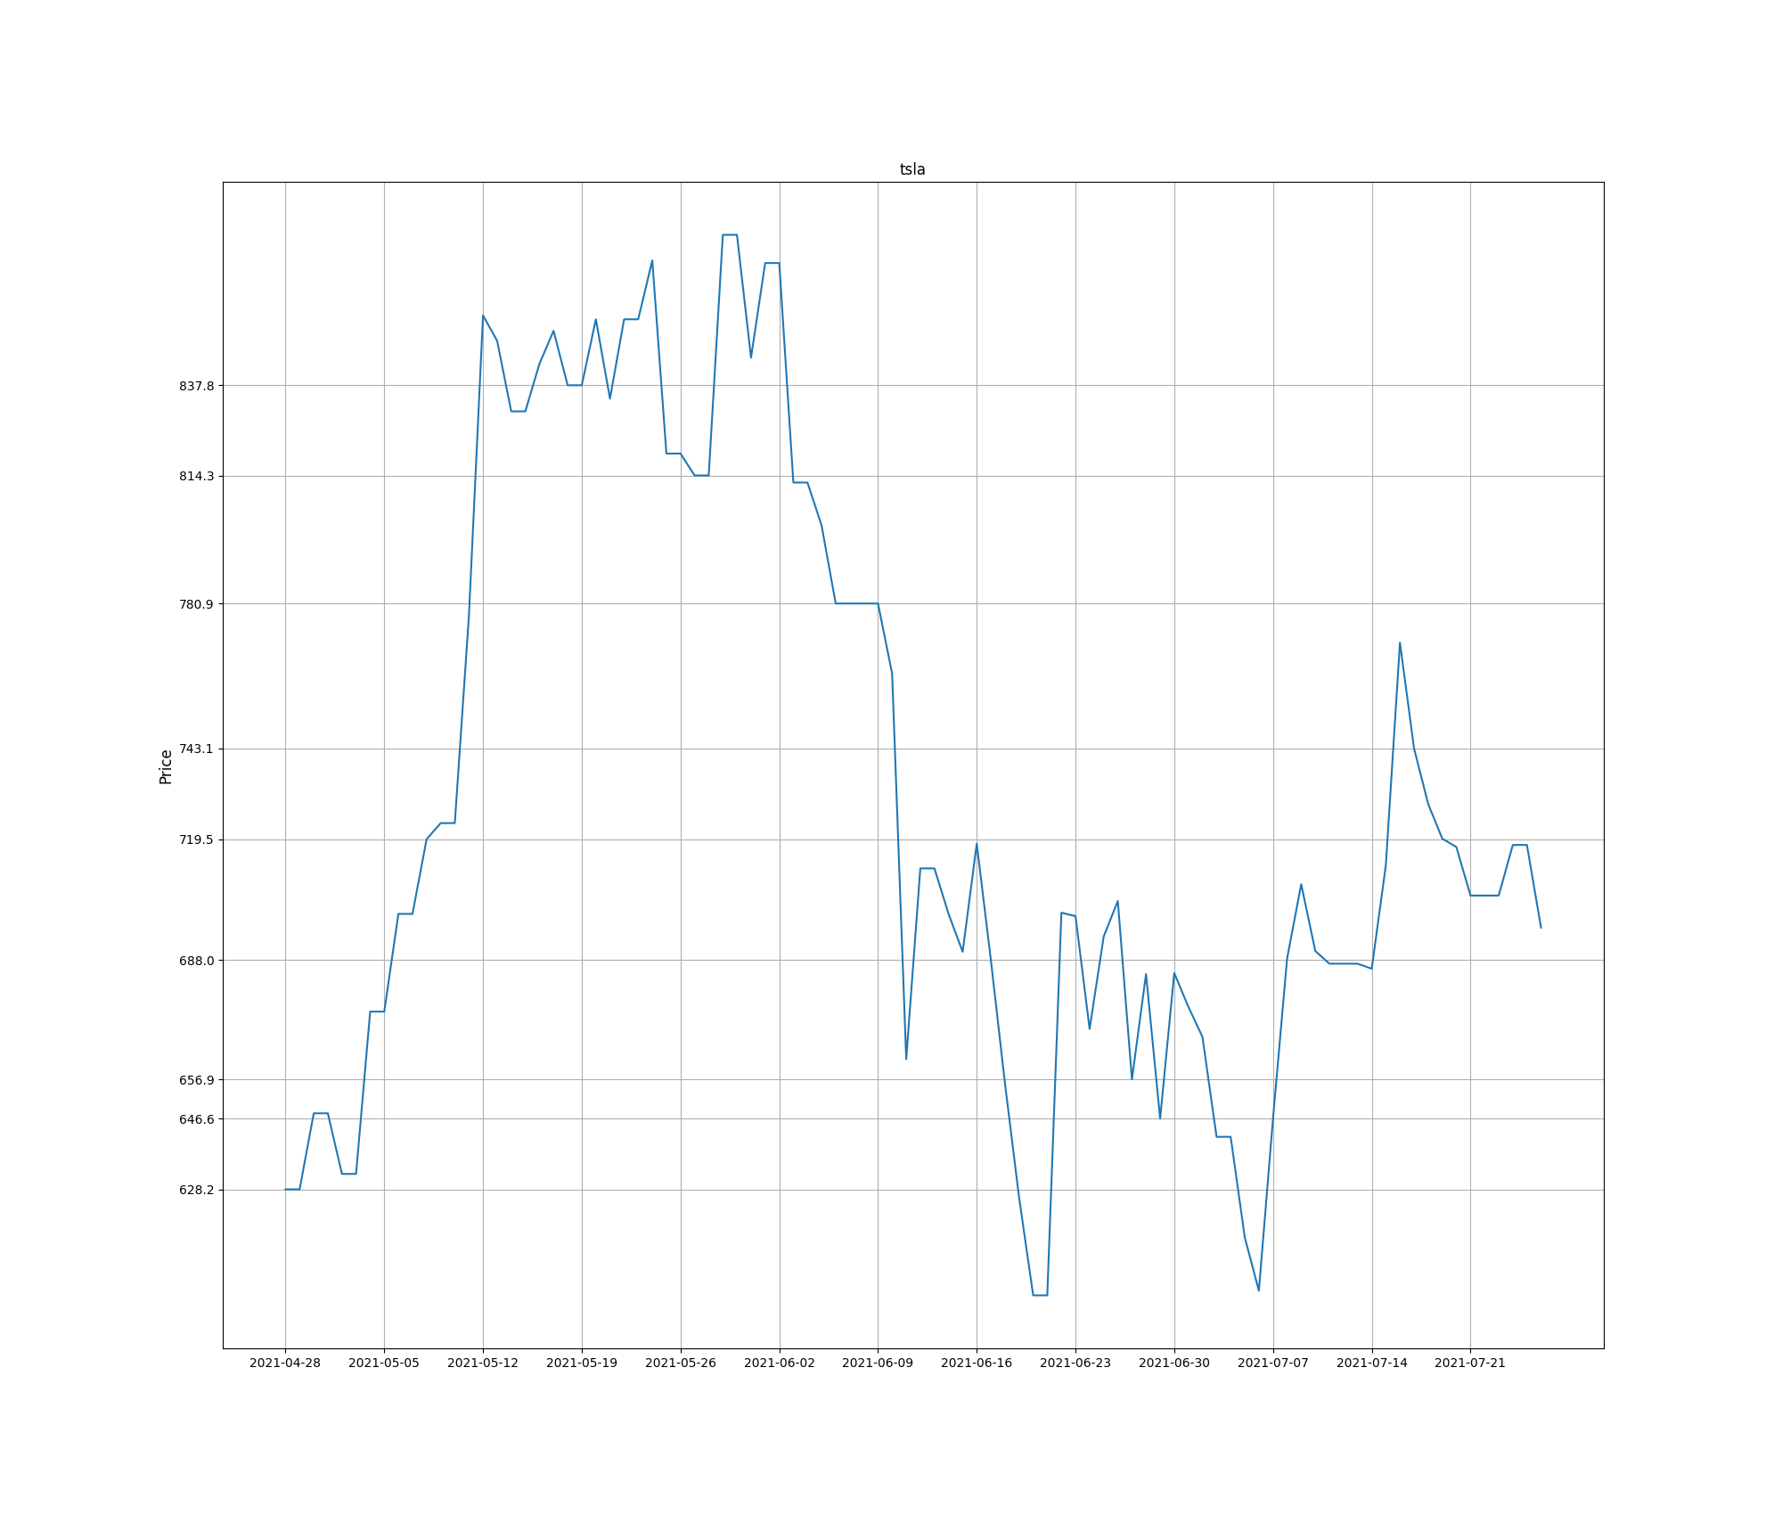
Plot - TSLA
NOK

Slide 25
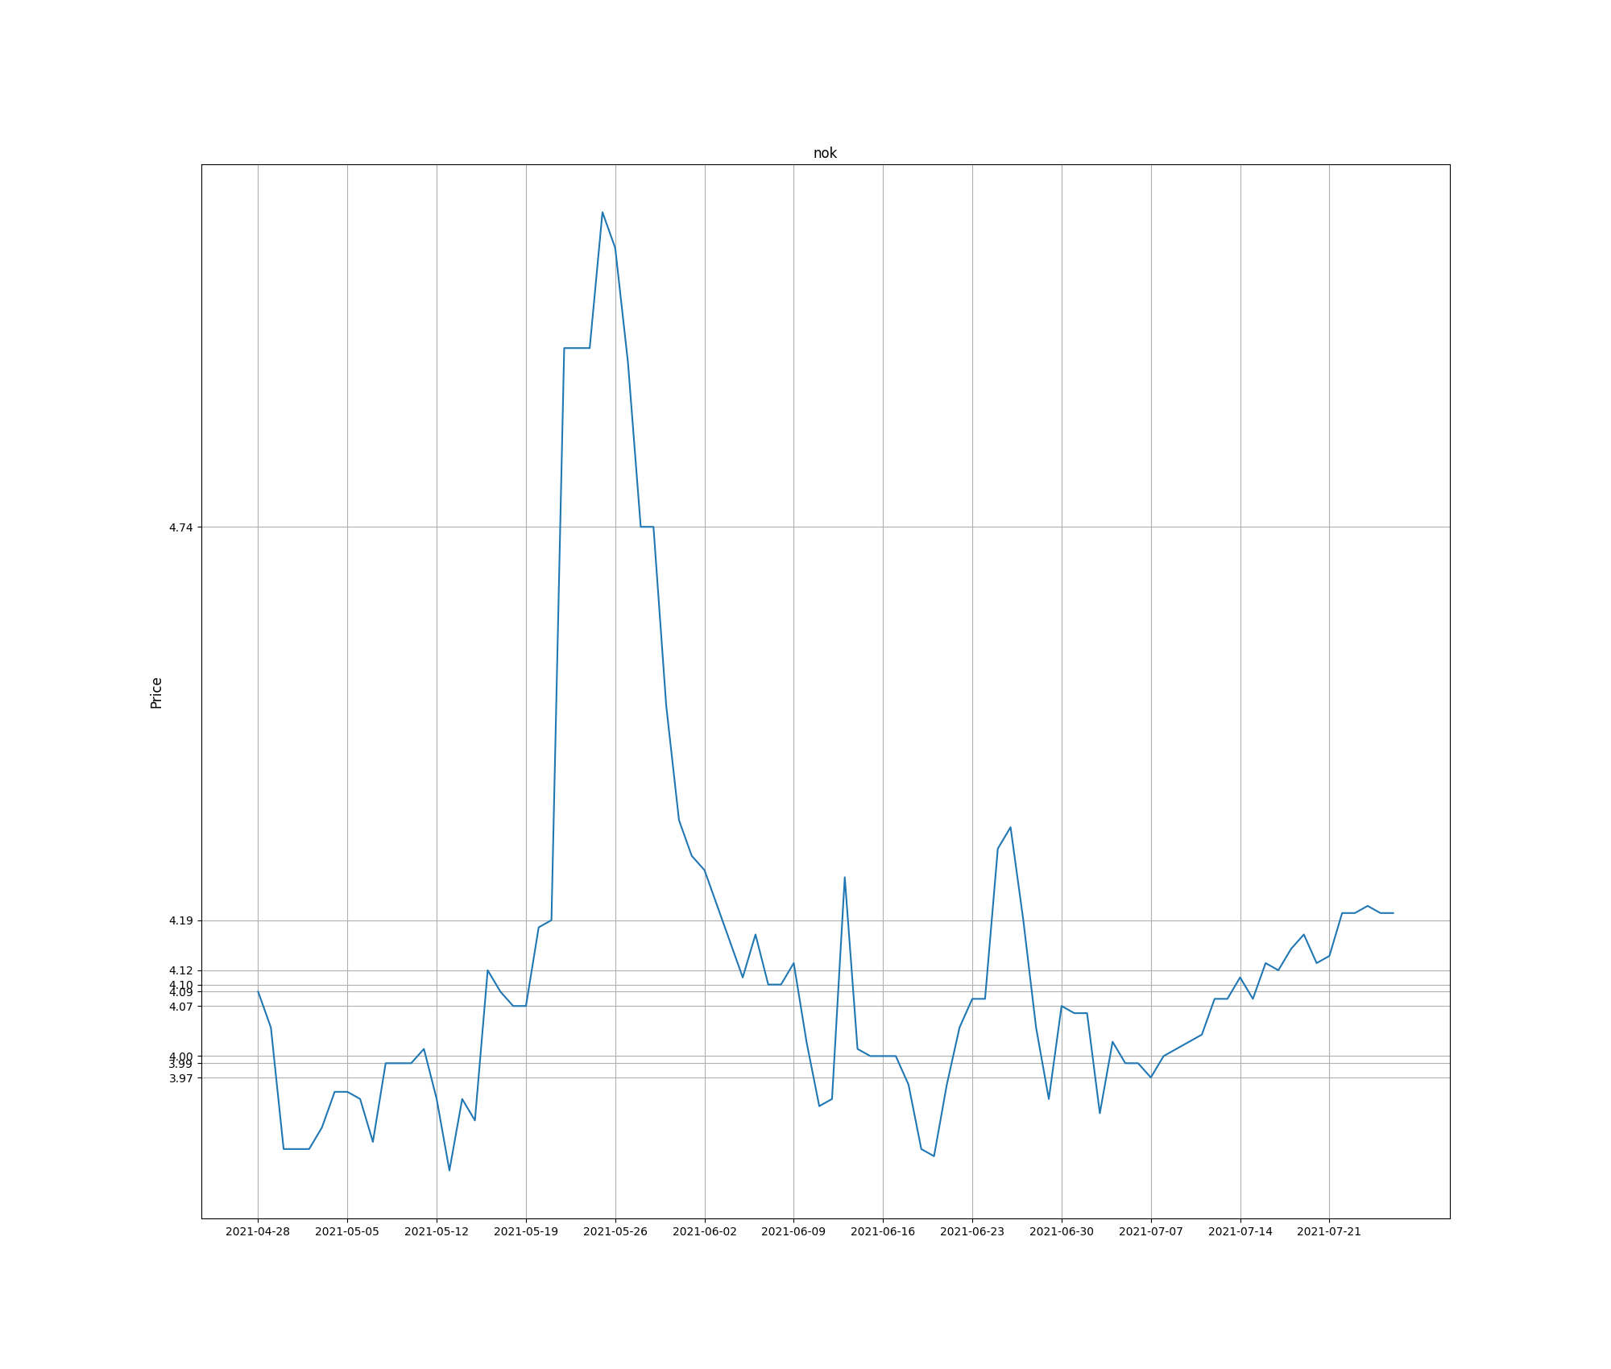
Plot - NOK
NOK

Slide 26
predict_test.py

Slide 27
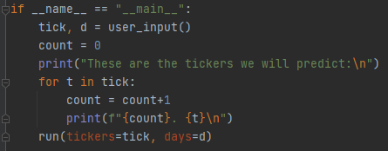
Main Method
user_input() method
run(tickers, days) method

Slide 28
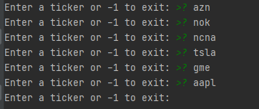
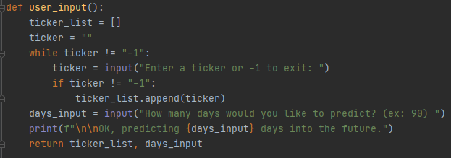
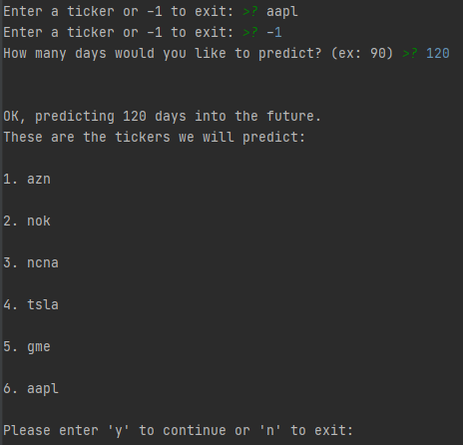
User Input

Slide 29
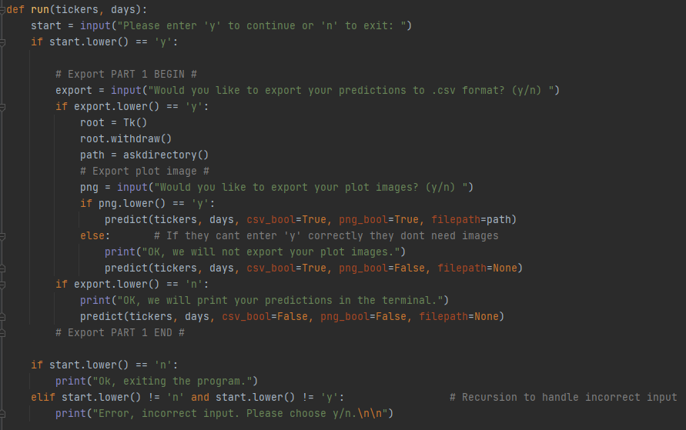
Run
Export to .csv AND export plot image
Export to .csv AND DO NOT export plot image
Do not export - only show predictions in terminal

Slide 30
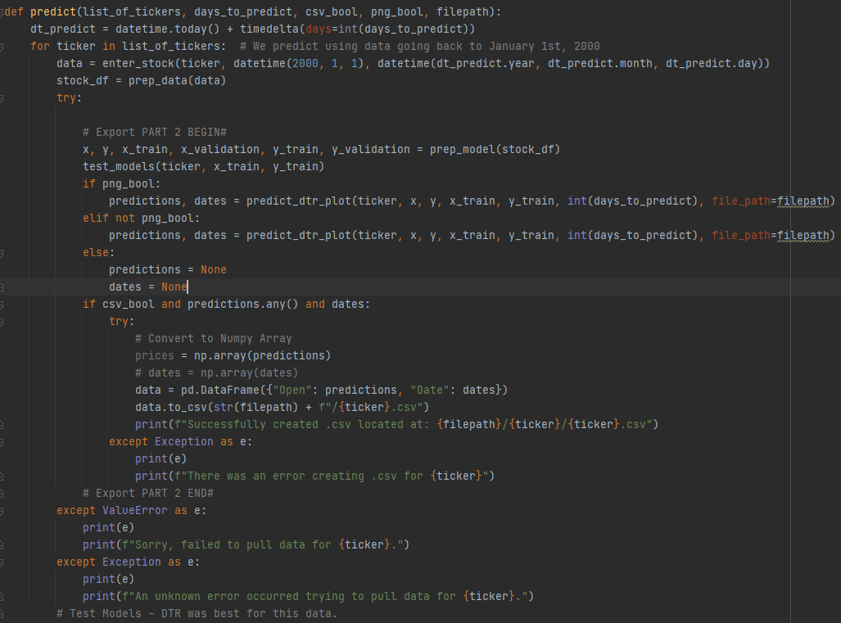
Predict
Predict with image or without image.
Create a new pandas dataframe that we will export to our .csv
Exception handling

Slide 31
Bias?
It may pick up on past (our model puts high weight on recent activity) trends and assume they will occur again in the future.
Gamestop example
AAPL example
TSLA example
The stock market is unpredictable - all of this speculation.

Slide 32
Links
https://pandas.pydata.org/docs/user_guide/reshaping.html
https://github.com/adamsiwiec1/stockPredictionsML
https://github.com/adamsiwiec1/irisflowers
https://towardsdatascience.com/performing-a-time-series-analysis-on-the-aapl-stock-index-3655da9612ff ¹

