Slide 1
Windows 3.0
Program Manager
File Manager
Control Panel
Sound Card Support
CD-ROM
Multimedia Support

Slide 2
Applications
Notepad
Write
Macro Recorder
Paintbrush
Calculator
Solitare

Slide 3
Modes
Real
Standard (286 Protected)
386 Enhanced

Slide 4
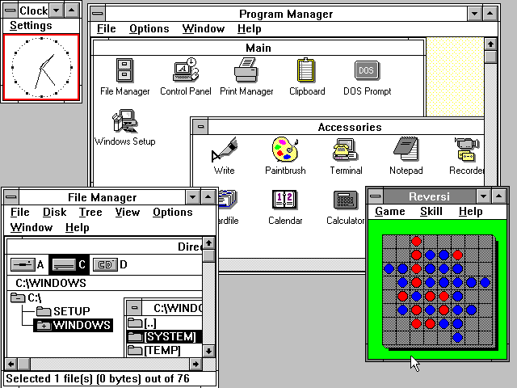

Slide 5
Linux
April 1991
Unix-like
User Mode
Kernel Mode

Slide 6
User Mode
User Applications
  Bash
C Standard Library
Low Level System Components

Slide 7
Kernel Mode
Linux Kernel
  System Call Interface
  Process Scheduling
  Network Subsystem
  Memory Management Subsystem
  ~380 System Calls

Slide 8
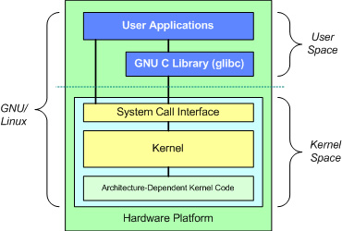

Slide 9
Mac OS (System 7)
May 13, 1991
User Interface
Applications
Stability
Virtual Memory
AppleScript

Slide 10
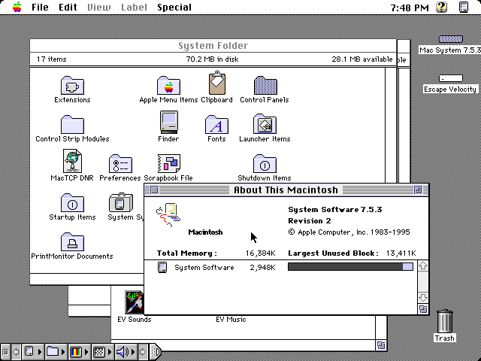

Slide 11
Solaris 2.0
SunOS 5
Unix-like
SPARC, i86pc
Symmetric Processing
SVR4
TCP/IP protocols
Sockets
Multiple groups
C shell

Slide 12
Windows NT 3.1
Windows-like Architecture
Win32
Program Manager
Goals
  Portable
  Reliable
  Personal

Slide 13
Win32
32-bit application runtime environment
32-bit applications to run on 16-bit OS

Slide 14
Programs
User Manager
Performance Monitor
Disk Administrator
Event Viewer
Backup

Slide 15
Windows 95
August 24, 1995
Stability
Performance
Virtual Machine Manager
Configuration Manager
Installable File System Manager

