Slide 2



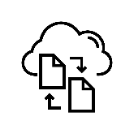




Project components
Raw data e.g., files on server, or in a database;
regular backups
Source code versioned, e.g., on Git, automatic backups
Generated temp temporary files (e.g., converted datasets); all generated by code, and kept locally
File exchange e.g., on temporary file share (like S3); used to pass pre-builds of projects to later stages, no backups
Notes e.g., meeting notes, literature: keep on cloud like Dropbox, automatic backups
Project pipeline
Prepare raw data set for analysis; pass final dataset to file exchange
e.g., workstation
Read final dataset from file exchange & build prototype model on subset of the data
e.g., laptop
Estimate final model on full data set; write model results to file exchange
e.g., cloud instance
Load final model results and data set; prepare tables and figures & write paper
e.g., laptop

Slide 3
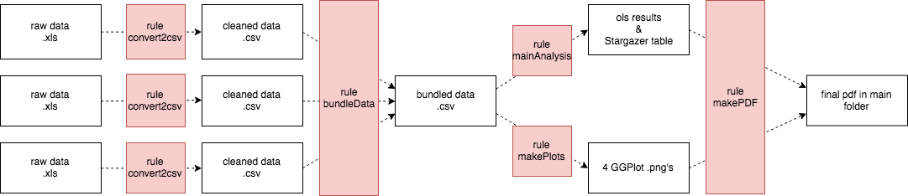
Example stage of a project pipeline
Source code versioned, e.g., on Git, automatic backups
Generated temp temporary files (e.g., converted datasets); all generated by code, and kept locally
File exchange e.g., on temporary file share (like S3); used to pass pre-builds of projects to later stages, no backups
Notes e.g., meeting notes, literature: keep on cloud like Dropbox, automatic backups
1. Convert raw data to CSV
2. Merge CSV files
3. Clean data, and save for other stages
raw data1.xlsx
Rule: convert to CSV
cleaned data1.csv
Rule: Merge data
raw data2.xlsx
Rule: convert to CSV
cleaned data2.csv
merged data.csv
raw data3.xlsx
Rule: convert to CSV
cleaned data3.csv
Project pipeline
e.g., workstation
Read final dataset from file exchange & build prototype model on subset of the data
e.g., laptop
Estimate final model on full data set; write model results to file exchange
e.g., cloud instance
Load final model results and data set; prepare tables and figures & write paper
e.g., laptop

Slide 4
Project components
Raw data e.g., files on server, or in a database;
regular backups
Source code versioned, e.g., on Git, automatic backups
Generated temp temporary files (e.g., converted datasets); all generated by code, and kept locally
File exchange e.g., on temporary file share (like S3); used to pass pre-builds of projects to later stages, no backups
Notes e.g., meeting notes, literature: keep on cloud like Dropbox, automatic backups
Project builds
Local computer 1
Prepare large data set for analysis
Local computer 2
Build prototype of econometric model (e.g., on sample of data)
Cloud Instance
Estimate final model

Slide 5
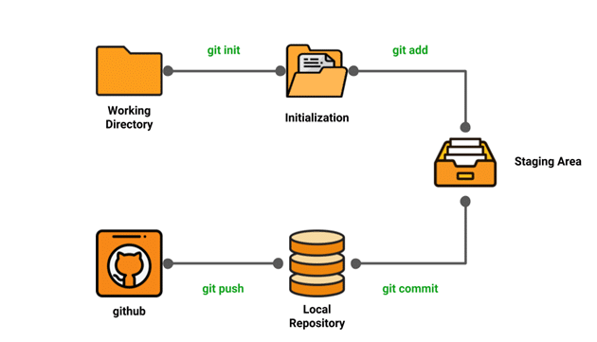

Slide 6
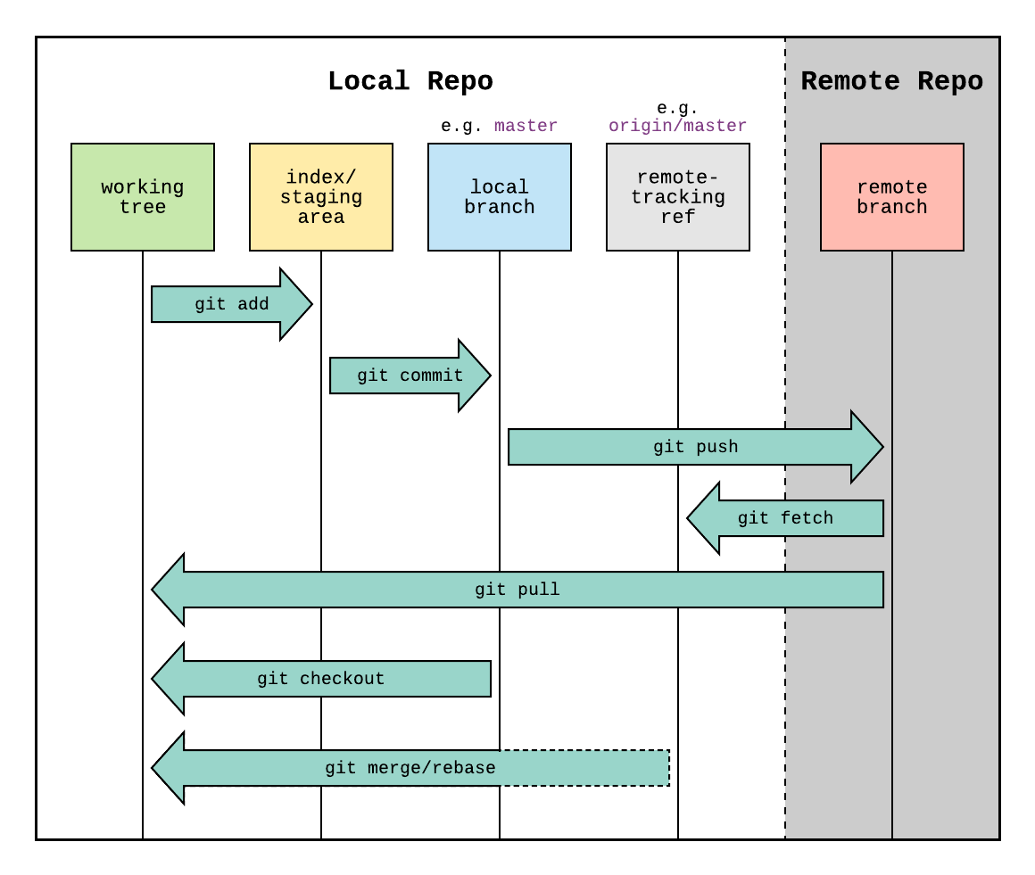
Local repository (e.g., on your local computer)
Remote repository (e.g., on GitHub)
working tree
staging area
local branch (e.g., master)
remote-tracking ref (e.g., origin/master)
remote branch
(1)
versioning
git add git status
use .gitignore to ignore files/ directories
git commit –m “msg”
(2) sync. changes
git pull
git fetch
git merge
git push
(3) others
git checkout
git clone

