Slide 1
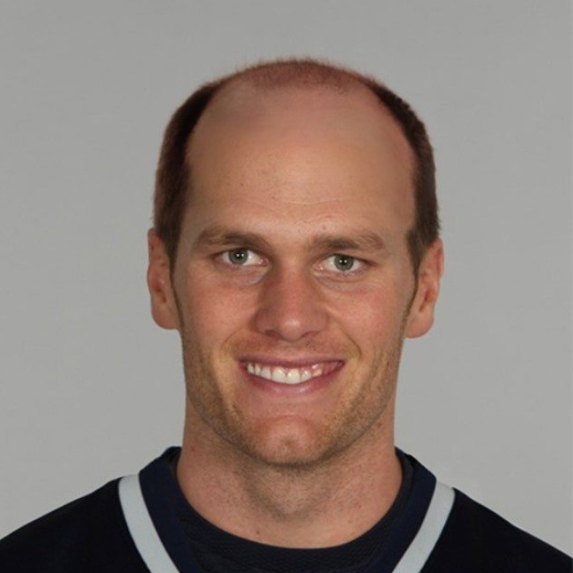

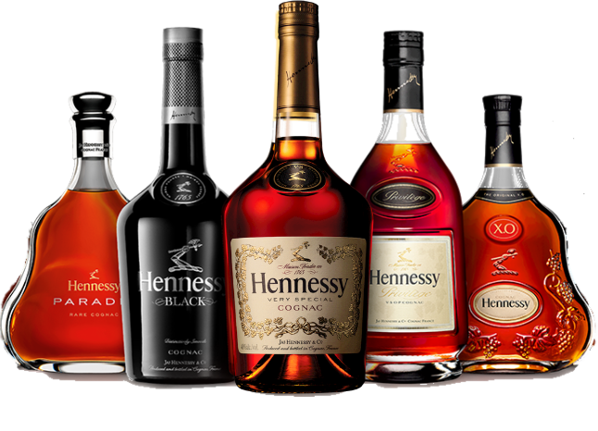
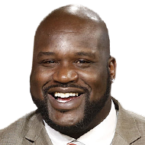
DOESMYTEAMSUCK.COM
the app you didn’t know you didn’t need…

Slide 2
Who are we?
Grassroots startup from Austin
Cloud-based deployable website
Synergy, scalability, manageability, high availability, and security
A website that helps those in need of liquor and sports statistics

Slide 3
What is our focus?
Win or lose, we help people find liquor stores after watching football
We provide updated scoring based on a state of the art, not shitty API
If you would like access to the “night club” feature please reference licensing information* see slide 5

Slide 4
About our site
Mysportsfeeds API & Google Maps API
We employ the use of Javascript, HTML, CSS, and AJAX callouts to fill our web page
Clicking on teams fills a table with the latest play by play information
Doing a search for a team will fill a modal with that team’s current record
Depending on team record, if your team has a less than 50% win rating, you will be given the location of the nearest CB-DOS official liquor distributor
If you purchase the Extreme Performance license you will gain access to the “Night Club” map, which will give you the location of all night clubs in your area if your team has a greater than 50% win rating

Slide 5
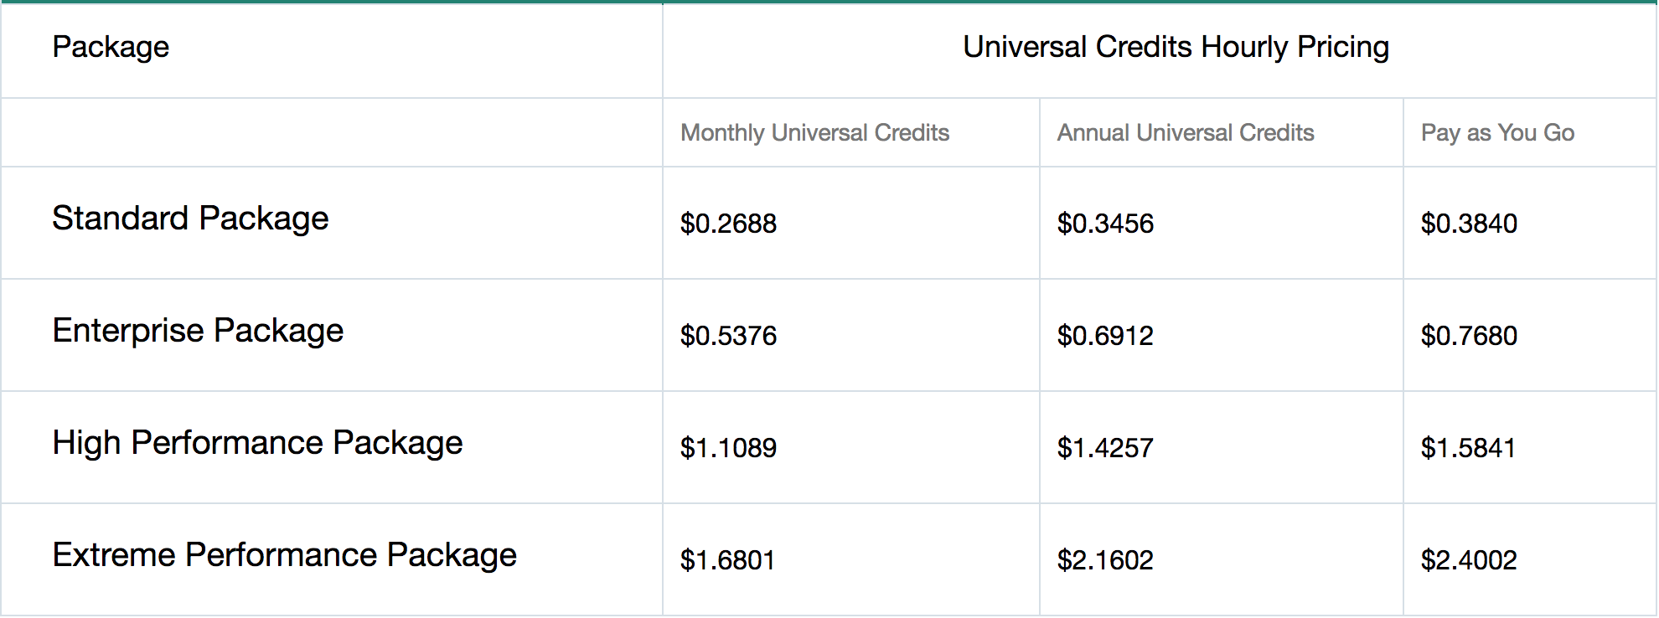
licensing

Slide 6
Problems
Finding a reliable sports statistic API
API documentation
Getting map to load
Sidebar positioning
Modals with response data
We’re not very good at coding

