Slide 1
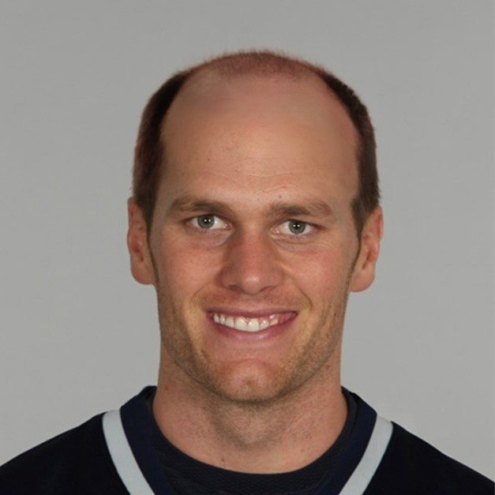

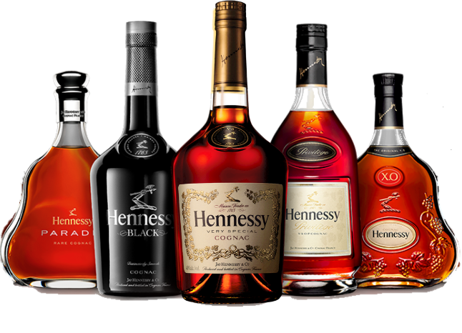
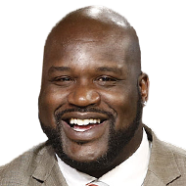
DOESMYTEAMSUCK.COM
the app you didn’t know you didn’t need…

Slide 2
Who are we?
Grassroots startup from Austin
Cloud-based deployable website
Synergy, scalability, manageability, high availability, and security
A website that helps those in need of liquor and sports statistics

Slide 3
What is our focus?
Win or lose, we help people find liquor stores after watching football
We provide updated scoring based on a state of the art, not shitty API
If you would like access to the “night club” feature please reference licensing information* see slide 4

Slide 4
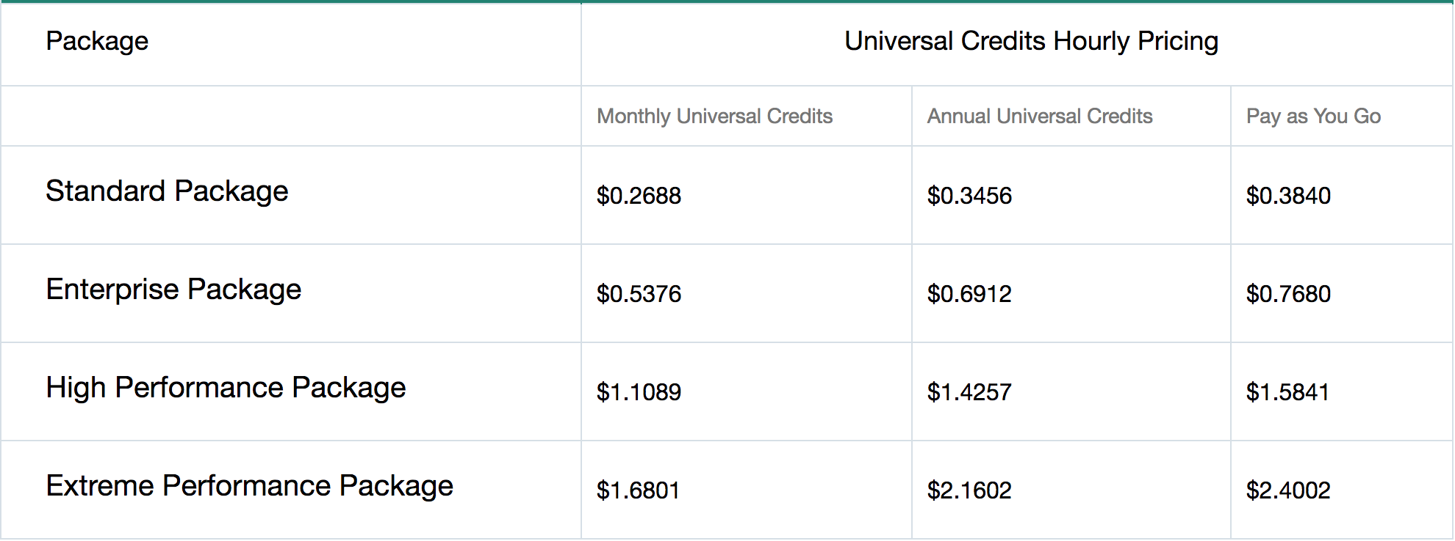
licensing

Slide 5
Problems
Finding a reliable sports statistic API
API documentation
Getting map to load
Sidebar positioning
Modals with response data
We’re not very good at coding

