Slide 1
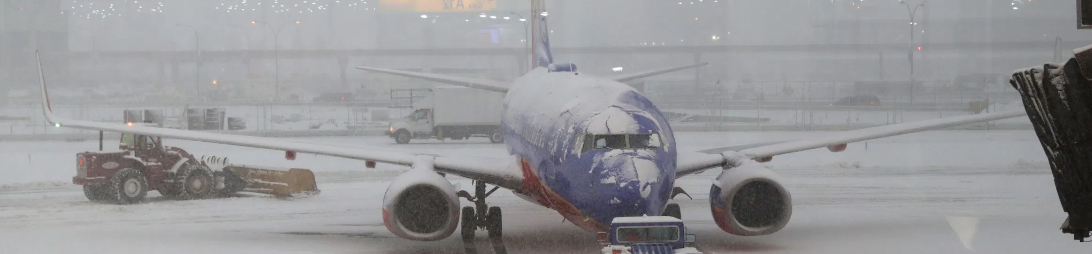
Predicting late flight arrivals in US
Objective: Predict Airline Arrival Delays within US using Airline and Weather datasets
Team 25
Jayesh Parikh, Tucker Anderson, Chandra Shekar Bikkanur, Adam Sohn

Slide 2
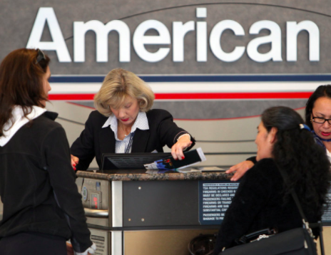
Business Case
Key technology for prediction product
Prediction will quantify minutes late
Prediction is made immediately after takeoff
iRebook - Help airlines proactively rebook customer’s connecting flights
Inference after takeoff increases confidence of action by reducing variability
MIL8? - Help customers stress level during flight
Reduce mystery

Slide 3
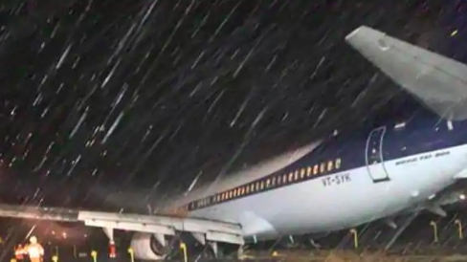
Plan
EDA
Feature selection
Data cleaning
Feature engineering
Identify optimum regression algorithm
Identify optimum parameters

Slide 4

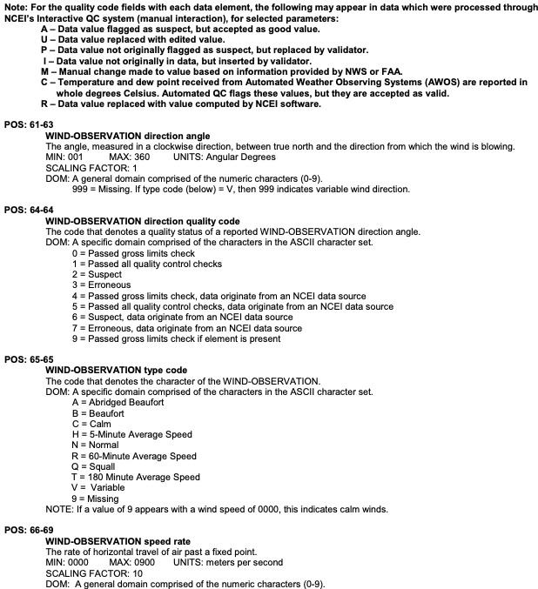
Datasets
Data | Source | Rows (raw) | Rows (adj) | Columns (raw) | Columns (adj)
Airlines | https://www.transtats.bts.gov/ | 31.7 M | 137 k | 56 | 29
Weather | https://www.ncei.noaa.gov/ | 627.0 M |  | 177
Stations | dbfs:/mnt/mids-w261/data/DEMO8/gsod/stations.csv.gz | 30 k | No adj | 11 | No adj
Airport Location | https://openflights.org/data.html | 7 k | No adj | 3 | No adj

Slide 5
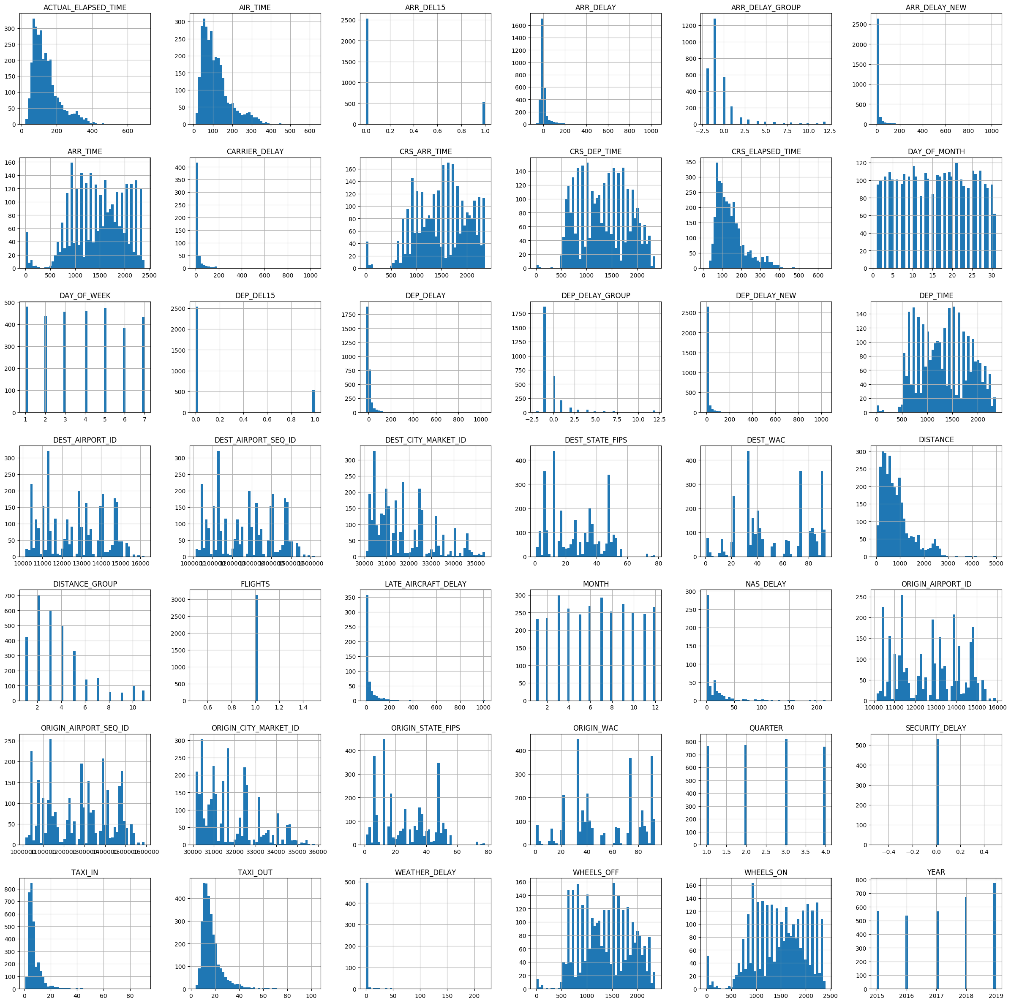
Exploratory Data Analysis (EDA)
Correlation plot: Ensure little to no collinearity
Histogram: Identify Feature Engineering efforts
Checked for Null and Incorrect values
Less than 2% of the data had null values
Others due to Cancelled and Diverted flight classification
Weather set had many values encoded as
“inaccurate”, chose to remove these
Notes:
--T--
We generate a correlation matrix of all features in our dataset to help determine or future feature engineering efforts. We tried to avoid choosing multiple independent variables with high-collinearity, as this can hurt the performance of linear regression models.
We also generated a histogram of every quantifiable feature. This helps identify which features may have outliers that we needed to curate, and determine if any data transformations would be necessary when we include them in our model.
We finally checked for null values in each variable. Most flight variables contained 0 to less than 2% null values, so we felt comfortable removing this small portion of the data.
There were a large amount of null values in the categorical delay variables (CARRIER_DELAY, SECURITY_DELAY) , which we found to primarily be instances of “0” or FALSE values. These were handled by imputing these null values to “0”
The Weather set was seen to have no nulls, but some variables had encodings to signify that the recording was “inaccurate”. We chose to remove these labels so as to not bias our model towards incorrect weather recordings.

Slide 6
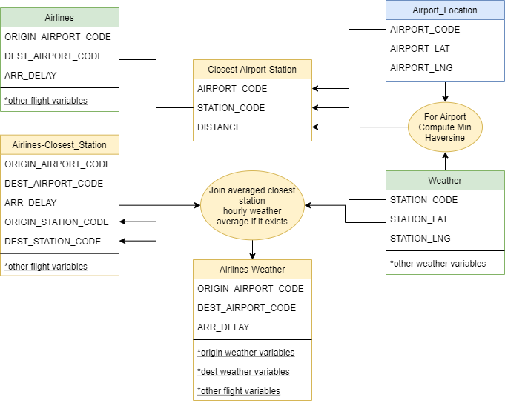
Data Wrangling
Combined Airlines and Weather dataset using geoposition
Joined if weather records are present within an hour of takeoff
Weather & Airlines dataset was limited to required features and geoposition prior to merge to reduce data traffic
Split combined curated dataset into 80:10:10 Train, Val and Test sets
Notes:
T:
With our basic EDA out of the way, one of the biggest hurdles of our project was somehow joining the aforementioned airlines and weather datasets. We felt that weather data could explain a significant portion of the variance in the arrival delay variable, so we wanted to include some aspect of it in our flight records.
Joining these datasets was no easy task, as there was no common key between datasets (such as closest airport etc.) We ultimately ended up generating a table that held the closest weather station to each airport based on the latitude and longitude positions of the airport (from open source airport location dataset) and the weather stations based on Haversine distance. This allowed us to join weather records to every flight record with weather data from the closest station within the hour of takeoff, resulting in accurate weather data at both the origin and destination airports at time of model prediction.
To facilitate this process, we pre-trimmed the airlines and weather dataset to only include US airports, (as many weather stations were hundreds or thousands of miles from each airport) and the weather table to only include columns we were interested in .
These joins were easily parallelizable through spark SQL queries.
With our joined dataset in hand we chose to randomly split it into 80:10:10 train, val ,test component.

Slide 7
Feature Engineering
MONTH: integer (nullable = true)
|-- DAY_OF_WEEK: integer (nullable = true)
|-- DEP_DELAY: double (nullable = true)
|-- DEP_TIME_BLK: string (nullable = true)
|-- ARR_DELAY: double (nullable = true)
|-- ARR_TIME_BLK: string (nullable = true)
|-- CRS_ELAPSED_TIME: double (nullable = true)
|-- DISTANCE: double (nullable = true)
|-- CARRIER_DELAY: integer (nullable = true)
|-- WEATHER_DELAY: integer (nullable = true)
|-- NAS_DELAY: integer (nullable = true)
|-- SECURITY_DELAY: integer (nullable = true)
|-- LATE_AIRCRAFT_DELAY: integer (nullable = true)
|-- IS_WEEKEND: integer (nullable = true)
|-- DEP_RUSH_HOUR: integer (nullable = true)
|-- ARR_RUSH_HOUR: integer (nullable = true)
|-- ORIGIN_CARRIER: string (nullable = true)
|-- DEST_CARRIER: string (nullable = true)
|-- FLIGHT_BEARING: string (nullable = true)
|-- ORIGIN_STATION_WND: double (nullable = true)
|-- ORIGIN_STATION_VIS: double (nullable = true)
|-- ORIGIN_STATION_SLP: double (nullable = true)
|-- ORIGIN_STATION_AA1: double (nullable = true)
|-- ORIGIN_STATION_WND_DIR: string (nullable = true)
|-- DEST_STATION_WND: double (nullable = true)
|-- DEST_STATION_VIS: double (nullable = true)
|-- DEST_STATION_SLP: double (nullable = true)
|-- DEST_STATION_AA1: double (nullable = true)
|-- DEST_STATION_WND_DIR: string (nullable = true)
|-- DEP_TIME_BLKIndex: double (nullable = false)
|-- DEP_TIME_BLKclassVec: vector (nullable = true)
|-- ARR_TIME_BLKclassVec: vector (nullable = true)
|-- ORIGIN_CARRIERclassVec: vector (nullable = true)
|-- DEST_CARRIERclassVec: vector (nullable = true)
|-- FLIGHT_BEARINGclassVec: vector (nullable = true)
|-- ORIGIN_STATION_WND_DIRclassVec: vector (nullable = true)
|-- DEST_STATION_WND_DIRclassVec: vector (nullable = true)
|-- MONTHclassVec: vector (nullable = true)
|-- DAY_OF_WEEKclassVec: vector (nullable = true)
Keys Features selected
Introduced additional features
is_Weekend, is_RushHour, Origin_Carrier Interaction TermDest_Carrier Interaction Term
Flight_Bearing and Origin & Destination Station Wind Direction (N,E,W,S, etc.)
Transformed all categorical features to one-hot encoded
Notes:
T:
After all this data munging and transformation, it was time to finalize our feature selection.
We identified a set of key non-collinear independent features to generate models on our training and validation set. We trimmed these with elastic net regularization later.
For our weather data, we had to Split comma-separated columns to individual columns, and subsequently calculate categorical bearing similar to flight bearing for the wind direction
We also one-hot encoded all categorical variables, such as rush_hour and flight bearing, to allow our regression model to properly assign weights to these variables.
Im now going to hand the presentation over to Chandra to further dive into our model.

Slide 8
Algorithms Explored
Our business case required to train a supervised regression model
Predicting Arrival Delay (Y) for given set of airlines & weather features (X)
Explored and compared following regression algorithms available in PySpark:
Linear Regression (OLS, Lasso, Ridge and Elastic Net)
Decision Tree Regressor
Random Forest Regressor
Gradient Boosting Regressor
All Machine Learning models were trained using 5-fold cross-validation
Grid search was used for Hyperparameter tuning for all models

Slide 9
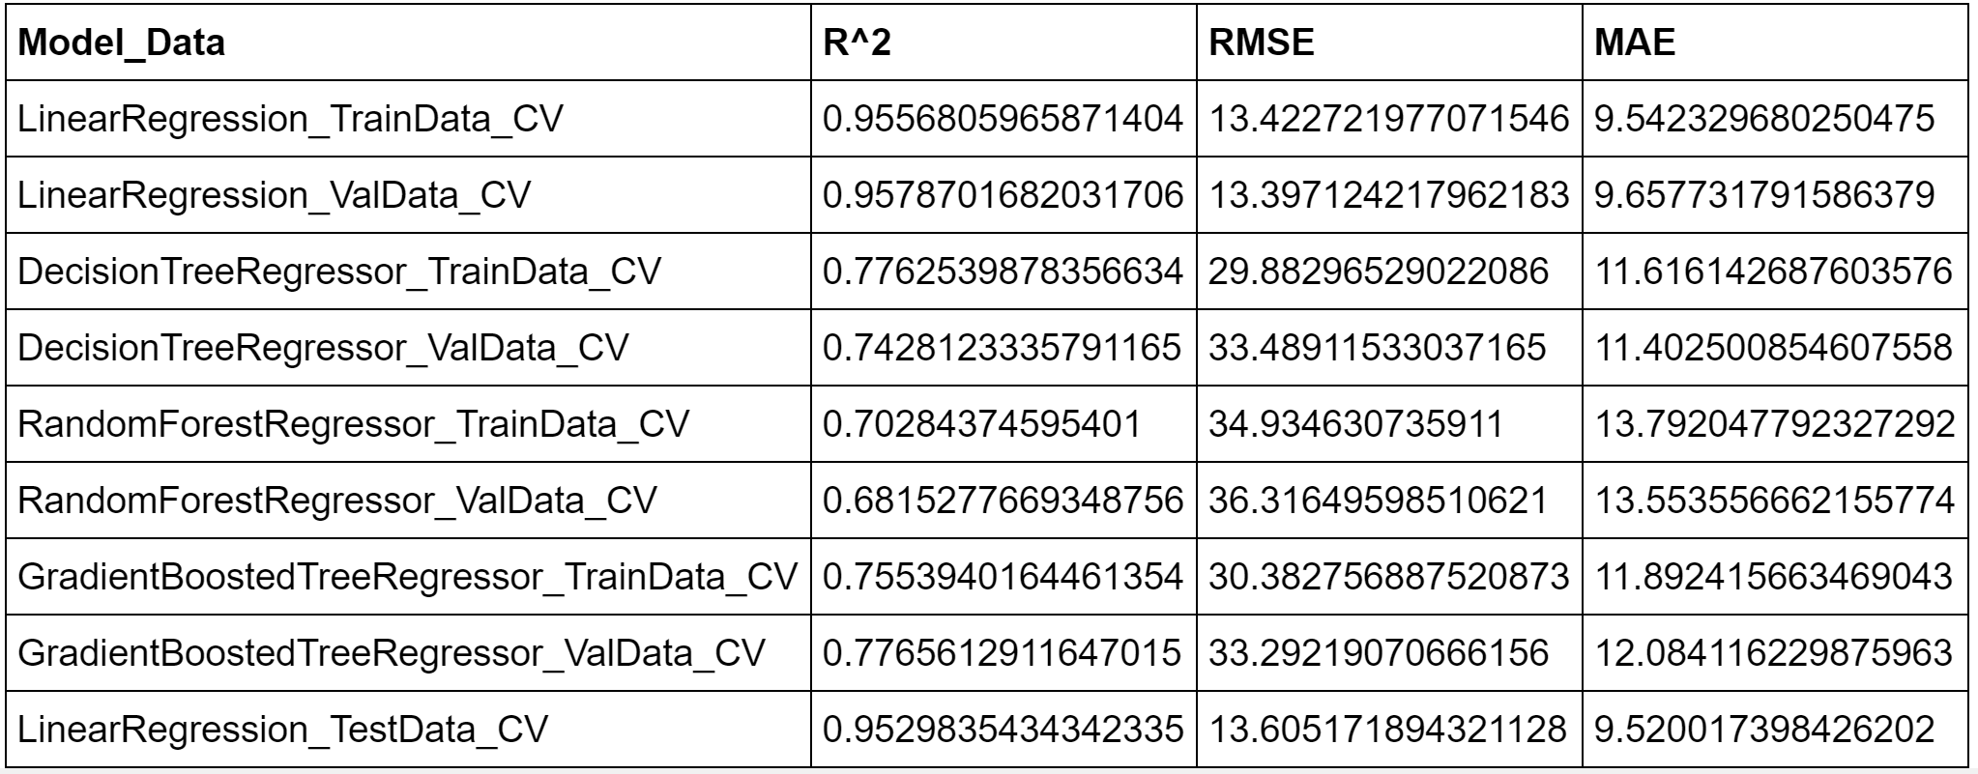
Evaluation Metrics
Primary evaluation metric: R^2
Linear Regression with L2 penalty turned out to be best performing algorithm.
Based on R^2 value, ~ 95% of variance in the dependent variable (ARR_DELAY) is explained by Linear Regression model with L2 regularization.
Notes:
Implementation of baseline + parameter grid & cross-validation.
Regularization (Linear Regression only) - Hyperparameter tuning using grid search showed L2 Ridge regression as best regularization function.
Regularization (*_Tree) - Max depth, Num trees, Min instance/node

Slide 10

Performance & Scalability
Initial models based on airlines dataset took longer to run prior to merging it with weather data
Performance was better after the merge as dataset reduced
Weather Dataset was huge & unmanageable
Cluster overload and stuck in processing
Shared workspace
Online learning - Scalability concerns
Training time performance as dataset grows
Explore using Stochastic gradient descent (SGD) for linear regression function as data volume goes up
Notes:
Initially both Airlines and Weather data volume was high, which resulted in lot of performance issues. After some clean up, filtering, cleansing and merging the 2 datasets, performance improved as dataset was reduced.
Weather dataset was huge (600m+ rows and 170+ columns. Reduced to US stations and filtered erroneous data
Everyone encountered this - Cluster overload and getting stuck in processing or getting hung, requiring re-start
Scalability concerns with training the model with real time data as data will grow
Concerns regarding training time performance as dataset grows….explore using SGD for linear regression during training

Slide 11
Model Performance
Model | Performance (Train) Before Merge | Performance (Train) After Merge | Performance (Val) Inference | Performance (Test)
Linear Regression | 31 mins | 15 mins | 8 seconds | 2 seconds
Decision Tree | 3 hrs | 5 mins | 4 seconds
Random Forest | 18.5 hrs | 9 mins | 7 seconds
Gradient Boost Tree | 4 days | 21 mins | 15 seconds
Notes:
Performance Before & After merging Airlines/Weather data

Slide 12

Limitation, Challenges & Future Work
Explore other ways to join Weather data with Airline data
Pull Real Time data to train the model
Retrain frequency for Year by Year or Month by Month data to see if there is any difference
Train using different algorithms such as Neural Network
Expand feature set
Weather related features such as Snow Conditions
Airline related features such as International Arrival/Departure
Notes:
Given the dataset and problem you chose, how important is the training time? Ie, does the data change frequently? Do we need real-time results? How frequently will this model need to be retrained
Real Time for inference
Training data will not be updated real time
Retrain frequency -
Year by Year or Month by Month to see if there is any difference

Slide 13



Slide 14


Slide 15

Appendix

Slide 16
Learnings
Spark dataframes were much more efficient than RDDs
Parquet format worked better
Sparse Matrix handled better in Spark (VectorAssembler, OneHotEncoderEstimator)
Learning curve for Spark SQL

Slide 17
Findings
By using geoposition from weather dataset to map to airport location, Station dataset was no longer required
Airline dataset with parquet format worked fine after limiting the features to desired columns and creating additional features
No clear index was identified to join Airline to Weather dataset

