Slide 1
Corners (Local Invariant Feature Detection)
CSC 249/449 Spring 2018
http://www.cs.rochester.edu/~cxu22/t/249S18/
Instructor: Chenliang Xu
chenliang.xu@rochester.edu

Slide 2
Logistics
It is important you come to lecture, otherwise it takes much more time to digest the materials after class.
Use Piazza for QA. Make your post public so that all class can benefit.
HW1 is extended to Saturday 2/2 midnight.
We plan to release HW2 on Saturday 2/2.

Slide 3
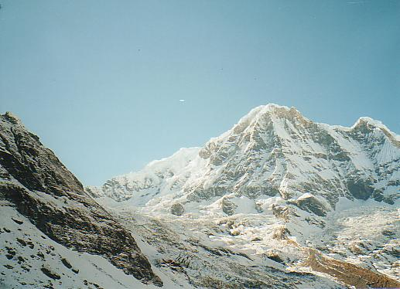
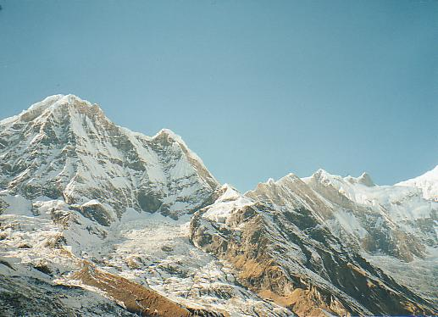
Why extract features?
Motivation: panorama stitching
We have two images – how do we combine them?
Slide credit: S. Lazebnik

Slide 4
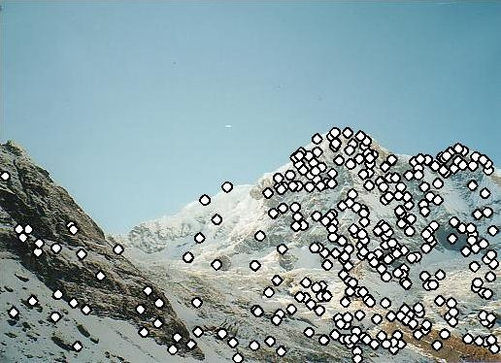
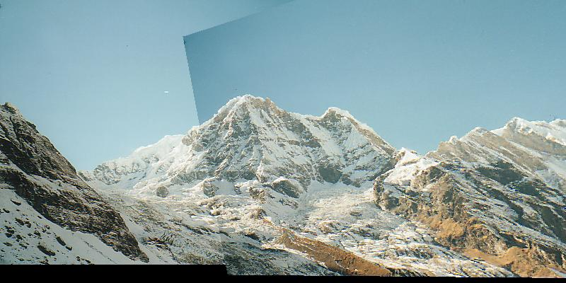
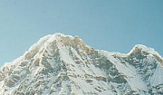

Local features: main components
Feature Detection Identify the interest points
Feature Description Extract vector feature descriptor surrounding each interest point
Feature Matching Determine correspondence between descriptors in two views
Image Alignment Compute a transformation matrix between two images
Adapted from: K. Grauman

Slide 5
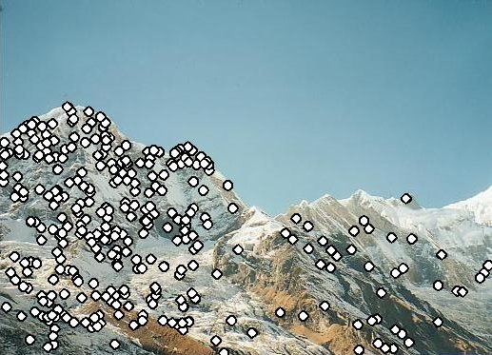
Local features: desired properties
Repeatability
The same feature can be found in several images despite geometric and photometric transformations
Saliency
Each feature is distinctive
Compactness and efficiency
Many fewer features than image pixels
Locality
A feature occupies a relatively small area of the image; robust to clutter and occlusion
Adapted from: S. Lazebnik

Slide 6
Goal: interest operator repeatability
We want to detect (at least some of) the same points in both images.
Yet we have to be able to run the detection procedure independently per image.
No chance to find true matches!
Slides from: K. Grauman
Notes:
6

Slide 7
Goal: descriptor distinctiveness
We want to be able to reliably determine which point goes with which.
Must provide some invariance to geometric and photometric differences between the two views.
?
Slides from: K. Grauman

Slide 8
Local features: main components
Feature Detection Identify the interest points
Feature Description Extract vector feature descriptor surrounding each interest point
Feature Matching Determine correspondence between descriptors in two views
Image Alignment Compute a transformation matrix between two images
Adapted from: K. Grauman

Slide 9
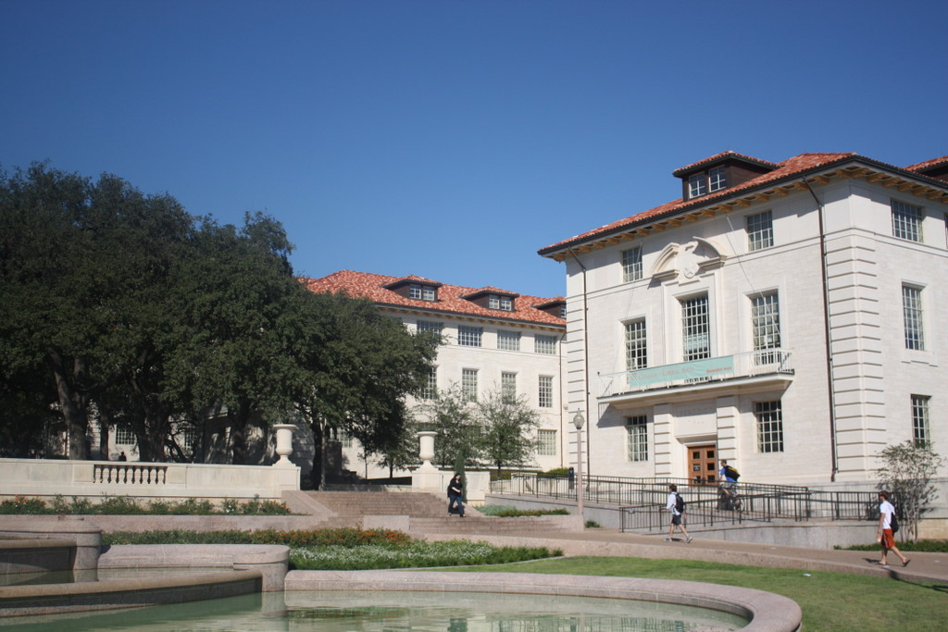
What points would you choose?
Slide credit: Kristen Grauman

Slide 10
Detecting corners
Slide credit: Kristen Grauman

Slide 11
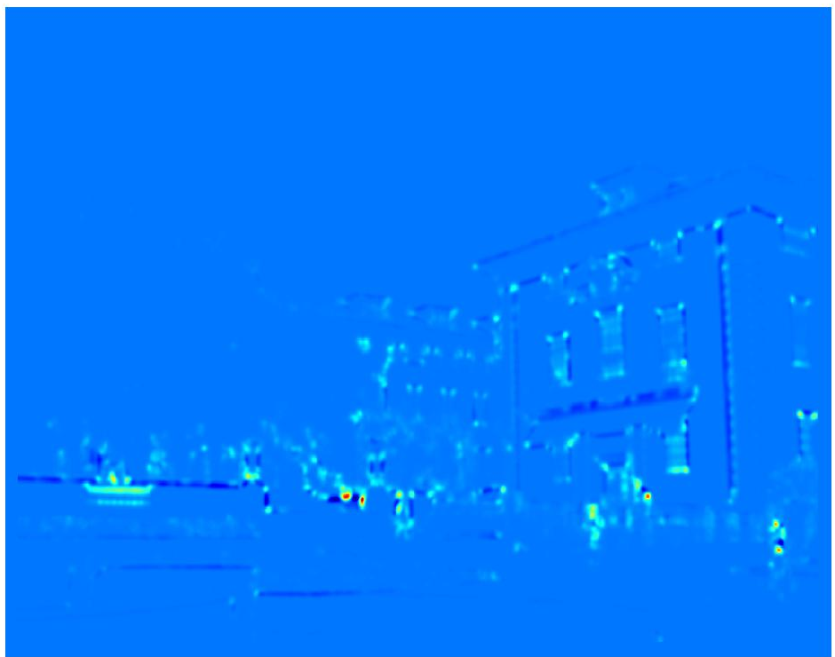
Detecting corners
Compute “cornerness” response at every pixel.
Slide credit: Kristen Grauman

Slide 12
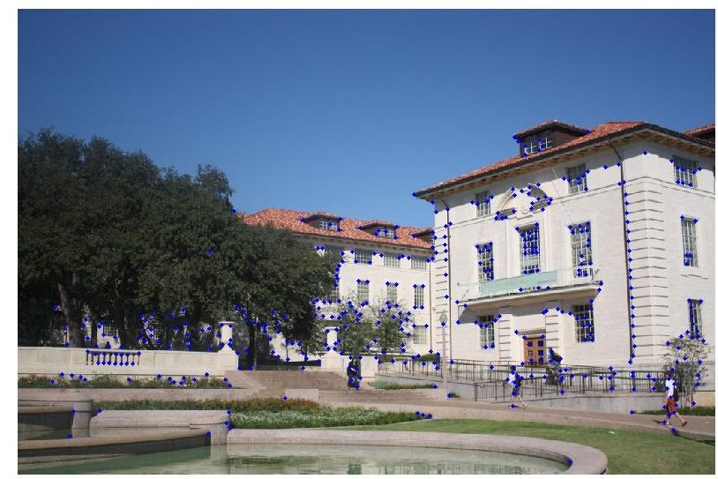
Detecting corners
Slide credit: Kristen Grauman

Slide 13
Detecting local invariant features
Detection of interest points
Harris corner detection
Scale invariant blob detection: LoG

Slide 14

Corner Detection: Basic Idea
We should easily recognize the point by looking through a small window
Shifting a window in any direction should give a large change in intensity
“flat” region: no change in all directions
“edge”: no change along the edge direction
“corner”: significant change in all directions
Slide credit: S. Lazebnik

Slide 15
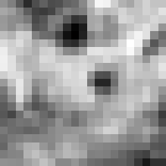
Corner Detection: Mathematics
Change in appearance of window W for the shift [u,v]:
Image I
Window W
E(3,-2)
Modified from S. Lazebnik

Slide 16

Corner Detection: Mathematics
Change in appearance of window W for the shift [u,v]:
We want to find out how this function behaves for small shifts
E(u, v)
Slide credit: S. Lazebnik
Notes:
Specifically, E has to have a unique minimum at (0,0)

Slide 17
Corner Detection: Mathematics
First-order Taylor approximation for small motions [u, v]:
Let’s plug this into E(u,v):
Slide credit: S. Lazebnik

Slide 18
Corner Detection: Mathematics
The quadratic approximation can be written as
where M is a second moment matrix (or structure tensor) computed from image derivatives:
(the sums are over all the pixels in the window W)
Slide credit: S. Lazebnik

Slide 19
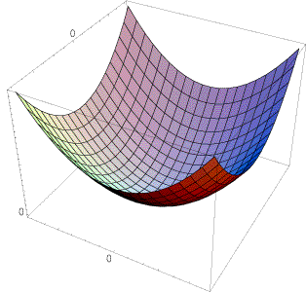
Interpreting the second moment matrix
The surface E(u,v) is locally approximated by a quadratic form. Let’s try to understand its shape.
Specifically, in which directions does it have the smallest/greatest change?
E(u, v)
Slide credit: S. Lazebnik
Notes:
Per-pixel estimate of the local (quadratic) shape of the auto-correlation function

Slide 20
Interpreting the second moment matrix
First, consider the axis-aligned case (gradients are either horizontal or vertical)
Look for locations where both a and b are large.
If either a or b is close to 0, then this is not corner-like.
What if we have a corner that is not aligned with the image axes?
Notes:
A special corner case

Slide 21
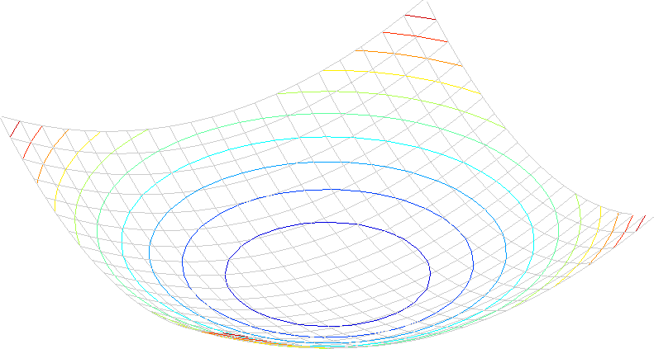
Interpreting the second moment matrix
Consider a horizontal “slice” of E(u, v):
This is the equation of an ellipse.
Slide credit: S. Lazebnik

Slide 22
Interpreting the second moment matrix
Consider a horizontal “slice” of E(u, v):
This is the equation of an ellipse.
Diagonalization of M:
The axis lengths of the ellipse are determined by the eigenvalues and the orientation is determined by R
direction of the fastest change
direction of the slowest change
(λ_{max})^{-1/2}
(λ_{min})^{-1/2}
Slide credit: S. Lazebnik
Notes:
An eigenvalue analysis of the auto-correlation matrix, which produces two eigenvalues and two directions

Slide 23
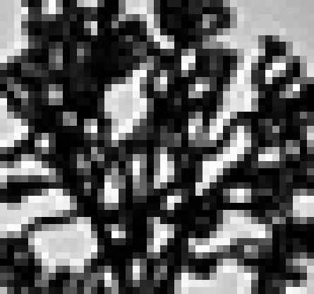
Visualization of second moment matrices
Slide credit: S. Lazebnik

Slide 24
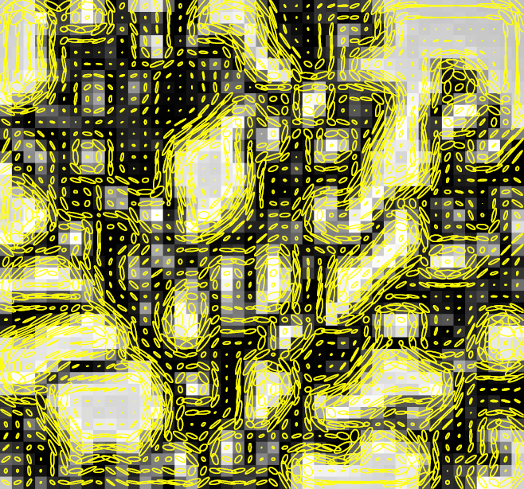
Visualization of second moment matrices
Slide credit: S. Lazebnik

Slide 25
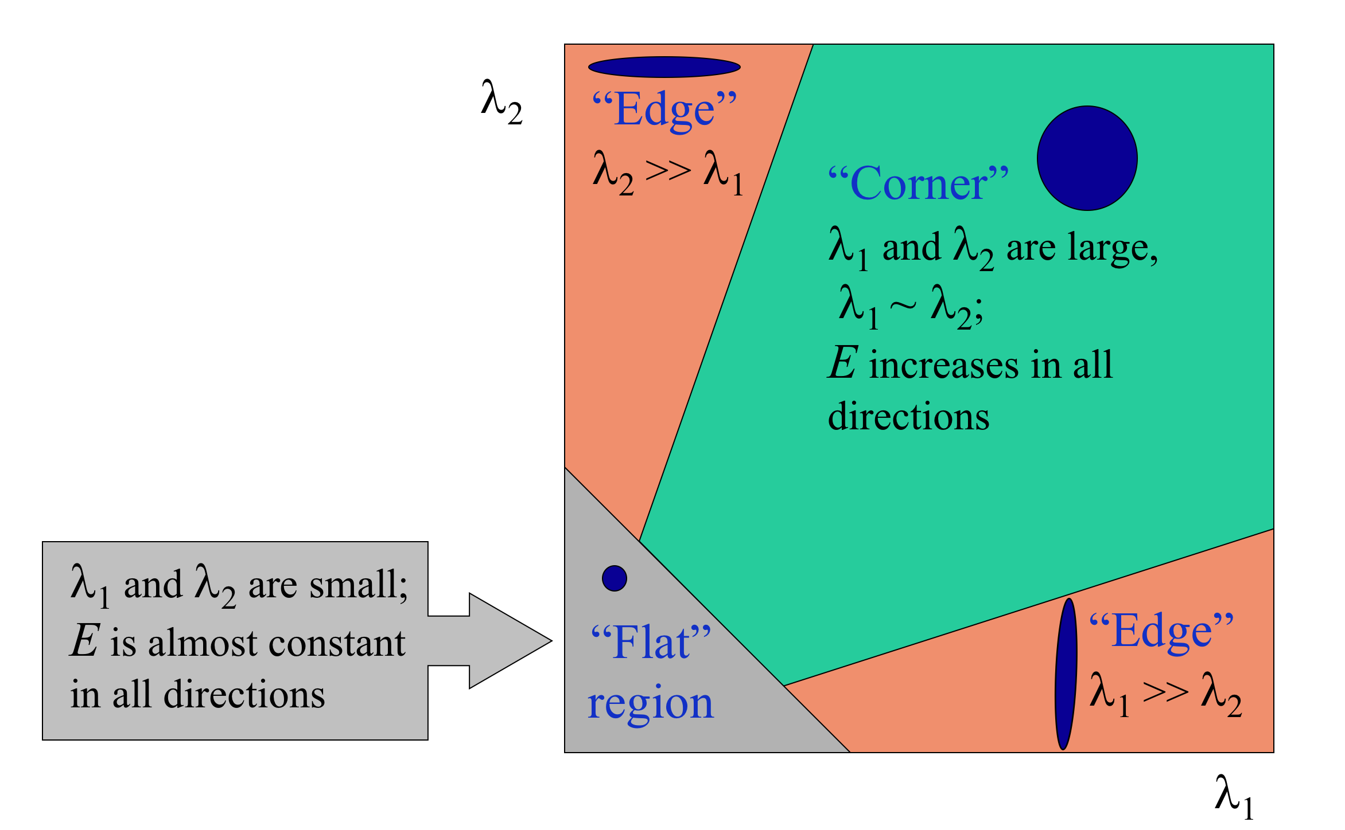
Interpreting the eigenvalues
Classification of image points using eigenvalues of M:
Slide credit: S. Lazebnik

Slide 26

Corner response function (Shi-Tomasi)
Shi-Tomasi corner detector: R =

Slide 27
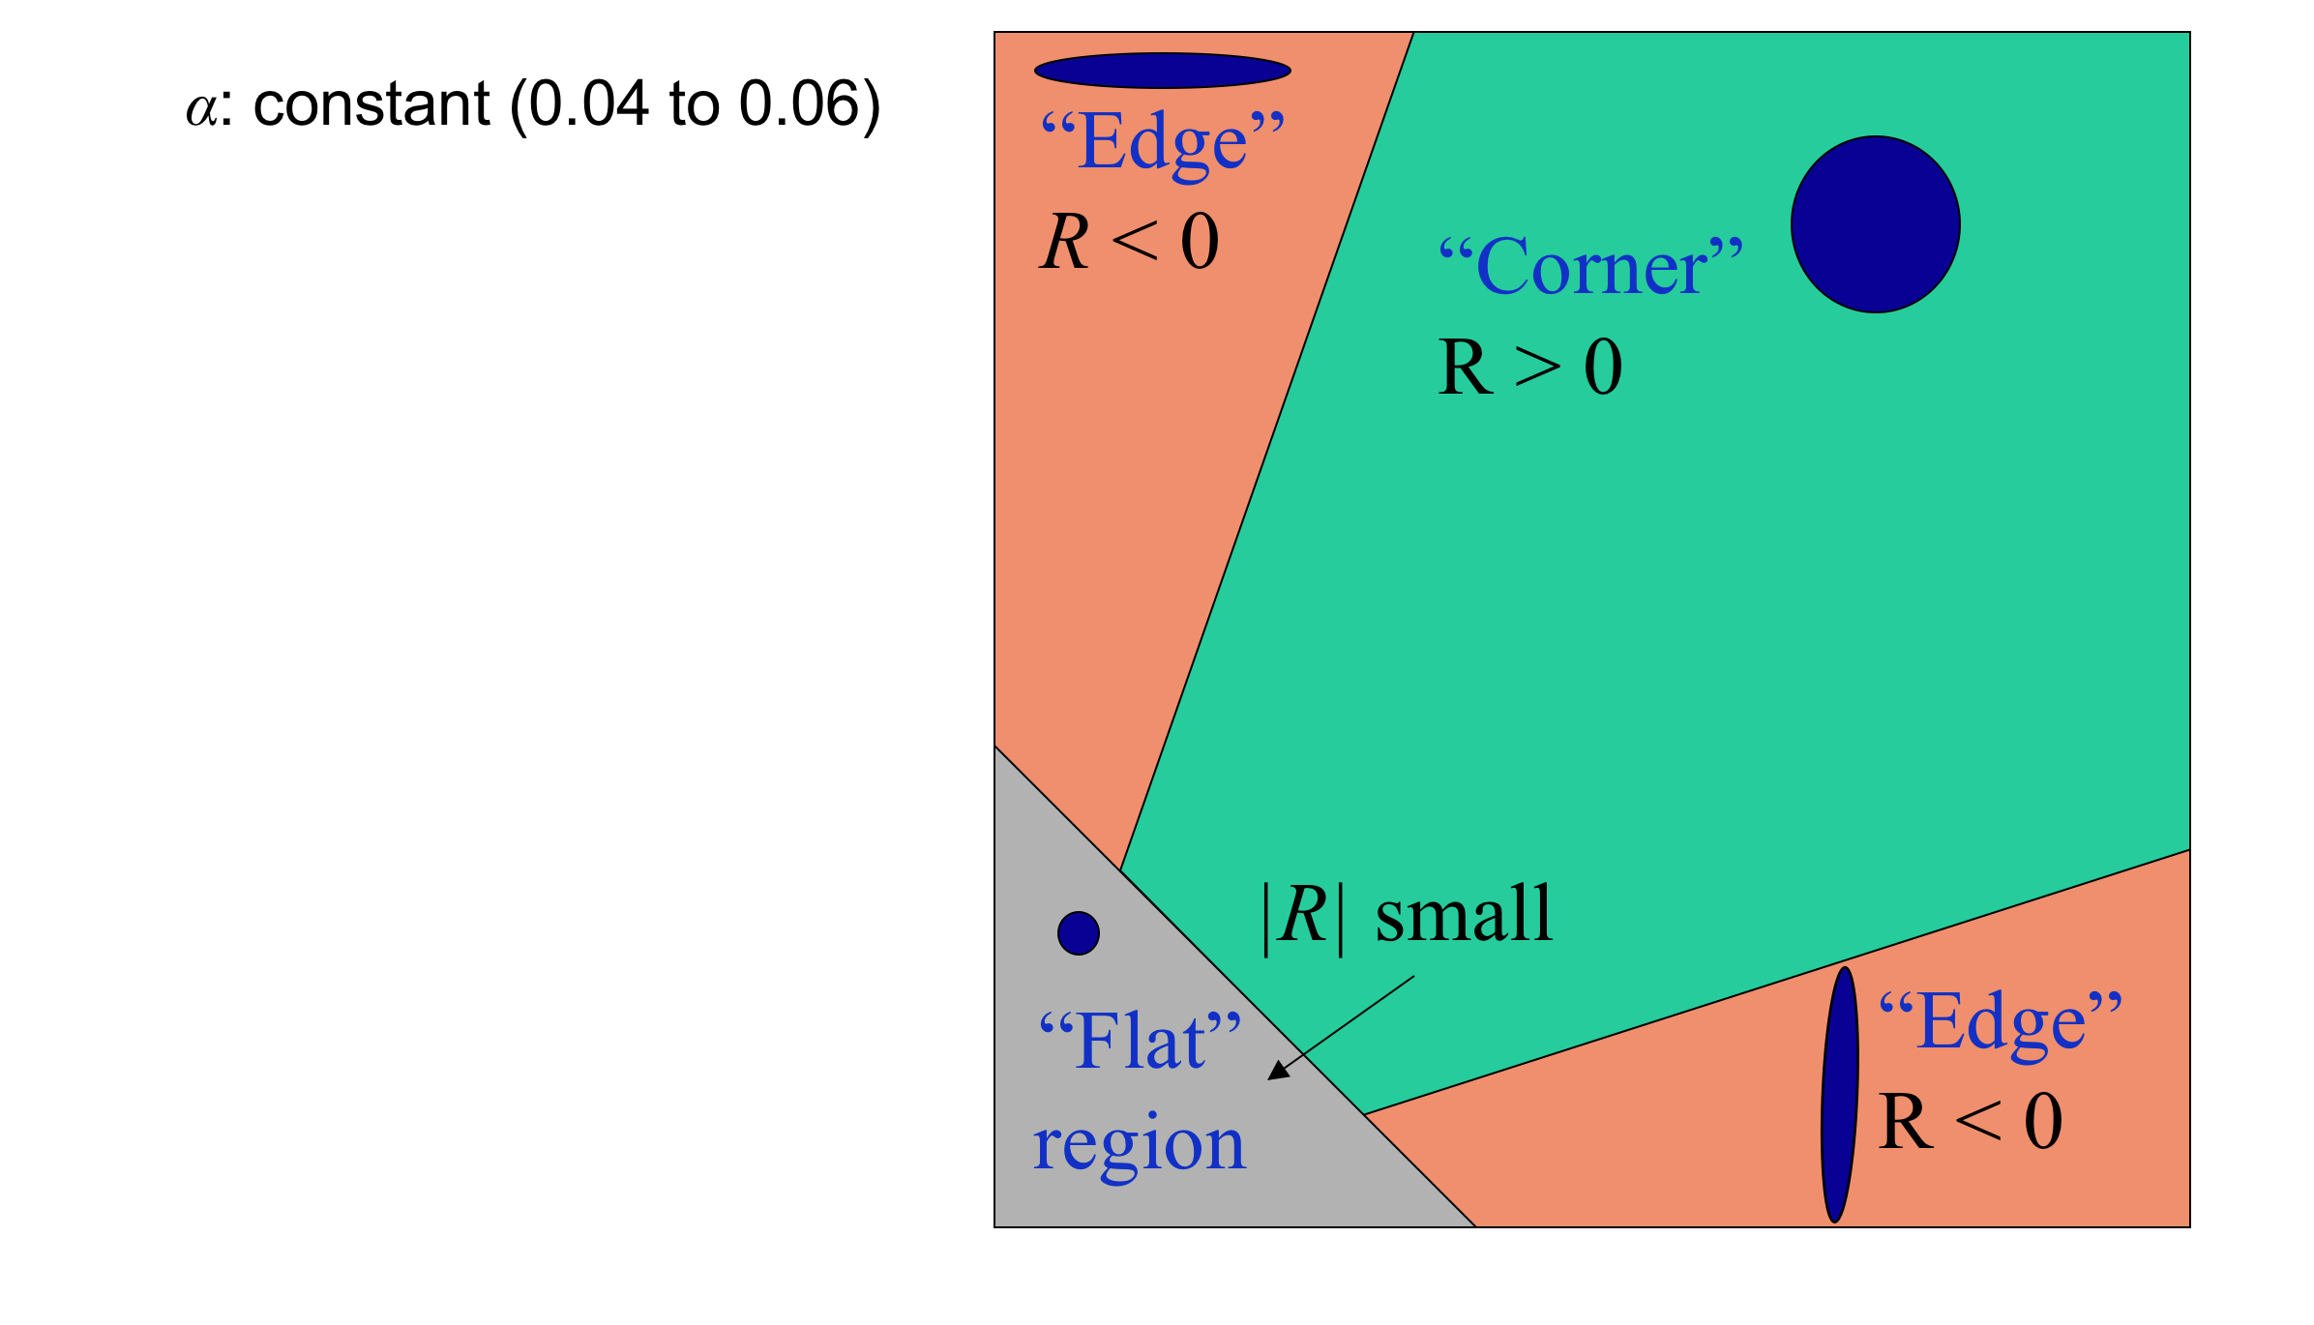
Corner response function (Harris)
α: constant (0.04 to 0.15)
Eigenvalue decomposition is expensive, evaluate the determinant and trace instead is sufficient.
Modified from: S. Lazebnik

Slide 28
The Harris corner detector
Compute partial derivatives at each pixel
Compute second moment matrix M in a Gaussian window around each pixel:
C.Harris and M.Stephens. “A Combined Corner and Edge Detector.” Proceedings of the 4th Alvey Vision Conference: pages 147—151, 1988.
Slide credit: S. Lazebnik

Slide 29
The Harris corner detector
Compute partial derivatives at each pixel
Compute second moment matrix M in a Gaussian window around each pixel
Compute corner response function R
C.Harris and M.Stephens. “A Combined Corner and Edge Detector.” Proceedings of the 4th Alvey Vision Conference: pages 147—151, 1988.
Slide credit: S. Lazebnik

Slide 30
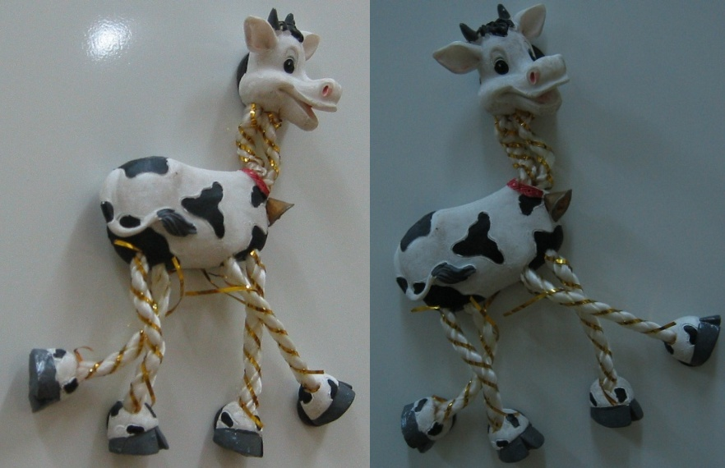
Harris Detector: Steps
Slide credit: S. Lazebnik

Slide 31
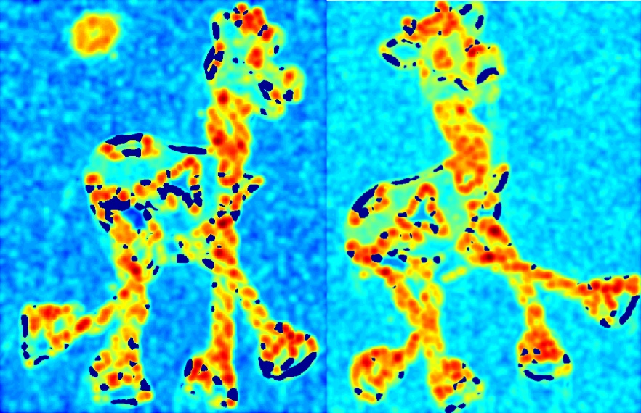
Harris Detector: Steps
Compute corner response R
Slide credit: S. Lazebnik

Slide 32
The Harris corner detector
Compute partial derivatives at each pixel
Compute second moment matrix M in a Gaussian window around each pixel
Compute corner response function R
Threshold R
Find local maxima of response function (non-maximum suppression)
C.Harris and M.Stephens. “A Combined Corner and Edge Detector.” Proceedings of the 4th Alvey Vision Conference: pages 147—151, 1988.
Slide credit: S. Lazebnik

Slide 33
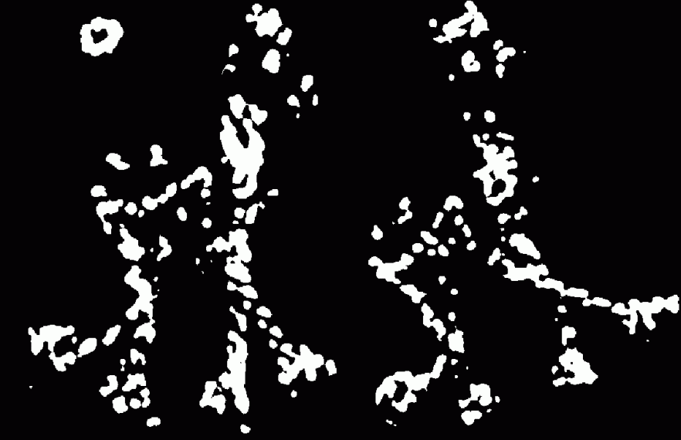
Harris Detector: Steps
Find points with large corner response: R > threshold
Slide credit: S. Lazebnik

Slide 34
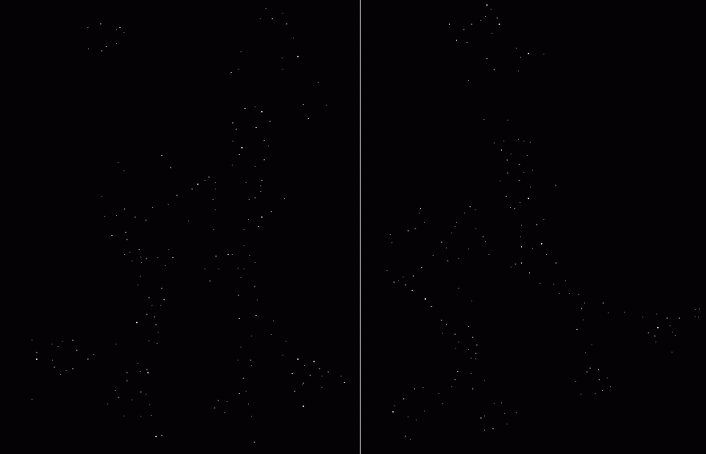
Harris Detector: Steps
Take only the points of local maxima of R
Slide credit: S. Lazebnik

Slide 35

Harris Detector: Steps
Slide credit: S. Lazebnik

Slide 36
Invariance and covariance
We want corner locations to be invariant to photometric transformations and covariant to geometric transformations
Invariance: image is transformed and corner locations do not change
Covariance: if we have two transformed versions of the same image, features should be detected in corresponding locations
Slide: S. Lazebnik

Slide 37
Affine intensity change
I → a I + b
Only derivatives are used => invariance to intensity shift I → I + b
Intensity scaling: I → a I
R
R
threshold
x (image coordinate)
x (image coordinate)
Partially invariant to affine intensity change
Slide: S. Lazebnik

Slide 38
Image translation
Derivatives and window function are shift-invariant
Corner location is covariant w.r.t. translation
Slide: S. Lazebnik

Slide 39
Image rotation
Second moment ellipse rotates but its shape (i.e. eigenvalues) remains the same
Corner location is covariant w.r.t. rotation
Slide: S. Lazebnik

Slide 40
Scaling
Corner
All points will be classified as edges
Corner location is not covariant to scaling!
Modifiied from S. Lazebnik

Slide 41
Summary
Image alignment pipeline
Feature detection, description, matching
Image alignment (we will talk about this later)
Detection of interest points
Harris corner detectors
Invariant and covariant properties of Harris corner detectors.
Next lecture: The rest of sec. 4.1

