Slide 1
Fitting
CSC 249/449 Spring 2019
http://www.cs.rochester.edu/~cxu22/t/249S19/
Instructor: Chenliang Xu
chenliang.xu@rochester.edu

Slide 2
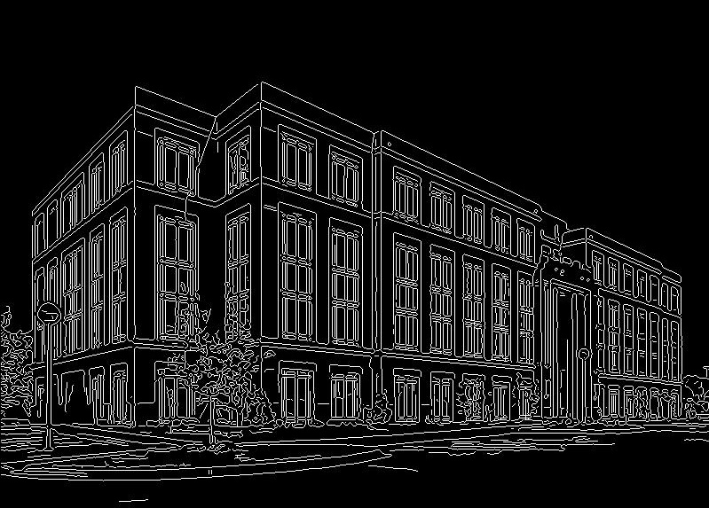
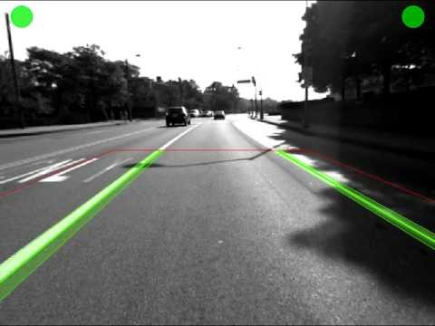
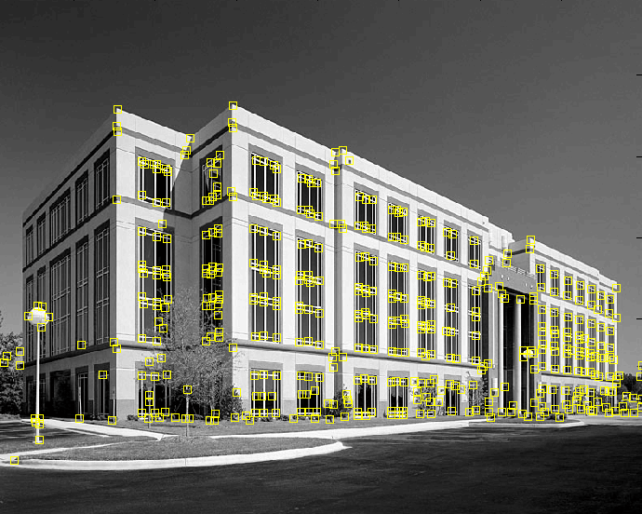
Fitting
We’ve learned how to detect edges, corners, blobs.
We would like to form a higher-level, more compact representation of the features by grouping them according to a simple model.
E.g., very useful for manmade structures.
Modified from: S. Lazebnik

Slide 3
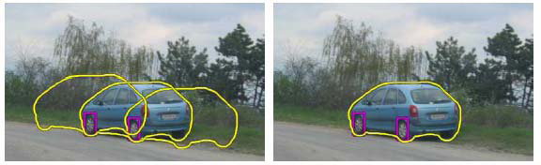
Fitting
Choose a parametric model to represent a set of features
simple model: lines
simple model: circles
complicated model: car
Source: K. Grauman

Slide 4
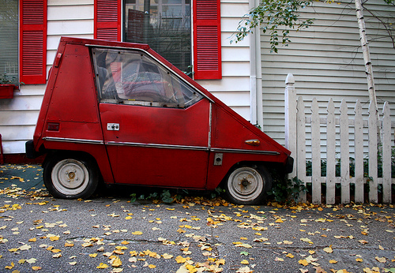
Fitting: Issues
Case study: Line detection
Noise in the measured feature locations
Extraneous data: clutter (outliers), multiple lines
Missing data: occlusions
Source: S. Lazebnik

Slide 5
Fitting: Overview
If we know which points belong to the line, how do we find the “optimal” line parameters?
Least squares
What if there are outliers?
Robust fitting, RANSAC
What if there are many lines?
Voting methods: RANSAC, Hough transform
Modified from: S. Lazebnik

Slide 6
Fitting: Overview
Least Squares Fit → Over Constraint
RANSAC → Constraint
Hough Transform → Under Constraint

Slide 7
Fitting: Overview
Least Squares Fit → Over Constraint
RANSAC → Constraint
Hough Transform → Under Constraint

Slide 8
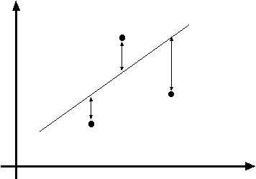
Least squares line fitting
Data: (x₁, y₁), …, (x_{n}, y_{n})
Line equation: y_{i} = m x_{i} + b
Find (m, b) to minimize
y=mx+b
(x_{i}, y_{i})
Normal equations: least squares solution to XB=Y
Therefore, B=(X^{T}X)⁻¹X^{T}Y
Modified from: S. Lazebnik

Slide 9
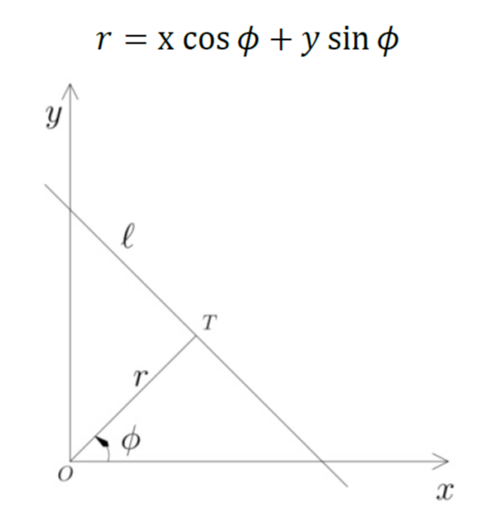
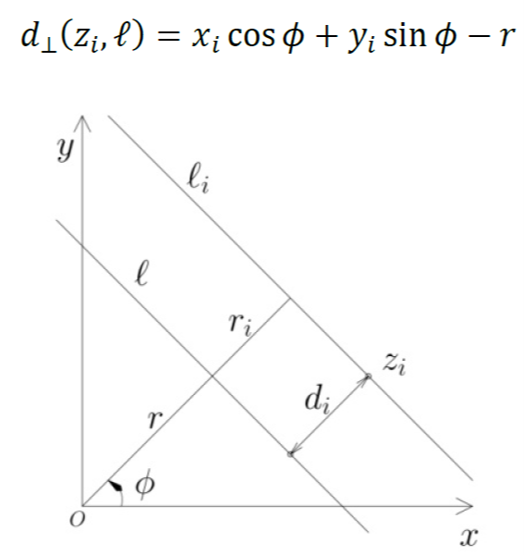
Problem with “vertical” least squares
Not rotation-invariant
Fails completely for vertical lines
Solution?
Alternative: polar representation
=(x_{i},y_{i})
Orthogonal distance from a point zi to the line l

Slide 10
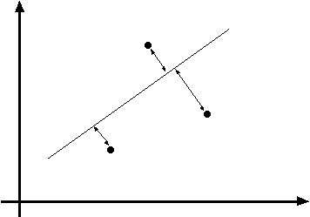
Total least squares
Distance between point (x_{i}, y_{i}) and line ax+by=d (a²+b²=1): |ax_{i} + by_{i} – d|
Find (a, b, d) to minimize the sum of squared perpendicular distances
ax+by=d
Unit normal: N=(a, b)
(x_{i}, y_{i})
Solution to (U^{T}U)N = 0, subject to ||N||² = 1: eigenvector of U^{T}U associated with the smallest eigenvalue.
Modified from: S. Lazebnik

Slide 11
Total least squares
second moment matrix
Source: S. Lazebnik

Slide 12
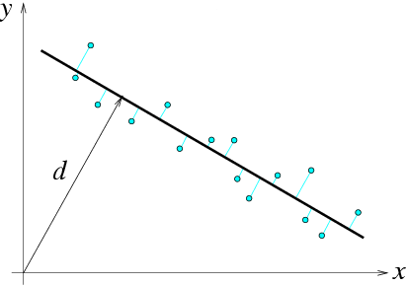
Total least squares
second moment matrix
N = (a, b)
F&P (2nd ed.) sec. 22.1

Slide 13
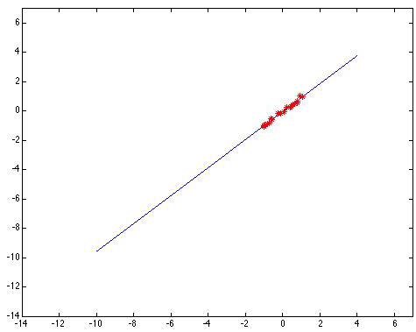
Least squares: Robustness to noise
Least squares fit to the red points:
Source: S. Lazebnik

Slide 14
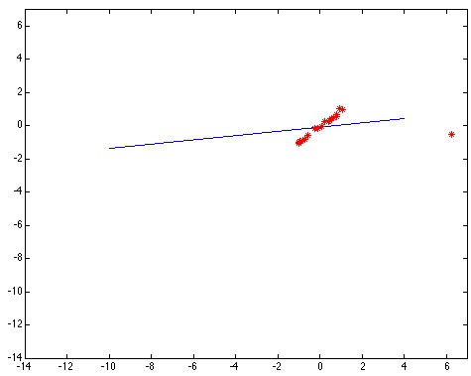
Least squares: Robustness to noise
Least squares fit with an outlier:
Problem: squared error heavily penalizes outliers
Source: S. Lazebnik

Slide 15
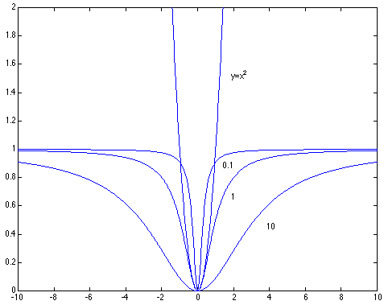

Robust estimators
General approach: find model parameters θ that minimize r_{i} (x_{i}, θ) – residual of ith point w.r.t. model parameters θ ρ – robust function with scale parameter σ
The robust function ρ behaves like squared distance for small values of the residual u but saturates for larger values of u
Source: S. Lazebnik

Slide 16

Choosing the scale: Just right
The effect of the outlier is minimized
Source: S. Lazebnik
Notes:
Fit to earlier data with an appropriate choice of s

Slide 17
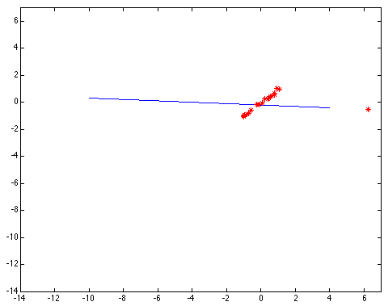
Choosing the scale: Too small
The error value is almost the same for every point and the fit is very poor
Source: S. Lazebnik

Slide 18

Choosing the scale: Too large
Behaves much the same as least squares
Source: S. Lazebnik

Slide 19
Robust estimation: Details
Robust fitting is a nonlinear optimization problem that must be solved iteratively
Least squares solution can be used for initialization
Scale of robust function should be chosen adaptively based on median residual
Source: S. Lazebnik

Slide 20
Fitting: Overview
Least Squares Fit → Over Constraint
RANSAC → Constraint
Hough Transform → Under Constraint

Slide 21
RANSAC
Robust fitting can deal with a few outliers – what if we have very many?
Random sample consensus (RANSAC): Very general framework for model fitting in the presence of outliers
Outline
Choose a small subset of points uniformly at random
Fit a model to that subset
Find all remaining points that are “close” to the model and reject the rest as outliers
Do this many times and choose the best model
M. A. Fischler, R. C. Bolles. Random Sample Consensus: A Paradigm for Model Fitting with Applications to Image Analysis and Automated Cartography. Comm. of the ACM, Vol 24, pp 381-395, 1981.
Source: S. Lazebnik
Notes:
This algorithm contains concepts that are hugely useful; in my experience, everyone with some
experience of applied problems who doesn’t yet know RANSAC is almost immediately able to use it to simplify some problem they’ve seen.

Slide 22
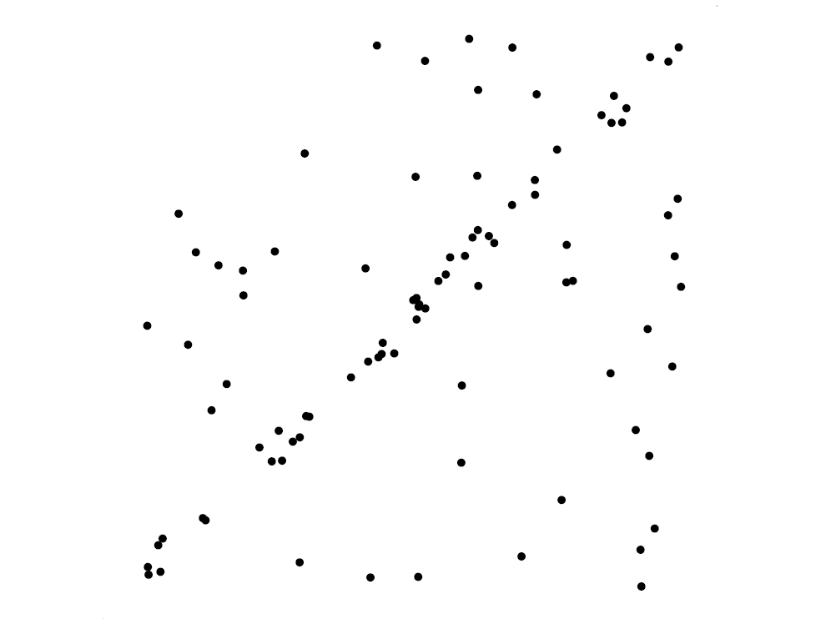
RANSAC for line fitting example
Source: R. Raguram

Slide 23
RANSAC for line fitting example
Least-squares fit
Source: R. Raguram

Slide 24
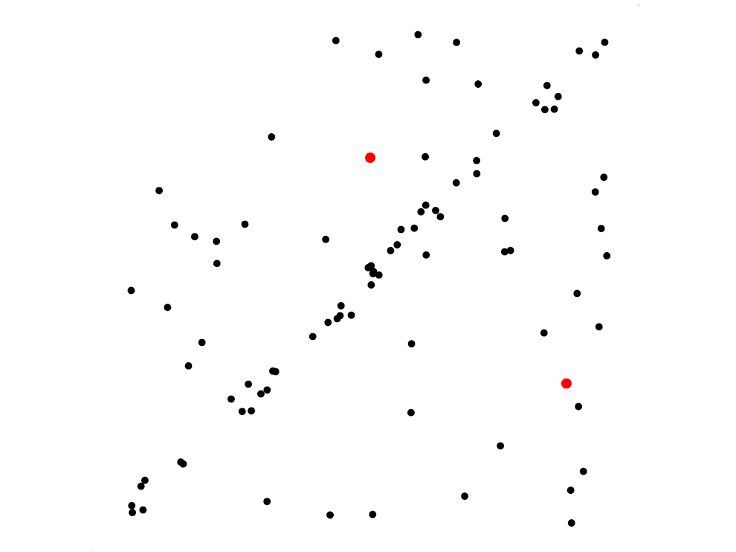
RANSAC for line fitting example
Randomly select minimal subset of points
Source: R. Raguram

Slide 25
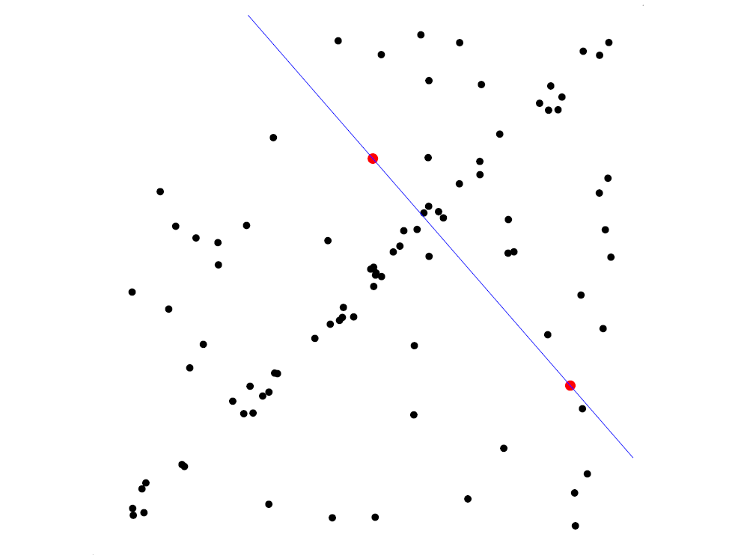
RANSAC for line fitting example
Randomly select minimal subset of points
Hypothesize a model
Source: R. Raguram

Slide 26
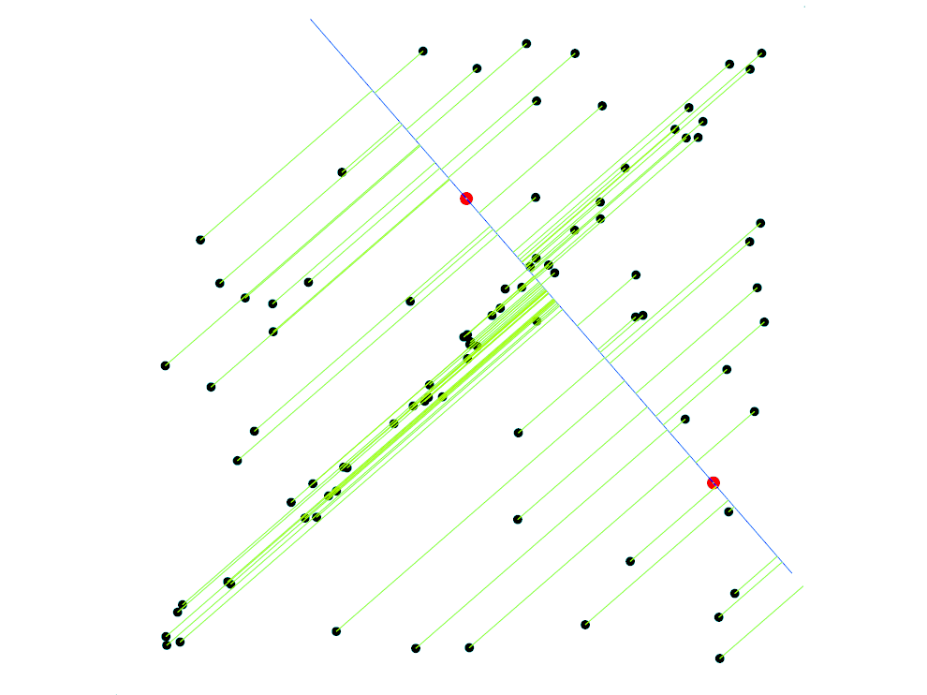
RANSAC for line fitting example
Randomly select minimal subset of points
Hypothesize a model
Compute error function
Source: R. Raguram

Slide 27
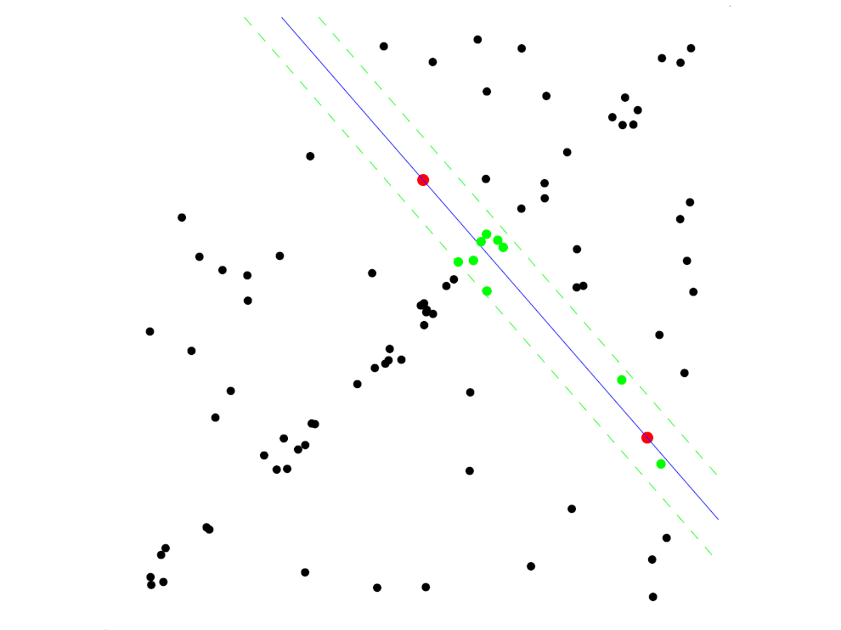
RANSAC for line fitting example
Randomly select minimal subset of points
Hypothesize a model
Compute error function
Select points consistent with model
Source: R. Raguram

Slide 28
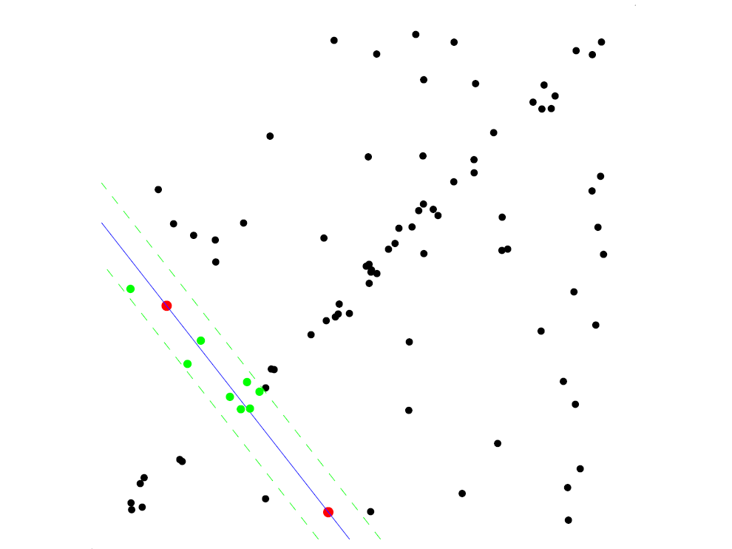
RANSAC for line fitting example
Randomly select minimal subset of points
Hypothesize a model
Compute error function
Select points consistent with model
Repeat hypothesize-and-verify loop
Source: R. Raguram

Slide 29
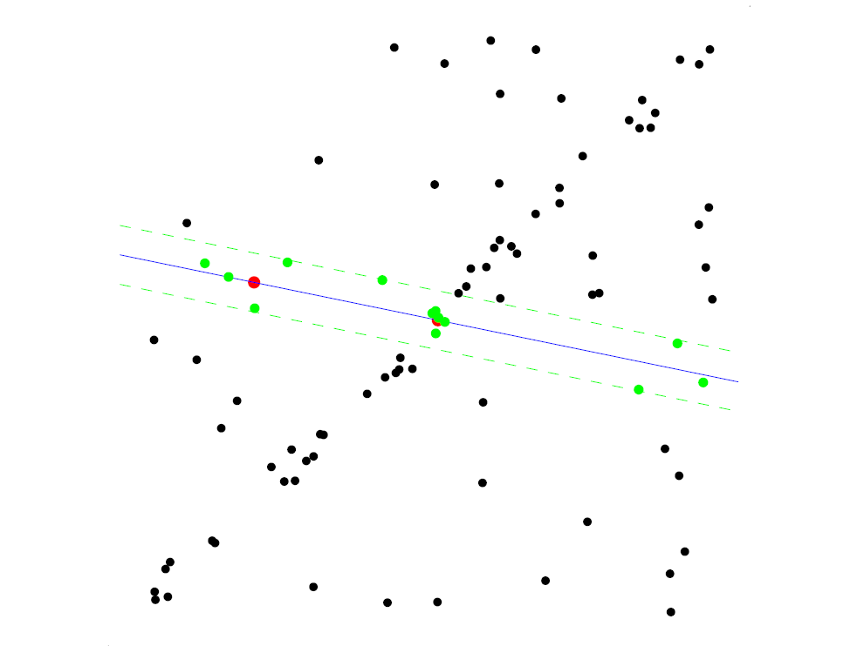
RANSAC for line fitting example
Randomly select minimal subset of points
Hypothesize a model
Compute error function
Select points consistent with model
Repeat hypothesize-and-verify loop
Source: R. Raguram

Slide 30
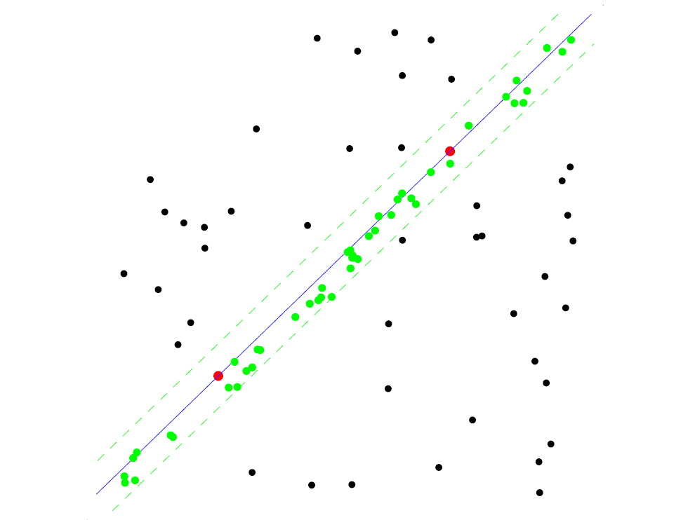
RANSAC for line fitting example
Uncontaminated sample
Randomly select minimal subset of points
Hypothesize a model
Compute error function
Select points consistent with model
Repeat hypothesize-and-verify loop
Source: R. Raguram

Slide 31
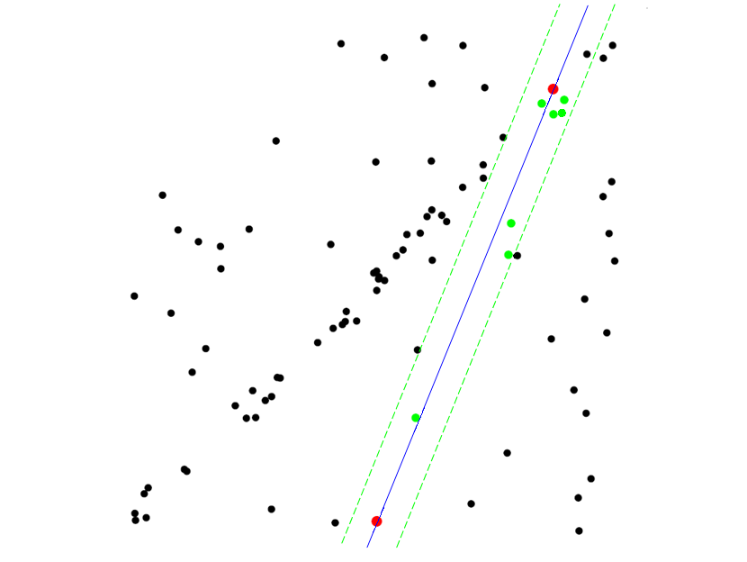
RANSAC for line fitting example
Randomly select minimal subset of points
Hypothesize a model
Compute error function
Select points consistent with model
Repeat hypothesize-and-verify loop
Source: R. Raguram
Notes:
31

Slide 32
RANSAC for line fitting
Repeat N times:
Draw s points uniformly at random
Fit line to these s points
Find inliers to this line among the remaining points (i.e., points whose distance from the line is less than t)
If there are d or more inliers, accept the line and refit using all inliers
Source: S. Lazebnik

Slide 33
Choosing the parameters
Initial number of points s
Typically minimum number needed to fit the model
Distance threshold t
Choose t so probability for inlier is p (e.g., 0.95)
Think about zero-mean Gaussian noise with std. dev. σ
Consensus set size d
Should match expected inlier ratio
Both t and d are determined based on specific requirements of the application, and experimental evaluation on the dataset

Slide 34
Choosing the parameters
Number of samples N
Choose N so that, with probability p, at least one random sample is free from outliers
Let e be outlier ratio and assume that s points are selected independently
(1-e)^{s} is the probability that all s points are inliers
1 - (1-e)^{s} is the probability that at least one of the s points is an outlier, i.e., a case which implies that a bad model will be estimated
The probability that the algorithm never selects a set of s points that all are inliers and it must be the same as 1 - p.

Slide 35
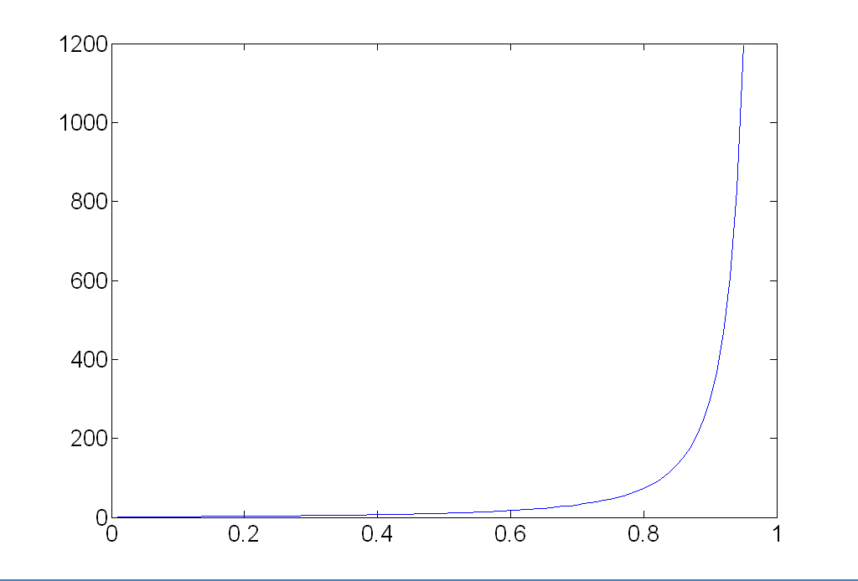
Choosing the parameters
Number of samples N
Choose N so that, with probability p, at least one random sample is free from outliers (e.g. p=0.99) (outlier ratio: e)
 | proportion of outliers e
s | 5% | 10% | 20% | 25% | 30% | 40% | 50%
2 | 2 | 3 | 5 | 6 | 7 | 11 | 17
3 | 3 | 4 | 7 | 9 | 11 | 19 | 35
4 | 3 | 5 | 9 | 13 | 17 | 34 | 72
5 | 4 | 6 | 12 | 17 | 26 | 57 | 146
6 | 4 | 7 | 16 | 24 | 37 | 97 | 293
7 | 4 | 8 | 20 | 33 | 54 | 163 | 588
8 | 5 | 9 | 26 | 44 | 78 | 272 | 1177

Slide 36
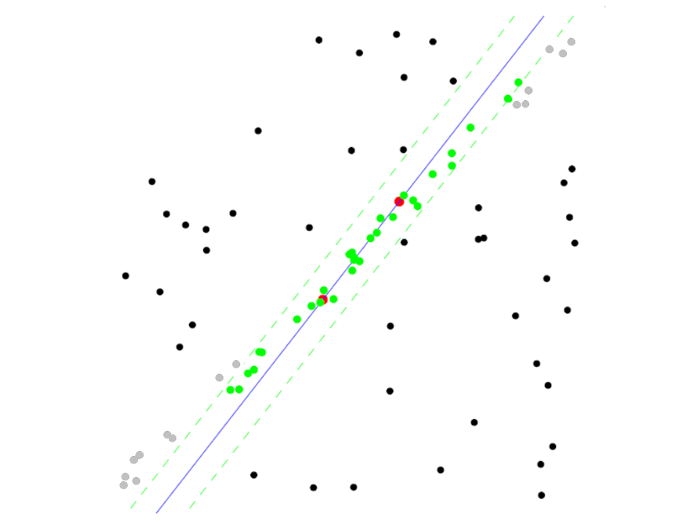
RANSAC pros and cons
Pros
Simple and general
Applicable to many different problems
Often works well in practice
Cons
Lots of parameters to tune
Doesn’t work well for low inlier ratios (too many iterations, or can fail completely)
Can’t always get a good initialization of the model based on the minimum number of samples
Source: S. Lazebnik

Slide 37

Fitting: Overview
Least Squares Fit → Over Constraint
RANSAC → Constraint
Hough Transform → Under Constraint
(Both segmentation and fitting)
Several lines
How do we know which points belong to which lines?
Figure from Yilmaz and Shah

Slide 38
Hough Transform
METHOD AND MEANS FOR RECOGNIZING COMPLEX PATTERNS, Paul V. C. Hough et al
– Inventors:PaulV.C.Hough,PaulV.C.Hough Current U.S. Classification: 382/281; 342/176; 342/190; 382/202
https://patents.google.com/patent/US3069654

Slide 39
Voting schemes
Let each feature vote for all the models that are compatible with it
Hopefully the noise features will not vote consistently for any single model
Missing data doesn’t matter as long as there are enough features remaining to agree on a good model
Source: S. Lazebnik

Slide 40
Hough transform
An early type of voting scheme
General outline:
Discretize parameter space into bins
For each feature point in the image, put a vote in every bin in the parameter space that could have generated this point
Find bins that have the most votes
Image space
Hough parameter space
P.V.C. Hough, Machine Analysis of Bubble Chamber Pictures, Proc. Int. Conf. High Energy Accelerators and Instrumentation, 1959
Source: S. Lazebnik

Slide 41
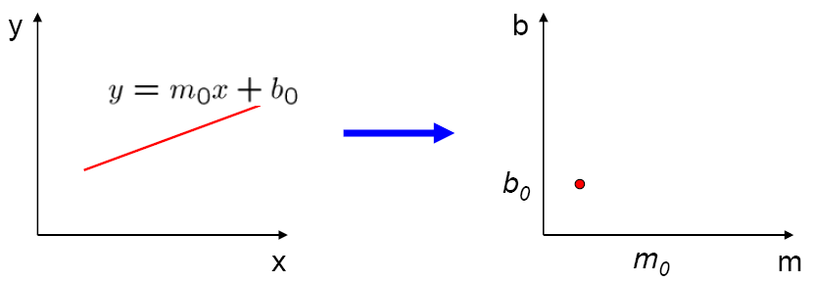
Parameter space representation
A line in the image corresponds to a point in Hough space
Image space
Hough parameter space
m₀
Source: S. Seitz

Slide 42
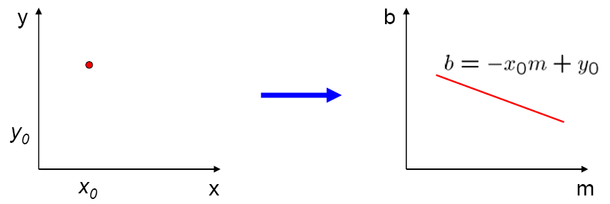
Parameter space representation
What does a point (x₀, y₀) in the image space map to in the Hough space?
Image space
Hough (line) parameter space
y₀ = mx₀ + b
y₀
Modified from: S. Seitz

Slide 43
Parameter space representation
What does a point (x₀, y₀) in the image space map to in the Hough space?
Answer: the solutions of b = –x₀m + y₀
This is a line in Hough space
Image space
Hough (line) parameter space
y₀ = mx₀ + b
y₀
Modified from: S. Seitz

Slide 44
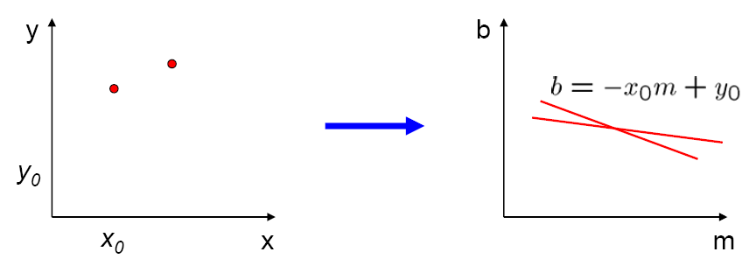
Parameter space representation
Where is the line that contains both (x₀, y₀) and (x₁, y₁)?
Image space
Hough parameter space
(x₁, y₁)
(x₀, y₀)
b = –x₁m + y₁
Source: S. Seitz

Slide 45
Parameter space representation
Where is the line that contains both (x₀, y₀) and (x₁, y₁)?
It is the intersection of the lines b = –x₀m + y₀ and b = –x₁m + y₁
Image space
Hough parameter space
(x₁, y₁)
(x₀, y₀)
b = –x₁m + y₁
Source: S. Seitz

Slide 46
Parameter space representation
Problems with the (m,b) space:
Unbounded parameter domains
Vertical lines require infinite m
Source: S. Seitz

Slide 47
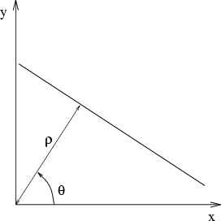
Parameter space representation
Problems with the (m,b) space:
Unbounded parameter domains
Vertical lines require infinite m
Alternative: polar representation
Each point (x,y) will add a sine wave in the (θ,ρ) parameter space
Source: S. Seitz

Slide 48
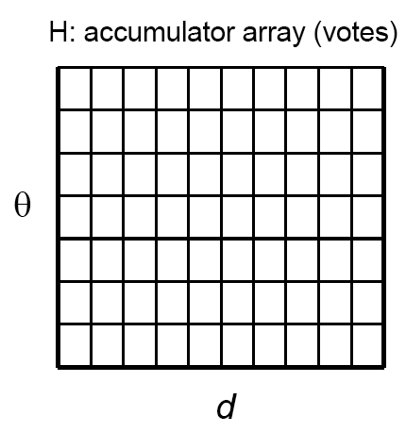
Algorithm outline
Initialize accumulator H to all zeros
For each feature point (x,y) in the image For θ = 0 to 180 ρ = x cos θ + y sin θ H(θ, ρ) = H(θ, ρ) + 1 end end
Find the value(s) of (θ, ρ) where H(θ, ρ) is a local maximum
The detected line in the image is given by ρ = x cos θ + y sin θ
ρ
θ
Source: S. Seitz

Slide 49
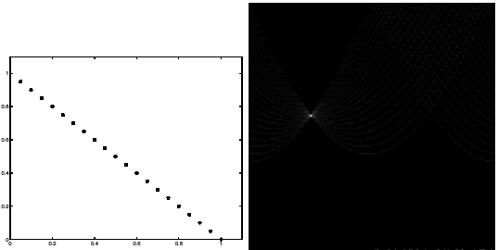
Basic illustration
features
votes
Source: S. Lazebnik
Notes:
Figure 15.1, top half. Note that most points in the vote array are very dark, because they
get only one vote.

Slide 50
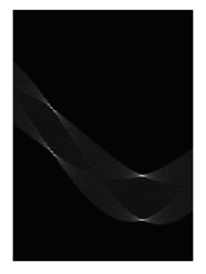
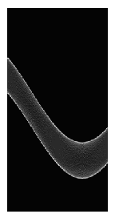
Other shapes
Square
Circle
Source: S. Lazebnik

Slide 51
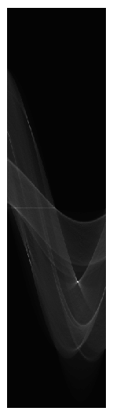
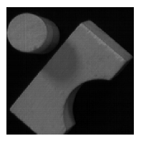
Several lines
Source: S. Lazebnik

Slide 52
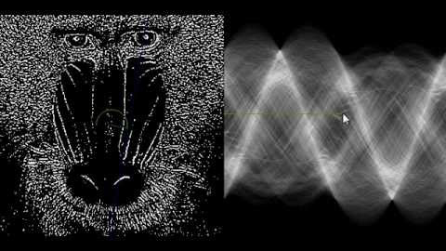
Demo
https://www.youtube.com/watch?v=ebfi7qOFLuo

Slide 53
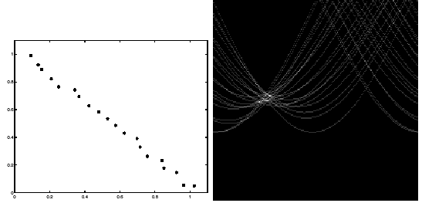
Effect of noise
features
votes
Source: S. Lazebnik
Notes:
This is 15.1 lower half

Slide 54
Effect of noise
features
votes
Peak gets fuzzy and hard to locate
Source: S. Lazebnik
Notes:
This is fig. 10.1 lower half

Slide 55
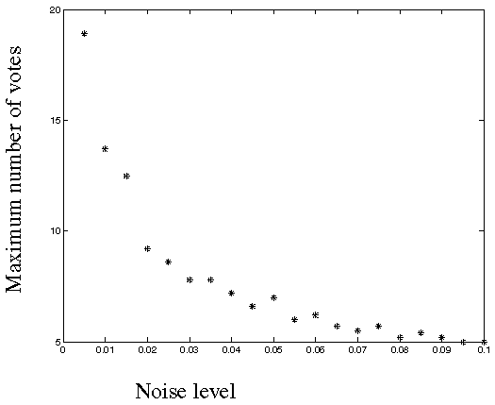
Effect of noise
Number of votes for a line of 20 points with increasing noise:
Source: S. Lazebnik
Notes:
This is the number of votes that the real line of 20 points gets with increasing noise (figure15.3)

Slide 56
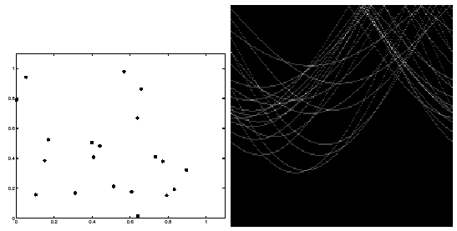
Random points
features
votes
Uniform noise can lead to spurious peaks in the array
Source: S. Lazebnik
Notes:
10.2; main point is that lots of noise can lead to large peaks in the accumulator array

Slide 57
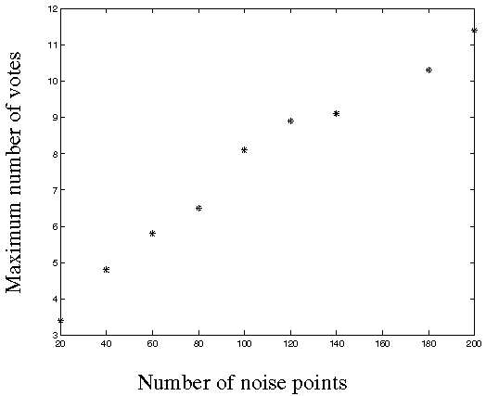
Random points
As the level of uniform noise increases, the maximum number of votes increases too:
Source: S. Lazebnik
Notes:
Figure 15.4; as the noise increases in a picture without a line, the number of points in the max cell goes
up, too

Slide 58
Dealing with noise
Choose a good grid / discretization
Too coarse: large votes obtained when too many different lines correspond to a single bucket
Too fine: miss lines because some points that are not exactly collinear cast votes for different buckets
Increment neighboring bins (smoothing in accumulator array)
Try to get rid of irrelevant features
E.g., take only edge points with significant gradient magnitude
Source: S. Lazebnik

Slide 59
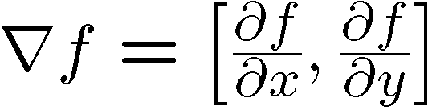

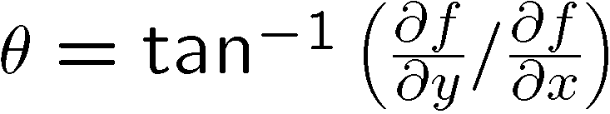
Incorporating image gradients
Recall: when we detect an edge point, we also know its gradient direction
But this means that the line is uniquely determined!
Modified Hough transform:
For each edge point (x,y) θ = gradient orientation at (x,y) ρ = x cos θ + y sin θ H(θ, ρ) = H(θ, ρ) + 1 end
Source: S. Lazebnik

Slide 60
Review Fitting
If we know which points belong to the line, how do we find the “optimal” line parameters?
Least squares
What if there are outliers?
Robust fitting, RANSAC
What if there are many lines?
Voting methods: RANSAC, Hough transform
Source: S. Lazebnik

Slide 61
Review Fitting
If we know which points belong to the line, how do we find the “optimal” line parameters?
Least squares
What if there are outliers?
Robust fitting, RANSAC
What if there are many lines?
Voting methods: RANSAC, Hough transform
Source: S. Lazebnik

