Slide 1
Fitting
CSC 249/449 Spring 2019
http://www.cs.rochester.edu/~cxu22/t/249S19/
Instructor: Chenliang Xu
chenliang.xu@rochester.edu

Slide 2
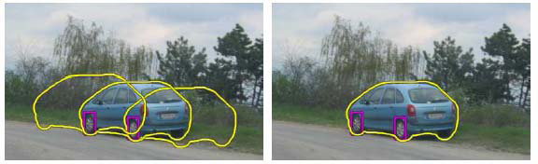
Fitting
Choose a parametric model to represent a set of features
simple model: lines
simple model: circles
complicated model: car
Source: K. Grauman

Slide 3

Fitting: Overview
Least Squares Fit → Over Constraint
RANSAC → Constraint
Hough Transform → Under Constraint
(Both segmentation and fitting)
Several lines
How do we know which points belong to which lines?
Figure from Yilmaz and Shah

Slide 4
Hough Transform
METHOD AND MEANS FOR RECOGNIZING COMPLEX PATTERNS, Paul V. C. Hough et al
– Inventors:PaulV.C.Hough,PaulV.C.Hough Current U.S. Classification: 382/281; 342/176; 342/190; 382/202
https://patents.google.com/patent/US3069654

Slide 5
Voting schemes
Let each feature vote for all the models that are compatible with it
Hopefully the noise features will not vote consistently for any single model
Missing data doesn’t matter as long as there are enough features remaining to agree on a good model
Source: S. Lazebnik

Slide 6
Hough transform
An early type of voting scheme
General outline:
Discretize parameter space into bins
For each feature point in the image, put a vote in every bin in the parameter space that could have generated this point
Find bins that have the most votes
Image space
Hough parameter space
P.V.C. Hough, Machine Analysis of Bubble Chamber Pictures, Proc. Int. Conf. High Energy Accelerators and Instrumentation, 1959
Source: S. Lazebnik

Slide 7
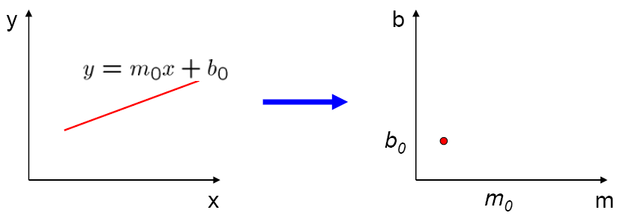
Parameter space representation
A line in the image corresponds to a point in Hough space
Image space
Hough parameter space
m₀
Source: S. Seitz

Slide 8
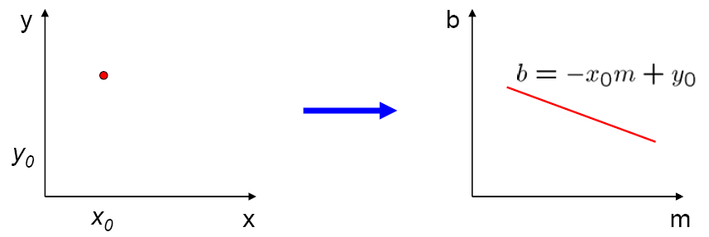
Parameter space representation
What does a point (x₀, y₀) in the image space map to in the Hough space?
Image space
Hough (line) parameter space
y₀ = mx₀ + b
y₀
Modified from: S. Seitz

Slide 9
Parameter space representation
What does a point (x₀, y₀) in the image space map to in the Hough space?
Answer: the solutions of b = –x₀m + y₀
This is a line in Hough space
Image space
Hough (line) parameter space
y₀ = mx₀ + b
y₀
It will be different in the polar system!
Modified from: S. Seitz

Slide 10
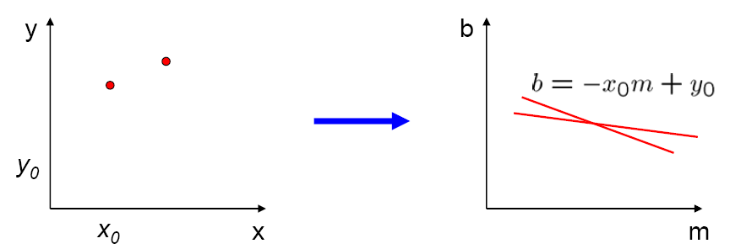
Parameter space representation
Where is the line that contains both (x₀, y₀) and (x₁, y₁)?
Image space
Hough parameter space
(x₁, y₁)
(x₀, y₀)
b = –x₁m + y₁
Source: S. Seitz

Slide 11
Parameter space representation
Where is the line that contains both (x₀, y₀) and (x₁, y₁)?
It is the intersection of the lines b = –x₀m + y₀ and b = –x₁m + y₁
Image space
Hough parameter space
(x₁, y₁)
(x₀, y₀)
b = –x₁m + y₁
Source: S. Seitz

Slide 12
Parameter space representation
Problems with the (m,b) space:
Unbounded parameter domains
Vertical lines require infinite m
Source: S. Seitz

Slide 13
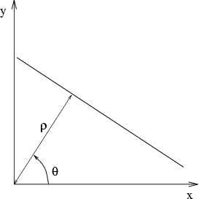
Parameter space representation
Problems with the (m,b) space:
Unbounded parameter domains
Vertical lines require infinite m
Alternative: polar representation
Each point (x,y) will add a sine wave in the (θ,ρ) parameter space
Source: S. Seitz

Slide 14
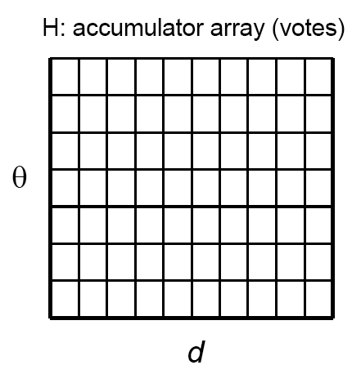
Algorithm outline
Initialize accumulator H to all zeros
For each feature point (x,y) in the image For θ = 0 to 180 ρ = x cos θ + y sin θ H(θ, ρ) = H(θ, ρ) + 1 end end
Find the value(s) of (θ, ρ) where H(θ, ρ) is a local maximum
The detected line in the image is given by ρ = x cos θ + y sin θ
ρ
θ
Source: S. Seitz

Slide 15
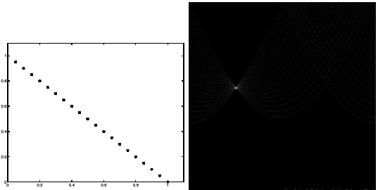
Basic illustration
features
votes
polar parameter space
Modified from: S. Lazebnik
Notes:
Note that most points in the vote array are very dark, because they get only one vote.

Slide 16
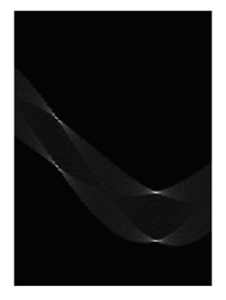
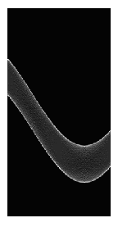
Other shapes
Square
Circle
Source: S. Lazebnik

Slide 17
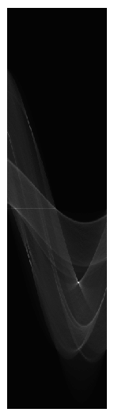
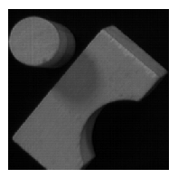
Several lines
Source: S. Lazebnik

Slide 18
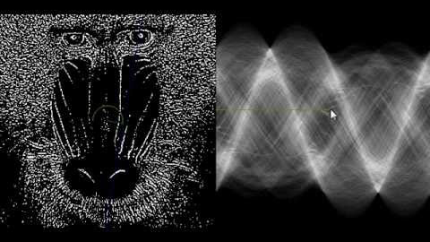
Demo
https://www.youtube.com/watch?v=ebfi7qOFLuo

Slide 19
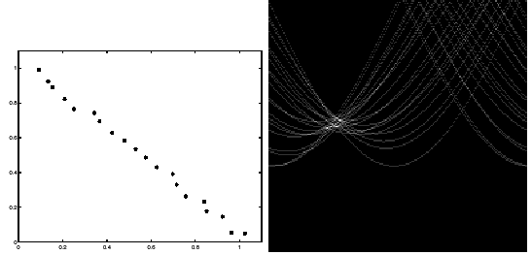
Effect of noise
features
votes
Source: S. Lazebnik

Slide 20
Effect of noise
features
votes
Peak gets fuzzy and hard to locate
Source: S. Lazebnik

Slide 21
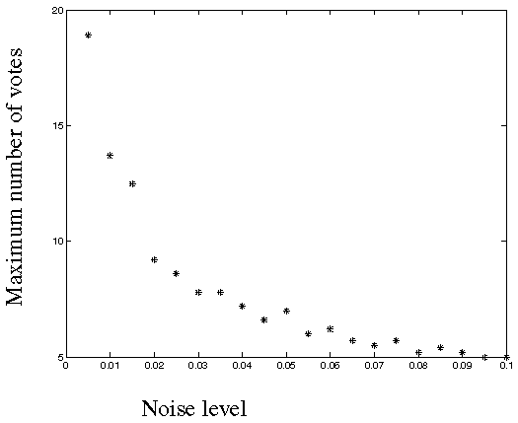
Effect of noise
Number of votes for a line of 20 points with increasing noise:
Source: S. Lazebnik
Notes:
This is the number of votes that the real line of 20 points gets with increasing noise.

Slide 22
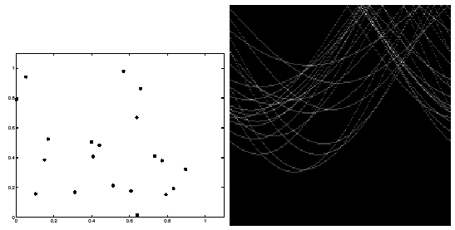
Random points
features
votes
Uniform noise can lead to spurious peaks in the array
Source: S. Lazebnik
Notes:
Lots of noise can lead to large peaks in the accumulator array

Slide 23
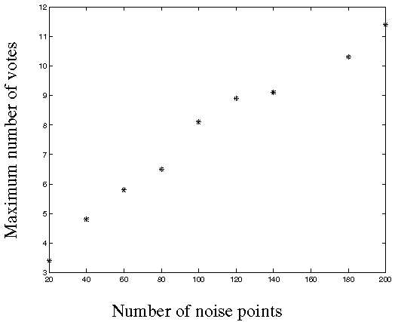
Random points
As the level of uniform noise increases, the maximum number of votes increases too:
Source: S. Lazebnik
Notes:
Figure 15.4; as the noise increases in a picture without a line, the number of points in the max cell goes
up, too

Slide 24
Dealing with noise
Choose a good grid / discretization
Too coarse: large votes obtained when too many different lines correspond to a single bucket
Too fine: miss lines because some points that are not exactly collinear cast votes for different buckets
Increment neighboring bins (smoothing in accumulator array)
Try to get rid of irrelevant features
E.g., take only edge points with significant gradient magnitude
Source: S. Lazebnik

Slide 25
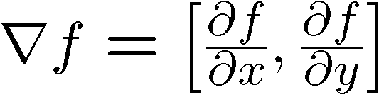

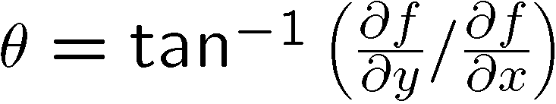
Incorporating image gradients
Recall: when we detect an edge point, we also know its gradient direction
This means that the line is uniquely determined!
Modified Hough transform:
For each edge point (x,y) θ = gradient orientation at (x,y) ρ = x cos θ + y sin θ H(θ, ρ) = H(θ, ρ) + 1 end
Source: S. Lazebnik

Slide 26
Review Fitting
If we know which points belong to the line, how do we find the “optimal” line parameters?
Least squares
What if there are outliers?
Robust fitting, RANSAC
What if there are many lines?
Voting methods: RANSAC, Hough transform
Source: S. Lazebnik

Slide 27
Hough transform for circles
How many dimensions will the parameter space have?
(a, b): the center of the circle
r: the radius
Given an un-oriented edge point, what are all possible bins that it can vote for?
Assume the detected point is (x₀,y₀) in image space
All points satisfy (x₀-a)²+(y₀-b)²=r².
The surface of an inverted cone.
What about an oriented edge point?
What is this?

Slide 28
Hough transform for circles
image space
Hough parameter space
r
y
0
a
x
b
Modified from: S. Lazebnik

Slide 29
Hough transform for circles
Initialize accumulator H to all zeros
For each feature point (x,y) in the image VOTE! end
Find the local maxima in the parameter space
r
a
b

Slide 30

Hough transform for circles
Alternative approach (conceptually equivalent procedure): for each (a,b,r), draw the corresponding circle in the image and compute its “support”
r
a
b
Is this more or less efficient than voting with features?
Modified from: S. Lazebnik

Slide 31
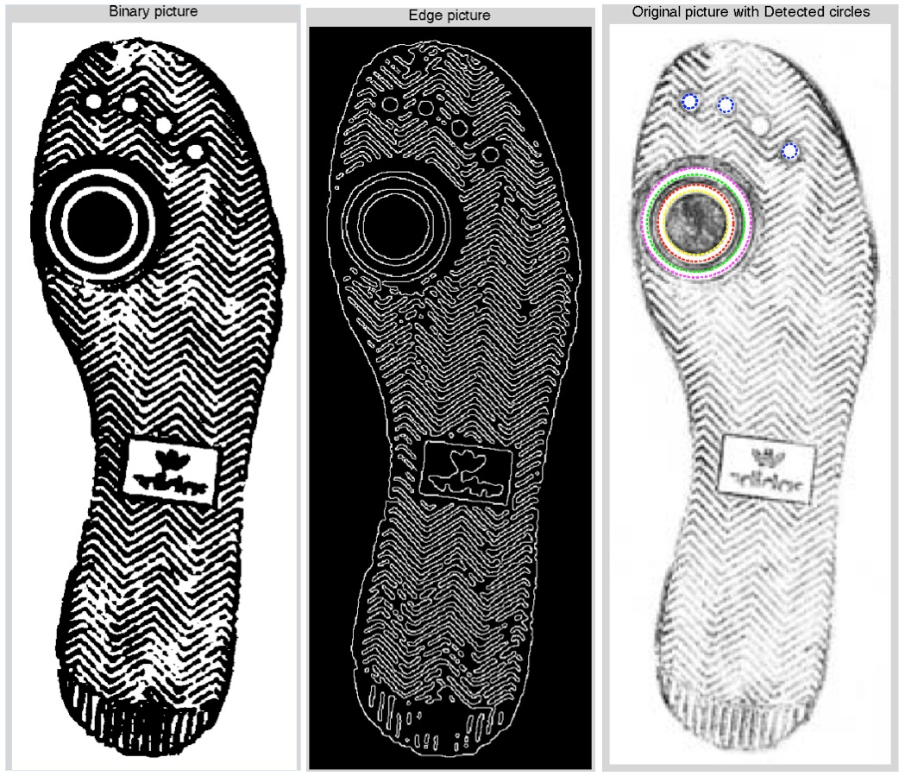
Hough transform for circles
The original picture (right) is first turned into a binary image (left) using a threshold and Gaussian filter. Then edges (mid) are found from it using canny edge detection. After this, all the edge points are used by the Circle Hough Transform to find underlying circle structure.
Figure from https://en.wikipedia.org/wiki/Circle_Hough_Transform

Slide 32
Generalized Hough transform
We want to find a template defined by its reference point (center) and several distinct types of landmark points in stable spatial configuration
Template
c
Source: S. Lazebnik
Notes:
-The center or reference point is not necessarily a visible point, it’s just the “origin” of the shape’s coordinate system
-The landmark points don’t have to be located on the boundary, they just need to be in a stable spatial configuration w.r.t. the center
- The types of landmark points correspond to “visual words” or features that have a distinct local appearance (how to identify such visual words will be discussed later in the course)

Slide 33
Generalized Hough transform
Template representation: for each type of landmark point, store all possible displacement vectors towards the center
Model
Template
Source: S. Lazebnik

Slide 34
Generalized Hough transform
Detecting the template:
For each feature in a new image, look up that feature type in the model and vote for the possible center locations associated with that type in the model
Model
Test image
Notes:
Note that some of the features present in the template may actually be absent in the test image. The positions of the features can move around; new “noise” or “clutter” features can be added.
The small circles represent votes for possible center location.

Slide 41

Application in recognition
Index displacements by “visual codeword”
visual codeword with displacement vectors
training image
B. Leibe, A. Leonardis, and B. Schiele, Combined Object Categorization and Segmentation with an Implicit Shape Model, ECCV Workshop on Statistical Learning in Computer Vision 2004
Source: S. Lazebnik
Notes:
This is not just some useless historic idea, but is actually extensively used in modern recognition.

Slide 42
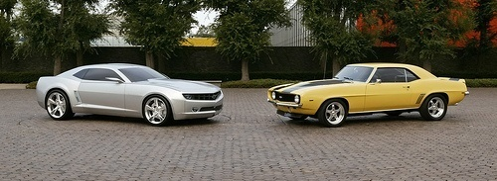
Application in recognition
Index displacements by “visual codeword”
test image
B. Leibe, A. Leonardis, and B. Schiele, Combined Object Categorization and Segmentation with an Implicit Shape Model, ECCV Workshop on Statistical Learning in Computer Vision 2004
Source: S. Lazebnik

Slide 43
Hough transform: Pros and cons
Pros
Can deal with non-locality and occlusion
Can detect multiple instances of a model
Some robustness to noise: noise points unlikely to contribute consistently to any single bin
Cons
Complexity of search time increases exponentially with the number of model parameters
It’s hard to pick a good grid size
Non-target shapes can produce spurious peaks in parameter space (e.g., induced by textures)
Source: S. Lazebnik

Slide 44
Review Fitting
If we know which points belong to the line, how do we find the “optimal” line parameters?
Least squares
What if there are outliers?
Robust fitting, RANSAC
What if there are many lines?
Voting methods: RANSAC, Hough transform
Source: S. Lazebnik

